Slide 1
Loops and cyclic graphs
Presenter
MaxAcademy Lecture Series – V1.0, September 2011

Slide 2
Overview of Accelerating Loops
Classifying Loops
Attributes and measures
Simple Fixed Length Stream Loops
Example vector add
Custom memory controllers
Nested Loops
Counter chains
Streaming and unrolling
How to avoid cyclic graphs
Variable Length Loops
Convert to fixed length
Loops with dependence cycles
How to build cyclic data-flow graphs
How to exploit pipelining in cyclic graphs
Objective: understand how to get from source-code loops to MaxCompiler configurations
That go fast

Slide 3
Classifying Loops
for (i=0; i<N; ++i) {
A[i] = ...B[i]...
...B[i*M]...
...B[C[i]]...
}
for (i=0; i<N; ++i) {
A[i] = ...A[i-1]...
...A[i-100]...
...A[i-k]...
}
Loop Attributes:
Array access
pattern is important (stride)
Iteration: loop-carried dependency
distance is important
fixed distance (good) or variable distance (bad)
Loop performance metrics:
Computation to memory-access ratio
Working set size => custom memory hierarchy
Loop bottlenecks: CPU or Memory or IO

Slide 4
Overview of Accelerating Loops
Classifying Loops
Attributes and measures
Simple Fixed Length Stream Loops
Example vector add
Custom memory controllers
Nested Loops
Counter chains
Streaming and unrolling
How to avoid cyclic graphs
Variable Length Loops
Convert to fixed length
Loops with dependence cycles
How to build cyclic data-flow graphs
How to exploit pipelining in cyclic graphs

Slide 5
The Stream Loop
uint A[...]; uint B[...];
for (int count=0; ; count += 1)
B[count] = A[count] + 1;
A
1
+
HWVar A = io.input(”input” , hwUInt(32));
HWVar B = A + 1;
io.output(”output” , B , hwUInt(32));
B
Notes:
Removed:
An array-access loop with stride-1 memory accesses
Computation-to-MemoryAccess = 1 (bad, ~100 is good)
Bottleneck is “Memory Throughput”
Working set size = 0 (easy to fit inside the chip)
Note: Stream Loop is implicit in the MaxCompiler code

Slide 6
Adding a Loop Counter
A
for (int count=0; ; count += 1)
B[count] = A[count] + count;
count
+
HWVar A = io.input(”input” , hwUInt(32));
HWVar count = control.count.simpleCounter(32);
HWVar B = A + count;
io.output(”output” , B , hwUInt(32));
B
Notes:
Removed:
An array-access loop with stride-1 memory accesses
Computation-to-MemoryAccess = 2 (still bad)
Bottleneck is “Memory Throughput”
Working set size = 1 (loop counter)
Note: Stream Loop is implicit in the MaxCompiler code

Slide 7
Adding a Loop Counter
for (int count=0; ; count += 1)
B[count] = A[count] + count;
If the array subscripts are more complicated, you need to think about how to generate addresses for the DRAM
HWVar A = io.input(”input” , hwUInt(32));
HWVar count = control.count.simpleCounter(32);
HWVar B = A + count;
io.output(”output” , B , hwUInt(32));
Notes:
The cloud should contain a cross-reference to the lecture or tutorial chapter on DRAM
Removed:
An array-access loop with stride-1 memory accesses
Computation-to-MemoryAccess = 2 (still bad)
Bottleneck is “Memory Throughput”
Working set size = 1 (loop counter)
Note: Stream Loop is implicit in the MaxCompiler code

Slide 8
Overview of Accelerating Loops
Classifying Loops
Attributes and measures
Simple Fixed Length Stream Loops
Example vector add
Custom memory controllers
Nested Loops
Counter chains
Streaming and unrolling
How to avoid cyclic graphs
Variable Length Loops
Convert to fixed length
Loops with dependence cycles
How to build cyclic data-flow graphs
How to exploit pipelining in cyclic graphs

Slide 9
Loop Nest without Dependence
int count = 0;
for (int i=0; i<N; ++i) {
for (int j=0; j<M; ++j) {
B[count] = A[count]+(i*M)+j;
count += 1;
}
}
100
i
j
A
*
+
+
HWVar A = io.input(”input” , hwUInt(32));
CounterChain chain = control.count.makeCounterChain();
HWVar i = chain.addCounter(N, 1).cast(hwUInt(32));
HWVar j = chain.addCounter(M, 1).cast(hwUInt(32));
HWVar B = A + i*100 + j;
io.output(”output” , B , hwUInt(32));
Use a chain of counters to generate i and j
B
Notes:
You only need to generate i and j if you need them. So no counters are needed in
for (int i=0; i<N; ++i) {
for (int j=0; j<M; ++j) {
B[count] = A[count]*2;
count += 1;
}
}
Removed:
An array-access loop with stride-1 memory accesses
Computation-to-MemoryAccess = 3 (still bad)
Working set size = 2 (loop counters)

Slide 10
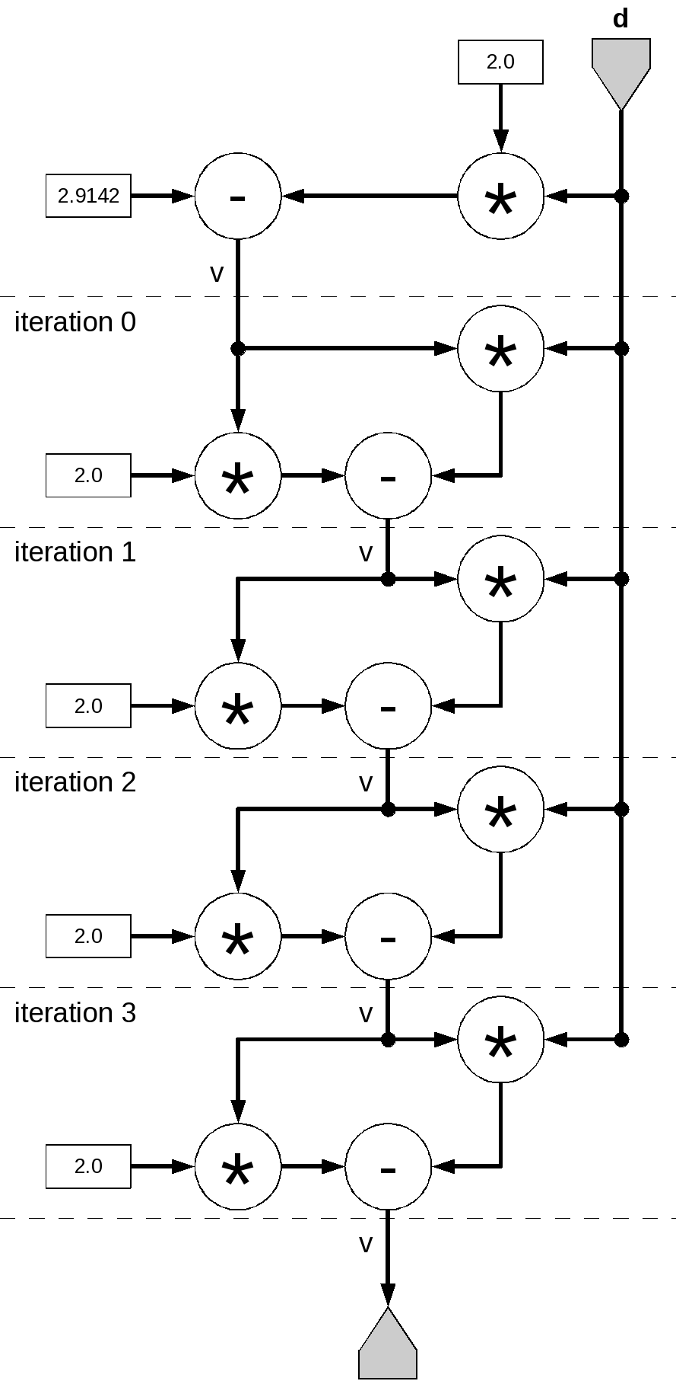
Loop Unrolling with Dependence
for (i = 0; ; i += 1) {
float d = input[count];
float v = 2.91 – 2.0*d;
for (iter=0; iter < 4; iter += 1)
v = v * (2.0 - d * v);
output[i] = v;
}
HWVar d = io.input(”d”, hwFloat(8, 24));
HWVar TWO= constant.var(hwFloat(8,24), 2.0);
HWVar v = constant.var(hwFloat(8,24), 2.91) − TWO*d;
for ( int iteration = 0; iteration < 4; iteration += 1) {
v = v*TWO− d*v;
}
io.output(”output” , v, hwFloat(8, 24));
Notes:
Removed:
Array-access (i) & Loop-carried dependency (v)
Computation-to-MemoryAccess = 12 (better)
Working set size = 0

Slide 11
Loop Unrolling with Dependence
for (i = 0; ; i += 1) {
float d = input[count];
float v = 2.91 – 2.0*d;
for (iter=0; iter < 4; iter += 1)
v = v * (2.0 - d * v);
output[i] = v;
}
HWVar d = io.input(”d”, hwFloat(8, 24));
HWVar TWO= constant.var(hwFloat(8,24), 2.0);
HWVar v = constant.var(hwFloat(8,24), 2.91) − TWO*d;
for ( int iteration = 0; iteration < 4; iteration += 1) {
v = v*TWO− d*v;
}
io.output(”output” , v, hwFloat(8, 24));
The software loop has a cyclic dependence (v)
But the unrolled datapath is acyclic

Slide 12
Overview of Accelerating Loops
Classifying Loops
Attributes and measures
Simple Fixed Length Stream Loops
Example vector add
Custom memory controllers
Nested Loops
Counter chains
Streaming and unrolling
How to avoid cyclic graphs
Variable Length Loops
Convert to fixed length
Loops with dependence cycles
How to build cyclic data-flow graphs
How to exploit pipelining in cyclic graphs

Slide 13
Variable Length Loop
Count | Condition | Finished | shift
1 | f | f | 1
2 | f | f | 2
3 | f | f | 3
4 | f | f | 4
5 | t | t | 5
6 | f | t | 5
7 | f | t | 5
8 | f | t | 5
9 | F | t | 5
for (count=0; ; count += 1) {
int d = input[count];
int shift = 0;
while (d != 0 && ((d & 0x3FF) != 0x291)) {
shift = shift + 1;
d = d >> 1;
}
output[count] = shift;
}
What do we do with a while loop (or a loop with a “break”)?
// converted to fixed length
for (count=0; ; count += 1) {
int d = input[counCt];
int shift = 0;
bool finished = false;
for (int i = 0; i < 22; ++i) {
bool condition = (d != 0 && ((d & 0x3FF) != 0x291));
finished = condition ? true : finished; // loop-carried
shift = finished ? shift : shift + 1; // dependencies
d = d >> 1;
}
output[count] = shift;
}
Find maximum number of iterations
Predicate execution of loop body
Using a bool that is set to false when the while loop condition fails

Slide 14
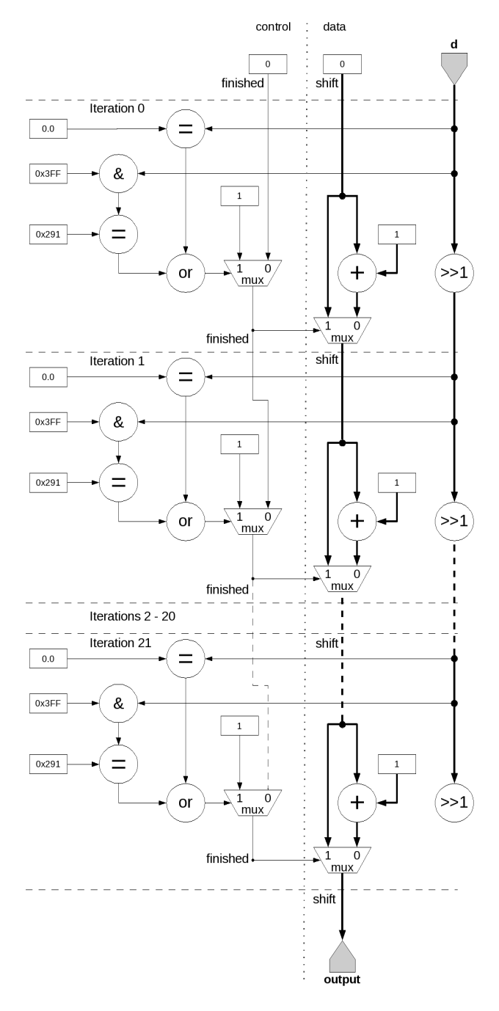
Variable Length Loop – in hardware
for (count=0; ; count += 1) {
int d = input[count];
int shift = 0;
bool finished = false;
for (int i = 0; i < 22; ++i) {
bool condition=(d!=0&&((d&0x3FF)!=0x291));
finished = condition ? true : finished;
shift = finished ? shift : shift + 1;
d = d >> 1;
}
output[count] = shift;
}
HWVar d = io.input(”d”, hwUInt(32));
HWVar shift = constant.var(hwUInt(5), 0);
HWVar finished = constant.var(hwBool(), 0);
for ( int i = 0; i < 22; ++i) { // unrolled
HWVar condition = d.neq(0)&((d&0x3FF).neq(0x291));
finished = condition ? constant.var(1) : finished ;
shift = finished ? shift : shift + constant.var(1);
d = d >> 1;
}
// Output
io.output(”output” , shift , hwUInt(5));

Slide 15
Variable Length Loop – in hardware
for (count=0; ; count += 1) {
int d = input[count];
int shift = 0;
bool finished = false;
for (int i = 0; i < 22; ++i) {
bool condition=(d!=0&&((d&0x3FF)!=0x291));
finished = condition ? true : finished;
shift = finished ? shift : shift + 1;
d = d >> 1;
}
output[count] = shift;
}
HWVar d = io.input(”d”, hwUInt(32));
HWVar shift = constant.var(hwUInt(5), 0);
HWVar finished = constant.var(hwBool(), 0);
for ( int i = 0; i < 22; ++i) { // unrolled
HWVar condition = d.neq(0)&((d&0x3FF).neq(0x291));
finished = condition ? constant.var(1) : finished ;
shift = finished ? shift : shift + constant.var(1);
d = d >> 1;
}
// Output
io.output(”output” , shift , hwUInt(5));
Again, the unrolled loop is acyclic

Slide 16
To Unroll or Not to Unroll
Loop Unrolling
Gets rid of loop-carried dependency by creating a long pipeline
Requires O(N) space on the chip...what if it does not fit?
If we can’t unroll, we end up with a cycle in the dataflow graph
As we will see, we need to take care to make sure the cycle is compatible with the pipeline depth
Variable-length loop (with loop-carried dependency)
Can be fully unrolled, BUT need to know maximal number of iterations
Utilization depends on actual data...
What if max iterations is much larger than average? Or max is not known? Or max iterations don’t fit on the chip?

Slide 17
Overview of Accelerating Loops
Classifying Loops
Attributes and measures
Simple Fixed Length Stream Loops
Example vector add
Custom memory controllers
Nested Loops
Counter chains
Streaming and unrolling
How to avoid cyclic graphs
Variable Length Loops
Convert to fixed length
Loops with dependence cycles
How to build cyclic data-flow graphs
How to exploit pipelining in cyclic graphs

Slide 18
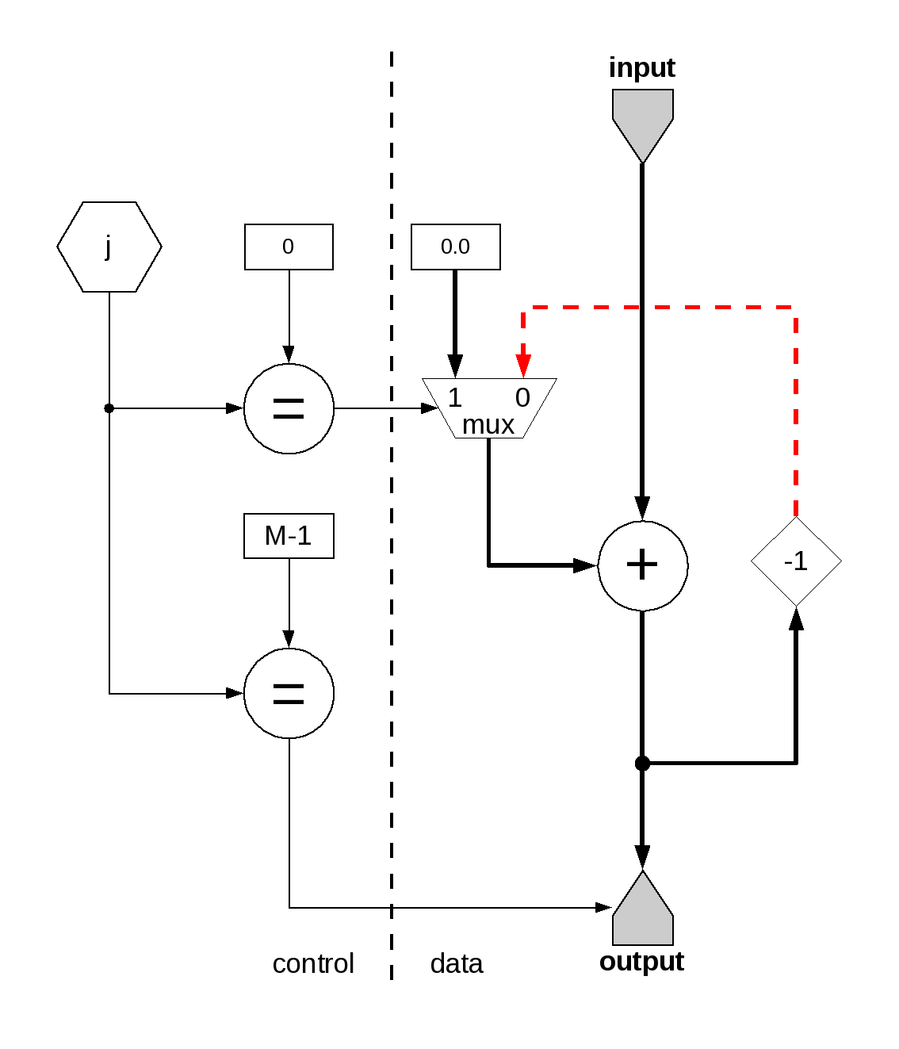
Cyclic Data Flow with MaxCompiler
int count = 0;
for (int i=0; ; i += 1) {
sum[i] = 0.0;
for (int j=0; j<M; j += 1) {
sum[i] = sum[i] + input[count];
count += 1;
}
output[i] = sum[i];
}
HWVar jCounter = control.count.simpleCounter(32, M);
HWVar carry = scalarType.newInstance(this);
HWVar sum = jCounter.eq(0) ? 0.0 : carry;
sum = input + sum;
carry.connect(stream.offset(sum, −13)); // trial-and error => -13
io.output(”output” , sum, scalarType, jCounter.eq(M − 1));
-13
Notes:
I think this is confused. Or maybe broken.

Slide 19
Pipeline Depth, Why -13
The multiplexer has a pipeline depth of 1
The floating-point adder has
a pipeline depth of 12
Total loop latency = 13 cycles,
carry.connect(stream.offset(sum, −13));
-13

Slide 20
input[0,0], input[0,1], input[0,2]...
1
2
3
4
5
6
7
8
9
After an initial pipeline fill phase, all 13 pipeline stages are occupied
13 independent summations are computed in parallel
0.0
Output[0]
input[1,0], input[1,1], input[1,2]...
0.0
1
2
3
4
5
6
7
8
9
Output[1]
input[2,0], input[2,1], input[2,2]...
0.0
1
2
3
4
5
6
7
8
9
Output[2]
input[3,0], input[3,1], input[3,2]...
0.0
1
2
3
4
5
6
7
8
9
Output[3]
time

Slide 21
Pipeline Depth and Loop-Carry Distance
for (i=0;i<N;i++){
for (j=0;j<M;j++)
v[i]=v[i]*v[i]+1; // distance 1
}
Now the j-loop has a loop-carried dependency with distance 1, i.e. Each loop needs the v[i] result of the previous loop, BUT the v[i]*v[i]+1 operations have X stages and thus take X clock cycles.
Note that v[i]s are independent, i.e. the i-loop has no dependency!
We thus need X activities (v[i]s) to be in the loop at all times to fully utilize all stages of the multiplication pipeline.
for (i=0;i<N/X;i++){
for (j=0;j<M;j++)
for (k=0;k<X;k++) // distance X
v[i*X+k]=v[i*X+k]*v[i*X+k]+1;
}
X

Slide 22
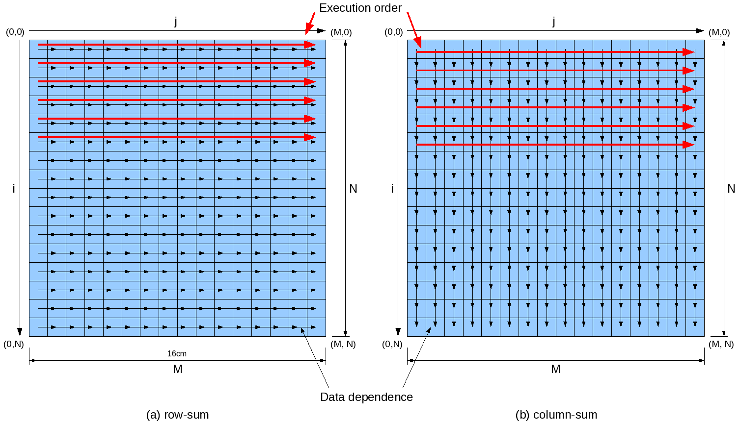
Loop interchange
Example: Row-wise summation is serial due to chain of dependence
Column-wise summation would be easy of course
So we can keep the pipeline in a cyclic data datapath full by flipping the problem – ie by interchanging the loops
Notes:
I think the title of this slide is unhelpful?

Slide 23
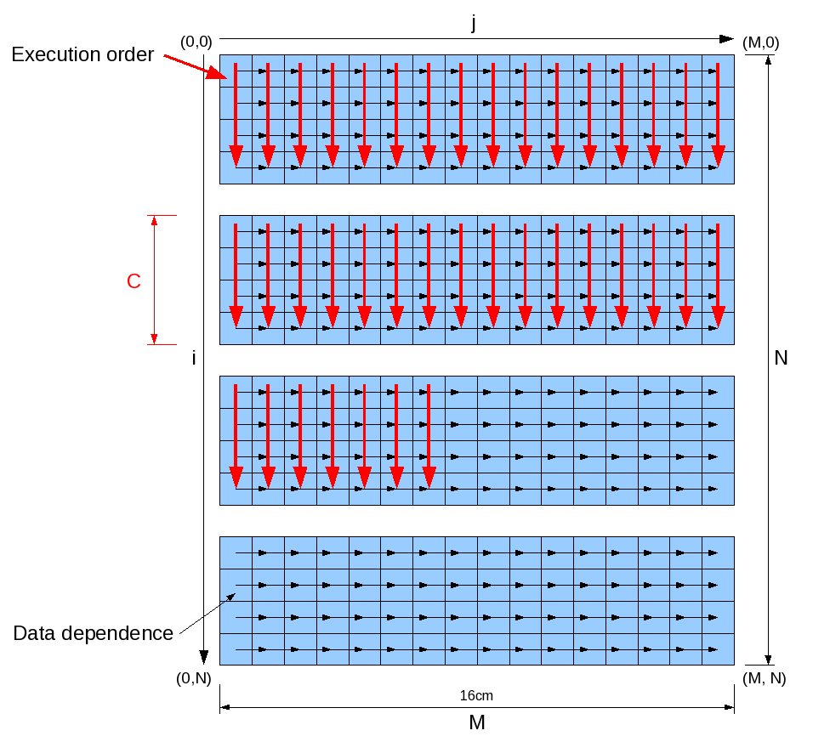
Loop Tiling reduces local BRAM requirement
Idea: sum a block of rows at a time (“tiling”)
We can choose the tile size
Just big enough to fill the pipeline
so no unnecessary buffering is needed

Slide 24
Summary
Loops are where parallelism comes from
The loop control variables are generated using counters
In a nested loop this needs a counter chain
Inner loops with small bounds can be unrolled
Loops with dependences lead to acyclic graphs when unrolled
Loops with variable/unknown bounds (while loops) need to be converted into for-loops with predication
If a loop with a loop-carried dependence cannot be unrolled, we need to build a cyclic data flow graph
Each pipeline stage in the cycle needs to be occupied by an independent operation
Interchanging loops can avoid this problem – by making the loop-carried dependence distance sufficiently large
Splitting loops into blocks (“tiling”) allows us to control the amount of buffering required

Slide 25
Exercises
Write a MaxCompiler kernel that computes the Mandelbrot set. Compare (a) fully unrolled and (b) partially unrolled with loop implementation.

