Slide 1
Elementary Functions
Presenter
MaxAcademy Lecture Series – V1.0, September 2011

Slide 2
Lecture Overview
Motivation
How to evaluate functions
Polynomial and rational approximation
Table-based methods
Shift and add methods

Slide 3
Motivation
Elementary function are required for compute intensive applications, for example:
2D/3D graphics: trigonometric functions
Image Processing: e.g. Gamma Function
Signal Processing, e.g. Fourier Transform
Speech input/output
Computer Aided Design (CAD): geometry calculations
and of course Scientific Applications:
Physics, Biology, Chemistry, etc…

Slide 4
Evaluating Functions
3 steps to compute f(x)
Given argument x, find x’=g(x) with x’ in [a,b], and
f(x) = h( f( g(x) ))
Step 1: Argument Reduction = g(x)
Step 2: Approximation over interval [a,b]
I.e. compute f( g(x) )
Step 3: Reconstruction:
f(x) = h( f(g(x) ) )

Slide 5
Example: sin(x)
Example: sin(float x)
float sin(float x){
float y = x mod (π/2); // reduction
float r1 = c0*y*y+c1*y+c2;
float r2 = c3*y*y+c4*y+c5;
return (r1/r2); // rational approx.
}
c0-c5 are coefficients of a rational approximation of
sin(x) in [0, π/2 ]. (note: no reconstruction is needed)

Slide 6
Example f(x) = exp(x)
x / (0.5 ln 2) = N + r/(0.5 ln 2)
x = N (0.5 ln 2) + r
exp(x) = 2^ (0.5 N) *exp(r)
Step 1:
N = integer quotient of x/(0.5 ln 2)
r = remainder of x/(0.5 ln 2)
Step 2:
Compute exp(r) by approximation (e.g. polynomial)
Step 3:
Compute exp(x) = 2^ (0.5 N) *exp(r) which is just a shift!!

Slide 7
2nd Step: Approximations in [a,b]
Polynomial and rational approximations
1 full lookup table
Bipartite tables (2 tables + 1 add/sub)
Piecewise affine approximation (tables + mult/add)
Shift-and-add methods (with small tables)

Slide 8
Evaluating Polynomials
Horner Rule transforms polynomial into a “Multiply-Add Structure”
As a consequence, DSP Microprocessors have a Multiply-Add Instruction (Madd) by simply adding another row to an array multiplier.

Slide 9
Polynomial and Rational Approximation
“Rational Approximation”
“Polynomial Approximation”

Slide 10
Finding the Coefficients
Taylor series finds optimal coefficient for a specific point x=x0.
We need optimal coefficient for an entire interval [a,b]. Software such as Maple computes optimal coefficients for polynomial and rational approximations with Remez’s method (a.k.a. minimax coefficients).
Bottom line: we can find optimal coefficients for any function and any interval [a,b].

Slide 11
Table-based Methods
Full table lookup: N-bit input, M-bit output
Lookup Table Size = M×2^{N} bits
Delay of a lookup in large tables increases with size!
For N > 8 bits we need to use smaller tables:
Add elementary operations to reduce table size
Tables + 1 Add/Sub
Tables + Multiply
Tables + Multiply-Add
Tables + Shift-and-Add

Slide 12
Bi-Partite Tables
x₀ x₁ x₂
n₀
n₁
n₂
Table
a₀ (x₀ ,x₁)
Table
a₁ (x₀ ,x₂)
p₀
p₁
Adder
p
f(x)
̃̃

Slide 13
Symmetric Bipartite Tables Sizes
f(x) | n | n₀ , n₁ , n₂ | SBTM | Standard | Compression
1/x | 16 | 7, 3, 5 | 2¹⁰ x 17 + 2¹¹ x 7 | 2¹⁵ x 15 | 15.5
1/x | 20 | 8, 5, 6 | 2¹³ x 21 + 2¹³ x 8 | 2¹⁹ x 19 | 41.9
1/x | 24 | 9, 7, 7 | 2¹⁶ x 25 + 2¹⁵ x 9 | 2²³ x 23 | 99.8
√x | 16 | 5, 5, 6 | 2¹⁰ x 17 + 2¹⁰ x 6 | 2¹⁶ x 15 | 41.9
√x | 20 | 6, 7, 7 | 2¹³ x 21 + 2¹² x 7 | 2²⁰ x 19 | 99.3
√x | 24 | 8, 7, 9 | 2¹⁵ x 25 + 2¹⁶ x 9 | 2²⁴ x 23 | 273.9
sin (x) | 16 | 6, 4, 6 | 2¹⁰ x 18 + 2¹¹ x 7 | 2¹⁶ x 16 | 32.0
sin (x) | 20 | 7, 4, 7 | 2¹³ x 22 + 2¹³ x 8 | 2²⁰ x 20 | 85.3
sin (x) | 24 | 8, 8, 8 | 2¹⁶ x 26 + 2¹⁵ x 9 | 2²⁴ x 24 | 201.4
log₂ (x) | 16 | 7, 3, 5 | 2¹⁰ x 18 + 2¹¹ x 8 | 2¹⁵ x 16 | 15.1
log₂ (x) | 20 | 8, 5, 6 | 2¹³ x 22 + 2¹³ x 9 | 2¹⁹ x 20 | 41.3
log₂ (x) | 24 | 9, 7, 7 | 2¹⁶ x 26 + 2¹⁵ x 10 | 2²³ x 24 | 99.1
2^{x} | 16 | 5, 5, 6 | 2¹⁰ x 17 + 2¹⁰ x 7 | 2¹⁶ x 15 | 40.0
2^{x} | 20 | 6, 7, 7 | 2¹³ x 21 + 2¹² x 8 | 2²⁰ x 19 | 97.3
2^{x} | 24 | 8, 7, 9 | 2¹⁵ x 25 + 2¹⁶ x 10 | 2²⁴ x 23 | 261.7

Slide 14
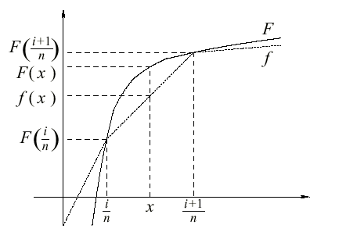
Table + Multiply Add
f(x) = a×x+b with a,b stored in tables
X_{m} are leading bits of X which determine which linear piece of f(x) should be used.
TABLE
x_{m}
Mult Add
f(x)
x

Slide 15
Shift-and-Add Methods
Fixed shift in Hardware = shifted wiring → no cost
Fixed shift = multiply by 2^{x}
Modify Multiply-Add algorithms to only multiply by powers of 2.
Is this possible ? How do we choose the k’s, c’s?

Slide 16
CORDIC
Iterations:
e(i) = table lookup
μ = {-1,0,1}
di = ±sign(z(i))
x
add/sub
y
constant add
z
0
Parallel CORDIC

Slide 17
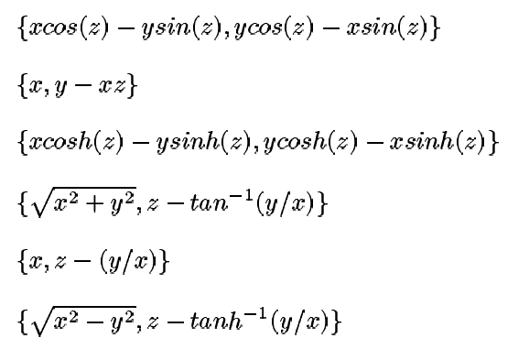
CORDIC on Xilinx XC4000
{ X’ , Y’ }
X
X’
Y
Y’

Slide 18
Area-Time Tradeoff
In general we trade area for speed.
Tables+Add/Sub Tables + Mult-Add Shift-and-Add
small
fast

Slide 19
Summary
3 steps to compute f(x)
Step 1: Argument Reduction = g(x)
Step 2: Approximation over interval [a,b]
Lookup Table for a small number of bits.
Lookup Table + Add/Sub => Bi-partite tables
Lookup Table + Mult-Add => Piecewise Linear Approx.
Shift-and-Add Methods => e.g. CORDIC
Polynomial and Rational Approximations
Step 3: Reconstruction = h(x)

Slide 20
Further Reading on Function Evaluation
J.M. Muller, “Elementary Functions,” Birkhaeuser, Boston, 1997.
Story, S. and Tang, P.T.P., "New algorithms for improved transcendental functions on IA-64," in Proceedings of 14th IEEE symposium on computer arithmetic, IEEE Computer Society Press, 1999.
D.E. Knuth, “The Art of Computer Programming”, Vol 2, Seminumerical Algorithms, Addison-Wesley, Reading, Mass., 1969.
C.T. Fike, “Computer evaluation of mathematical functions,”
Englewood Cliffs, N.J., Prentice-Hall, 1968.
L.A. Lyusternik, “Handbook for computing elementary functions”, available in english translation.

Slide 21
Exercises
Write a MaxCompiler kernel which takes an input stream x and computes a polynomial approximation of sin(x). Draw the dataflow graph.
Write a MaxCompiler kernel that implements a CORDIC block. Vary the number of stages in the CORDIC and evaluate the impact on the result.

