Slide 1
Maxeler Essence Revisited
Veljko Milutinovic and Nenad Korolija

Slide 2
Essence (1)
What applications are potentially migratable to Maxeler?
  Extra long execution time.
  Most of the execution time is in loops.
What loops to migrate?
  High data reusability, once the data is moved to the accelerator.
  High tolerance to long latencies, by the application.
What acceleration to expect?
  If below the hardware limits,
  the more data,
  the higher the expected acceleration
  (good for Big Data)
  The less sophisticated the data dependencies
  of different loop iterations,
  the higher the expected acceleration.

Slide 3


Essence (2)
FOR i = 1 2 3 4 5 … k … n DO FOR i = 1 2 3 4 5 … n DO
T₀ T₁ T₂ T₃ T₄ T₀ T_{k} T_{2k} T_{3k}
_{OP1 OP1}
_{OP2 OP2}
_{OP3 OP3}
_{OP4 OP4}
_{OP5 OP5}
_{OP6 OP6}
. .
. .
. .
_{OPk OPk}
T_{k} T_{k+1} T_{k+2} T_{k} T_{2k}
1 result/clock_{MAX} T_{3k} T_{4k}
1 result/k*clock_{CPU}

Slide 4
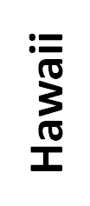
Essence (3)
Tahiti

Slide 5
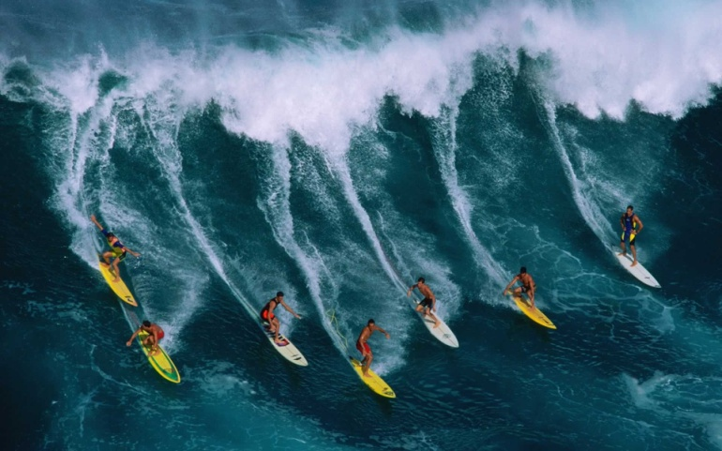

Essence (4)

