Slide 1
Using pivot tables for employees turnover analysis
Name. : K.Megavarthiny.
Register no : 312211730
Department. : BCOM general
College: Thiruthangal Nadar college

Slide 2

Table of content
Meaning of employee turnover
Formula for calculating employee turnover
Types of employee turnover
How to analysis employees turnover
Project overview and their key benefits
Who are the end users?
Modelling
Data set
Result
Conclusion

Slide 3
Employee turnover
Employee turnover analysis is a process that helps organizations understand why employees leave, and how to improve retention and hiring. It involves collecting, analyzing, and reporting human resources (HR) data to understand a company’s turnover rate.

Slide 4

Formula for calculating employee turnover
How many people are leaving each year Turnover = Number of staff leaving per year x 100 / average number of staff

Slide 5

Types of employee turnover
1. Voluntary turnover This type of turnover is when an employee decides to voluntarily leave the organization. It is the employee’s choice to disassociate from the organization without pressure from any external forces. 2. Involuntary turnover Involuntary turnover is when an employee is fired or asked to leave the organization due to various factors (which cannot always be pinpointed). 3. Desirable turnover Turnover is considered desirable when an organization fires or loses underperforming employees and replaces them with new hires. This process may not go down well with a lot of employees, yet it is essential to keep the momentum going within the organization. 4. Undesirable turnover Undesirable turnover is when an organization loses its top-performing employees. Some employees leave a deeper impact than others, and those are the employees that are difficult to replace.

Slide 7

How can you analyze your organization’s turnover rate?
Analyzing an organization’s turnover rate is a critical task that can provide important insights into the organization’s health. High turnover rates can indicate problems such as poor management, insufficient compensation, and benefits, or a hostile work environment. A low employee turnover rate, on the other hand, can indicate that the organization is effectively retaining its employees and creating a positive workplace culture

Slide 8
Project overview
Using pivot tables allows for dynamic, interactive analysis of employee turnover data, making it easier to identify trends, draw insights, and make informed decisions on retention strategies.
This overview should help you understand how pivot tables can be used for a comprehensive analysis of employee turnover, offering actionable insights to improve retention and organizational stability
Key Benefits of Using Pivot Tables for Turnover Analysis
Dynamic Data Analysis: Easily adjust your analysis with drag-and-drop functionality.
Flexible Reporting: Customize your reports to highlight different aspects of turnover, such as by time, department, or reason.
Quick Insights: Pivot tables allow for rapid identification of trends and problem areas without complex formulas or coding.
Data-Driven Decisions: Provides clear, quantitative evidence to support strategic HR decisions.

Slide 9
WHO ARE THE END USERS?
Human Resources (HR) Managers: Department Managers/Supervisors: Senior Management/Executives: Employees

Slide 10

Modelling
In the “Employee Performance Analysis Using Excel” project, the modeling phase involves setting up the Excel workbook with various tools and techniques to analyze and visualize the data effectively. Here’s how each component will be used: 1. Data Filtering Purpose: To sort and refine the data to focus on specific criteria, such as department, date range, or individual employee performance. Implementation: Excel’s filtering feature will be applied to datasets, allowing users to easily narrow down the data to view only the relevant information. For example, filtering by department or by performance rating. 2. Pivot Tables Purpose: To summarize and analyze large datasets by grouping and aggregating data based on different performance metrics. Implementation: Pivot tables will be used to dynamically calculate and display key performance indicators (KPIs) such as average task completion time, total hours worked, or percentage of targets met. This will allow users to view performance metrics by different categories, like employee, team,

Slide 11
Dataset Description
Descriptions for each of the columns in the dataset: 1.Employee ID: Unique identifier for each employee in the organization.
2. First Name: The first name of the employee. 3. Last Name: The last name of the employee. 4. Email: The email address associated with the employee’s communication within the organization.
5. Business Unit: The specific business unit or department to which the employee belongs. 6. State: The state or region where the employee is located.
7. Job Function: A brief description of the employee’s primary job function or role. 8. Gender: A code representing the gender of the employee (e.g. M for Male, F for Female, N for Non-binay
9. Performance Score: A score indicating the employee’s performance level (e.g.. Excellent, Satisfactory.
Needs Improvement). 10. Current Employee Rating: The current rating or evaluation of the employee’s overall performance

Slide 12
Data set
Name of employee | Employee ID | Performance score of employee
Zackery | 2 | 2
Zaiden | 1 | 1
Zain | 2 | 2
Zander | 2 | 2
Zaniyah | 3 | 3
Zara | 2 | 2
Zaria | 3 | 3
Zariah | 3 | 3
Zavier | 1 | 1
Zayne | 2 | 2

Slide 13
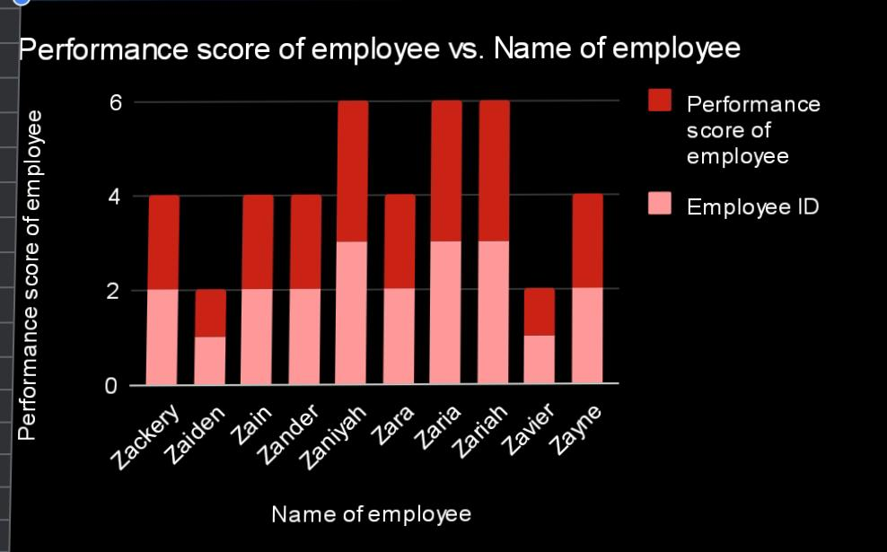
RESULT

Slide 14
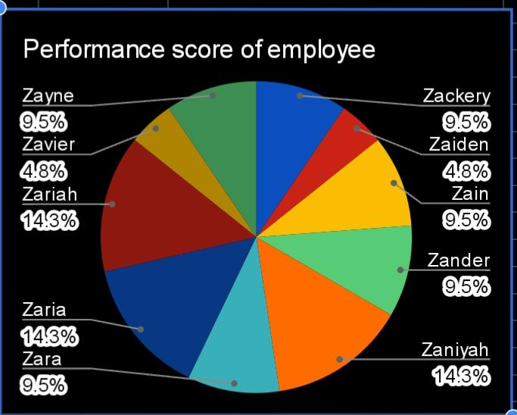
Pie chart

Slide 15
Conclusion
Employee turnover analysis using pivot tables is an essential tool for HR professionals and managers to understand the dynamics of employee departures within an organization. By leveraging pivot tables, you can efficiently analyze large datasets to uncover key insights about turnover rates, trends over time, departmental impacts, and the reasons behind employee exits.
Overall, employee turnover analysis using pivot tables provides a data-driven foundation for making informed decisions that support long-term organizational success and employee satisfaction.

