Slide 1
Avocado Price Prediction

Slide 2
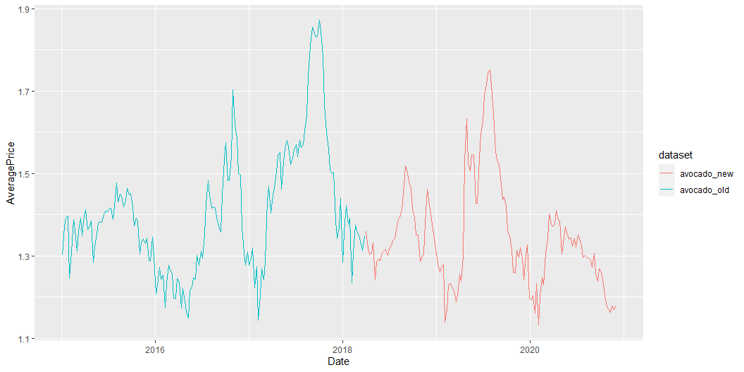
Description of the project
For our project we took an avocado price analysis from Kaggle.
The analysis has been written in Python language and original code can be found in file translated_code_with_old_data/avocado-price-prediction.ipynb.
The translation to R can be found in translated_code_with_old_data/avocado.R.
They both use data specified in article and the new code reproduces the same results.
Later on we used the new code to update the data with 2019-2020 values. In the presentation we will explore the differences between old and new results.
The timeline
Date range in original dataset is 2015-01-04 to 2018-03-25 . Available 1176 days.
Date range in updated dataset is 2018-04-01 to 2020-11-29 . Available 973 days.

Slide 3
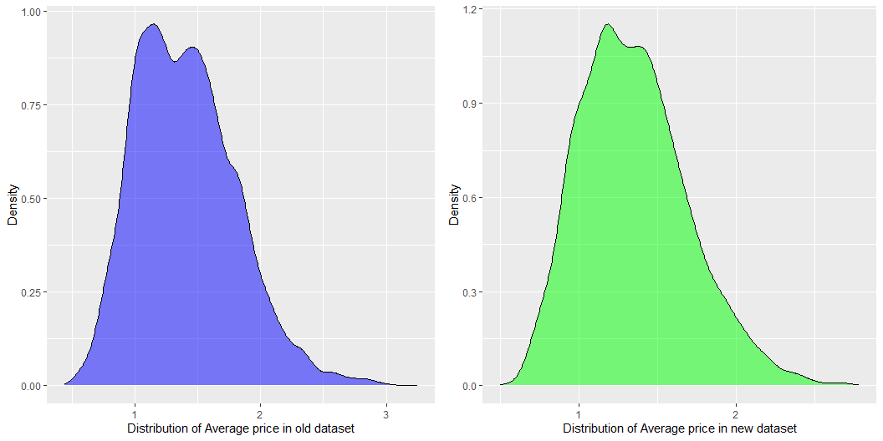
Spread of Average Price in the data
Old dataset
Min. 1st Qu. Median Mean 3rd Qu. Max. 0.440 1.100 1.370 1.406 1.660 3.250
New dataset
Min. 1st Qu. Median Mean 3rd Qu. Max. 0.500 1.090 1.320 1.348 1.560 2.780

Slide 4
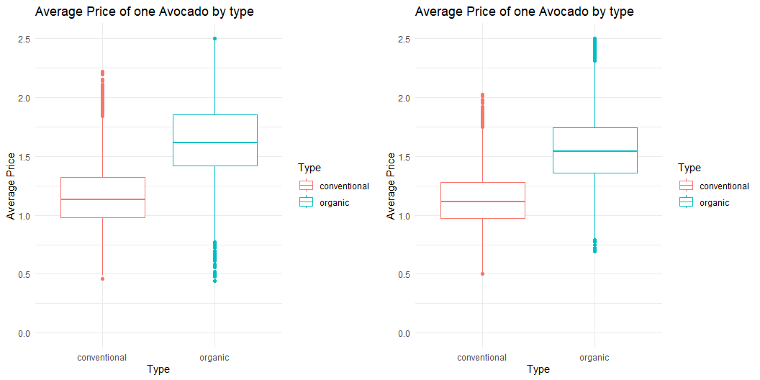
Type of avocado vs Average Price
Average price of organic avocados drops when we compare 2015-2018 to 2018-2020.

