Slide 1
Forecasting Future Energy Consumption Based on Historical Data
Presented by Ramy Othman
Sep 29, 2024

Slide 2
Introduction & Problem Statement
Overview of the Project:
This project aims to predict the power output of a microgrid using historical weather data, leveraging an LSTM model to account for the time-series nature of the data.

Slide 3
Problem Statement:
Predicting future power output is critical for efficient energy management. Accurate predictions allow for better decision-making, optimizing energy generation and consumption

Slide 4
Objective:
The objective of this project is to use past weather data and energy consumption patterns to forecast future power output, enabling more effective energy management.

Slide 5
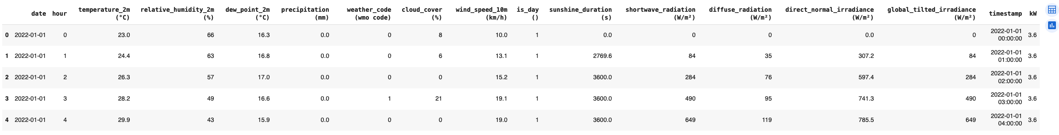
Dataset Description
The dataset contains hourly weather data and power output (kW) values from a microgrid. It includes variables such as temperature, humidity, cloud cover, and solar radiation.

Slide 6
Key Features:
Temperature (°C)
Relative Humidity (%)
Wind Speed (km/h)
Precipitation (mm)
Cloud Cover (%)
Lagged kW values for previous hours (Lag 1, Lag 3, etc.)
Rolling averages (temperature, humidity, etc.)
>>> The target variable for prediction is the power output in kilowatts (kW).

Slide 7

Data Preprocessing:
The data was normalized using MinMaxScaler, and lag features were created to allow the model to learn from past values.

Slide 8
Feature Engineering
To capture daily patterns, we encoded the hour column using sine and cosine transformations. Additionally, we created rolling averages and lag features to help the model learn from past trends.
Impact of Feature Engineering:
By incorporating these features, we provided the model with more context, improving its ability to capture both short-term fluctuations and long-term trends.

Slide 9
Model Architecture
LSTM Model:
LSTM (Long Short-Term Memory) is a type of recurrent neural network (RNN) designed to handle time-series data. Its ability to maintain long-term dependencies makes it ideal for predicting power output based on historical data.

Slide 10
Why using lstm
Ability to Capture Long-Term Dependencies
Handling of Sequential and Time-Series Data
Flexibility in Input Features
Robustness to Missing Data (to Some Extent)
Probabilistic Forecasting
Integration with Other AI Techniques

Slide 11

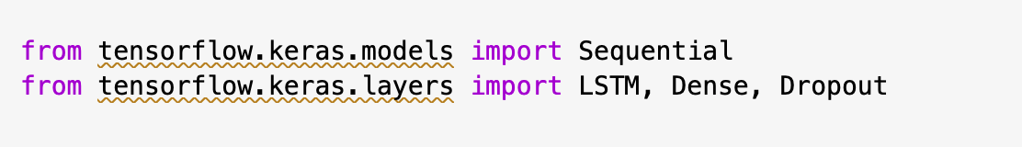
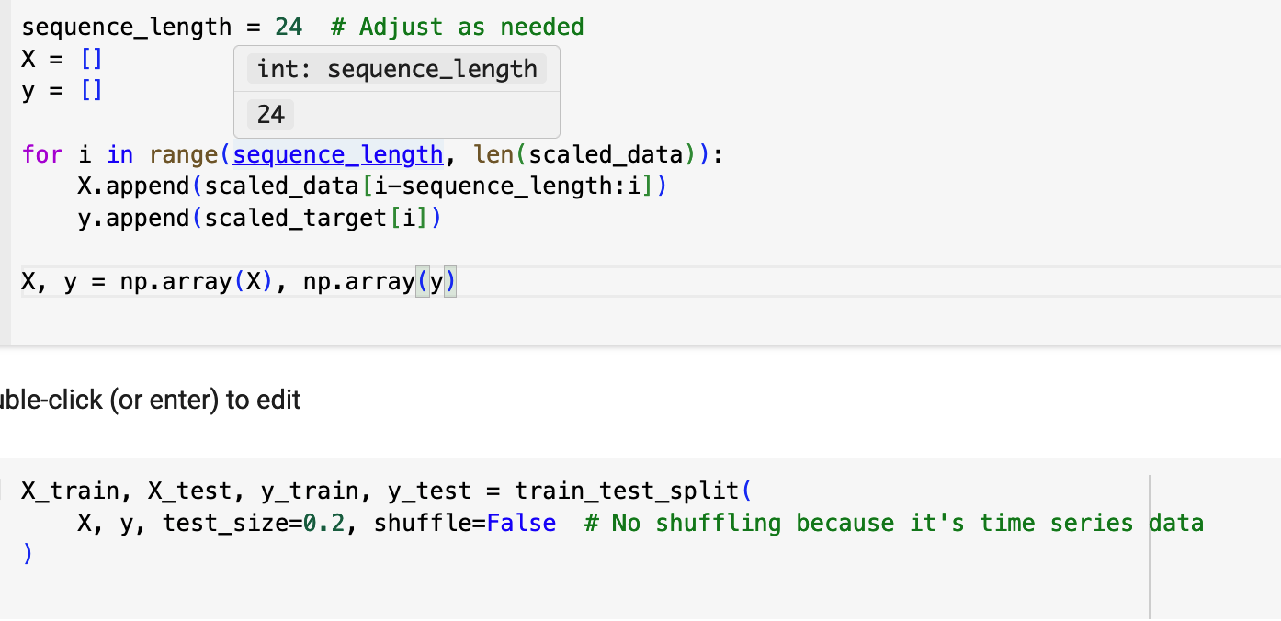
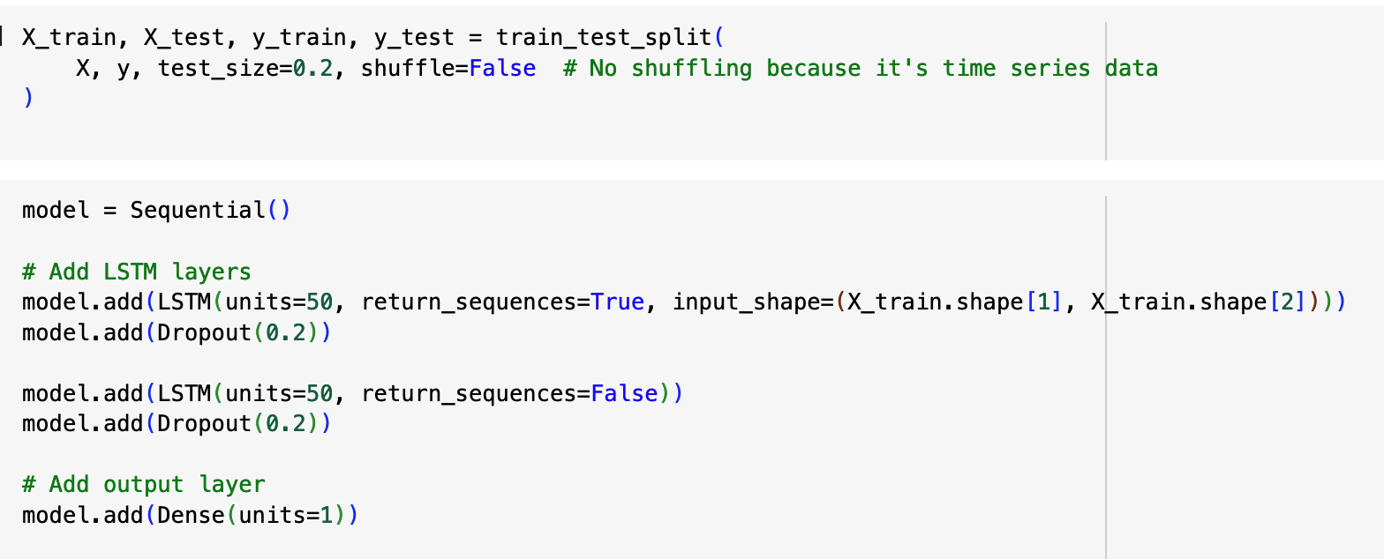
Model Structure:
The model consists of two LSTM layers with 100 units each, followed by dropout layers to reduce overfitting. The final layer is a dense layer with one unit, which outputs the predicted power (kW).

Slide 12

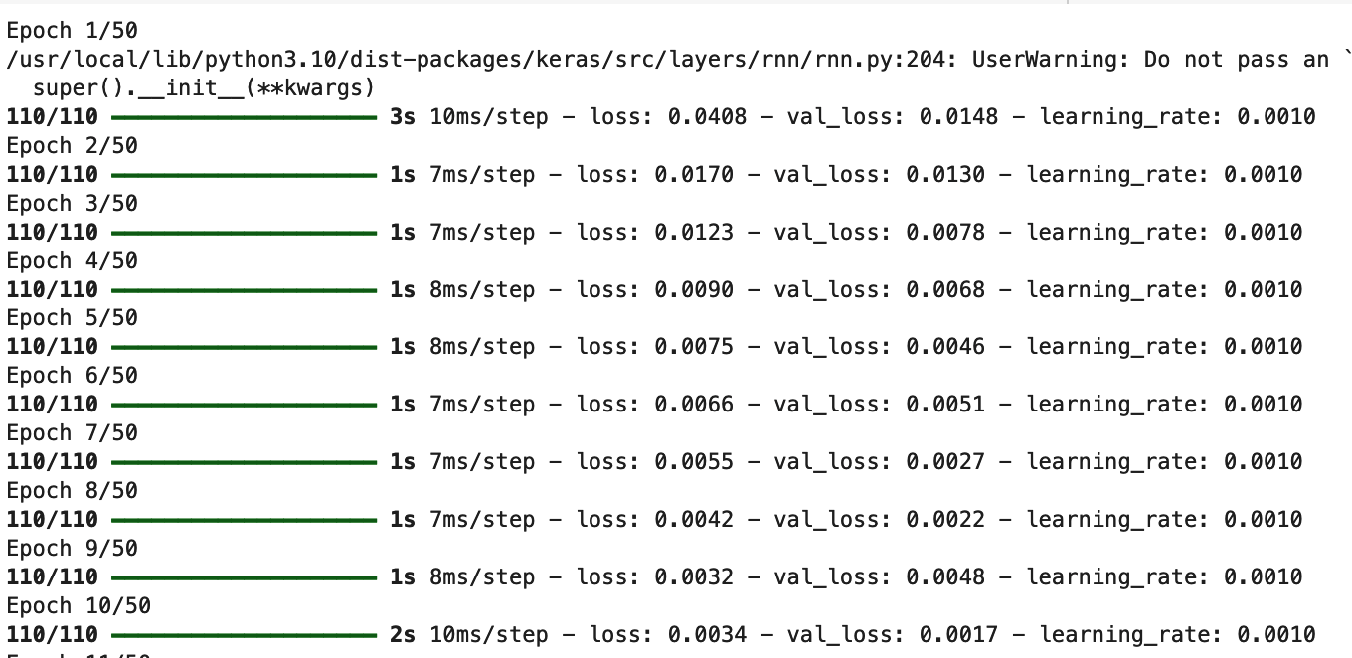
Hyperparameters
The model was trained for 50 epochs with a batch size of 64, using the Adam optimizer and early stopping to prevent overfitting.

Slide 13
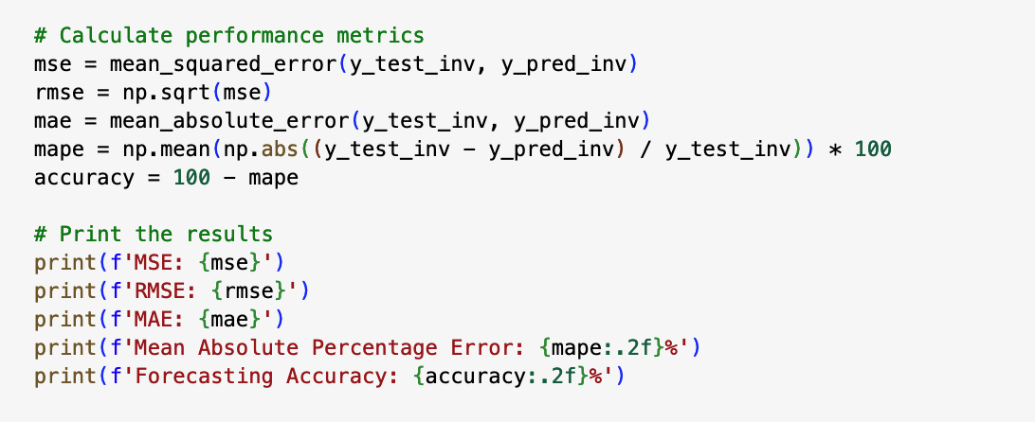
Evaluation Metrics
Metrics Used:
To evaluate the model’s performance, we used the following metrics:
Mean Squared Error (MSE)
Root Mean Squared Error (RMSE)
Mean Absolute Error (MAE)
Mean Absolute Percentage Error (MAPE)

Slide 14
Why These Metrics?
RMSE and MAE help in understanding how much the predicted power output deviates from the actual values, while MAPE gives a percentage error, allowing us to assess performance relative to the size of the power output.

Slide 15
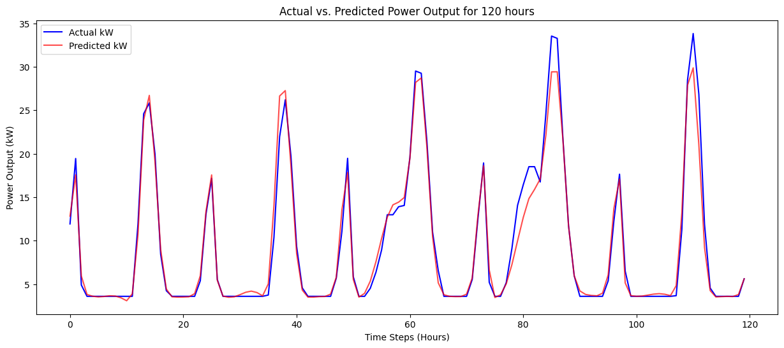
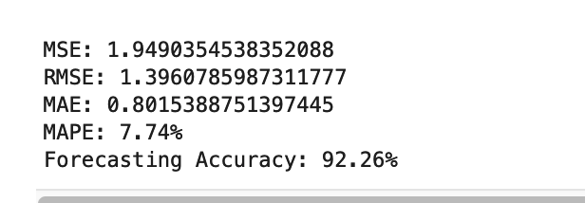
Results & Insights
Predicted vs. Actual
Here, we observe how closely the model's predictions align with the actual values over a 120 hours period.

Slide 16
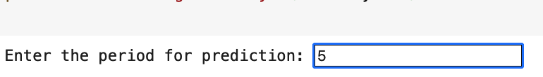

User Input Prediction Mechanism
User Prediction Feature:
Users can input a time period for prediction, which is converted to hours for consistency. The model then predicts power output for the specified period, and the results are graphed.
Interactive Prediction:
-This functionality allows users to predict power output over varying time scales, from short-term predictions (hours) to long-term predictions (months).

Slide 17
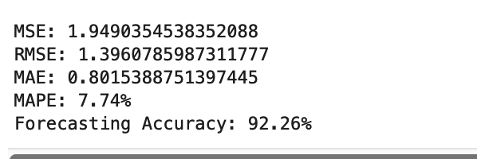
Model Performance
Forecasting Accuracy:
- The model achieved a forecasting accuracy of 92%, which demonstrates its potential for energy management applications.

Slide 18
Conclusion
In conclusion, LSTM model performed well in predicting power output based on historical weather data. The ability to make accurate short-term and long-term prediction
Importance of Predictions:
Accurate predictions can lead to optimized energy production, reduced costs, and improved grid stability, making them crucial for future energy management systems.

