Slide 1

The AlgoInvest & Trade

Slide 2
Contents
Analysis of Brute-Force Algorithm
Proposed Optimized Approach: Knapsack by Dynamic Programming
Flowchart of Optimized Algorithm
Limitations of the Optimized Algorithm
Performance Analysis of Two Algorithms
Outputs Comparison

Slide 3
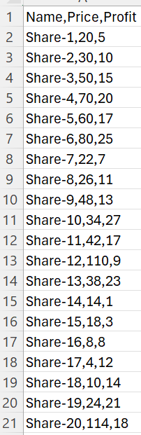
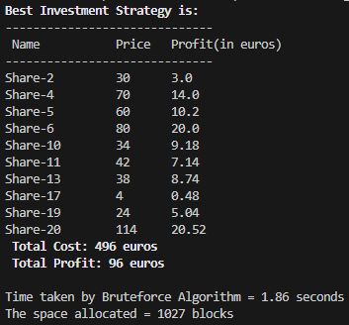
Analysis of Brute-Force Algorithm
Brute force algorithm explores all possible combinations of items and selecting the one that maximizes the profit while staying within the budget constraint.
With the given dataset of 20 shares, the algorithm would explore all possible combinations of shares (2 ^ 20 = 1048576) to find the optimal combination gaining the maximum profit of 96 euros within the budget of 500 euros.
However, as the number of items increases for example given Dataset1 and Dataset2 containing 1k+ items, exploring all possible combinations (2^1K), would become impractical.
Advantages of Brute Force:
Guarantees finding the optimal solution.
Simple and direct implementation.
Disadvantages of Brute Force:
Exponential time complexity.
Inefficiency for scenarios involving numerous items.
Asymptotic Complexity Analysis: O(2^n)

Slide 4
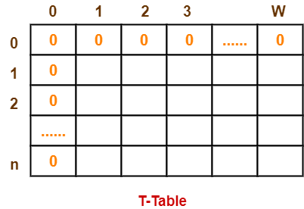
Proposed Optimized Approach: Knapsack by Dynamic Programming
Dynamic programming offers a more efficient solution by decomposing the problem into smaller sub-problems and storing their solutions for reuse.
The given problem is like Knapsack problem. To solve it using dynamic programming involves following steps:
Table Construction:
Create a table ‘T’ with (n+1) number of rows and (w+1) number of columns.
Fill all the boxes of 0th row and 0th column with zeroes as shown-
Filling the Table:
Start filling the table row wise top to bottom from left to right using following formula
T (i , j) = max { T ( i-1 , j ) , value_{i} + T( i-1 , j – weight_{i} ) }
Here, T(i , j) = maximum value of the selected items if we can take items 1 to i and have weight restrictions of j.
Backtracking for Optimal Solution:
identify the items that must be put into the knapsack to obtain that maximum profit,
Consider the last column of the table.
Start scanning the entries from bottom to top.
On encountering an entry whose value is not same as the value stored in the entry immediately above it, mark the row label of that entry.
After all the entries are scanned, the marked labels represent the items that must be put into the knapsack.

Slide 5
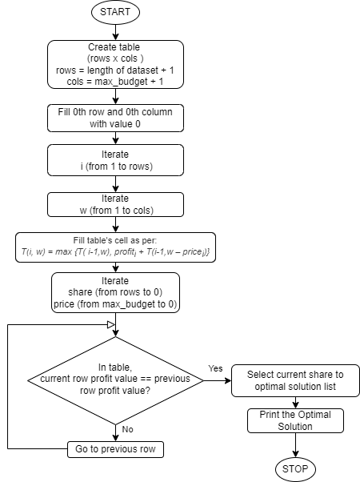
Flowchart
of
Optimized Algorithm
Table Construction
Filling the table
Backtracking for
Optimal solution

Slide 6
Limitations of Optimized Algorithm
Disadvantages of Dynamic Programming:
Requires additional space to store the dynamic programming table.
Not as intuitive or straightforward as the brute force approach.

Slide 7


Performance Analysis of Two Algorithms
Brute Force
Dynamic Programming
Given Dataset
Execution Time and Memory Analysis:
Asymptotic Complexity:
O(2^n)
where n = length of dataset,
Execution Time and Memory Analysis:
Asymptotic Complexity:
O(nW)
where n = length of dataset,
W = maximum budget..

Slide 8
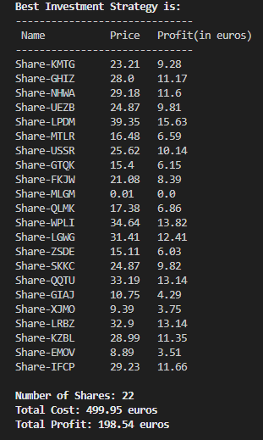
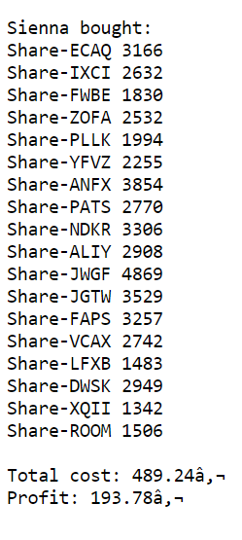
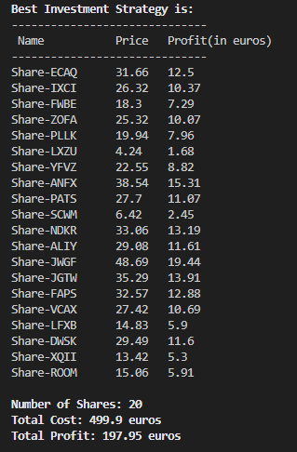
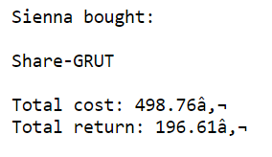
Output Comparison
Dataset1
Dataset2
Sienna’s Output
My Algorithm’s Output
Sienna’s Output
My Algorithm’s Output

Slide 9
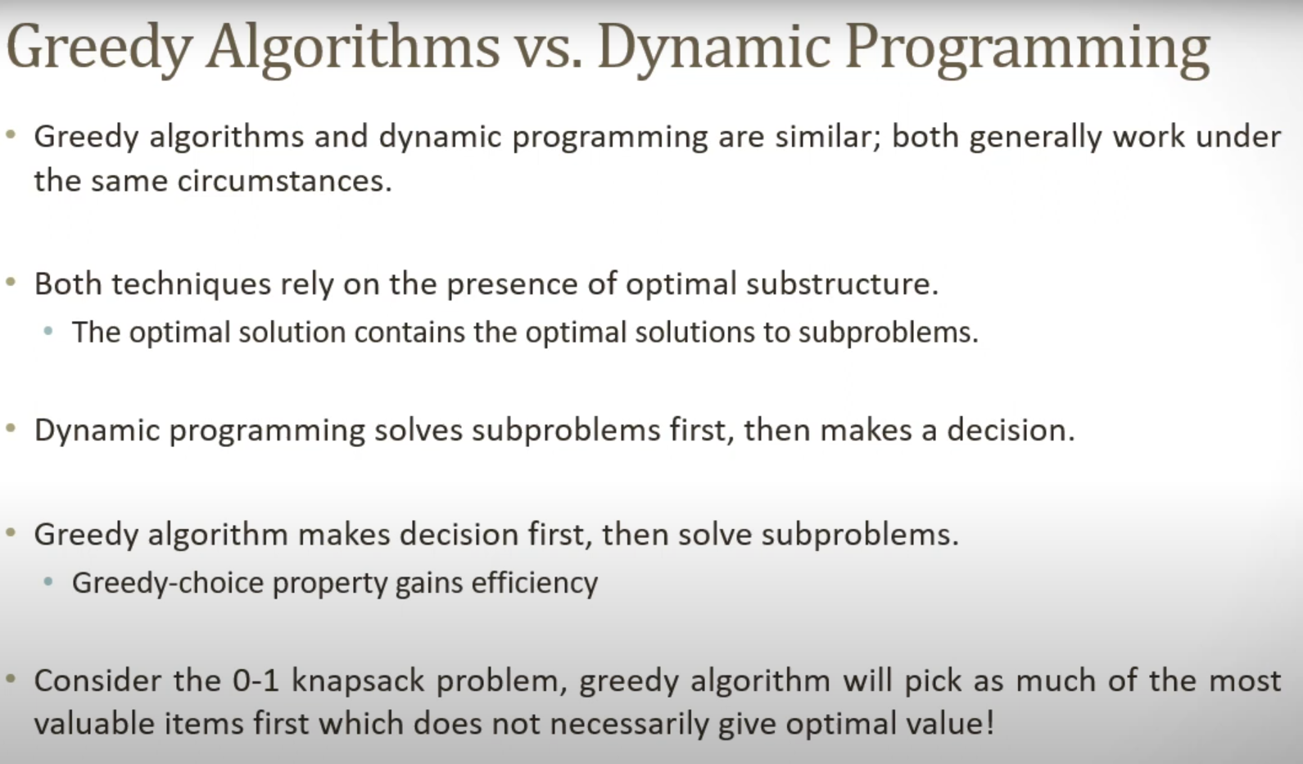
Asymptotic Complexity Analysis: O(nW), where n = length of dataset, W = maximum budget.

Slide 10
Thank You…

