Slide 1
Kv1.3

Slide 2
Kv1.3
Kv1.3 is a member of the Kv1 subfamily of voltage-gated potassium (K⁺) channels.
These channels are essential for regulating the flow of potassium ions across cell membranes, which helps maintain membrane potential and electrical excitability.
The KV proteins comprise 12 subfamilies (KV 1–K V12) that can be classified into three groups.
The KV 1 (Shaker) subfamily is the largest KV subfamily, as it includes eight voltage‐gated K+ channels (KV 1.1–KV 1.8)
KV 1.3 is highly expressed in macrophages, microglia, and effector memory T‐cells, suggesting that KV1.3 plays a role in immune and inflammatory responses in human diseases.

Slide 3
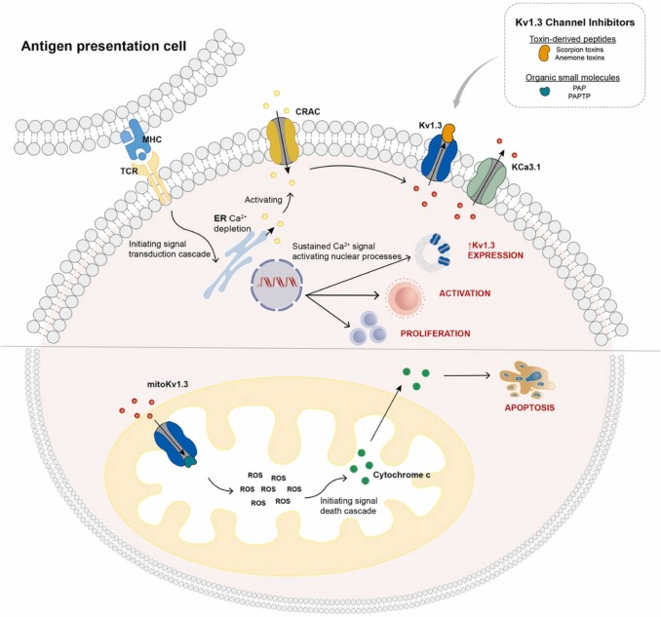
Mechanism of action of Kv1.3 inhibitors
When immune cells such as T lymphocytes are activated by antigen-presenting cells (ADCs), immunological synapses are formed and recruit the T cell receptor (TCR), Kv1.3 and KCa3.1. Kv1.3 and KCa3.1
They are elicited through cell membrane depolarization in response to increased intracellular calcium, which leads to membrane hyperpolarization and promotes calcium influx through calcium release activated channels (CRACs) triggered by TCR downstream signaling.
Sustained Ca2+ signaling activate nuclear processes, leading to increased Kv1.3 channel expression, T cell activation, proliferation, and cytokine production.
Blockade of Kv1.3 channels severely affects the mRNA synthesis machinery, the unfolded protein response, and intracellular vesicle trafficking, thereby affecting T cell proliferation and aggressiveness.
In tumor cells, Kv1.3 organic small molecule inhibitors also target the inner mitochondrial membrane (mitoKv1.3) to modulate mitochondrial membrane potential, mitochondrial volume, and reactive oxygen species (ROS) production, thereby promoting apoptosis.
Schematic representation of the mechanism of action of
Kv1.3 inhibitors
https://doi.org/10.1016/j.biopha.2024.116651

Slide 4
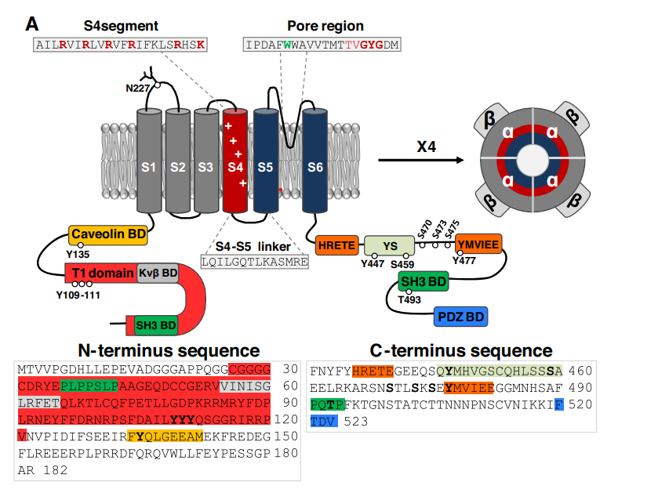
Kv1.3
charged residues(red)
N-glycosylation
site
The pore region sequence with a tryptophan residue critical for ion permeation and the K⁺ selectivity filter highlighted.
The SH3 domain, the tetramerization T1 domain , the Kvβ domain, and caveolin binding domain on the NH2 terminus.
The HRETE or YMVIEE forward trafficking motifs, another SH3-binding domain, and the PDZ binding domain on the COOH terminus.
The intracellular phosphorylatable residues are depicted as black dots.
schematic picture of human Kv1.3 α-subunit with
auxiliary domains.

Slide 5
Kv1.3

