Slide 1
Moving Beyond Rules: The Development of a CNS MPO Approach

Slide 2
Introduction
CNS drug discovery is highly challenging due to BBB restrictions, metabolic instability, and high attrition rates.
Traditional approaches relying on single-parameter cutoffs are insufficient for predicting CNS success.
The CNS MPO algorithm integrates multiple physicochemical parameters to create a more accurate drug-likeness model.

Slide 3
CNS MPO Score Distribution
74% of marketed CNS drugs had a high CNS MPO score (>4).
60% of Pfizer CNS candidates scored >4.
Demonstrates CNS MPO’s predictive capability for successful drugs.

Slide 4
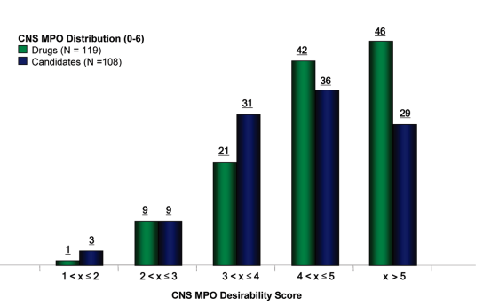
CNS MPO Score Distribution
Analyzed 119 Marketed CNS Drugs & 108 Pfizer CNS Candidates
Used six fundamental properties:
ClogP (Lipophilicity)
ClogD (Distribution Coefficient at pH 7.4)
Molecular Weight (MW)
Topological Polar Surface Area (TPSA)
Hydrogen Bond Donors (HBD)
Most Basic pKa.
74% of marketed CNS drugs had a high CNS MPO score (>4).
60% of Pfizer CNS candidates scored >4.
CNS MPO scores for drugs (green bars) and candidates (blue bars) were plotted from low to high CNS MPO score

Slide 5
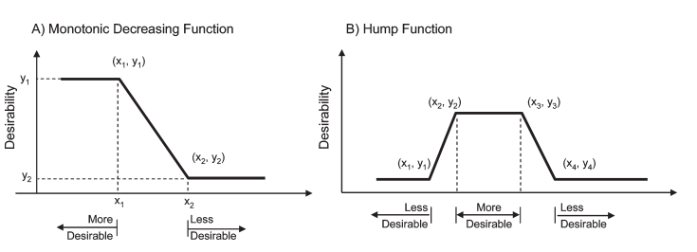
CNS MPO Scoring Function
The CNS MPO score is computed using a desirability function.
Which transforms each property into a normalized desirability score (T0) between 0 and 1.
Types of Scoring Functions Used:
Monotonic Decreasing Function (Used for ClogP, ClogD, MW, HBD, and pKa)
As the property value increases beyond a threshold, the desirability score decreases
Hump Function (Used for TPSA)
There is an optimal range (40-90 Å²) where the score is highest (T0 = 1).
Values too high or too low lead to a decline in desirability.

Slide 6
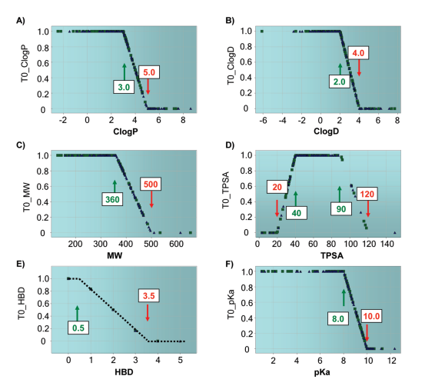
Key Physicochemical Properties
The CNS MPO score is calculated based on six key properties.
Each property has a desirable range (high desirability score) and an undesirable range (low desirability score).
Property | Desirable Range (T0 = 1.0) | Undesirable Range (T0 = 0.0)
ClogP (Lipophilicity) | ≤ 3.0 | > 5.0
ClogD (pH 7.4) | ≤ 2.0 | > 4.0
Molecular Weight (MW) | ≤ 360 Da | > 500 Da
Topological Polar Surface Area (TPSA) | 40-90 Å² | ≤ 20 Å² or ≥ 120 Å²
Hydrogen Bond Donors (HBD) | ≤ 0.5 | > 3.5
Most Basic pKa | ≤ 8.0 | > 10.0

Slide 7
CNS MPO Score Calculation
Each of the six properties is assigned a transformed desirability score T0 (between 0 and 1).
The final CNS MPO score is the sum of the transformed scores across all six properties:
CNS MPO Score = T0_{ClogP}​ + T0_{ClogD} ​+ T0_{MW}​ + T0_{TPSA}​ + T0_{HBD}​ + T0_{pKa}
Score ranges from 0 to 6.
Higher scores (>4) indicate better alignment with CNS drug-like properties.
Lower scores (<2) suggest poor CNS drug-likeness.
MPO Score | Interpretation
>5 | Highly optimized for CNS penetration and ADME properties
4 to 5 | Good balance of drug-like properties
3 to 4 | May need some optimization for better CNS alignment
<3 | Likely to have poor CNS penetration or high toxicity risk

