Slide 1
What makes popular music of recent times thrive beyond its peak?
Music, Mind and Tech Final Project
Megha: 2019111021, Pranshul: 2019101057

Slide 2
Objective
Analyze the performance, in terms of number of weekly plays, of popular songs beyond their peak and study its relations with audio and lyrical features .

Slide 3
Motivation
It is important to study the trends in number of streams of popular songs in order to understand the impact of different features on the number of plays and hence the impact of the song.
There have been attempts at determining popularity scores of songs through the top chart positions, total number of streams, lifetime of songs, etc.
Spotifycharts provides data of weekly streams of the top 200 songs which can be a good indicator of how popular song performs over time around its peak and what makes it stay. This could in turn give an idea about whether a current song would break into the top charts or not. Hence, we undertake this approach to draw inferences about popularity trends.
Some interesting observations and trends over the years can be seen from the nature of the streaming curves and the anomalies.

Slide 4
Related Works
Rosati et al. studies data from a large and detailed database of song downloads from 2007 to 2014, a period when downloading (as opposed to streaming) was a primary method of music consumption and does epidemiological modelling of song popularity.
Iteriano et al. analyses more than 500k songs released in the UK between 1985 and 2015 to understand the dynamics of success. They define the dynamics of success as whether the song made entry into the top charts. They then correlate success with acoustic features.

Slide 5
Data Collection and Preprocessing

Slide 6


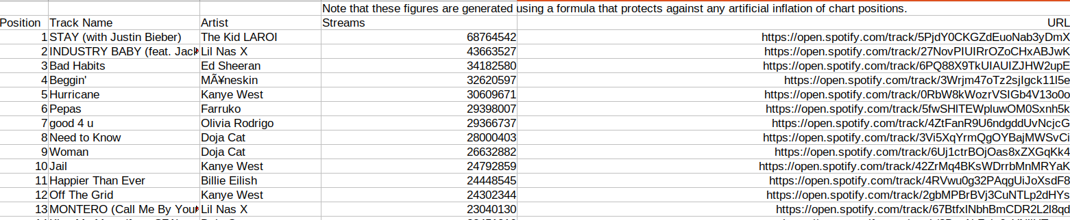
Data Collection
https://spotifycharts.com/regional/global/weekly/<week>
We collect the data from spotifycharts.com where we can get the number of streams of top songs in a given week. (It has data since Dec 2016) . We use spotipy to get audio feature values and genius.com to get the lyrics and derive lyrical features.

Slide 7
Data Preprocessing
We have picked all the songs which have occurred at least once in the top 50 songs
Since, we don’t have data outside top 200 songs therefore this ensures that we have data for the song over the entirety of a considerable sized window.
This also ensures that the song was released not long ago because for it to be in top 50 it must have released only a little earlier (for most songs)

Slide 8
Window Size Selection
We have taken the window of 20 weeks because :
Neither too small to exclude the behaviour in long run
Neither too large as we have seen that for most of the songs that we have taken we have data for around 20 weeks so we won’t have to mark 0’s
Out of the songs we chose after last filtering, we finally take those songs for which we have streaming data of 20 weeks following its first appearance into top 200.
Then we consider the streaming curves of these songs from start to start+window_size weeks. Finally we had 1388 songs.

Slide 9
Method

Slide 10
Features of Songs
Lyrical Features
Acoustic Features
We divide each feature into intervals.
For example, if feature "f" takes values from 0 to 10, a possible set of intervals of size 2 can be,
0-5
5-10
danceability
instrumentalness
energy
valence
loudness
liveness
tempo
mode
compressibility
gloom index
smog index

Slide 11
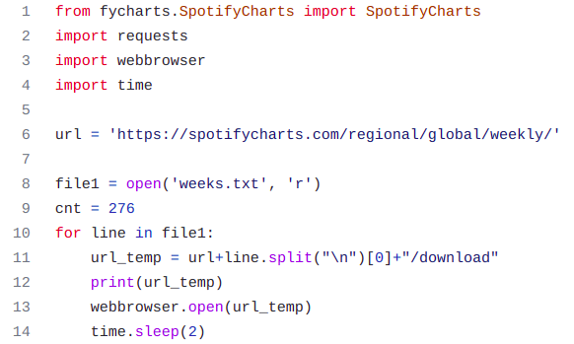
Feature Extraction
Wrote a script to collect data from spotifycharts for all the 275 weeks available
Processed the data according to each song
Extracted spotify audio features
Extracted lyrics and then calculated the lyrical features

Slide 12
Criteria for choosing bins - 2 ways
For the first case, we have taken above median as high and below median as low
For the second case we have taken 25% deviation from median as medium, more than 25% as high and low according to greater or lesser respectively.

Slide 13
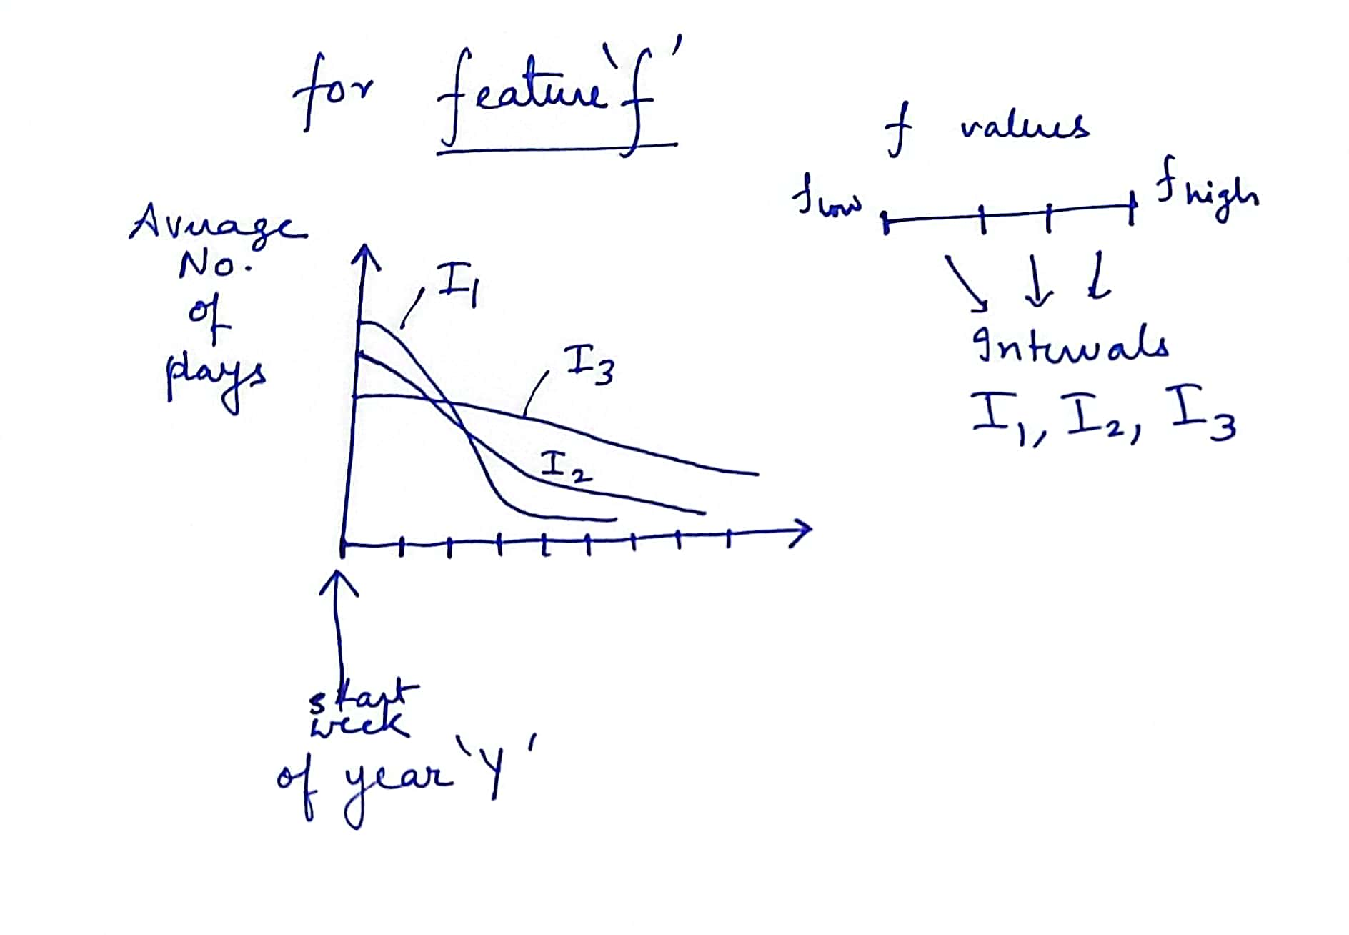
Feature Effect
Independent variables: feature f, number of intervals
Dependent variable: Number of weekly plays
We plot
the number of plays vs week graphs
to see how the number of weekly plays change on average
for each interval / bin of each feature.
We then check the
nature of curve for these intervals and
how they compare with each other.

Slide 14
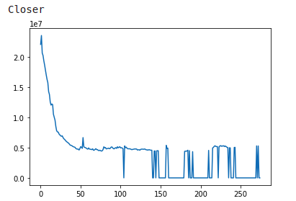
A General Result
Were we have got streaming graph for each of the songs. We can see that
Mostly the songs decrease exponentially
the song has peaks but of smaller size which implies that it oscillates around 200 position.

Slide 15
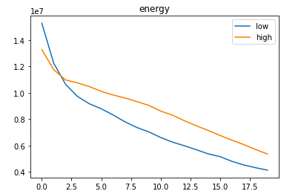
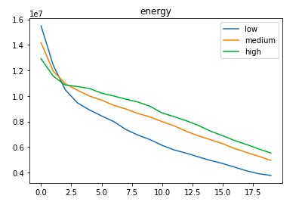
Inferences based on Energy Feature
We can see that for energy audio feature initially for around 2 weeks songs that have lower energy level are more popular
But, in longer run songs with lower energy die out quickly
This is intuitive also as people tend to remember and listen to songs that are more energetic

Slide 16
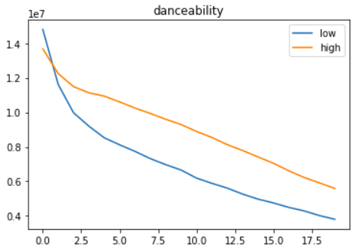
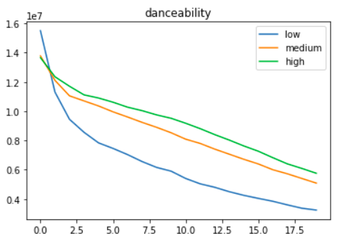
Inferences based on Danceability Feature
At the beginning songs that have more danceability are more popular, but this is only for less than a week.
So, basically songs which have more danceability are more popular in the long run. Also, people tend to dislike low danceability as high and medium curves are close but low very far from them.
We expected songs with higher danceability to be more popular and that is what we concluded apart from the 3-4 days initial period

Slide 17
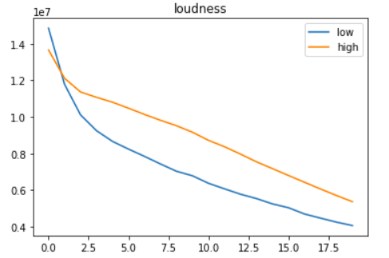
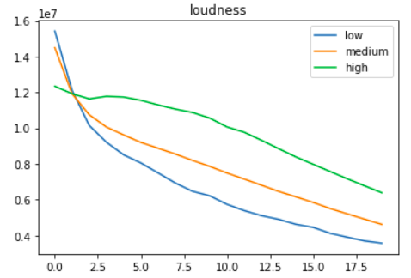
Inferences based on Loudness Feature
Songs with higher loudness are more popular except initial few days
Songs with high loudness don’t reach max popularity but they remain in the popular songs list for a longer time
We can think of it in such a way that songs with low loudness are initially more popular but people lose their interest in them exponentially as they might seem unexciting after some time.

Slide 18
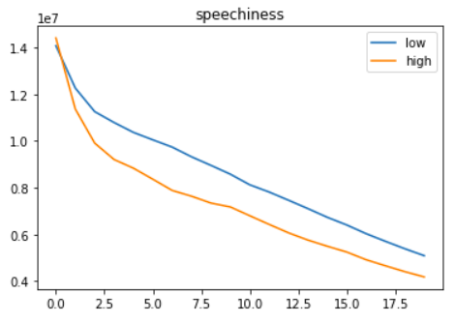
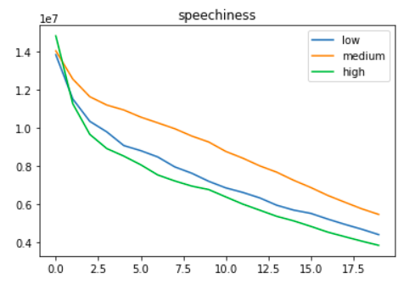
Inferences based on Speechiness Feature
We can see that songs with medium speechiness are more popular although they might start from similar popularity on average.
Speechiness detects the presence of spoken words in a track and thus poetry, talk show similar songs have more speechiness.
We find that songs with very less and very high speechiness do not interest the public and we know poetry or similar songs are not famous in general

Slide 19
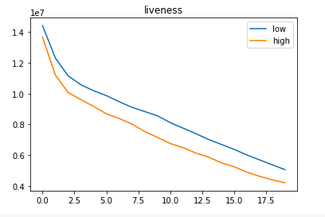
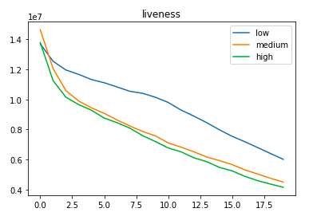
Inferences based on Liveness Feature
Songs with lower liveness are more popular by a high margin.
Liveness detects the presence of audience in the songs and songs with high liveness are those performed live.
This is also intuitive because songs performed live will not remain popular for long time even though at the beginning there is a popularity surge.

Slide 20
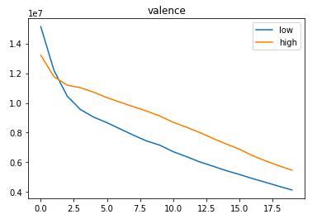
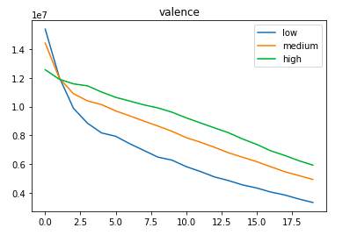
Inferences based on Valence Feature
We can see that songs with lower valence are in general more popular at the beginning (around 1.5 weeks) but their popularity decreases much faster.
Valence is the measure of positiveness in the song.
Songs with higher valence should therefore be more popular as people don’t like to listen to sad and depressing songs for a long time.

Slide 21
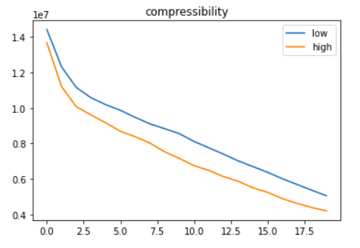
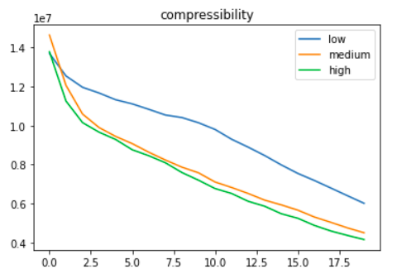
Inferences based on Compressibility Feature
Songs with lower compressibility are more famous
Lower compressibility implies less repetition
This can be justified because songs with really high compressibility cannot be of interest to people after many weeks but they still have similar popularity in the beginning.

Slide 22
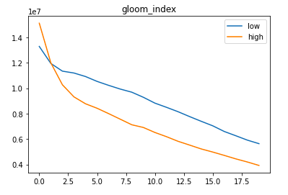
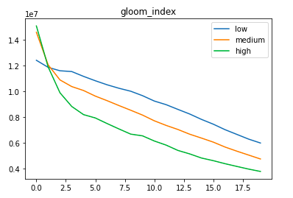
Inferences based on Gloom Index Feature
Gloom index is the measure of sadness in the song wrt lyrics i.e. higher gloom index implies more sad and depressing result
For lower gloom index the song should be more popular as people don’t like to listen to sad and depressing songs for a long time and this can be seen clearly. But, one thing to note is that in the beginning songs with high and medium gloom index are more popular as they can have higher impact on people

Slide 23
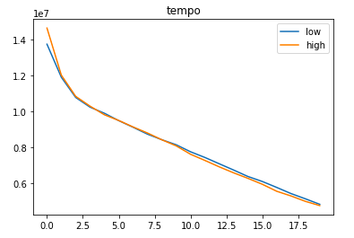
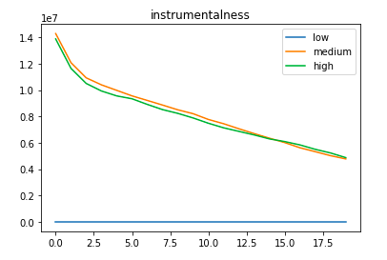
Features without considerable effect
Tempo is the measure of speed or pace of the music. We can see that popularity of songs is not dependent on tempo as we have similar curve for both high and low
Higher instrumentalness means low vocal work in the music. We can see that there are no popular songs with really low instrumentalness value. But popularity of songs does not depend on whether the instrumentalness is high or medium

Slide 24
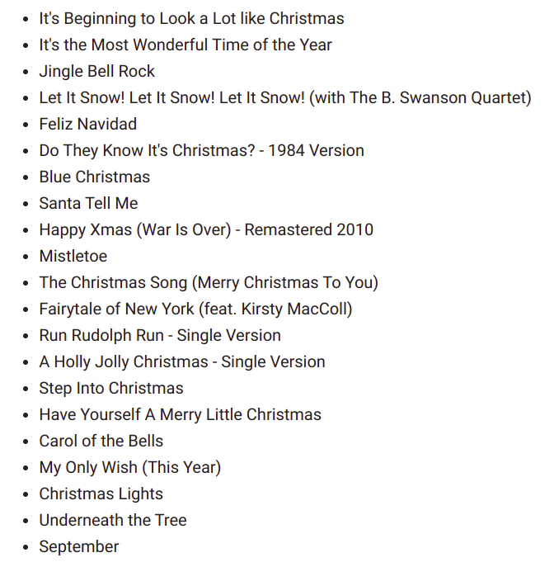
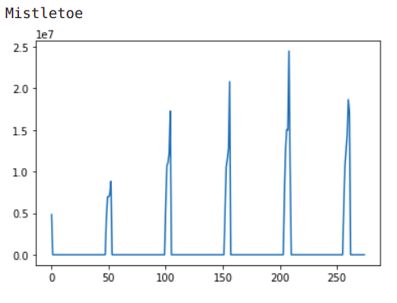
Interesting Observations - Christmas Songs
This observation was made during analysis of number of peaks in the streaming curves.
It can be seen from the graphs that songs for christmas and ones that mention about christmas eve have a periodic appearance of peak every year, i.e., after almost 52 weeks during Christmas.

Slide 25
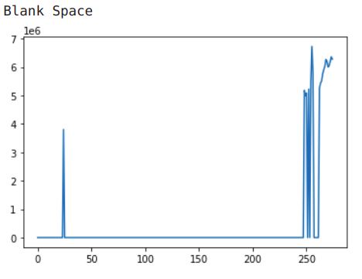
Interesting Observations - Event Triggers
Old songs being performed on tours by the artist:
Taylor Swift's Blank Space was released in 2014 but it is seen to have gotten sudden popularity in recent times. A reason behind this can be the inclusion of this song in her 2018 Reputation Stadium Tour.

Slide 26
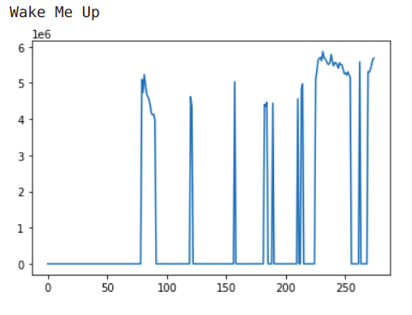
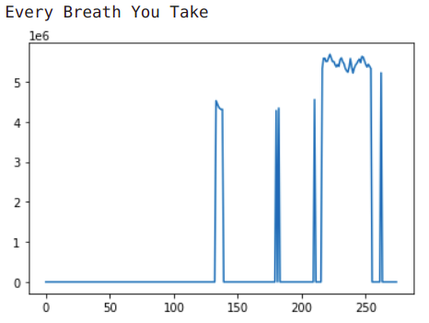
Interesting Observations - Event Triggers
Artist related events:
Avicii's 2013 song 'Wake Me Up' can be seen as a song frequented by the listeners in recent times, especially after his demise.
Old songs remixed or featured on popular shows:
An old classic song from the 1980s, 'Every Breath You Take' by The Police, can be seen to have risen to sudden prominence probably due to its use in famous TV series 'Stranger Things'.

Slide 27
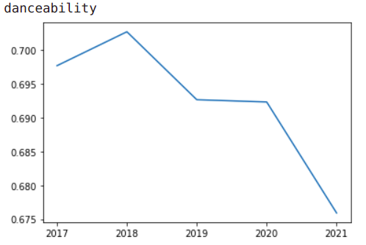
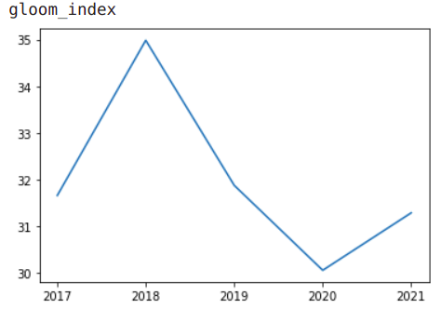
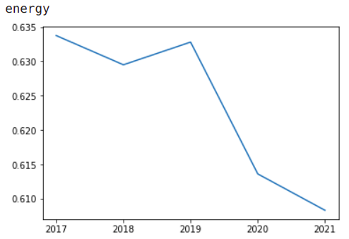
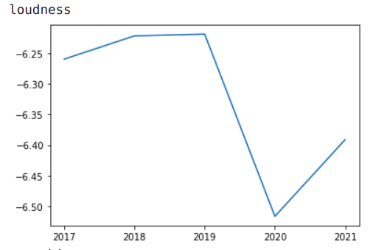
Year-wise trends in some features
There has been a clear downward trend in danceability and energy of popular songs over the recent years.
We see a sudden dip in gloom index and loudness in the years of 2019 and 2020, possibly due to the Covid-19 pandemic. People might be using music as a coping mechanism to feel better, thus choosing less loud songs and songs with lower gloom index.
Other features have mostly shown zigzag patterns and hence no clear trend.

Slide 28
Thanks
Questions?

