Slide 1

SALESFORCE ANALYSIS
Presented by: Group I
Pallavi G M
Megha Kerur
Niveditha K O
Koushik Reddy
Bhavana Kurabet

Slide 2
Objective
To design and implement a comprehensive Salesforce CRM analytics solution that optimizes customer relationship management processes by providing actionable insights through data analysis.
Track customer interactions and engagement through Salesforce data to improve customer satisfaction. Identify opportunities for cross-selling or upselling based on customer data and history.
Provide actionable insights to leadership through interactive dashboards and visualizations.
Enable real-time monitoring of key performance indicators (KPIs) to facilitate timely decision-making.

Slide 3
KPI’s
Running Total Expected Vs Commit Forecast Amount over Time.
Running Total Active Vs Total Opportunities over Time.
Closed Won Vs Total Opportunities over Time.
Closed Won vs Total Closed over Time.
Expected Amount by Opportunity Type.
Opportunities by Industry.
Lead By Source.
Lead By industry

Slide 4
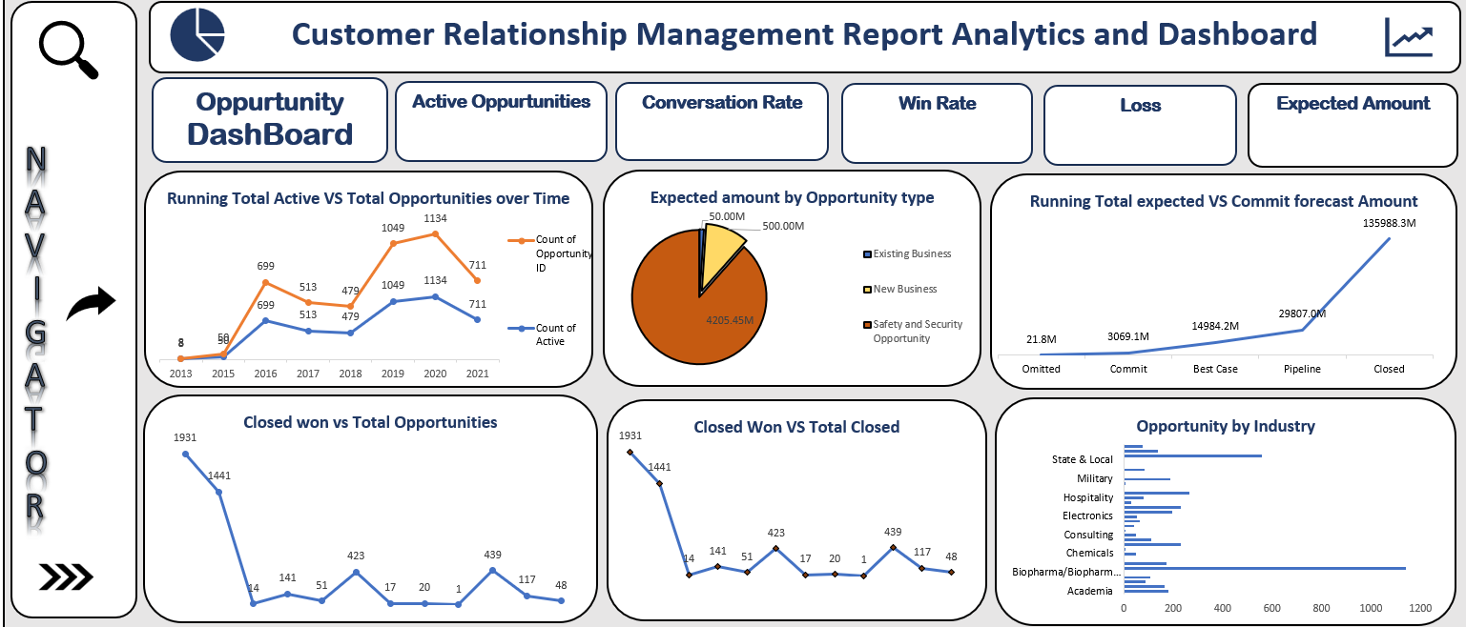
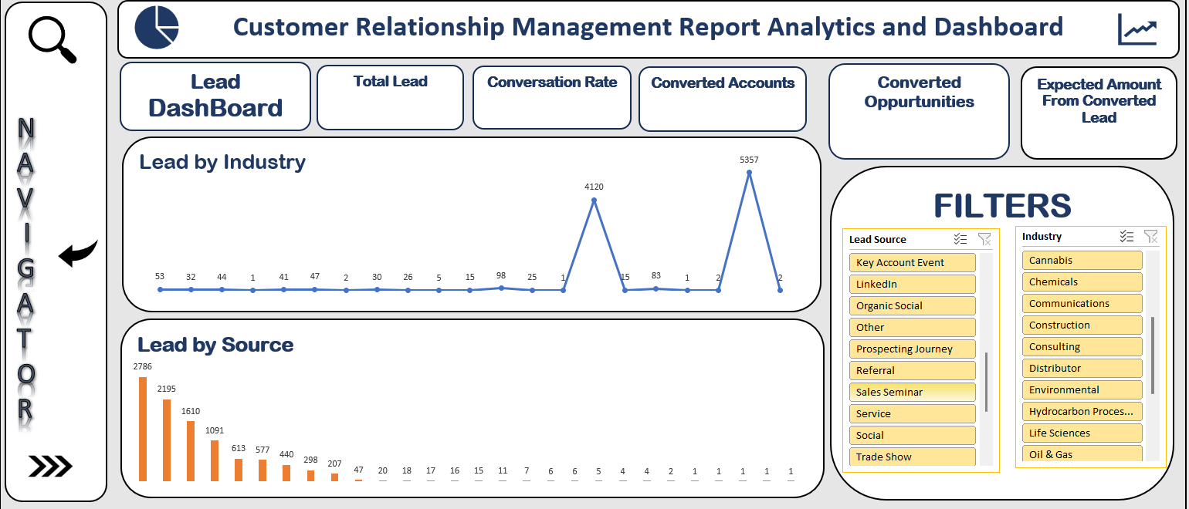
EXCEL DASHBOARD:

Slide 5
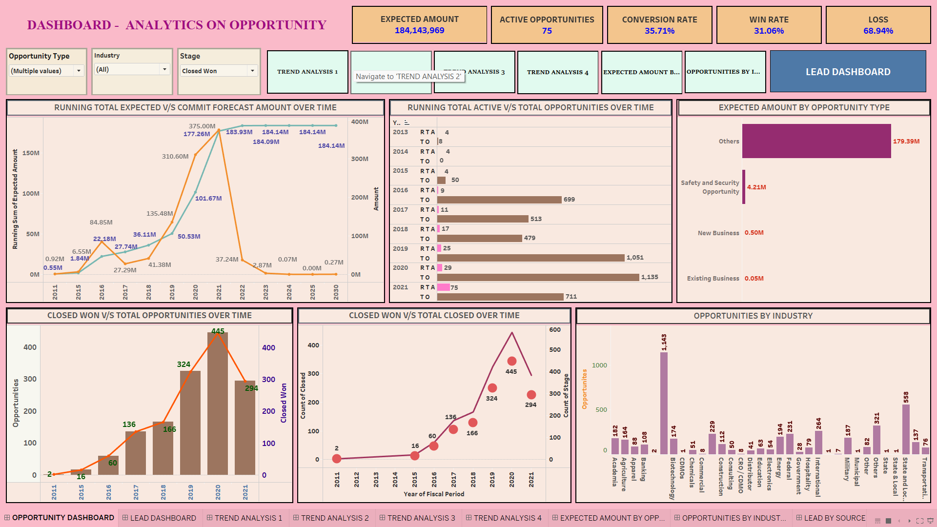
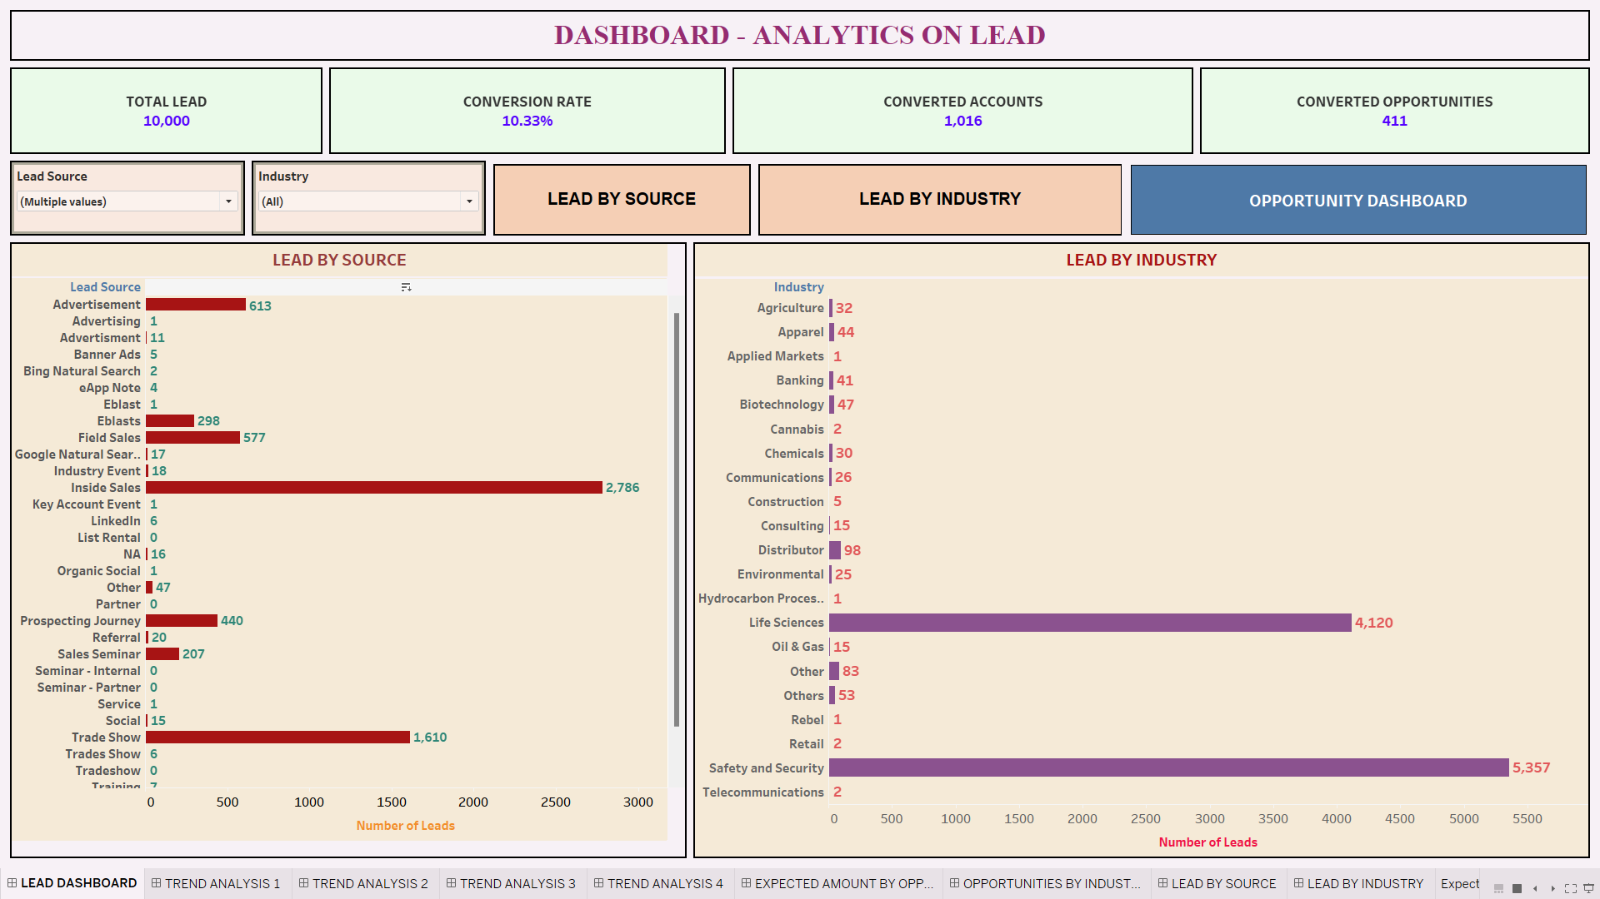
TABLEAU DASHBOARD:

Slide 6
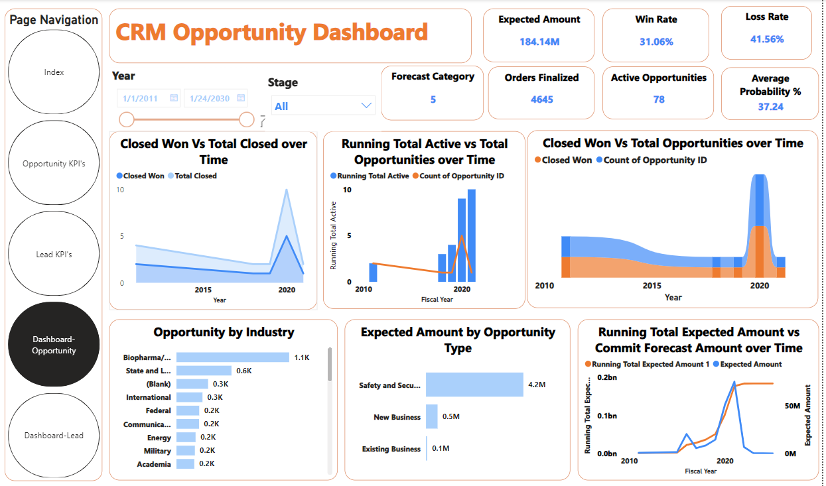
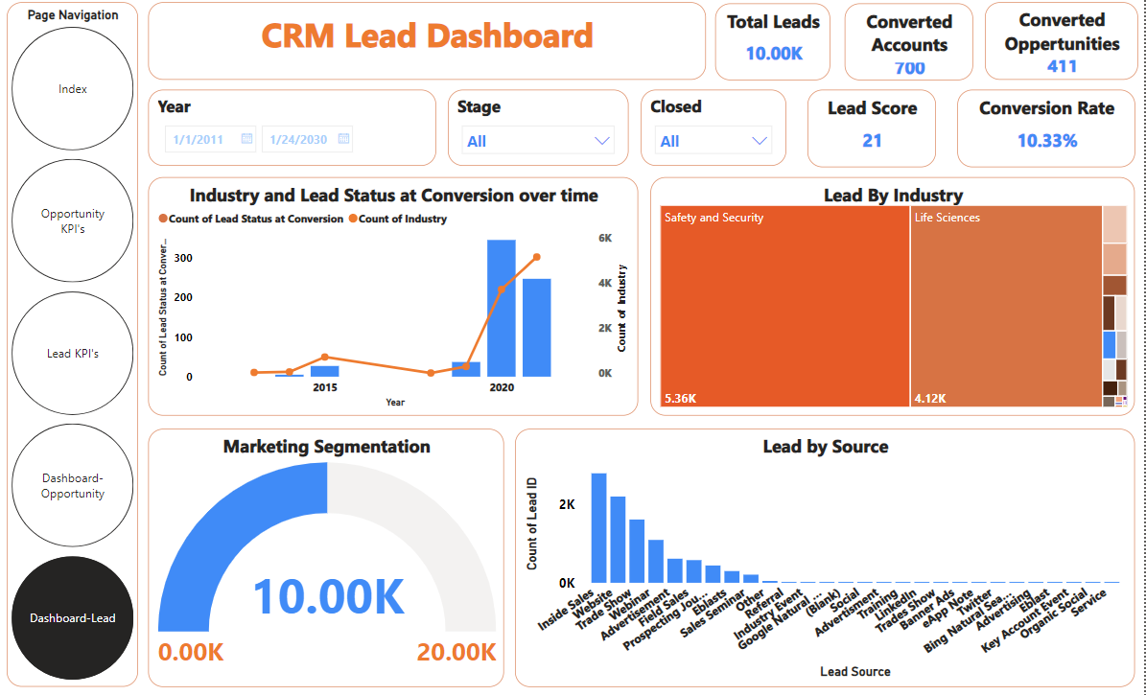
POWER BI DASHBOARD:

Slide 7
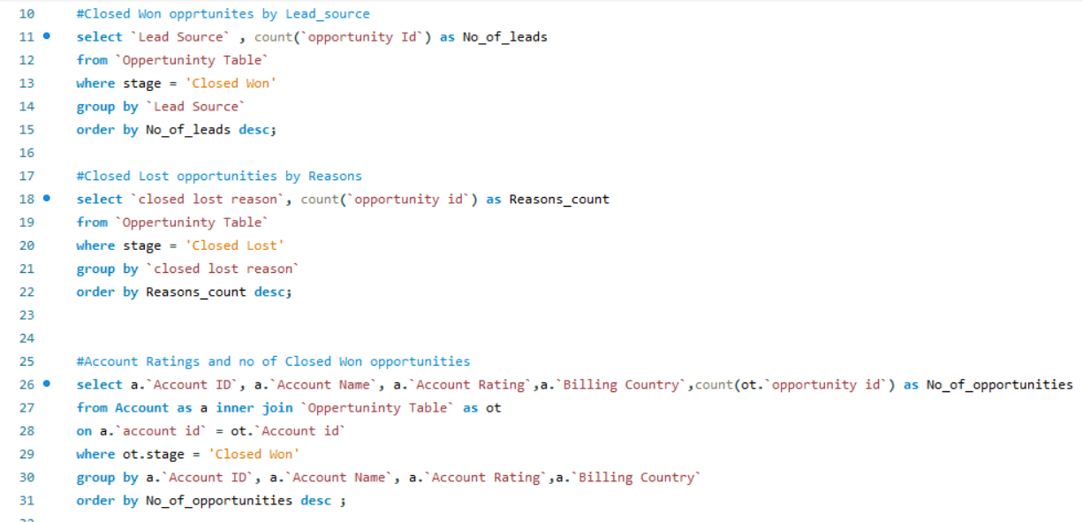
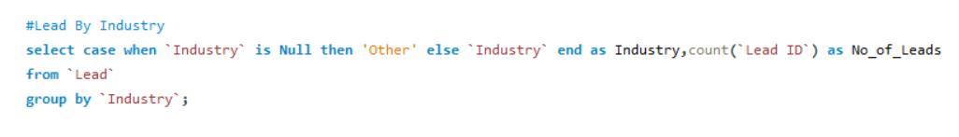
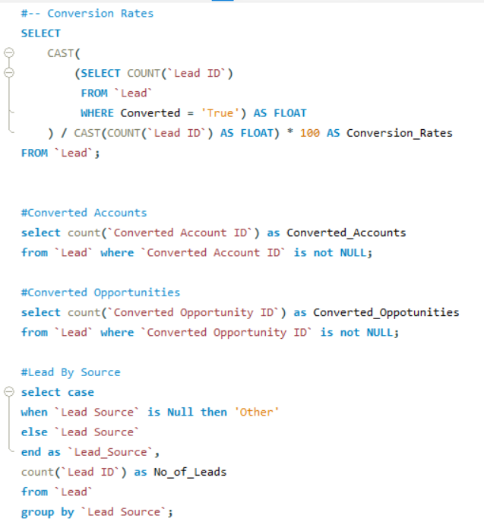
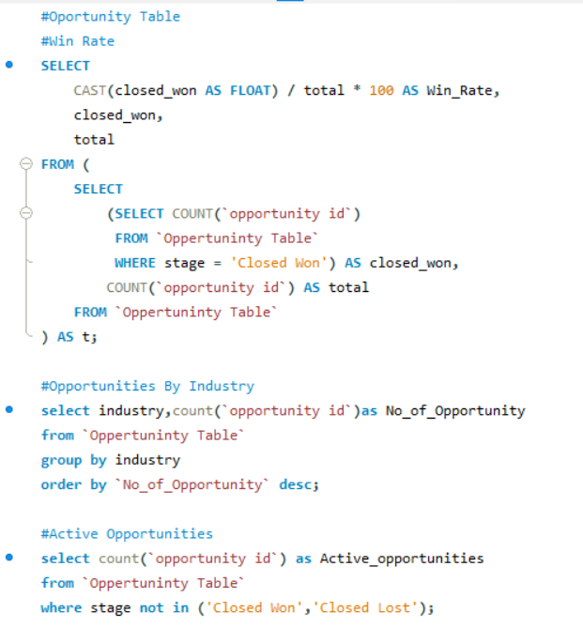
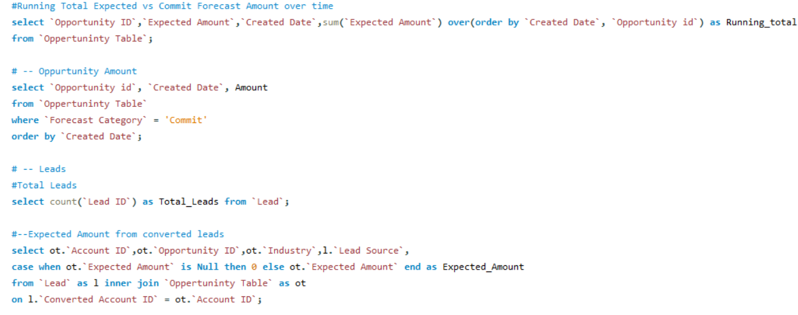
SQL Queries:

Slide 8
Key Insights:
The data suggests a significant peak in opportunities and closed deals around 2020, which could indicate a strategic shift or a favorable market condition during that time.
While the win rate is fairly good, the loss rate is also high at 41.56%, which might require attention to improve overall efficiency and profitability.
The Biopharma industry seems to be the most active, which could be a strategic area of focus for growth.
Most revenue is expected from Safety and Security opportunities, indicating a potential area for maximizing returns.
Safety and Security and Life Sciences industries, could be strategic areas of emphasis for the company.
Inside Sales is particularly effective, with a high number of leads generated, making it a critical component of the lead generation strategy.
A conversion rate of 10.33% indicates that while there is a good number of leads being converted, there is still room for improvement in nurturing and converting more leads into opportunities or accounts.
The significant spike in lead conversions around 2020 suggests a growth opportunity, possibly driven by market conditions, strategic shifts, or increased demand in key industries.

Slide 9
THANK YOU!

