Slide 1
Title Layout
Subtitle

Slide 2
Benford Analysis of Kickstarter Projects
MA615 Final Project By: Megha Pandit

Slide 3

Kickstarter Projects
Kickstarter is an online crowdfunding platform
Notable projects include 'Sun Come Up', 'Incident in New Baghdad', 'Pebble Time', 'Coolest Cooler' and 'Exploding Kittens'
Projects have a goal amount and are supported by 'backers'
Backers pledge money to the projects

Slide 4

Kickstarter Projects
Not all Kickstarter projects are genuine
Questions have been raised on fraudulent and controversial projects
Projects lack originality and genuity
Pledged money not used for project purposes
Deliverables do not meet the backers' expectations

Slide 5
Project Goal, Data and Variables

Slide 6
Objective
To examine the data for fraudulent projects
More specifically, number of backers and the amount pledged for the projects
Data:
Kickstarter Projects launched in the years 2009 through 2017
Data acquired from Kickstarter Platform
Variables:
Project ID, name and category
Project status, launch date, deadline, country of launch
Number of backers, goal amount of project
amount pledged, currency, amount in pledged in USD

Slide 7
Exploratory Data Analysis

Slide 8
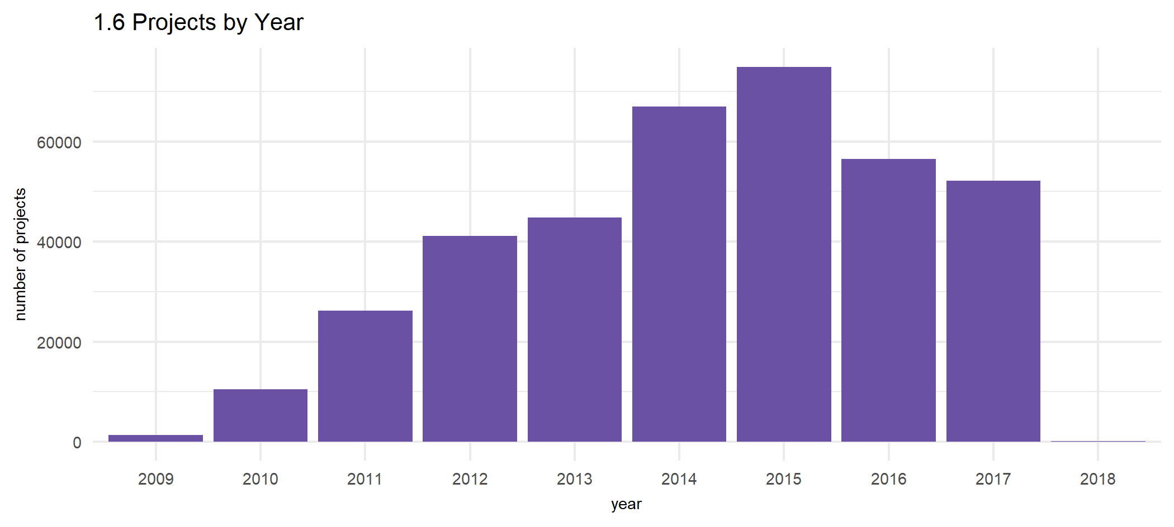
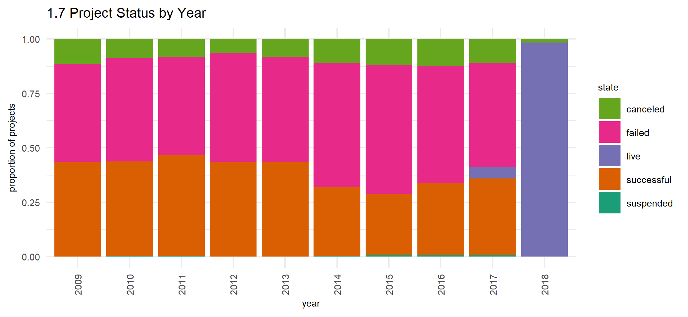
Projects by Year
Largest number of Projects in 2015
124 projects in 2018- all either live or cancelled at the time of data collection
Projects mostly failed or were successful

Slide 9
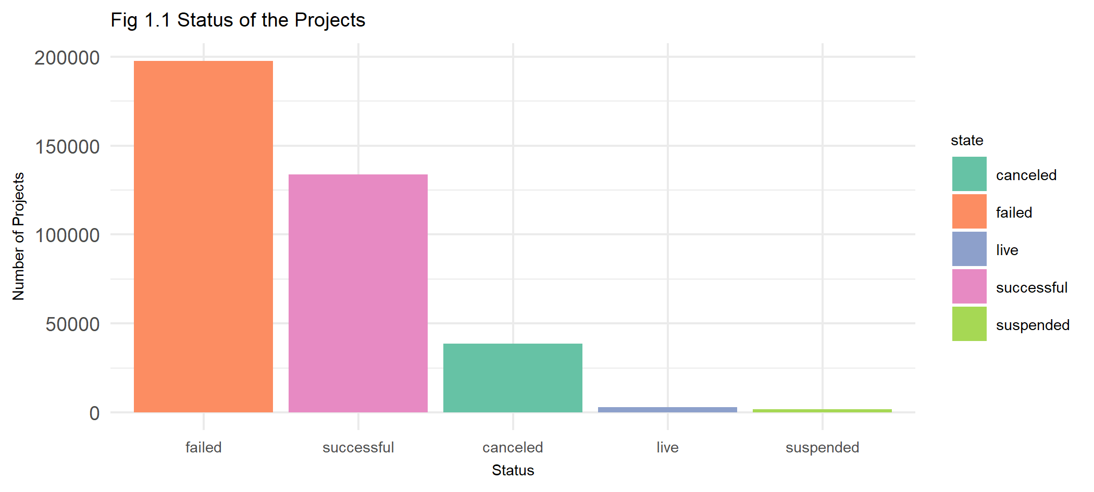
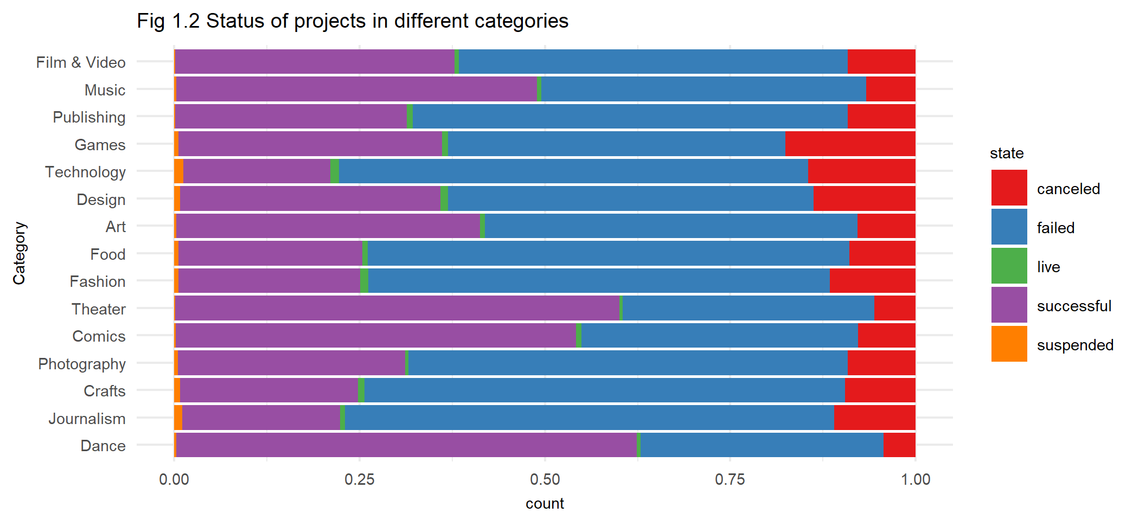
Projects by Status
52.7% failed, 35.7% succeeded, 10.3% cancelled, 0.7% live and 0.4% suspended
Most of the projects fall into the Film & Video category, followed by Music

Slide 10
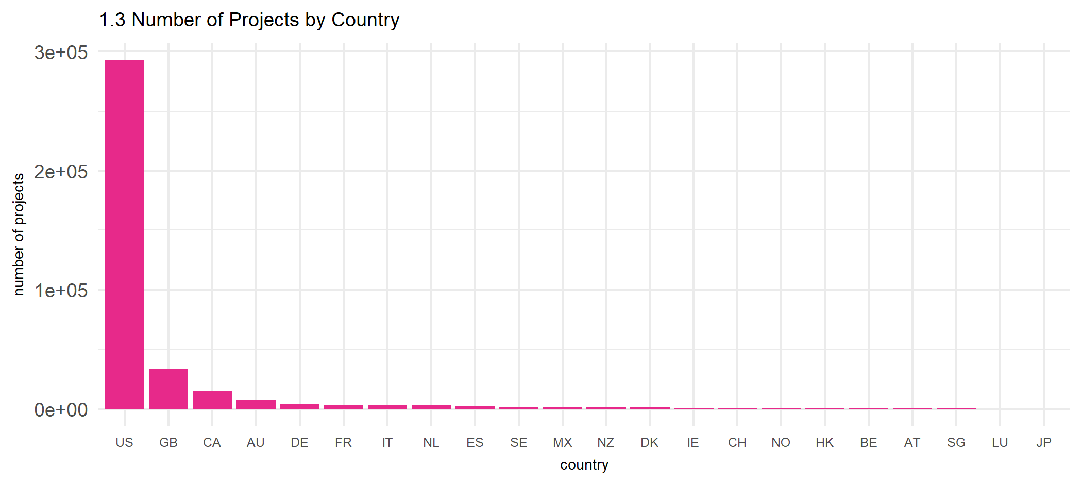
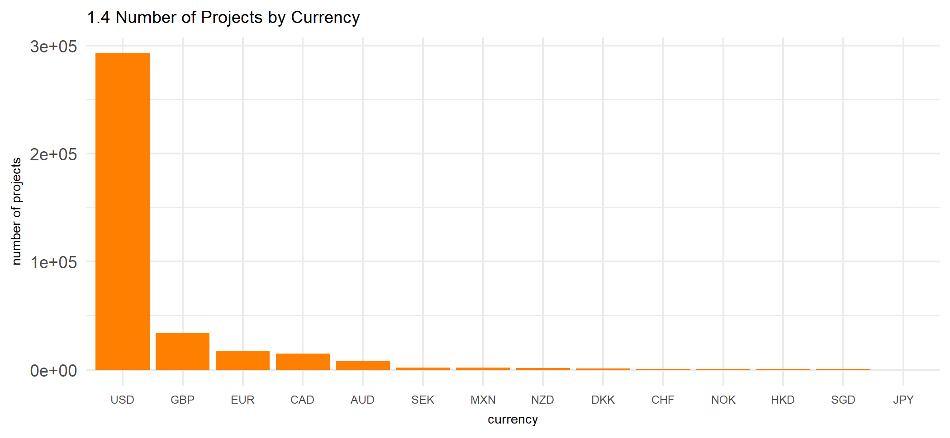
Projects by Country and Currency
A majority of the projects were launched in the USA
The amount pledged for most of the projects was in USD

Slide 11
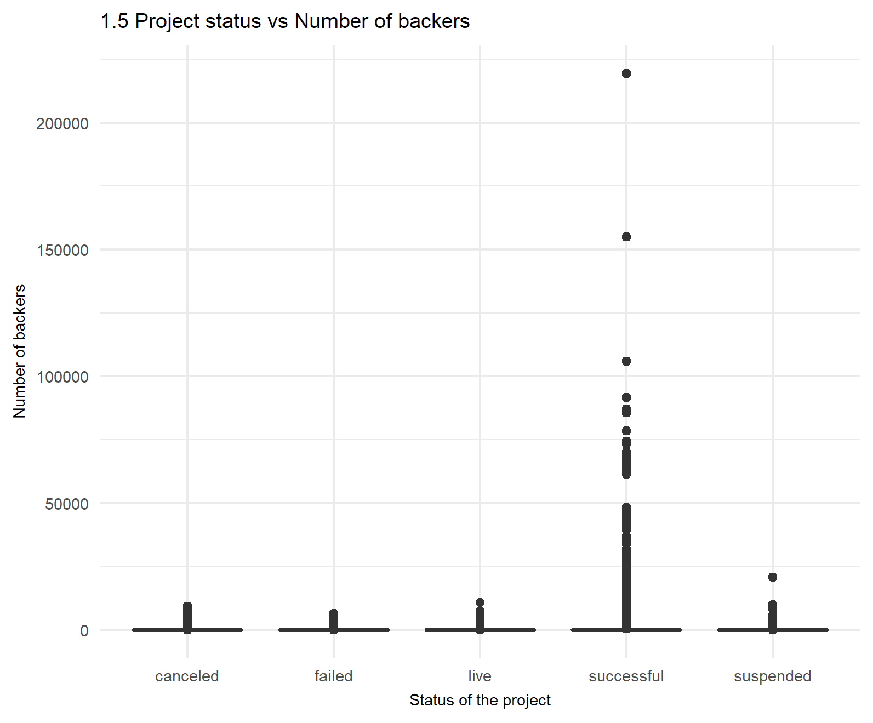
Number of Backers for the Projects
Projects with more than 150,000 backers and more than 200,000 backers
Project names - 'Exploding Kittens' and 'Fidget Cube'
These projects rank among the ten most successful Kickstarter projects by the total funds pledged
Outliers in the data

Slide 12
Benford Analysis

Slide 13
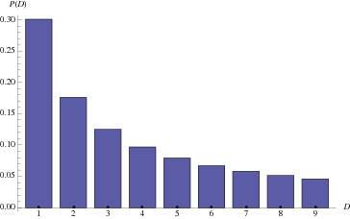
Benford's Law
Benford's Law - also the Law of Anomalous Numbers, and the First-Digit Law
In many naturally occuring numbers, the leading significant digit is likely to be small
The digit 1 is likely to occur as the leading significant digit 30% of the times, 2 is likely to occur 17.6% of the times, and the digit 9, less than 5% of the times

Slide 14
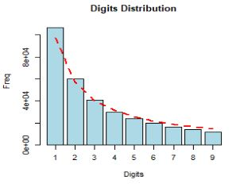
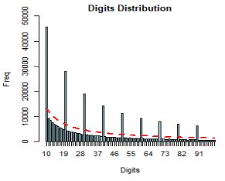
Benford Analysis for Number of Backers
Plot above shows first digit distribution, plot below shows first two digits distribution
Red Line - Benford's Law, blue bars - digits in the data
First digits follow Benford's Law
Frequency distribution of first two digits looks similar to the Benford frequency distribution
Discrepancies between the frequencies of occurences of first two digits in the data and the frequencies given by Benford's Law

Slide 15
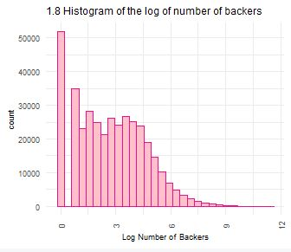
Distribution of log Number of Backers
Large number of projects with zero backers
May be a major reason for following Benford's Law

Slide 16
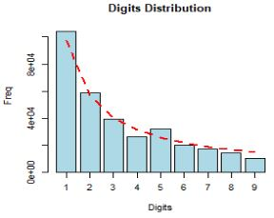
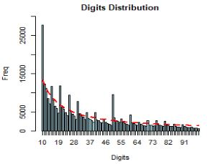
Benford Analysis for Total Funds Pledged
Plot above shows first digit distribution, plot below shows first two digits distribution
Red Line - Benford's Law, blue bars - digits in the data
First digits follow Benford's Law
Deviation at 5 and large deviations at 10 and 49

Slide 17
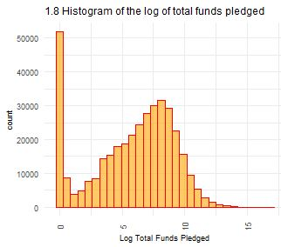
Distribution of log total funds pledged
Large number of projects with zero backers and therefore zero funds pledged
May be a major reason for following Benford's Law
However, histogram peaks at around 7
Value of funds pledged at this point is around 1906USD, the leading digit being 1 but the second digit being 9

Slide 18
Conclusion
Zero backers and hence zero funds pledged may be a reason for the digits following Benford's Law
Possibility of fabricated data
For potential future work:
Regression analysis along with Benford Analysis to compare and draw better conclusions

Slide 19
Thank You!

