Slide 1
Autosys
Job Scheduling

Slide 2
INDEX
Introduction to Autosys
  Reason for using Autosys
  System Components
  Event server ; Event Processor; Remote Agent Shadow Processor ; High Availability mode
  Environment variables
Autosys Console
Work Flow of Autosys
GUI and CLI
Creating jobs using GUI
  Parameters defined
  Conditions, Calendars

Slide 3
Creating jobs using CLI
      Job Types
      File Watcher
      Command
      Box
Job States
    Difference in ON-HOLD and ON-ICE
    File watch jobs and dependencies

Slide 4
What is Autosys?
A job Scheduling software.
An automated job control system used for:-
Scheduling
Monitoring, and
Reporting jobs
The jobs can reside on an Autosys configured machine attached to a network.

Slide 5
Job can be :-
An executable
A single command
Script
Batch file
WHY Autosys? (Event driven architecture)
Basic job scheduling is done using unix - Cron, which is “time based", it will fire the job based on the clock.
However, in real business, you need to fire jobs based on events (like an arrival of a file), success or failure of other jobs.
Autosys - allows you to define these events, dependencies, time schedules, alerts, etc, making it a complete data center automation tool.

Slide 6
Autosys System Components
Event Server
Event Processor
Remote Agent
Event Server:-
--The event server is the AutoSys database.
-- Stores all system state information such as all jobs, monitors, calendar, report definitions etc.
-- Stores the systems active state such as :-
event status, machine statuses, job statuses and machine queues.

Slide 7
• Event Processor
Program, running either as a UNIX process or as a Windows service, that actually runs AutoSys
Interprets and processes all the events it reads from the Autosys Database
Continually scans the database for processing events. Checks if the events satisfy the starting conditions of the job and the determines the actions

Slide 8
• Remote Agent
Temporary process started by the event processor to perform a specific task on a remote machine
It starts the command specified for a given job, sends running and completion information about a task to the Event Server
If it is unable to transfer the information, it waits and tries until it successfully communicates with the Db

Slide 9
Shadow Processor
Using single Autosys server, restricts the uptime of server during patches.
Single point of failure→ high vulnerability
Only option is to take Autosys down to perform patching.
SOLUTION is to use High Availability Mode i.e. Shadow Processor and Dual Event.
Shadow processor→ Runs on separate Machine
--failover Autosys to the shadow event processor (single server mode) →Autosys will continue to run batch jobs → apply patches to the primary Autosys server.

Slide 10
INSTANCE?
A set of server and client event processor.
Event Server + Event Processor → Instance
Defined by the following:
· An instance ID, an uppercase three-alphanumeric identifier defined by the AUTOSERV environment variable. You set the instance ID during installation and cannot change it. ex. PA4, PA5
Minimum configuration:-
· At least one event server.
· At least one event processor.

Slide 11
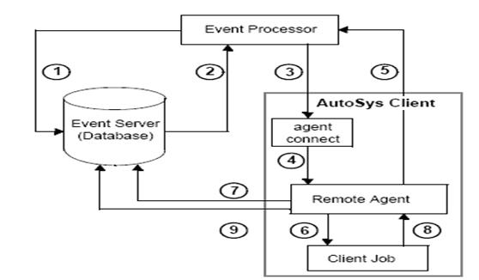
How Autosys Works?

Slide 12
• Step1: The Event Processor scans the Event Server for the next event to processor.If no event is ready,the Event Processor scans again in 5 seconds.
• Step2: The Event Processor reads from the Event Server that an event is ready.The autosys-job definition and attributes are retrieved from the Event Server,including the command and the pointer to the profile file to be used for the schedule
• Step3: The Event Processor processes the event.The Event Processor attempts to establish a connection with the Remote Agent on the client machine and passes the autosys-job ttributes to the client machne.The Event Processor sends a CHANGE_STATUS event marking in the Event Server that the autosys-jobs in STARTING state

Slide 13
• Step4: The Remote Agent is invoked using the UserID and Password passed from the Event Processor.
• Step5: The Remote Agent receives the autosys-job parameters and sends an acknowledgement to the Event Processor
• Step6: The Remote Agent Starts a process and executes the command in the job definition.
• Step7: The Remote Agent issues a CHANGE_STATUS event marking in the Event Server that the job is in RUNNING state
• Step8: The client autosys-job process runs to completion,then returns an exit code to the Remote Agent and quits.

Slide 14
• Step9: The Remote Agent sends the Event Server a CHANGE_STATUS event corresponding to the completion status of the autosys-job. The Remote Agent quits

Slide 15
Autosys GUI and CLI
Autosys Interfaces
GUI
Command Line

Slide 16
Creating Autosys Jobs(2 ways):-
Autosys Graphical User Interface(GUI)
Autosys Job Information Language via Command Line Interface(CLI)

Slide 17
Writing Autosys Jobs- Using JIL
JIL stands for Job Information Language.
It instructs autosys to save job definitions in autosys database.
Essential attributes for defining job
1. Job Name
JIL Keyword : insert_job. Name used to identify the job.
2. Job Type
a. JIL Keyword : job_type. The job type is one of job types: command (c), file watcher (f) or box (b).

Slide 18
3. Owner
a. JIL Keyword : owner (User /FID)
Insert_job: this will let the autosys server to recognize the job and inserts into autosys
box_name: this is the box job name: box job can have more than 1 child jobs. (this is just like grouping the jobs).
commands: this is where you tell autosys, what to do when the job runs. ( you’ll give reference to your scripts here).
machine: name of the machine where you want to run the job.
owner: owner of the job.
permissions.
date_conditions: 1 if you have any specifications.
days_of_week: on which days of the week you want the job to run.
start_time: the time at which the job should kick-off.

Slide 19
run_window: this option is for monitoring jobs. the job will run continously for the specified time window.
conditions: here you can specify the dependencies. like success of some other job.
description.
n_retrys: no of retrys on a failure.
term_run_job: the job will terminate if it runs for specified time.
box_terminator: if 1, terminates box job depends on term_run_time.
job_terminator: if 1, terminates child job depends on term_run_time.

Slide 20
std_out_file: standard output file (log) for the job
std_err_file: Error log file if the job fails
min_run_alarm: if the job terminates/completed within that time it generate an alarm
max_run_alarm: if the job runs for more than the specified time, it generate an alarm
alarm_if_fail: generates an alarm if the job fails

Slide 21
Job Types
File Watcher
Command
Box
File Watcher
Monitors the arrival of the file(s)

Slide 22
insert_job: JavaHonk_greeks_file_watch job_type: f
box_name: JavaHonk_Greeks_Copy_box
machine: JavaHonk.test.com
owner: JavaHonk
permission: gx,ge
date_conditions: 1
days_of_week: mo,tu,we,th,fr
exclude_calendar: CORP_CHRISTMAS_NEWYRS_ONLY
start_times: "20:35"
condition: s(JavaHonk_IMG_CurrentDate_c)
description: "JavaHonk~ Wait for the galaxy greeks file in uat nas location"
watch_file: /nas/JavaHonk/datafiles/galaxygreeks.$${JavaHonk_JavaHonk_CURRENT_DATE}.csv
watch_interval: 60
alarm_if_fail: 1

Slide 23
Command
insert_job: JavaHonk_greeks_local_copy job_type: c
box_name: JavaHonk_Greeks_Copy_box
command: cp /nas/JavaHonk/datafiles/galaxygreeks.$${JavaHonk_JavaHonk_CURRENT_DATE}.csv /apps/JavaHonk/uat/datafiles/
machine: JavaHonk.test.com
owner: JavaHonk
permission: gx,ge
date_conditions: 1
days_of_week: mo,tu,we,th,fr
exclude_calendar: CORP_CHRISTMAS_NEWYRS_ONLY
start_times: "20:37"

Slide 24
condition: s(JavaHonk_greeks_file_watch)
description: "JavaHonk~ Copies the galaxygreeks.<date>.csv file from /nas/ to locally in UAT"
term_run_time: 10
std_out_file: $${JavaHonk_JavaHonk_HOME_PATH}/logs/JavaHonk_greeks_local_copy.`date +%Y%m%d.%H%M`.out
std_err_file: $${JavaHonk_JavaHonk_HOME_PATH}/logs/JavaHonk_greeks_local_copy.`date +%Y%m%d.%H%M`.err
alarm_if_fail: 1

Slide 25
Box
insert_job: JavaHonk_Greeks_Copy_box job_type: b
box_name: JavaHonk_EOD_PrePNL_Box
owner: JavaHonk
permission: mx,me
date_conditions: 1
days_of_week: mo,tu,we,th,fr
exclude_calendar: CORP_NYSE_HOLIDAYS
start_times: "19:20"
box_success: s(JavaHonk_greeks_local_copy) | (e(JavaHonk_NYSEHolidayChk_Greeks_Copy_c) = 1)
description: "JavaHonk~ Galaxy Greeks File copy process from RV location"
term_run_time: 180
max_run_alarm: 180
alarm_if_fail: 1

Slide 26
GUI
Job Definition GUI
The Job Definition dialog contains fields representing all the basic information you need to define a job.
The fields in the Job Definition dialog are context sensitive based on the type of job being defined.
When you select a Job Type, only the fields appropriate to that type of job are displayed and
activated, and the other fields are disabled.

Slide 27
Main Tab:-
Shows all the INSTANCE and jobs user has access to.
QVIEW Tab:-
----Searching the Jobs
QVIEW tab→ Enter Job instance
Job name(Case Sensitive, does NOT ignore spaces)
sample job name: 146778_EmeaBatchRollBox
generally prefixed by applicationID
→Action (to be performed on job ; Can be selected from drop down )

Slide 28
QEDIT Tab:-
Quick Edit lets you create, edit, delete, and search for individual objects: jobs, machines, calendars, and global variables
Edit the:
Jobs
Job Box
Calendars
Machines

Slide 29
Name- Name of Job
Description- Purpose of job
Condition- Starting conditions(if any)
s(job_name)-> given job will run ONLY IF the jobs “job_name” will go to SUCCESS.
Owner- Owner of job
Max_Run_time- Max. time job is allowed to run
Sent_Alarm_on_Failure- Sends email alert notif.
Status Time- Latest runtime of job
Next_Run_Time- next scheduled run

Slide 30
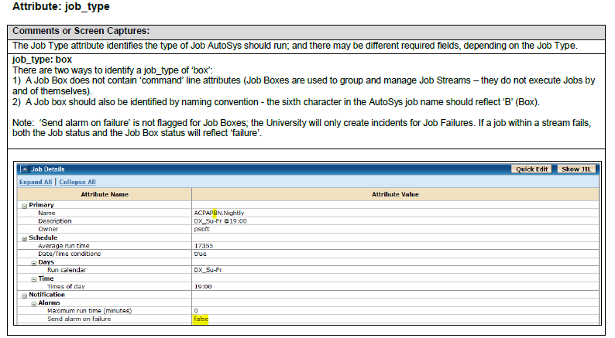
Previous Run Status
Dependencies and

Slide 31
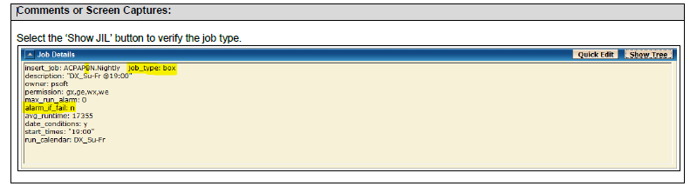

Slide 32
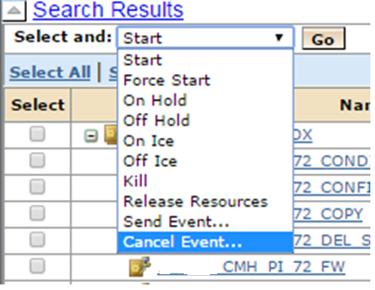
Job Action:-
Send Event:-
Marking job Success/ fail etc

Slide 33
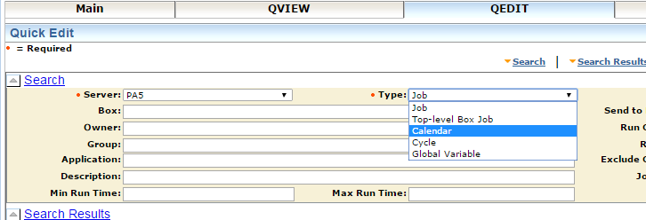
View and Edit Calendars:-

Slide 34
Date Scheduling:-
Calendars schedule the days job SHOULD run or should NOT run.
Standard Cal. –
Run Cal.- Specify the days job should process/ run
Exclude Cal.- Days job should NOT run
2. Extended Cal.-
Dynamic, Generated automatically based on a combination of holiday calendars, cycles, and conditions defined.

Slide 35
Defining job on GUI:-
→QEDIT
Create
Select Server (from Drop down)
select job TYPE(c, f, b)
Add details for job, name, parent, alarm, starting conditions etc
commit

Slide 36
Job States
Job State → the status of previous run
INACTIVE : The job has not yet been processed. Either the job has never been run, or its status was intentionally altered to “turn off” its previous completion status.
ACTIVATED :The top-level box that this job is in is now in the RUNNING state, but the job itself has not started yet.
STARTING : The event processor has initiated the start job procedure with the Remote Agent.
RUNNING : The job is running. If the job is a box job, this value simply means that the jobs within the box may be started (other conditions permitting). If it is a command or file watcher job, the value means that the process is actually running on the remote machine.

Slide 37
SUCCESS : The job exited with an exit code equal to or less than the “maximum exit code for success.” By default, only the exit code “0” is interpreted as “success.” If the job is a box job, this value means that all the jobs within the box have finished with the status SUCCESS (the default), or the “Exit Condition for Box Success” evaluated to true
FAILURE : The job exited with an exit code greater than the “maximum exit code for success.” By default, any number greater than zero is interpreted as “failure.” AutoSys issues an alarm if a job fails

Slide 38
TERMINATED : The job terminated while in the RUNNING state. A job can be terminated if a user sends a KILLJOB event or if it was defined to terminate if the box it is in failed. If the job itself fails, it has a FAILURE status, not a TERMINATED status. A job may also be terminated if it has exceeded the maximum run time (term_run_time attribute, if one was specified for the job), or if it was killed from the command line through a UNIX kill command. AutoSys issues an alarm if a job is terminated.
RESTART : The job was unable to start due to hardware or application problems, and has been scheduled to restart.

Slide 39
QUE_WAIT : The job can logically run (that is, all the starting conditions have been met), but there are not enough machine resources available.
ON_HOLD : This job is on hold and will not be run until it receives the JOB_OFF_HOLD event.
ON_ICE : This job is removed from all conditions and logic, but is still defined to AutoSys. Operationally, this condition is like deactivating the job. It will remain on ice until it receives the JOB_OFF_ICE event.

Slide 40
Difference between "on hold" and "on ice“
When "on hold" job taken off hold→ if its starting conditions satisfied→ will run immediately
when if an "on ice" job taken "off ice”→NOT start Automatically(Even if its starting conditions are satisfied)→ wait for starting conditions to reoccur→ RUN
Downstream/Dependent jobs from the “ON ICE” job will run as though the job succeeded.
Dependent jobs of “ON HOLD” job do NOT run until JOB is OFF HOLD

Slide 41
Status Propagation among Jobs
Any status changes in jobs, will propagate to the Box they are contained in.
Job Box “B” CONTAINS Job “A”
If A fails:-
Status of A- Failed ; Status of B- Failed
Status of other jobs in box- Unaffected

Slide 42
Job A Fails
Following happens:-
Status of A – Failed ; Status of B- Failed
To Mark both Box and Job success→
ONLY mark the Job as SU ;
Status change will propagate to parent Box
Note:- Machine is NOT specified for a Box Job on the Autosys, rather machine is specified for each job in box saperately.

Slide 43
Navigating the Dependencies
Check the dependencies of Job A:-
Open the jobs details of job A(QVIEW)
Check the “Conditions” column in details→
s(Dep_Job) ,
i.e. Job A is dependent for its start on Success of “Dep_Job” job
i.e. Job A will NOT run, until Dep_Job goes to Success.

Slide 44
OR
Scroll down the QVIEW page of job details
Check the “Starting Conditions” table
It will list the jobs on which the current job is dependent
ex. s(dep_job1)&& s(dep_job2) ,i.e. Both jobs need to be Success for Job A to start
Dependent Jobs:-
Check the “Dependent Jobs” table
Lists all the jobs that are dependent on the current job.
Those listed here will NOT run/start until the current job goes to Success.

Slide 45
Job Logs
Agent Logs:-
will contain the run/execute info of the job, the communication with Agent
Finding The Path:-
. ./profile_name → will be mentioned on GUI
echo $STDOUT
echo STDOUT
Job log:-
Will contain the details of actual processing done by the jobs
Path :- mentioned in agent log(generally will be ../var path on app server)

Slide 46
Checking if Autosys Agent is UP on application server:-
run below on server:-
ps –ef|grep WA_AGENT
Generally a server will have multiple agents running.

Slide 47
Thanks You ☺

