Slide 1

What is Web Service?
Type of Web Services

Slide 2
Web Services
Web services are web application components.
Webservices are used to allow users to access data from different sources like the Android app, IOS app, website etc from a centralized database.
It provides a common platform for several applications written in different programming languages to connect with one another.

Slide 3
Web Services
It uses a standardized messaging data format.
Web services are built on top of open standards such as TCP/IP, HTTP, HTML, and XML.

Slide 4
Types of Web Services
SOAP (Simple Object Access Protocol)
REST (Representational State Transfer) API’s

Slide 5
SOAP (Simple Object Access Protocol)
SOAP is easy to read because it's based on XML.
It provides an envelope to send a web services messages over the Internet, using the HTTP protocol
The messages are generally in XML format.
SOAP was intended to be a way to do remote procedure calls to remote objects by sending XML over HTTP.
SOAP is being used in the enterprise applications, generally in the legacy code.

Slide 6
REST (Representational State Transfer) API’s
REST locates the resources by using URL.
It depends on the type of transport protocol(with HTTP - GET, POST, PUT, DELETE,...)
For the actions to be performed on the resources.
It is more of architectural style and conventions based.
REST is not a set of standards or rules, rather it is a style of software architecture.

Slide 7
REST (Representational State Transfer) API’s
REST requests are related to CRUD operations (Create, Read, Update, Delete) in database.
REST uses GET, POST, PUT and DELETE requests.
Let me compare them with CRUD. GET is used to retrieve information which is similar to Read
POST is used to create new record which is similar to Create
DELETE is used to delete record which is similar to Delete
PUT is used to update record which is similar to Update

Slide 8
Create and Consume REST Services
JSON format is the most common output format of REST API.
we will use the JSON format to consume our simple REST API.
We will develope an online transaction payment REST API for our example.

Slide 9
Create REST API
Create a Database and Table with Dummy Data:
To create database run the following query:
Type the following command:
use allphptricks;

Slide 10
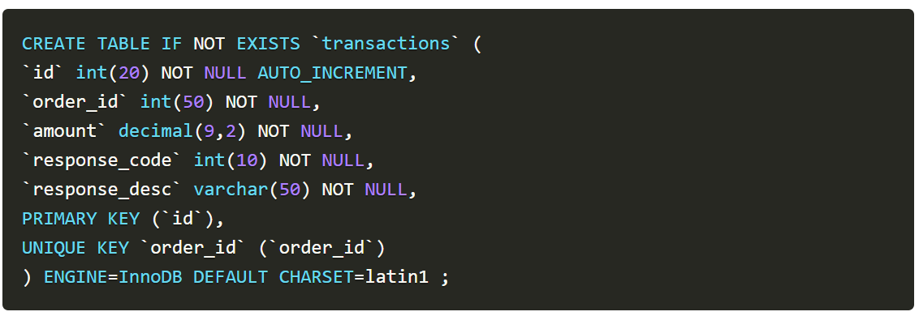
Create REST API
Create a Database and Table with Dummy Data:
To create a table run the following query:

Slide 11
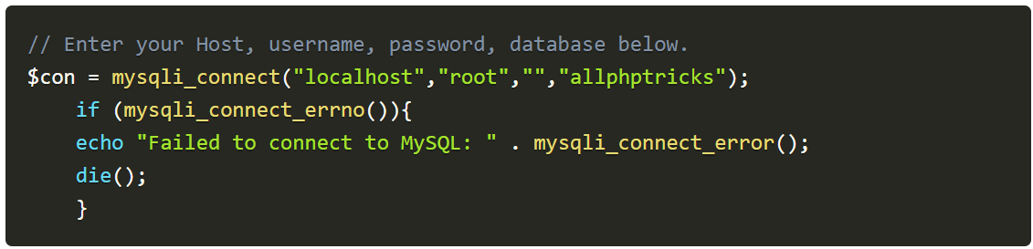
Create REST API
Create a Database Connection:
Create a db.php file in php-web-services folder and paste the following database connection in it.

Slide 12
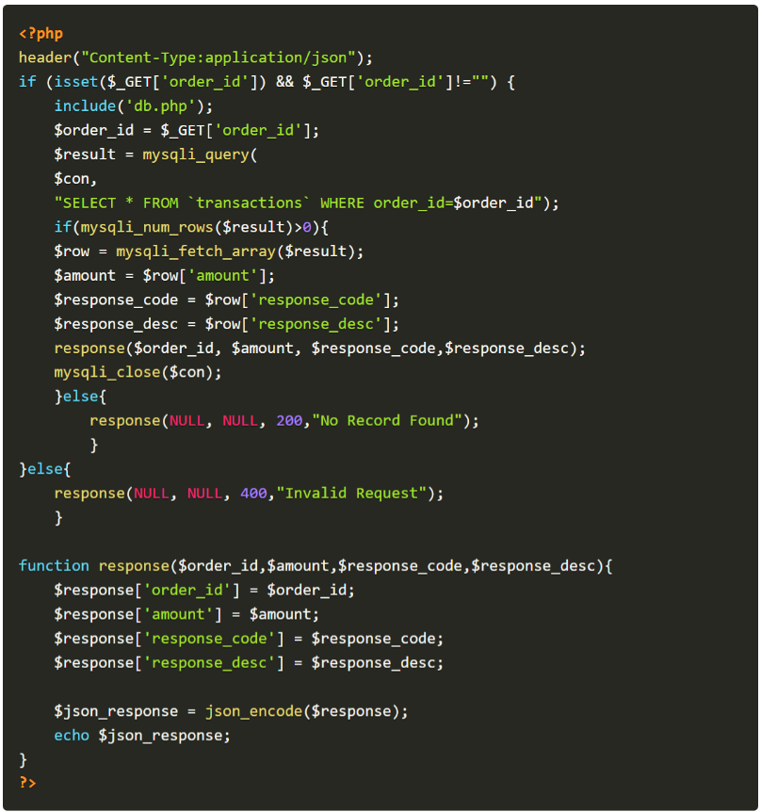
Create REST API
Create a REST API File:
Create a api.php file in php-web-services folder and paste the following code in it.

Slide 13
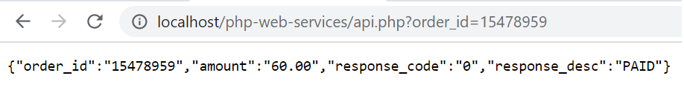
Create REST API
Script will accept the GET request and return output in the JSON format:
I have created all these files in folder name php-web-services, now you can get the transaction information by browsing the following URL.

Slide 14
Create REST API
But the URL is not user friendly, therefore we will rewrite URL through the .htaccess file, copy paste the following rule in .htaccess file.
RewriteEngine On # Turn on the rewriting engine
RewriteRule ^api/([0-9a-zA-Z_-]*)$ api.php?order_id=$1 [NC,L]

Slide 15
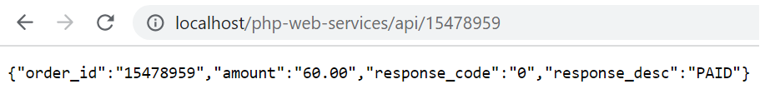
Create REST API
Now you can get the transaction information by browsing the following URL:
http://localhost/php-web-services/api/15478959

Slide 16
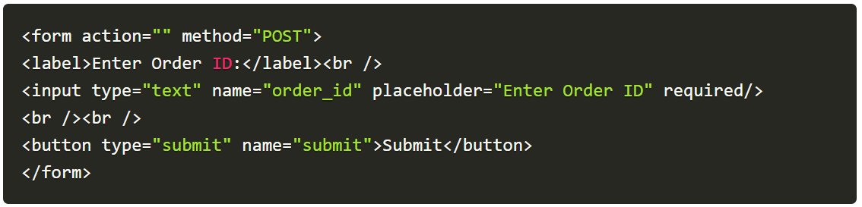
Consume REST API
To consume a REST API, you need to follow these steps:
Create an Index File with HTML Form in same folder(php-web-services)

Slide 17
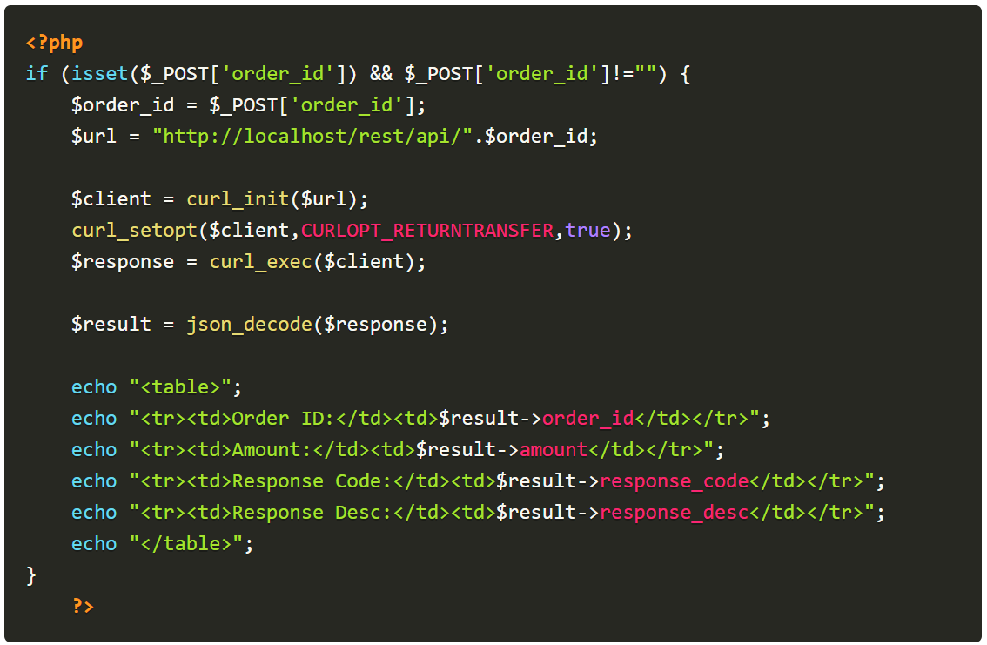
Consume REST API
Fetch Records through CURL(It’s a command line tool that developers use to transfer data to and from a server)

Slide 18
Consume REST API
Make sure CURL is enabled on your web server or on your localhost when you are testing demo.
You can do anything with these output data, you can insert or update it into your own database if you are using REST API of any other service provider.
Usually in case of online transaction, the service provider provides status of payment via API.
You can check either payment is made successfully or not.

Slide 19
Service-Oriented Architecture
A Service-Oriented Architecture or SOA is a design pattern which is designed to build distributed systems that deliver services to other applications through the protocol.
They are loosely coupled and support interoperability.

Slide 20
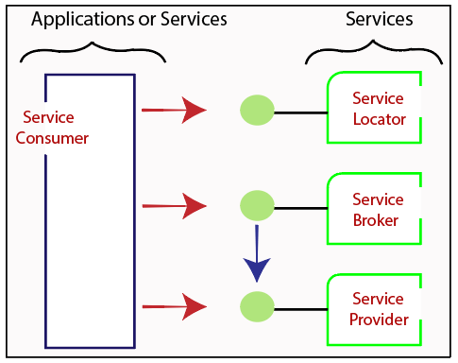
Service-Oriented Architecture

Slide 21
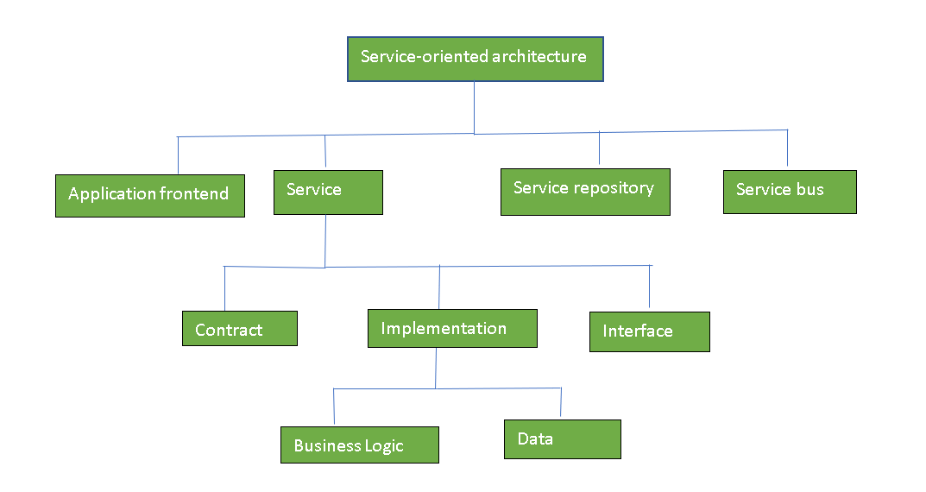
Components of SOA

Slide 22
Practical applications of SOA:
SOA is used to improve healthcare delivery.
Nowadays many apps are games and they use inbuilt functions to run For example, an app might need GPS so it uses the inbuilt GPS functions of the device.
Security - It represents the set of protocols required for identification and authorization.

Slide 23
Self Study Materials
https://cognizant.udemy.com/course/create-a-rest-api-using-basic-php-with-token-authentication/
https://tutorialsclass.com/learn/php/php-rest-api/
https://codeofaninja.com/create-simple-rest-api-in-php/

Slide 24
Assignments
https://www.toptal.com/php/building-rest-api-for-legacy-php-projects
https://www.9lessons.info/2012/05/create-restful-services-api-in-php.html

Slide 25

Thank You. ______ Wasim Pinjari

