Slide 1

Model View Controller(MVC)
software design pattern

Slide 2
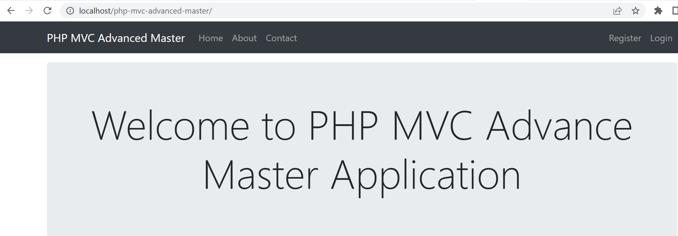
MVC Example Continuation
The main output of the example will look like this:

Slide 3
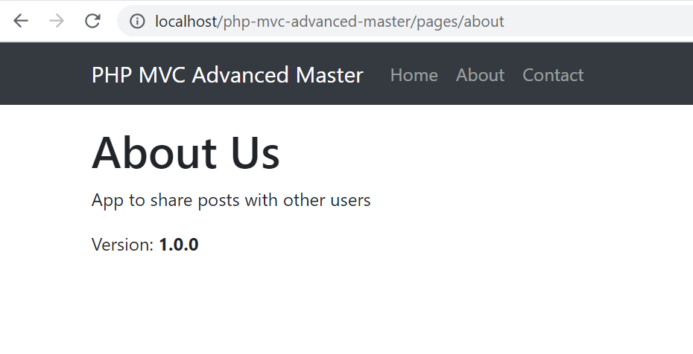
MVC Example
About Us Page:

Slide 4
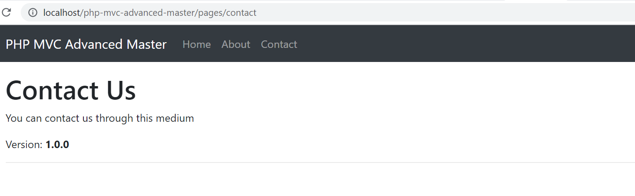
MVC Example
Contact Us Page:

Slide 5
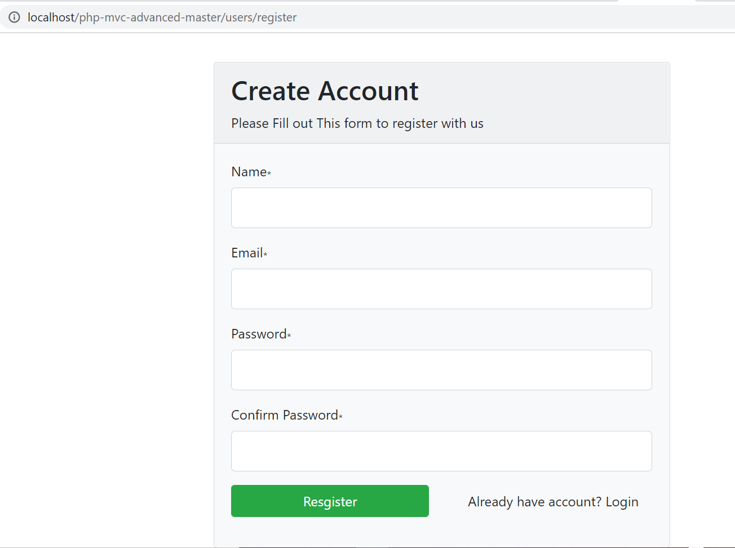
MVC Example
SignUp Page:

Slide 6
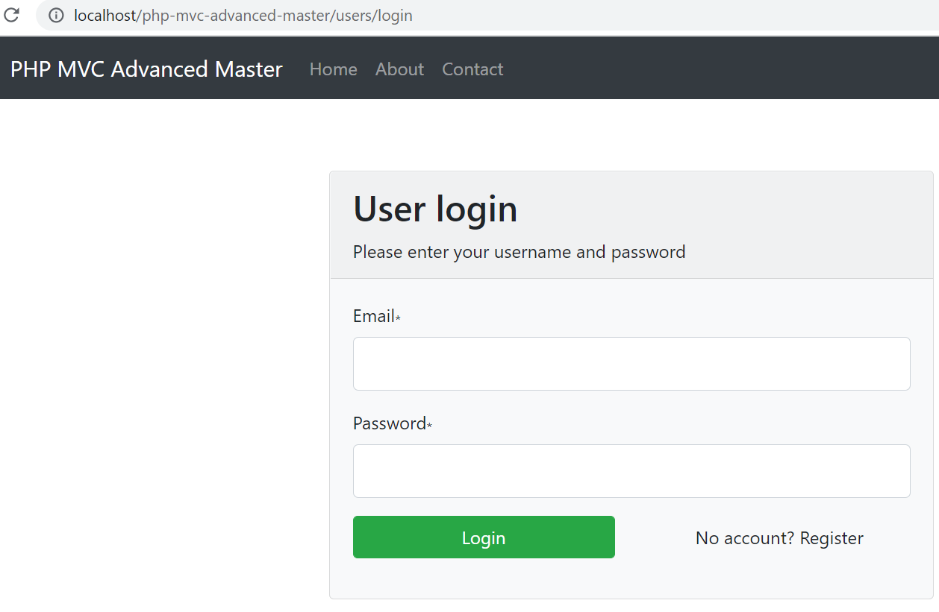
MVC Example
Sign In Page:

Slide 7
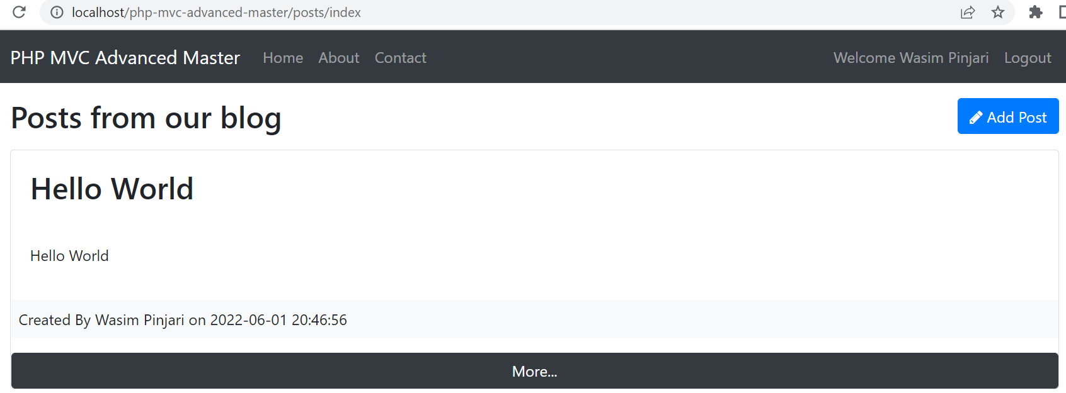
MVC Example
Posts Page:

Slide 8
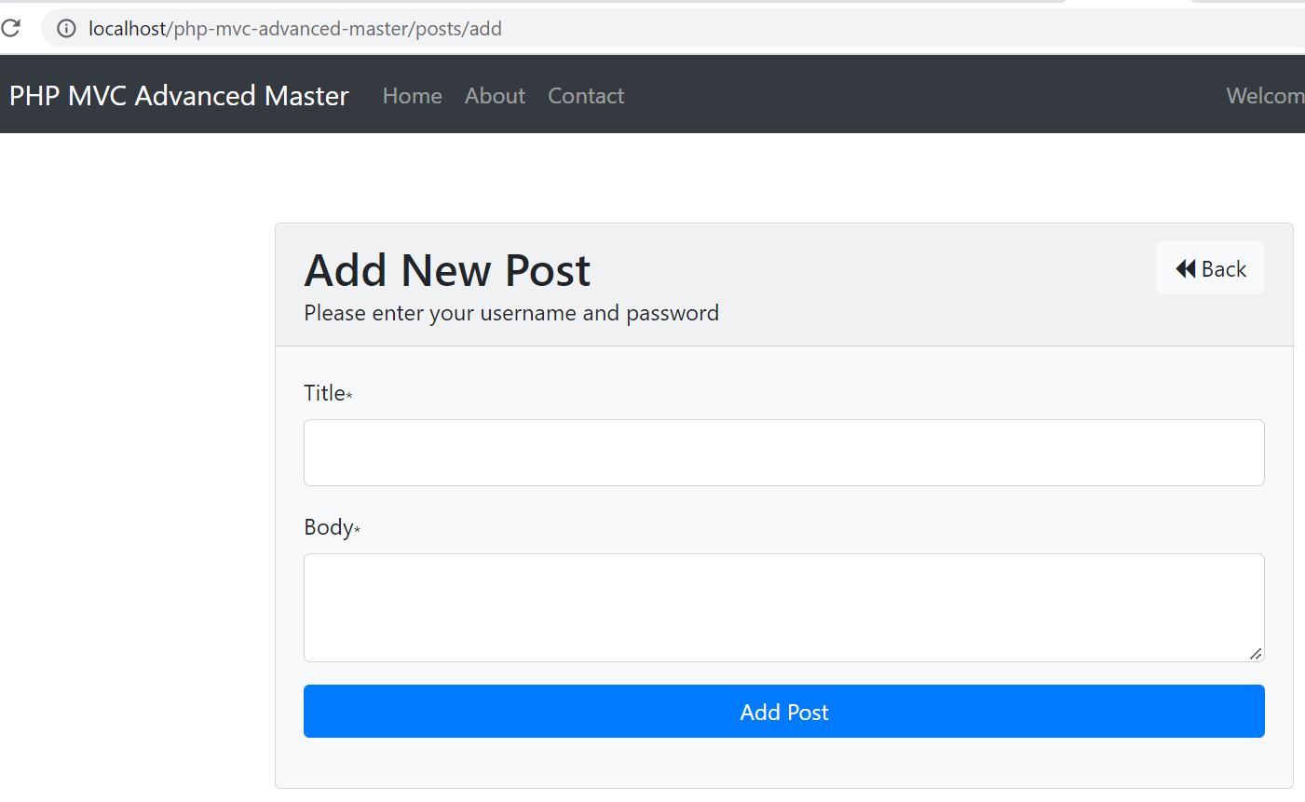
MVC Example
Add New Post:

Slide 9
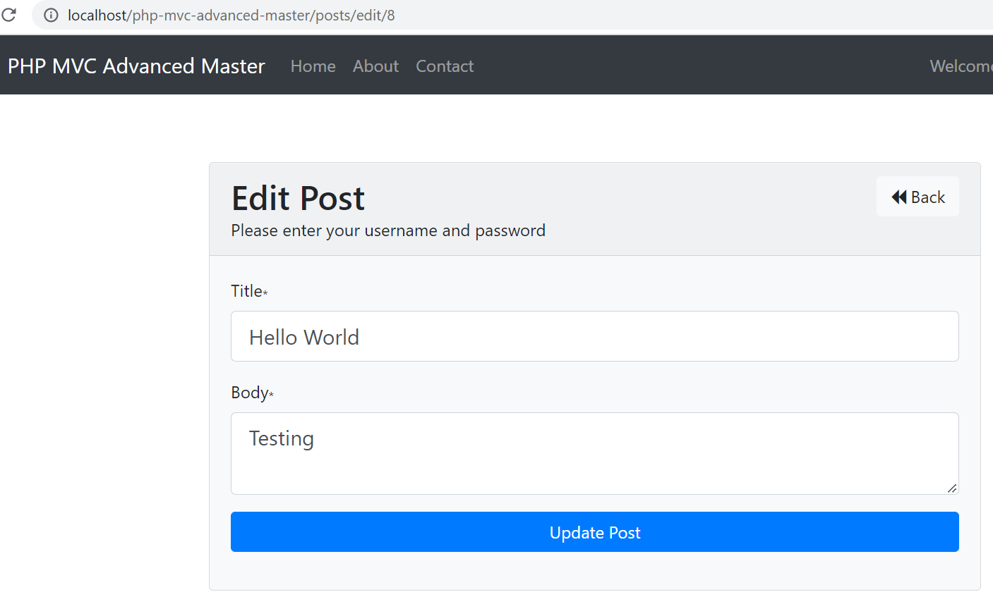
MVC Example
Edit Post:

Slide 10
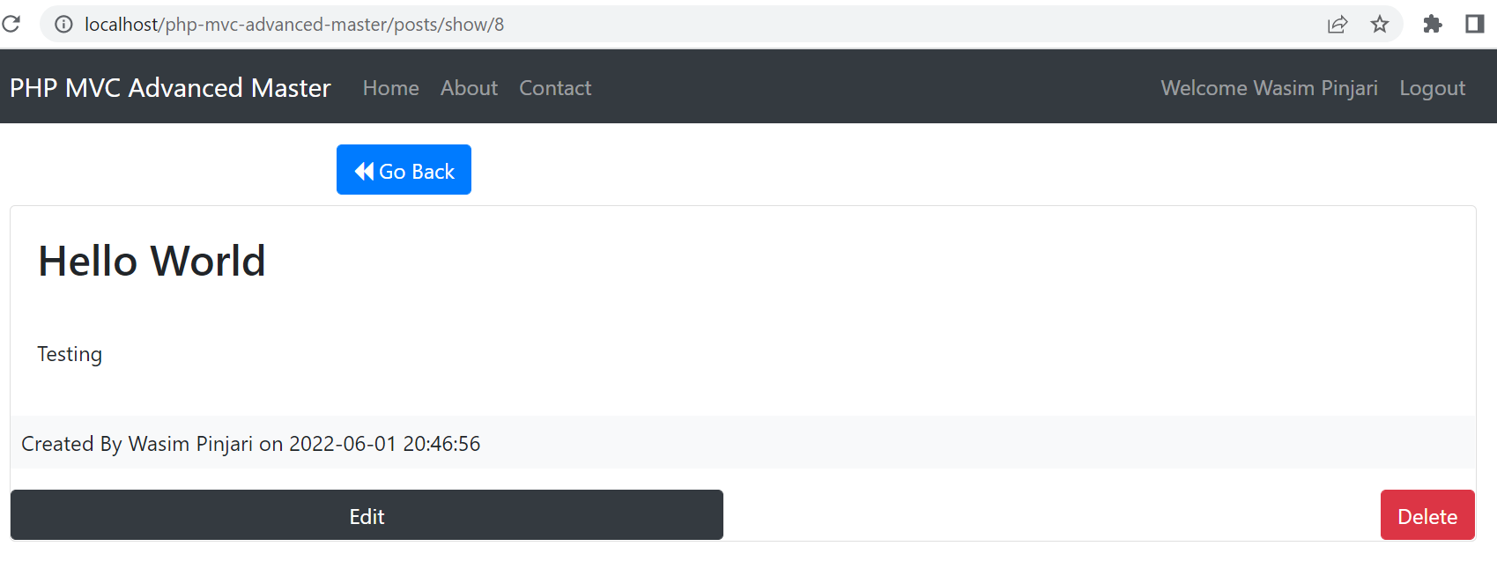
MVC Example
Delete Post:

Slide 11
Self Study Materials
https://www.codeproject.com/Articles/1080626/Code-Your-Own-PHP-MVC-Framework-in-Hour
https://www.codeproject.com/Tips/401121/MVC-in-PHP

Slide 12
Assignments
https://www.myprograming.com/php-mvc-step-by-step-live-project-example/
https://www.phpflow.com/php/simple-mvc-architecture-example-in-php/#:~:text=Today%20we%20will%20discuss%20how,we%20will%20separate%20all%20layer.

Slide 13

Thank You. ______ Wasim Pinjari

