Slide 1

AJAX Implementation
Asynchronous JavaScript

Slide 2
AJAX (Asynchronous JavaScript) Implementation
AJAX is a technique for creating fast and dynamic web pages.
It allows web pages to be updated asynchronously by exchanging small amounts of data with the server.
With AJAX when submit is pressed, JavaScript will make a request to the server, interpret the results and update the current screen.

Slide 3
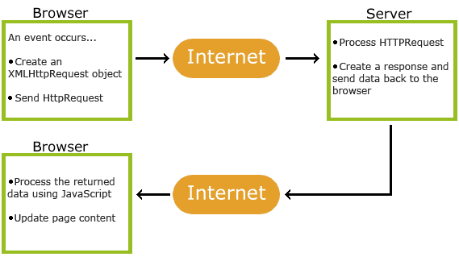
AJAX (Asynchronous JavaScript) Implementation

Slide 4
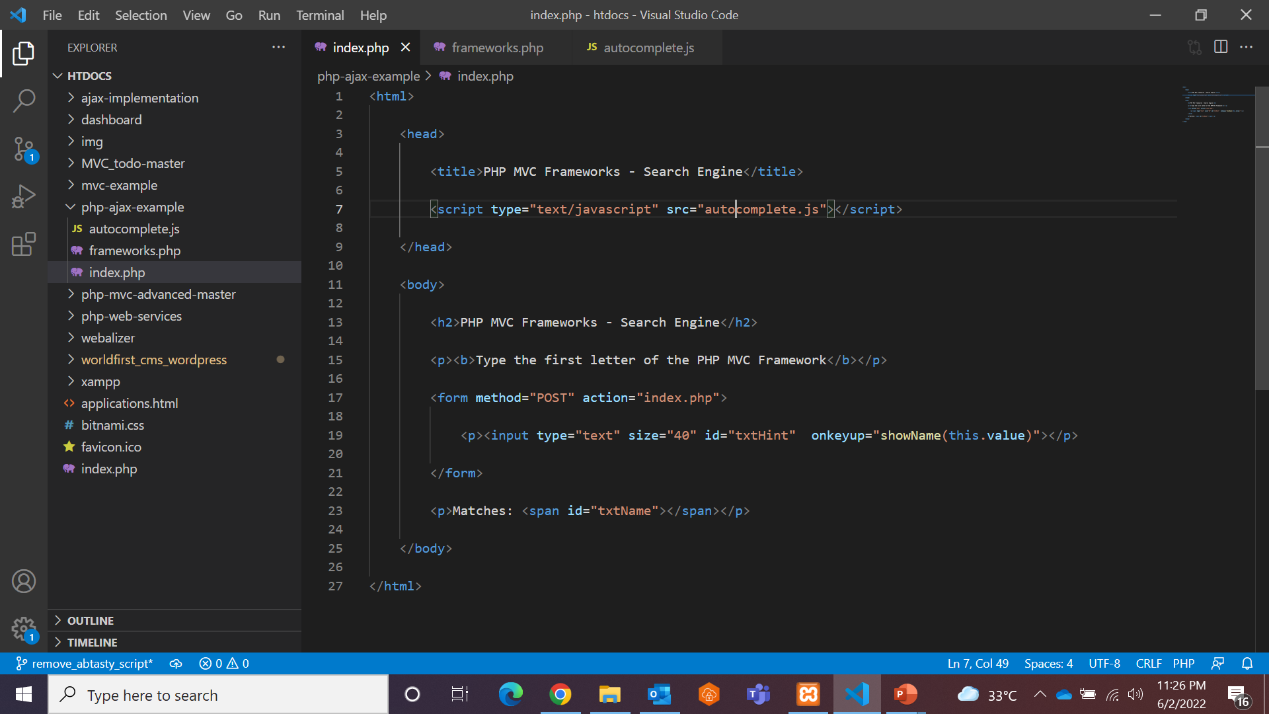
AJAX (Asynchronous JavaScript) Implementation Example

Slide 5
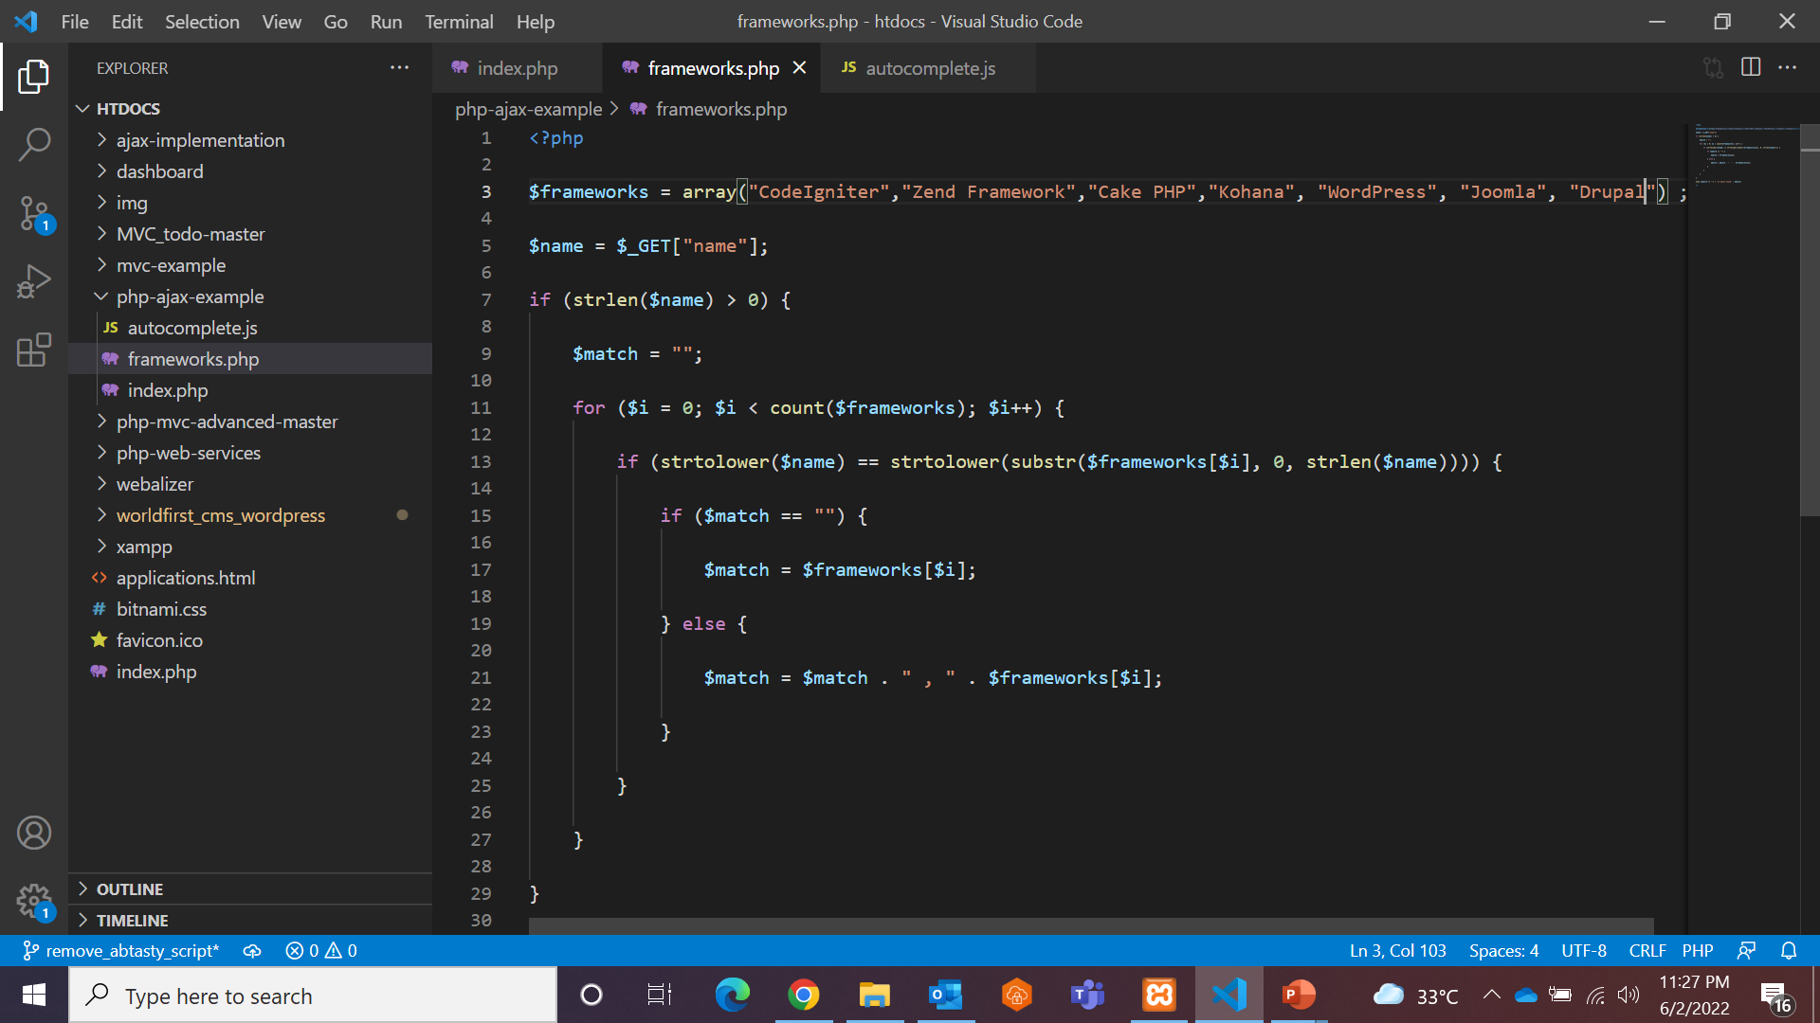
AJAX (Asynchronous JavaScript) Implementation Example

Slide 6
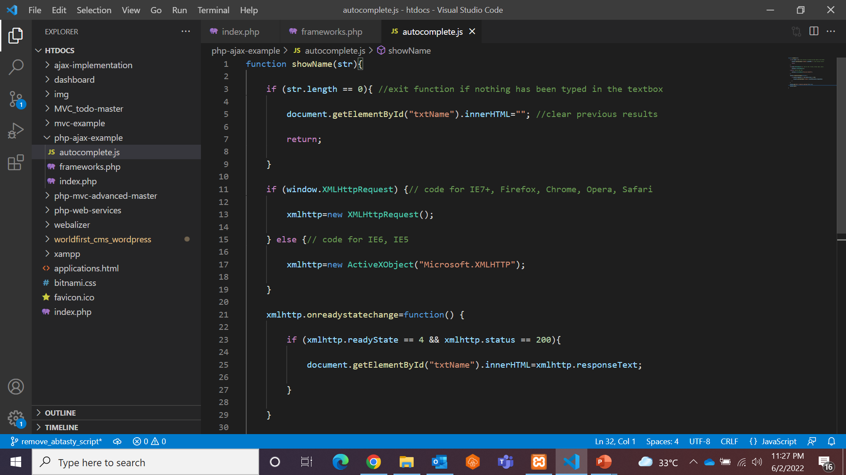
AJAX (Asynchronous JavaScript) Implementation Example

Slide 7
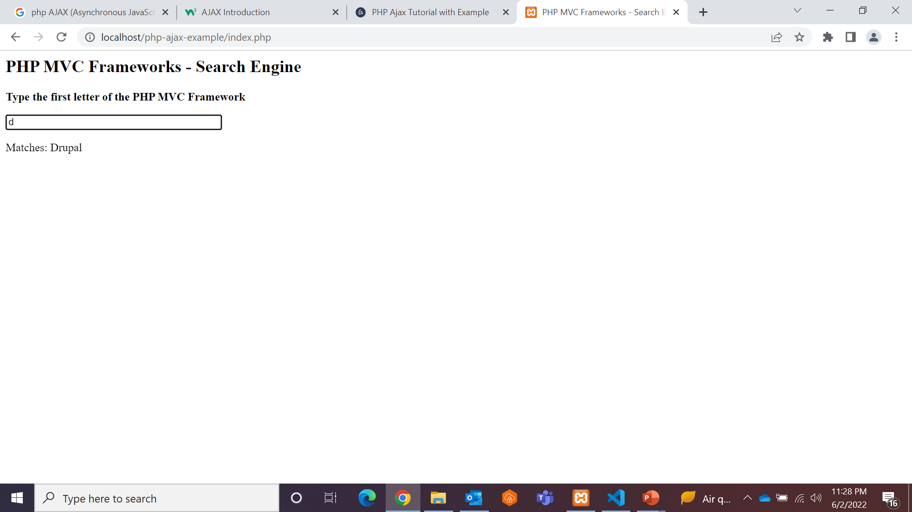
AJAX (Asynchronous JavaScript) Implementation Example

Slide 8
AJAX (Asynchronous JavaScript) Implementation Example
The PHP File - “frameworks.php“
checks an array of names, and returns the corresponding name(s) to the browser.
The PHP File - “index.php“
First, check if the input field is empty (str.length == 0). If it is, clear the content of the txtHint placeholder and exit the function.

Slide 9
Self Study Materials
https://guides.codepath.com/websecurity/PHP-Cookies-and-Sessions
https://www.codefixup.com/how-to-make-soap-client-call-in-php/
https://www.guru99.com/php-ajax.html

Slide 10
Assignments
https://csveda.com/mini-projects/php-project-using-ajax-bootstrap-and-mysql/

Slide 11

Thank You. ______ Wasim Pinjari

