Slide 1

NVIDIA
Rashil Rambhia rr275
Megha Manoj mm2773
Vishnupriya Santhosh vs263
Mohan Sai Nallala mn493
Ashwin Muralidharan am334
Notes:
Group Members
Why did

Slide 2
Introduction
Industry: Information Technology
Current market Cap: 2.24 Trillion Dollar
Current Price: $894
Executive Summary:
NVIDIA Corporation is a renowned technology company known for its groundbreaking contributions in GPUs, AI, and accelerated computing. With a diversified portfolio spanning gaming, data centers, autonomous vehicles, healthcare, and edge computing, NVIDIA has established itself as a leader in innovation. Leveraging AI and machine learning, NVIDIA provides efficient solutions for training and deploying models across various industries. The acquisition of Mellanox Technologies has bolstered its data center capabilities, while GeForce GPUs continue to dominate the gaming market. Cloud gaming services and strategic partnerships further extend its reach. Positioned for growth amidst increasing demand for AI and high-performance computing solutions, NVIDIA faces competition from established players and startups, alongside market fluctuations and regulatory challenges. Nonetheless, its technological expertise and market leadership ensure a promising future, sustaining its status as a trailblazer in the ever-evolving tech landscape.

Slide 3
History / Key Stats
Founded in 1993
Founder and CEO: Jensen Huang
22,500 employees in 50+ countries
$26.9 billion revenue in FY 22
7,500+ granted and pending patent applications worldwide
$1 trillion available market opportunity
3 million developers in the NVIDIA Developer Program
10,000 global startups in NVIDIA Inception
No. 1 “Best Places to Work in 2021” – Glassdoor
“World’s Best Performing CEO” – Harvard Business Review

Slide 4
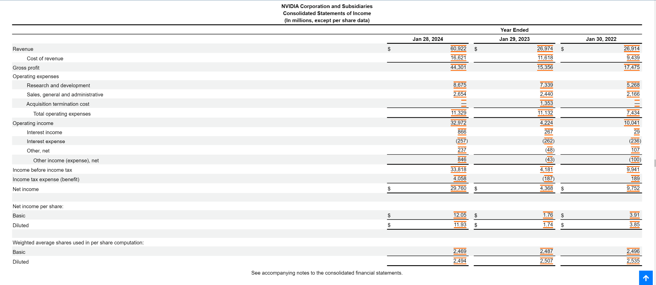
Income Statements

Slide 5
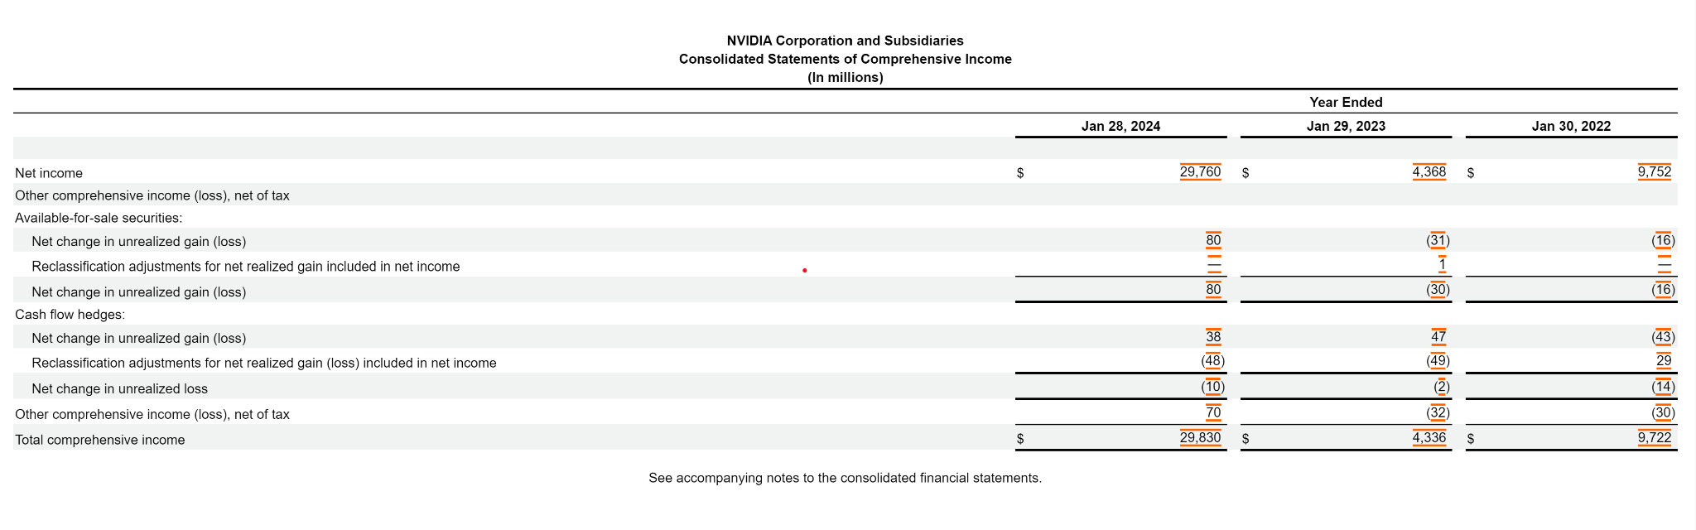
Financial Statement Analysis

Slide 6
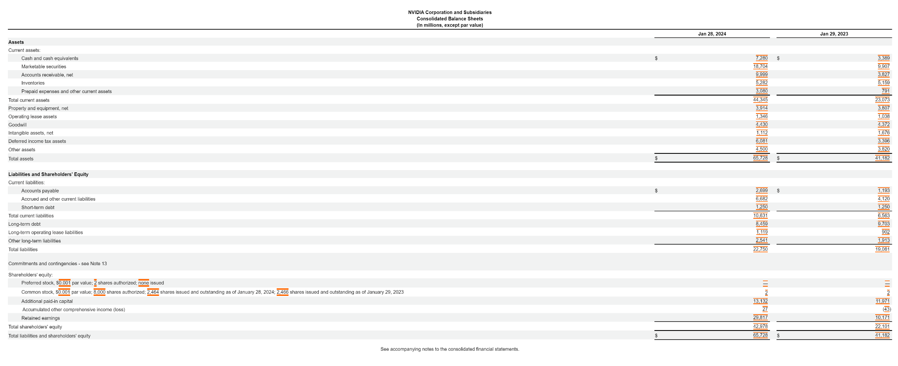
Balance Sheet

Slide 7
Outlook
NVIDIA’s outlook for the second quarter of fiscal 2024 is as follows:
Revenue is expected to be $11.00 billion, plus or minus 2%.
GAAP and non-GAAP gross margins are expected to be 68.6% and 70.0%, respectively, plus or minus 50 basis points.
GAAP and non-GAAP operating expenses are expected to be approximately $2.71 billion and $1.90 billion, respectively.
GAAP and non-GAAP other income and expense are expected to be an income of approximately $90 million, excluding gains and losses from non-affiliated investments.
GAAP and non-GAAP tax rates are expected to be 14.0%, plus or minus 1%, excluding any discrete items

Slide 8
Capital Budgeting and Capital structure
Capital Expenditure / Total Assets
2023 : CE/TA = $340.3 B / $41.182 B = 8.263
2024: CE/TA= $880.3 B/ $65.728 B = 13.393
Long Term Solvency:
Debt-Equity Ratio 2023
TD/TE = $9.703 B / $41.182 B = $0.235 B
Debt-Equity Ratio 2024
TD/TE = $8.459 B / $65.728 B = 0.128

Slide 9
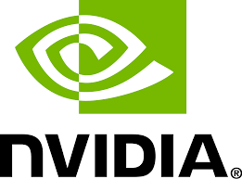
Risk and Return Analysis

Slide 10
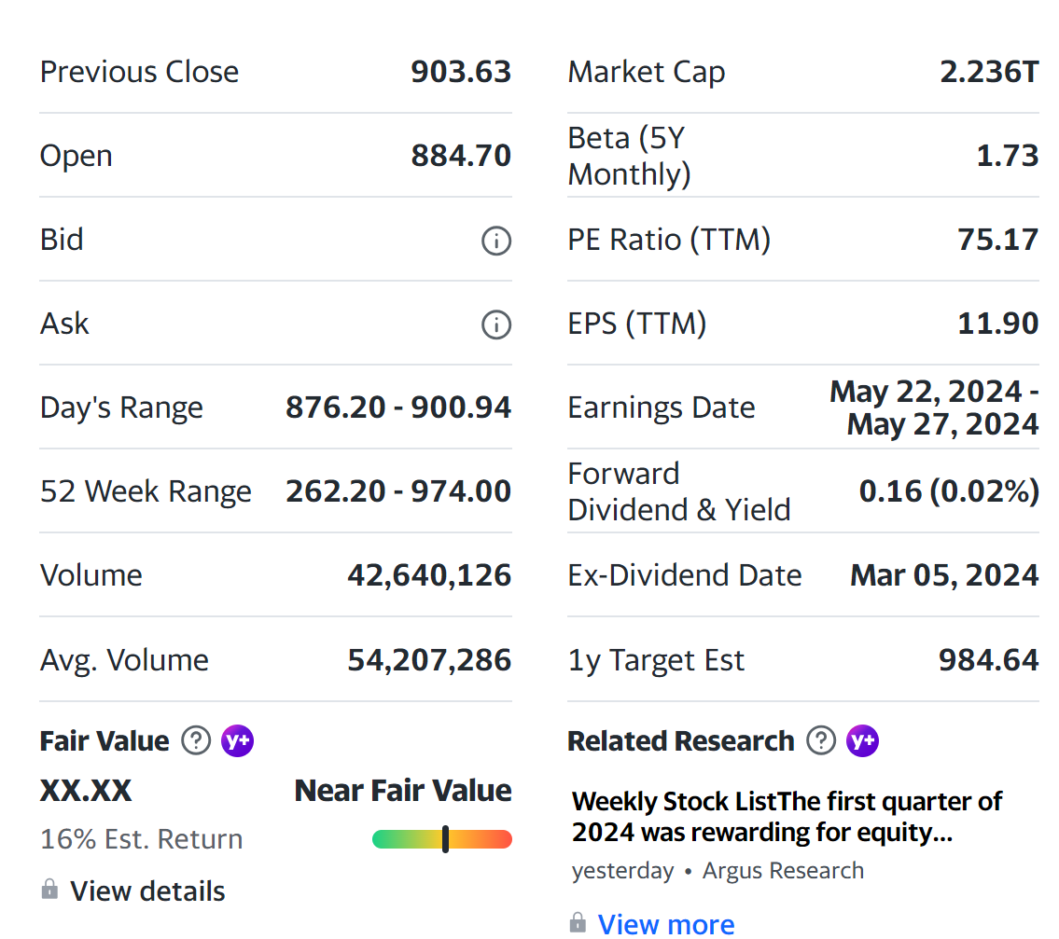
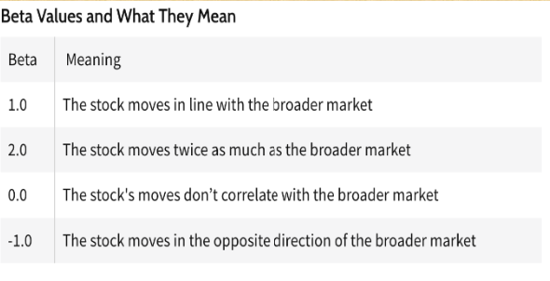
BETA: Measure of Systematic risk
Beta is a numerical value. The overall market has a beta of 1.0, and individual stocks are
ranked according to how much they deviate from the market.

Slide 11
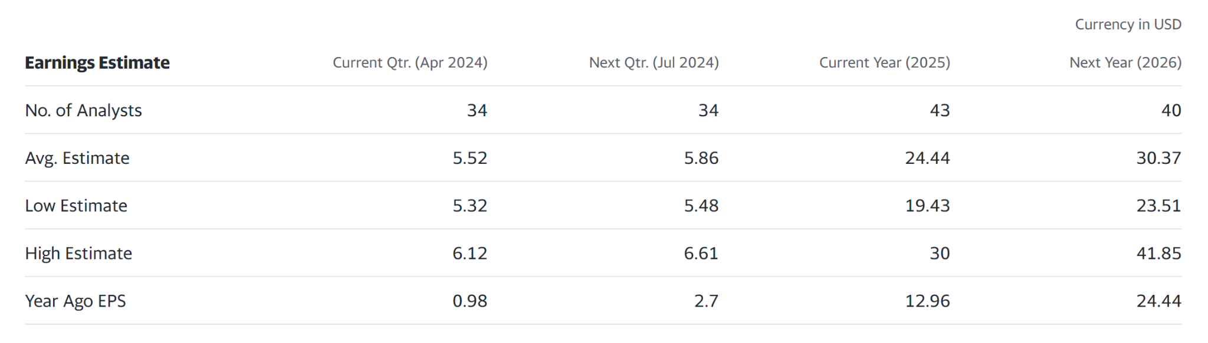
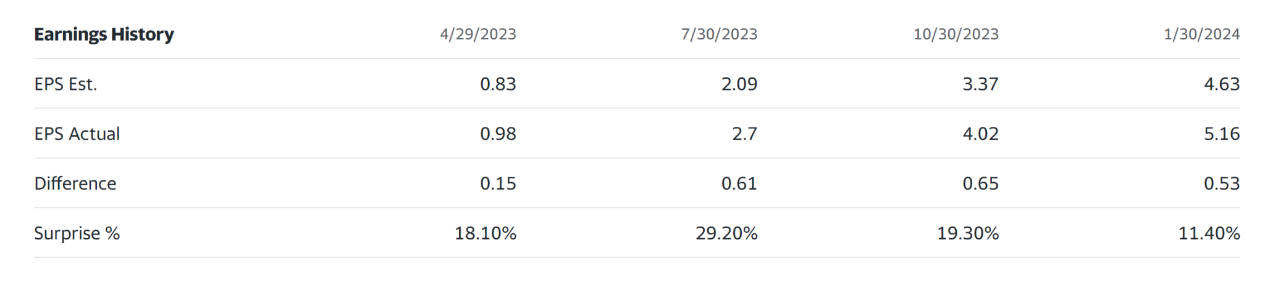
Firms Profitability & Analyst Forecast

Slide 12
Industry And Market Analysis
NVIDIA Announces Financial Results For Fourth Quarter And Fiscal 2024
February 21, 2024
Record quarterly revenue of $22.1 billion, up 22% from Q3, up 265% from year ago
Record quarterly Data Center revenue of $18.4 billion, up 27% from Q3, up 409% from year ago
Record full-year revenue of $60.9 billion, up 126%
SANTA CLARA, Calif., Feb. 21, 2024 (GLOBE NEWSWIRE) -- NVIDIA (NASDAQ: NVDA) today reported revenue for the fourth quarter ended January 28, 2024, of $22.1 billion, up 22% from the previous quarter and up 265% from a year ago.
For the quarter, GAAP earnings per diluted share was $4.93, up 33% from the previous quarter and up 765% from a year ago. Non-GAAP earnings per diluted share was $5.16, up 28% from the previous quarter and up 486% from a year ago.
For fiscal 2024, revenue was up 126% to $60.9 billion. GAAP earnings per diluted share was $11.93, up 586% from a year ago. Non-GAAP earnings per diluted share was $12.96, up 288% from a year ago.

Slide 13
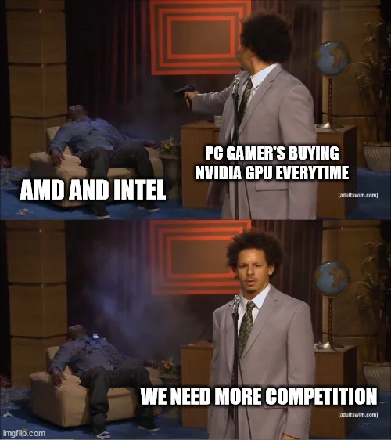
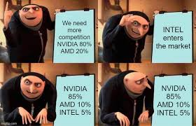
NVIDIA's Competitors

Slide 14
NVIDIA's Competitors
Nvidia has identified Chinese tech company Huawei as one of its top competitors in various categories such as chip production, AI and cloud services.
The tech giant said in a filing with the US Securities and Exchange Commission (SEC) on Wednesday that it expects "an increasingly competitive environment in the future" as rival companies ramp up CPU, GPU and AI production, among other technologies such as ethernet.
According to Reuters, Chinese tech giant Baidu ordered chips from Huawei before anticipated US regulations tightened restrictions on exporting advanced AI chips to China.
As well as Huawei, Nvidia also mentioned Alibaba, Alphabet, Amazon and Microsoft as rivals in providing cloud services, and the likes of Intel, Qualcomm and Samsung as competitors for providing hardware and software for SoC products.

Slide 15
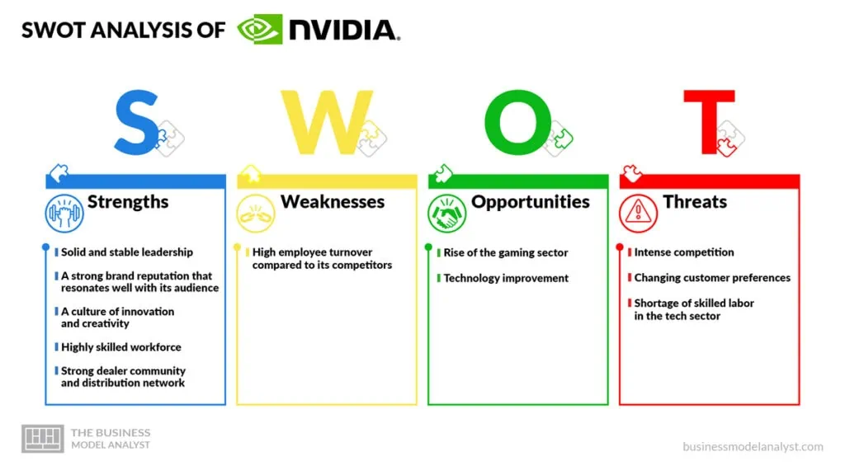
SWOT Analysis

Slide 16
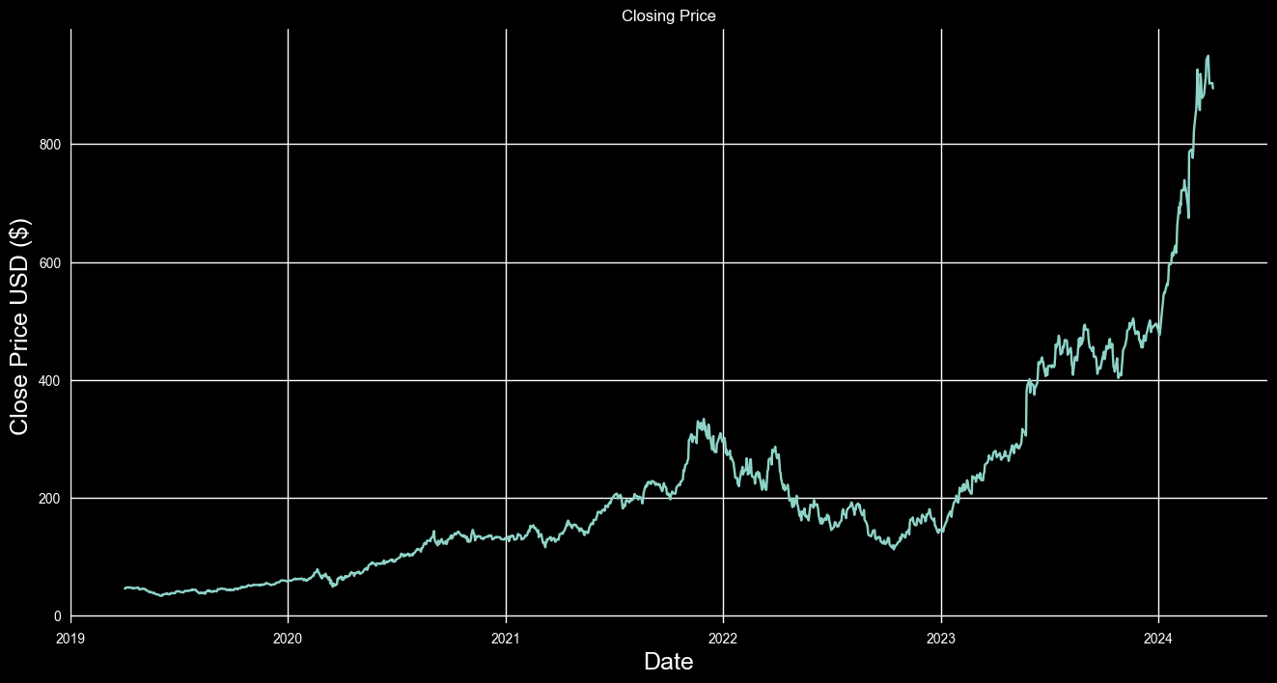
Historical Data of previous 5 years

Slide 17
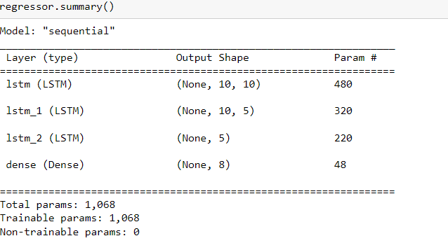
Value Analysis - Code
We have built a Sequential Model using LSTM components
We have used the historical data for last 5 years to make the prediction
Train Test Split is 80 : 20

Slide 18

Value Analysis - Code
The accuracy evaluated on the test set : 96.57%
We use the last 10 days data to predict the stock price for the next 8 days
Predicted Stock price on April 10th : $964

Slide 19
References
https://finance.yahoo.com/quote/NVDA/analysis
https://investor.nvidia.com/news/press-release-details/2023/NVIDIA-Announces-Financial-Results-for-First-Quarter-Fiscal-2024/default.aspx
https://www.sec.gov/ix?doc=/Archives/edgar/data/0001045810/000104581024000029/nvda-20240128.htm

Slide 20
Thank you

