Slide 1


Sankalan
An initiative by

Slide 2



Accuracy Twinning Data Reservoir
Data collection and management was never this easy! Give us your data and never worry about it again.
Developed with the latest Frameworks Technologies that make your life easier.
Easy to use A user friendly interface and support to queries.
Simple and Safe A simple process to enter and verify data on the go.

Slide 3


The most common problems while entering data are typos, spelling mistakes, and wrong information being conveyed!

Slide 4


Well, Sankalan got you covered!

Slide 5

Sankalan lets you enter data in complete cooperation with the Surveyor and lets you keep track of the submitted data by sending you an SMS before it is entered in the Centralised Database.

Slide 6
Perks of Using Sankalan
Sankalan comes with some exciting perks:
Say no to Erroneous Entries! There is no way wrong entries and typos are being entered in the database all thanks to a double layer of data validation.
Bilingual Support Available in Hindi to eliminate language barrier.
Support for Voice Capturing and Instructions A voice that guides you throughout the website in both Hindi and English and accepts your input as voice too!

Slide 7
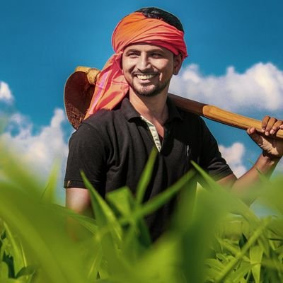
Meet Prakash.
He is a hard working farmer who lives in a remote village where technology is not prominent.
He doesn’t know any language other than Hindi and ends up missing signing up for any Farmer Welfare Scheme due to language barrier.
Prakash being illiterate can’t add his details on any website and avail any benefits!

Slide 8
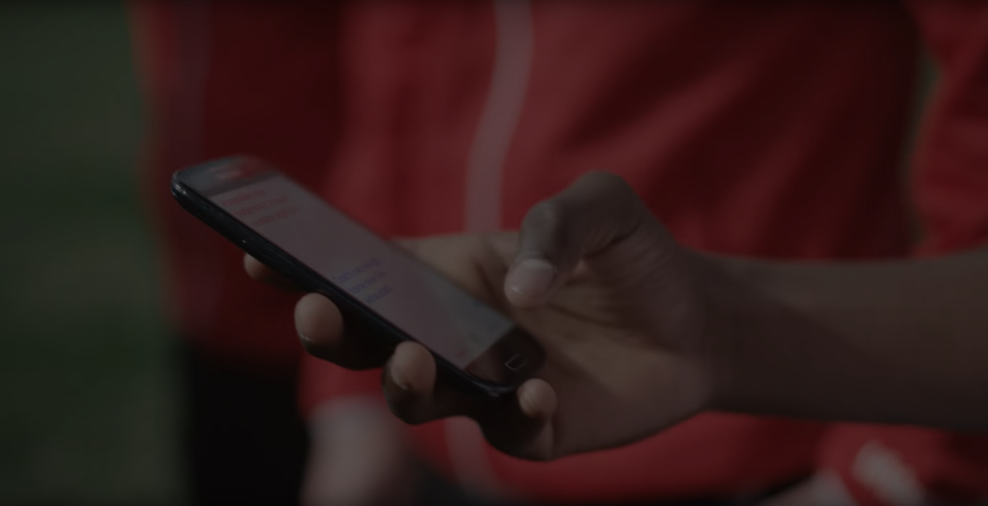

Sankalan brings in the involvement of Surveyor to help enter data along with bilingual support to keep him aware what’s going on in the entire process.
Sankalan is much more than a web application! It is a system in itself.

Slide 9
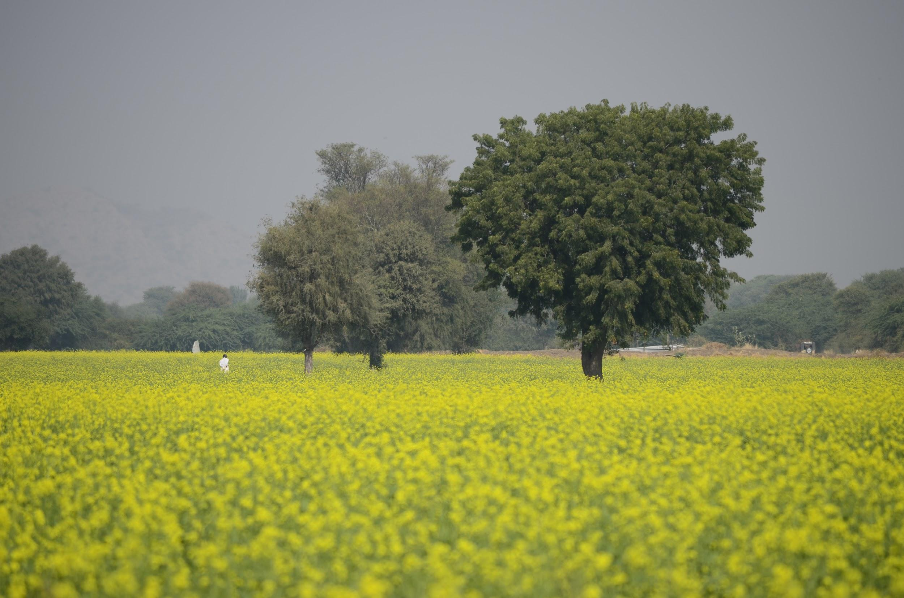
Prakash will have his problems solved!
He will be able to sign up for all the government schemes he is eligible for.
He will have all the support from Sankalan team, his queries will be answered and his feedback will be valued!

Slide 10
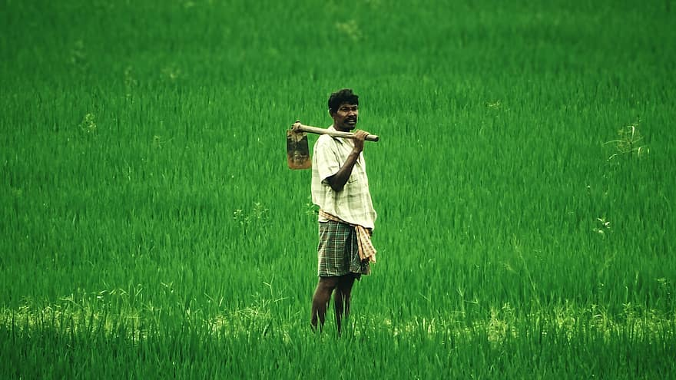
Sankalan is going to make life easy for farmers like Prakash and
make technology more prominent in remote rural areas.

