Slide 1
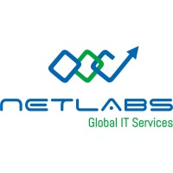
COMPANY PROFILE ORGANIZATION
Continuous Internal Evaluation - 01
NETLABS GLOBAL IT SERVICES PVT LTD
INDUSTRY SUPERVISOR :
Project Manager SANTOSH JENA
Presented by : Megha Bharathi M
Reg No : 102CS23031
6th sem CS Department
SJ (GOVT) Polytechnic College
Bangalore-560001
Submitted to : Cohort owner
Raghavendra M Y
Lecturer
SJ (GOVT) Polytechnic College
Bangalore-560001
Head of Department :
Haritha S M
SJ (GOVT) Polytechnic College
Bangalore-560001

Slide 2
AGENDA
TABLE OF CONTENT
OVERVIEW OF THE ORGANIZATION
VISION AND MISION OF THE ORGANIZATION
ORGANIZATION STRUCTURE
ROLES AND RESPONSIBILTIES
PRODUCTS AND SOLUTIONS
MARKET PERFORMANCE

Slide 3
Overview of the Organization
NetLabs Global IT Services Pvt. Ltd. is a global business transformation enabler providing Technology, Infrastructure, and People solutions. With offices in India, USA, and Australia, the company focuses on managed IT services, emerging technologies, cybersecurity, and talent solutions.
Netlabs Global IT Services Pvt Ltd was incorporated as a private limited company on 9 March 2016 under the Indian Companies Act. This is its official establishment date according to corporate records

Slide 4
2. Vision and Mission
Vision:
To create endless possibilities of growth and well being for all our stakeholders – customers , employees, partners, investors and societies
Mission:
We strive to be a global business transformation enabler by helping our customers adopt smart cutting-edge technologies, smart industry practices and smart people talent solutions to stay ahead of the curve

Slide 5
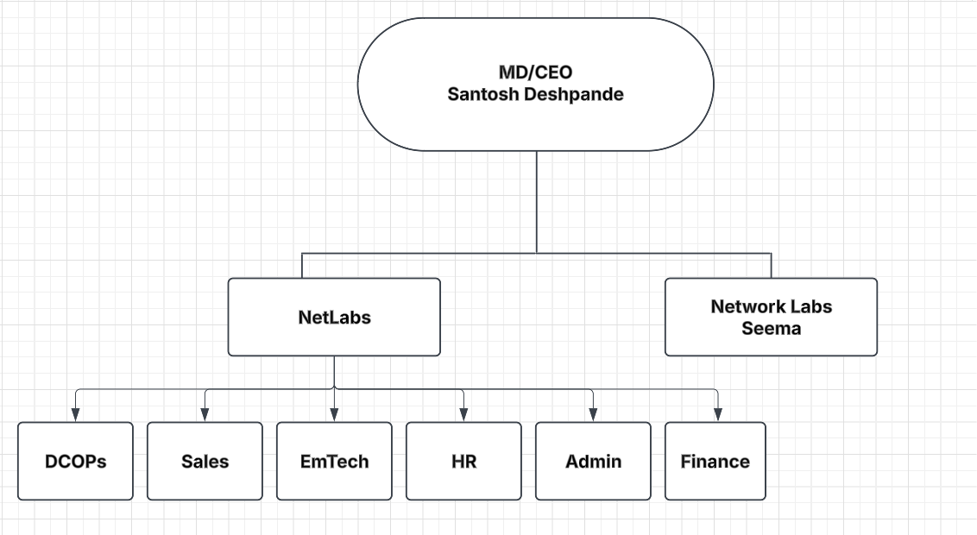
3. Organizational Structure

Slide 6
4. Roles and Responsibilities
• Management: Strategic planning and decision-making
• Network & DC Ops: Infrastructure and operations management
• Emerging Tech: RPA, AI, automation, product development
• HR: Talent management and employee engagement
• Finance: Budgeting, invoicing, and payment processing
• Sales: Business development and client relationships

Slide 7
5. Products and Solutions
• Procure X Fusion – Procurement-to-Payment automation platform
Procure X Fusion is a comprehensive solution that transforms the procurement-to-payment process, addressing key challenges faced by organizations through automation, centralization, and data-driven insights
• Data Center & Managed IT Services:
End to End Managed IT Services for Applications, Infrastructure, and the Cloud with a “Smart shoring” concept and patented methodology for Availability and Performance Management of IT. State of the Art Tier-II Data Centre.

Slide 8
Cyber Resilience & Compliance Solutions:
One-Stop Shop for Enabling Enterprise Business Continuity By Protecting Critical Assets Against Known And Emerging Threats Across The Ecosystem Including Advisory, Solutions And Compliance Assessments.
Talent-as-a-Service (TaaS):
Comprehensive Talent services for enterprises. A proven model of “Source-Train-Deploy” of freshers and Staffing of laterals helping enterprises recruit the best talent in a cost optimized, repeatable, and scalable model

Slide 9
6. Market Performance
• 100+ customer relationships
• 40+ technology partners
• Clients across BFSI(Banking, Financial Services, and Insurance), Healthcare, Education, Manufacturing, Govt & PSU
• Trusted by global and Indian enterprises with long-term partnerships
Conclusion
NetLabs Global continues to drive digital transformation through innovative products, robust infrastructure services, and customer-focused solutions, positioning itself as a reliable technology partner in the global market.

Slide 10
THANK YOU
Any Questions ?
Official Website :https://www.netlabsglobal.com/

