Slide 1

GP-SMS Automation Pipeline – OJT-1 Presentation
Continuous Internal Evaluation - 02
NETLABS GLOBAL IT SERVICES PVT LTD
INDUSTRY SUPERVISOR :
Project Manager SANTOSH JENA
Presented by : Megha Bharathi M
Reg No : 102CS23031
6th sem CS Department
SJ (GOVT) Polytechnic College
Bangalore-560001
Submitted to : Industry Supervisor
Santosh Jena
Project Manager/Team Lead
NetLabs Global IT Services PVT LTD
Bangalore-560001
Head of Department :
Haritha S M
SJ (GOVT) Polytechnic College
Bangalore-560001

Slide 2
AGENDA
Table of Content
Introduction & Job Role
OJT-1 Learning (Python & Data Processing, API & authentication)
Use Case-1: SMS Automation
Performance & Value Addition, conclusion

Slide 3
1. Introduction & Job Role
In the internship at NetLabs Global IT Services Pvt Ltd
Worked as an AI/ML Intern
Responsible for:
Data processing and automation
Working with Python and APIs
Building and testing backend APIs
Automating workflows using Automation Anywhere A360
Contributed to real-time project: GP-SMS Automation Pipeline

Slide 4
2. OJT Learning – Python & APIs
Python & Data Processing:
Learned Python fundamentals and problem-solving
Worked with iterables (List, Tuple, Dictionary, Set) ; Used loops, conditions, and functions
Performed data cleaning using Pandas
API & Backend Development:
Learned REST API concepts and architecture
Used HTTP methods: GET, POST, PUT, DELETE
Creating DataBases in MongoDB
Developed APIs:
HRMS API, Banking API, etc
Authentication & Security:
Token-based authentication (JWT) ; Session-based authentication ; API Key authentication

Slide 5
3. Use Case: Automated SMS Data Processing
Actor: System
Goal: Generate final SMS report automatically
Process Flow:
Download SMS data from Google Sheets , Clean and preprocess data, Remove duplicate records
Filter new SMS data ,Merge with GP master data
Generate Excel report
Send automated email
Automate entire workflow using Automation Anywhere A360
Execute process using TaskBot
Tools Used: Python (Pandas), Excel, Automation Anywhere A360
Outcome:
Accurate, automated, and real-time reporting

Slide 6
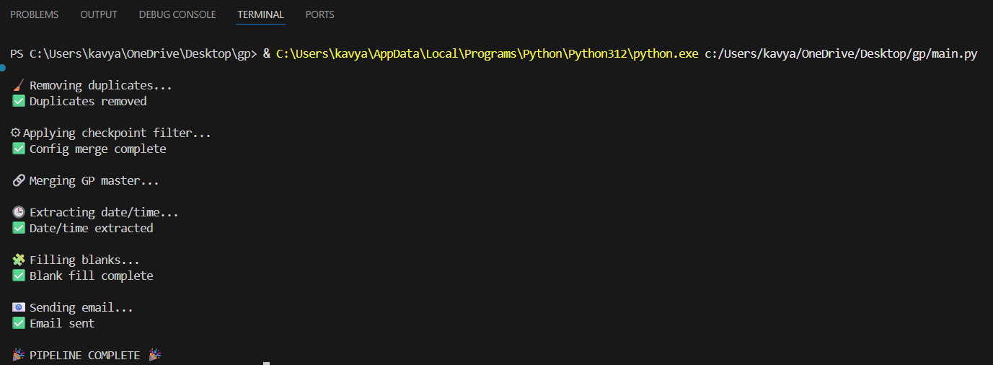
Output of use case

Slide 7
4. Performance & Conclusion
Reduced manual work significantly
Improved accuracy and efficiency
Faster processing time
Fully automated workflow using TaskBot
Value Added to Organization:
Saved time and human effort
Improved reporting quality
Conclusion:
Successfully applied OJT learning in real project
Gained hands-on experience in Python, APIs & Automation

Slide 8
THANK YOU
Any Questions?

