Slide 1

Agriculture Drought Prediction – OJT-2 Presentation
Continuous Internal Evaluation - 03
NETLABS GLOBAL IT SERVICES PVT LTD
INDUSTRY SUPERVISOR :
Project Manager SANTOSH JENA
Presented by : Megha Bharathi M
Reg No : 102CS23031
6th sem CS Department
SJ (GOVT) Polytechnic College
Bangalore-560001
Submitted to : Industry Supervisor
Santosh Jena
Project Manager/Team Lead
NetLabs Global IT Services PVT LTD
Bangalore-560001
Head of Department :
Haritha S M
SJ (GOVT) Polytechnic College
Bangalore-560001

Slide 2
AGENDA
Table of Content
Introduction & Job Role
OJT-2 Learning (AI/ML, APIs, Excel)
Use Case-2 : Agriculture Drought Prediction Syste,
Performance & Value Addition, conclusion

Slide 3
1. Introduction & Job Role
During OJT-2 at NetLabs Global IT Services Pvt Ltd,
Worked as an AI/ML & Backend Development Intern
Responsibilities:
Developing AI/ML-based applications
Designing frontend using HTML & CSS
Building backend using Flask
Learning API development
Performing Excel data processing

Slide 4
2. OJT Learning – Python & APIs
🔹 API Development (Invoice System)
Learned Invoice concepts and business usage
Developed APIs:
Invoice API
Payment API
Credit Memo API
Aging Report API
Ledger API
🔹 Excel & Data Processing
Extracted invoice data into Excel
Merged datasets from multiple files
Performed record matching and validation

Slide 5
3. Use Case: Automated SMS Data Processing
Actor: User/System
Goal: Predict drought conditions using environmental inputs
Process Flow:
User logs into the system
Enters input values:
Rainfall
Soil Moisture
Temperature
Humidity
Wind Speed
Data is sent to backend (Flask)
System processes inputs and predicts:
Drought / No Drought

Slide 6
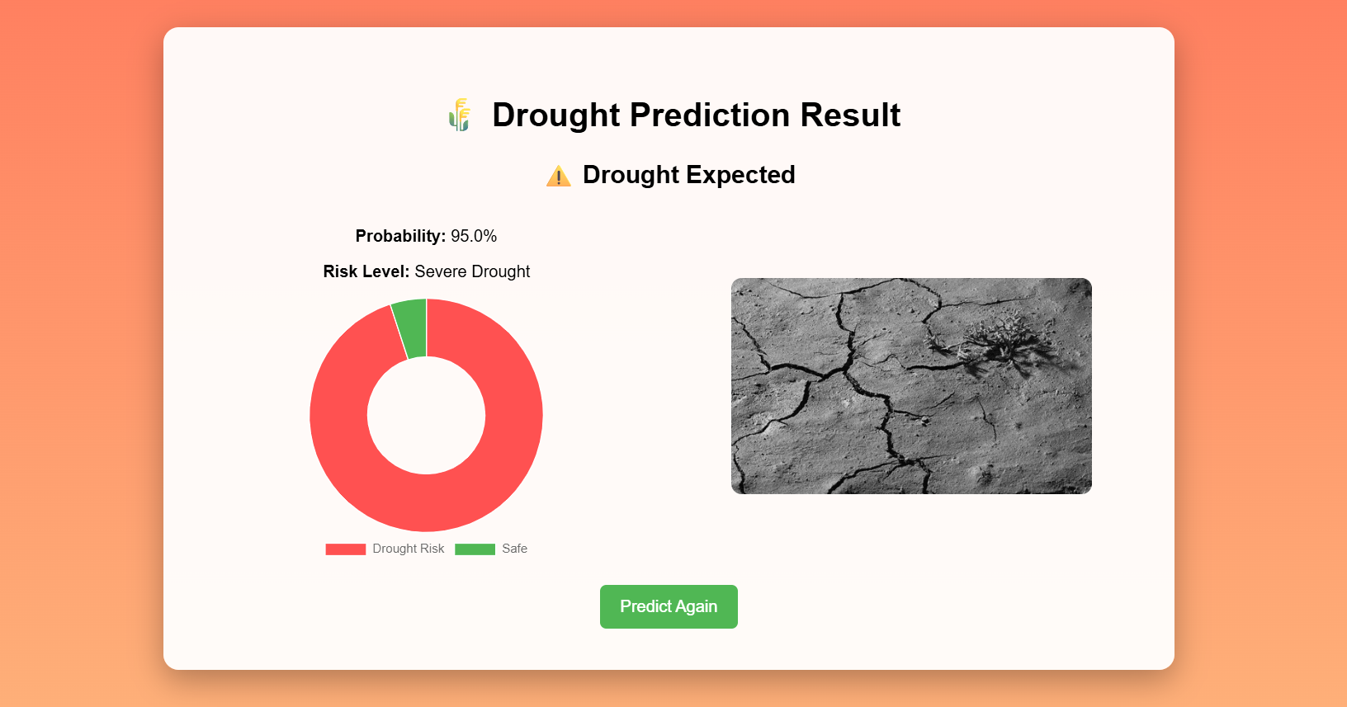
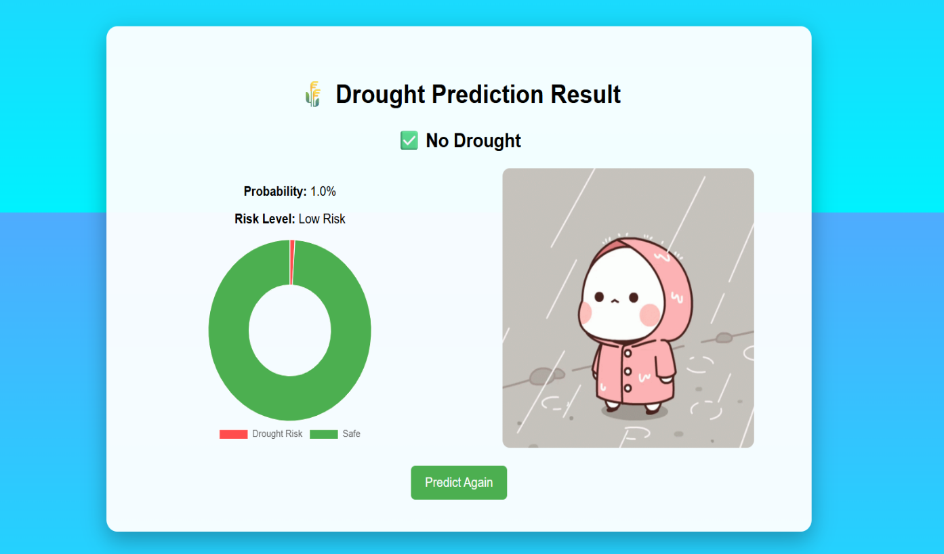
Output of use case

Slide 7
4. Performance & Conclusion
Performance
Developed drought prediction system
Integrated frontend & backend
Implemented invoice APIs and Excel tasks
Value Addition
Reduced manual effort
Improved efficiency and accuracy
Enabled smart drought prediction
Conclusion
Applied OJT-2 learning in real projects
Gained skills in AI/ML, APIs & data processing

Slide 8
THANK YOU
Any questions?

