Slide 1

THE SPARK FOUNDATION

Slide 2

WEB DEVELOPMENT AND DESIGNING TASK

Slide 3
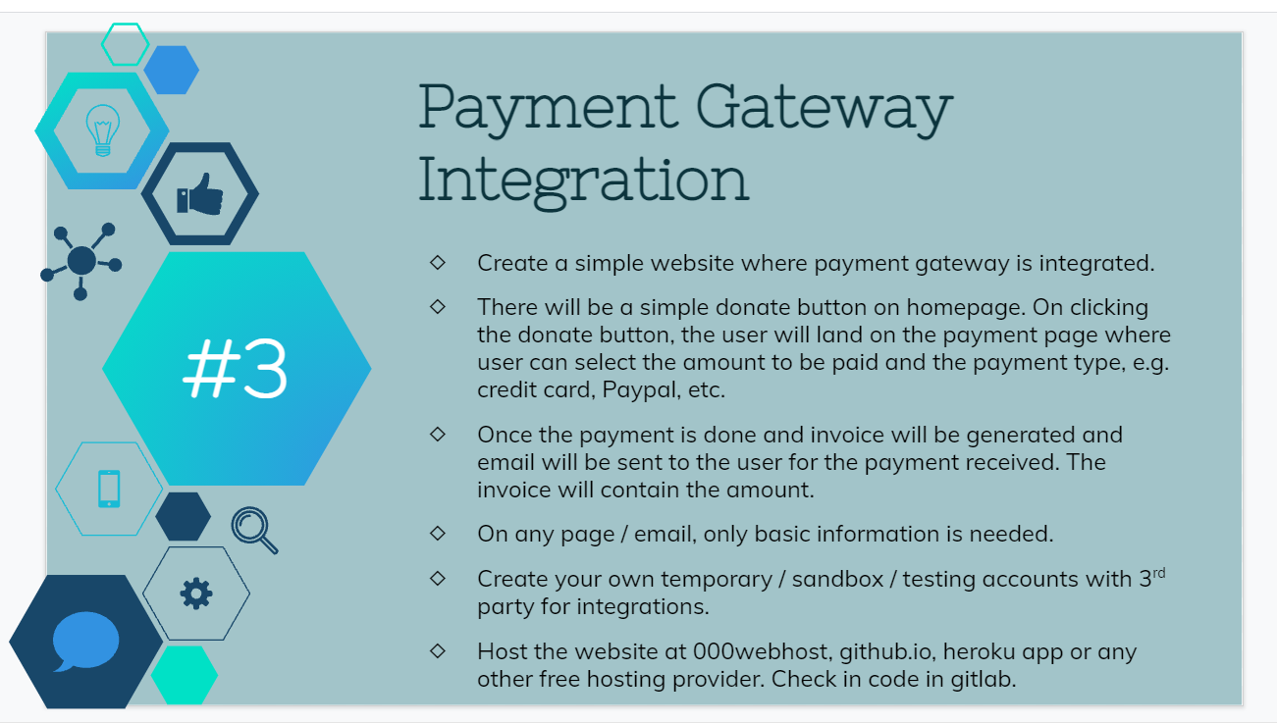
TASK NUMBER-3

Slide 4
THANK YOU
MEGHA C

