Slide 1
Project : Football Data Analysis

Slide 2
INTRODUCTION
Football is a global, popular and dynamic sport with many different factors that can influence the outcome of a match.
Football data analysis is the process of collection, cleaning and analyzing data to extract valuable insights.
The objective of this project is to analyze a football dataset to identify key factors for success , specifically within areas such as player performance, team tactics, fan behaviour, and injury analysis.
Extract actionable insights from the data that can be used to enhance decision-making in football.

Slide 3
DATA DESCRIPTION
The football dataset is a structured data, which includes 3809 rows and 48 columns in the data.
The column names which are used for data analysis :
Player Name : Name of the Player
Competition Type : Type of the competition
Date : Date of game
Goals : Number of goals scored by the player
Assists : Number of assists made by the player
Home Club Goals : Number of goals scored by the home club
Away Club Goals : Number of goals scored by the away club
Home Club Name : Name of the home club
Away Club Name : Name of the away club
Market Value : Current market value of the player in euros
Position : Main playing position of the player
Yellow cards : Number of yellow cards received by the player
Red cards : Number of red cards received by the player
Foot : Preferred foot of the player
Stadium : Name of the stadium where the game was played
Attendance : Number of attendees at the game
Referee : Name of the referee for th game
Minute : Minute of the game when the event occurred
Type : Type of the game event
Season : Season of the game
Country of Birth
Height : Height of player in centimeters
Date of Birth : Date of birth of the player
Player Id : Unique identifier for each player
Game Id : Unique identifier for each game

Slide 4
BUSINESS FOCUS AREA
Performance Analysis
Player Profile and Market Value
Team Comparison
Attendance and Stadium Analysis
Referee Analysis
Substitution Patterns
Event Analysis
Competition Analysis
Player Attributes and Demographics
Contract Management

Slide 5
DATA PREPROCESSING
Import the libraries
Read the files
Level 0 Analysis : Understanding Data
* Check the Shape
* Nature of Dataset
* Check the null values
4. Data Merging : Using the ‘.merge’ function in python
Data Cleaning
* Remove redundant columns from the dataset
* Check null values and perform null values treatment
* Save the cleaned file
* Create a data dictionary for the cleaned data

Slide 6
FOCUS AREAS AND OBJECTIVES
Focus Area | Objective 1 | Objective 2
1. Performance Analysis | Evaluate and analyze player performance based on various metrics such as goals, assists, yellow cards, red cards and minutes played. | Assess team performance in terms of home and away goals, club positions.
2. Player Profile and Market Value | Analyze player performance metrics such as goals, assists, and minutes played to identify undervalued players with high potential. | How do players' positions and dominant foot influence their yellow and red card counts throughout the season?
3. Team Comparison | How do home and away goals compared across different teams , considering their league positions ? | What is the relationship between match attendance and team performance( home and away goals) across different stadiums ?
4. Attendance and Stadium Analysis | Analyze attendance data over different stadiums. | Analyze attendance data over different competition types
5. Referee Analysis | Evaluate referee performance based on metrics such as cards issued, and on the basis of different leagues. | Identify the referees who issued the maximum number of yellow cards.

Slide 7
FOCUS AREAS AND OBJECTIVES
Focus Area | Objective 1 | Objective 2
6. Substitution Patterns | How do substitution impact the final match outcome based on goals, assists and player positions ? | Which player position benefit most from substitution in terms of performance metrics like goals and assists ?
7. Event Analysis | How does the timing of key events( goals, cards, substitution) influence final match scores ? | What is the distribution of event types across different player positions ?
8. Competition Analysis | How do attendance figures vary across different competition types and seasons ? | Which Competition have the highest average goals scored per match ?
9. Player Attributes and Demographics | How do the market value of players vary based on their country of birth and position ? | Identify correlations between player attributes (e.g., height) and performance metrics (e.g., goals scored) to optimize team composition.
10. Contract Management | Monitor top 10 players by market value and analyze their contract expiration dates | Analyze players and their contract expiration dates based on their playing position.

Slide 8
Focus Area 1 : Performance Analysis
Business Requirement 1 : Evaluate and analyze player performance based on various metrics such as goals, assists, yellow cards, red cards and minutes played.
A) Top Performer based on goals and assists
B) Number of red cards, yellow cards and average minutes played
Interpretation : The top performer based on goals scored is Aron Johannsson. He has received 1 red card and 18 yellow cards, with an average of 65 minutes played per game. The top performer based on number of assists is Christian Pulisic.
Business Requirement 2 : Assess team performance in terms of home and away goals, club positions.
A) Top Team Performance based on home goals
B) Top Team Performance based on away goals.
Interpretation : The club 'Football Club Utrecht' has the maximum number of home goals, but its away goals are much fewer compared to its home goals. This implies that the club is not performing well in away matches. In contrast, the club 'Fortuna Dusseldorf' has the maximum number of away goals, and its home goals and away goals are almost equal in number. This suggests that the club is performing well in both home and away matches. The club position of Fortuna Dusseldorf is better than Football Club Utrecht.

Slide 9
Focus Area 2 : Player Profile and Market Value
Business Requirement 1 : Analyze player performance metrics such as goals, assists, and minutes played and player attributes (age) to identify undervalued players with high potential.
A) Player Performance
B) Undervalued Players
Interpretation : Christian Pulisic has the highest market value, but Aron Johannsson has more than twice as many goals. Additionally, their number of assists and average minutes played are nearly identical. But Christian Pulisic is 8 years younger than Aron Johannsson. Therefore, Aron Johannsson can be considered the undervalued player.
Business Requirement 2 : How do players' positions and dominant foot influence their yellow and red card counts throughout the season?
A) Player’s positions and dominant foot
B) Player’s yellow and red cards count
Interpretation : Maximum number of yellow cards and red cards are issued to the right foot defender.

Slide 10
Focus Area 3 : Team Comparison
Business Requirement 1 : How do home and away goals compare across different teams, considering their league positions?
A) Home and Away Goals
B) League Positions
Interpretation : By creating a dual-axis bar chart, we can analyse the teams which have performed well both in home and away matches. The league position of the teams depends upon the number of goals scored by the team. The club 'Football Club Utrecht’ performed really well in the home matches but in the away matches the performance is bad.
Business Requirement 2 : What is the relationship between match attendance and team performance (home and away goals) across different stadiums?
A) Team Performance
B) Match Attendance
Interpretation : There is a positive relation between the numbers of goals scored and the number of attendees. ‘Signal Iduna Park’ has the maximum number of attendees and the number of home club goals are highest.

Slide 11
Focus Area 4 : Attendance and Stadium Analysis
Business Requirement 1 : Analyze attendance data over multiple stadiums.
A) Attendance Data
B) Stadium Analysis
Interpretation : ‘Signal Iduna Park’ Stadium has maximum number of attendees.
Business Requirement 2 : Analyse attendance data over different competition types.
Number of attendees
B) Competition Types
Interpretation : Maximum number of people like to watch Domestic league matches in the stadium.

Slide 12
Focus Area 5 : Referee Analysis
Business Requirement 1 : Evaluate referee performance based on metrics such as Yellow cards and red cards and on the basis of different leagues.
A) Different type of leagues
B) Metrics( Different Cards)
Interpretation : Maximum number of yellow cards are issued in domestic league matches.
Business Requirement 2 : Identify the referees who issued the maximum number of yellow cards.
A) Referees
B) Number of yellow cards issued
Interpretation : The referee who issued the maximum number of yellow cards is Felix Zwayer.

Slide 13
Focus Area 6 : Substitution Patterns
Business Requirement 1 : How do substitutions impact the final match outcome based on goals, assists, and player positions?
A) Player Positions
B) Timing of Substitutions
Interpretation : Late substitution in attack position results in scoring more goals and assists.
Business Requirement 2: Which player positions benefit most from substitutions in terms of performance metrics like goals and assists?
A) Performance Metrics
B) Beneficial Position
Interpretation : Player 'Attack' Position benefits most from the substitution in terms of performance metrics.

Slide 14
Focus Area 7 : Event Analysis
Business Requirement 1 : How does the timing of key events (goals, cards, substitution) influence final match scores?
A) Timing of key events
B) Substitution timings
Interpretation : Mid Substitution timing of player 'Aron Johannsson' results in maximum goals.
Business Requirement 2 : What is the distribution of event types across different player positions?
A) Event types
B) Player Positions
Interpretation : The maximum type of distribution of event types( Goals + Assists + Cards) is shown across 'Attack' Player Position.

Slide 15
Focus Area 8 : Competition Analysis
Business Requirement 1 : How do attendance figures vary across different competition types and seasons?
A) Attendance data
B) Competition types and season
Interpretation : For each competition type , attendance figures show an upward trend for season 2014 to 2016.
Business Requirement 2 : Which competitions have the highest average goals scored per match?
A) Competition type
B) Average goals scored
Interpretation : The competition type which has highest average goals scored per match is Domestic League.

Slide 16
Focus Area 9 : Player Attributes and Demographics
Business Requirement 1 : How does the market value of players vary based on their country of birth and position?
A) Market Value
B) Country of Birth and Position
Interpretation : The market values of players who plays on position ‘Attack’ is highest and the country of birth is USA.
Business Requirement 2 : Identify correlations between player attributes (e.g., height) and performance metrics (e.g., goals scored) to optimize team composition.
A) Height of player
B) Goals scored
Interpretation : The height of players between 184 - 186 cm scores the maximum number of goals.

Slide 17
Focus Area 10 : Contract Management
Business Requirement 1 : Monitor top 10 players by market value and analyze their contract expiration dates .
A) Market value
B) Contract expiration date
Interpretation : Seven players out of top ten players have their contract expiration date in year 2025.
Business Requirement 2 : Analyze players and their contract expiration dates based on their playing position.
A) Playing position
B) Contract expiration dates
Interpretation : Maximum number of players have their contract expiration date in year 2025 and their playing position is Defender.

Slide 18
SUMMARY
Aron Johannsson excelled in goal-scoring while Christian Pulisic led in assists. Despite similar playing minutes, Pulisic's younger age indicates higher future potential. Johannsson, with his higher goal count and similar assists, is identified as undervalued compared to Pulisic.
Football Club Utrecht performed significantly better at home, whereas Fortuna Dusseldorf showed consistent performance both home and away.
Teams with balanced home and away performance tend to secure better league positions.
Signal Iduna Park recorded the highest attendance, correlating with higher home team goals.
Domestic league matches attracted the highest number of attendees, showing a preference for local competitions.
Felix Zwayer issued the highest number of yellow cards, predominantly in domestic league matches.
Late substitutions in attack positions resulted in more goals and assists, optimizing match outcome
Mid-match substitutions of certain players, like Aron Johannsson, led to peak performance in terms of goals scored.
Players in attacking positions and from the USA have the highest market values.
Players with a height between 184-186 cm scored the most goals.
Most top players have contracts expiring in 2025, indicating potential market shifts.
Defenders have the highest number of contract expirations in 2025.

Slide 19
CONCLUSION
The analysis provided critical insights into player performance, team strategies, and market dynamics. Identifying undervalued players and understanding the impact of substitutions can help teams optimize their strategies. Additionally, understanding attendance patterns and referee performance can enhance matchday experiences and governance. These insights are vital for clubs, managers, and analysts aiming to make data-driven decisions in football.
Focus on younger talents like Christian Pulisic for long-term investment.
Improve away match strategies for teams like Football Club Utrecht.
Leverage high-attendance stadiums and popular competition types to enhance fan experiences.
Monitor upcoming contract expirations to strategize renewals and transfers, particularly focusing on high-value positions and players.
By leveraging these insights, football clubs can enhance their overall performance, optimize their financial investments, and improve fan engagement.

Slide 20
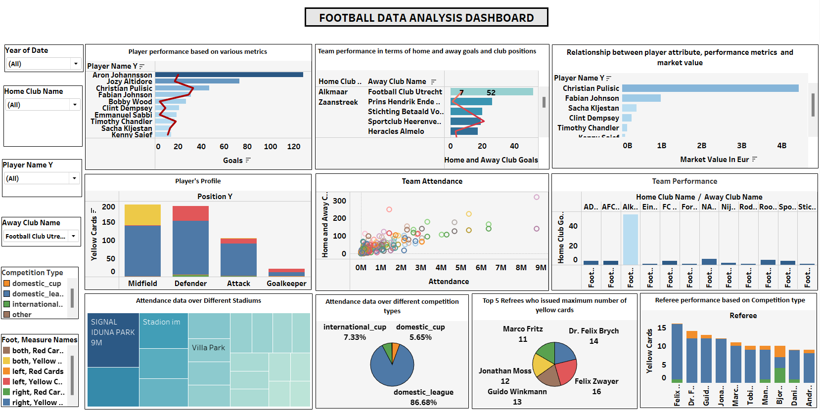

Slide 21
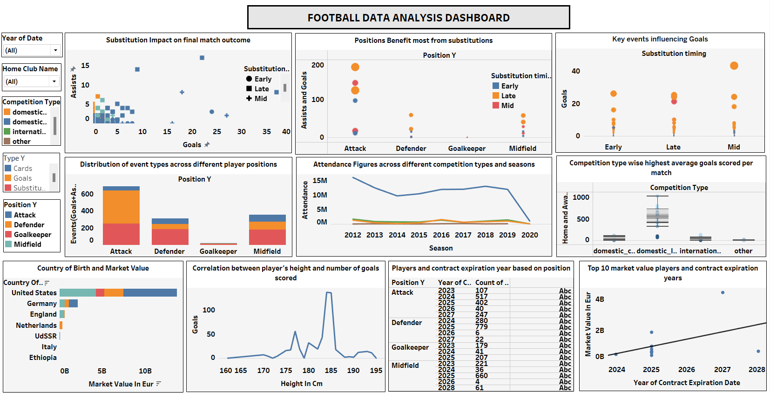

Slide 22
THANK YOU

