Slide 1
Project Name : Brazil Housing Case Study Student Name : Megha Arora Mentor Name : Jaya Pandey Batch Name : DA303S30

Slide 2
OBJECTIVES :
The goal of this presentation is to present findings from my data analysis, guiding a top real estate management firm ‘Castro Brazila Inc.’ in identifying cities suitable to the relocation of bachelors, mid-sized families, and large-sized families adapting to the work-from-home culture.
The objective is to highlight cities offering a balance of affordability, amenities, and remote work opportunities, facilitating a convenient transition for individuals and families seeking cost-effective living and remote work environments.

Slide 3
BUSINESS REQUIREMENT :
Check the cities based on expenses.
Verify whether the flat is in high-rise or low-rise building.
Assess the carpet area of flat.
Determine if the flat is furnished or unfurnished.
Evaluate the number of bedrooms, bathrooms and parking spaces.
Confirm whether pets are allowed.
Check the amount of HOA(Home Owner Tax), Property Tax and Fire Insurance
Check the rental amount.

Slide 4
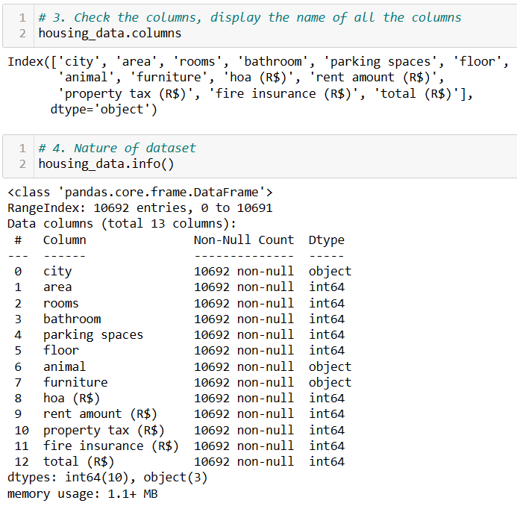
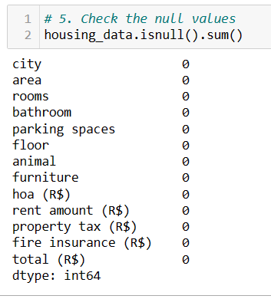
Level 0 Analysis: Understanding Data
1 . Read the File.
2. Check the top and bottom 5 rows.
3. Check the shape (number of rows and columns in the dataset.)
4. Display the name of all the columns.
5. Check the nature of the dataset.
6. Check the null values.

Slide 5
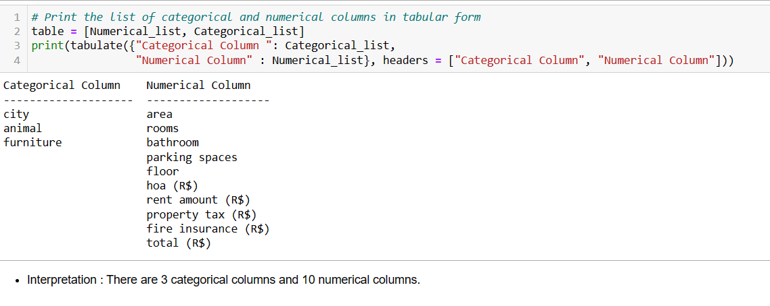
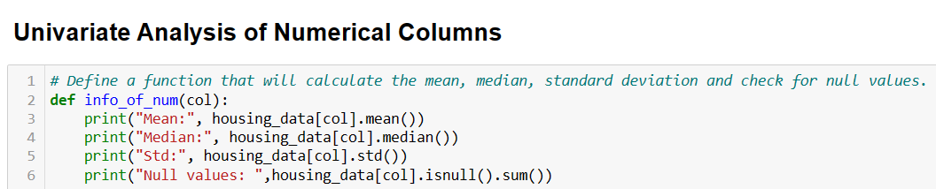
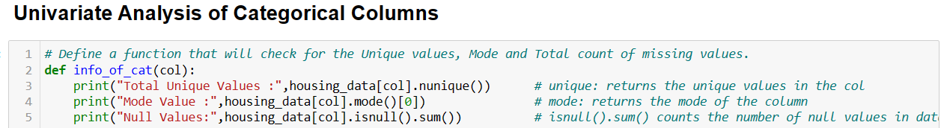
Level 1 Analysis : Univariate Analysis
1. Separate the Numerical and Categorical columns.
2. Univariate Analysis of Categorical columns .
3. Univariate Analysis of Numerical columns.

Slide 6
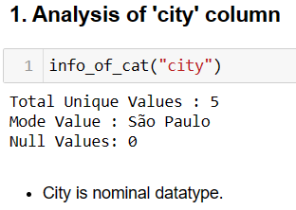
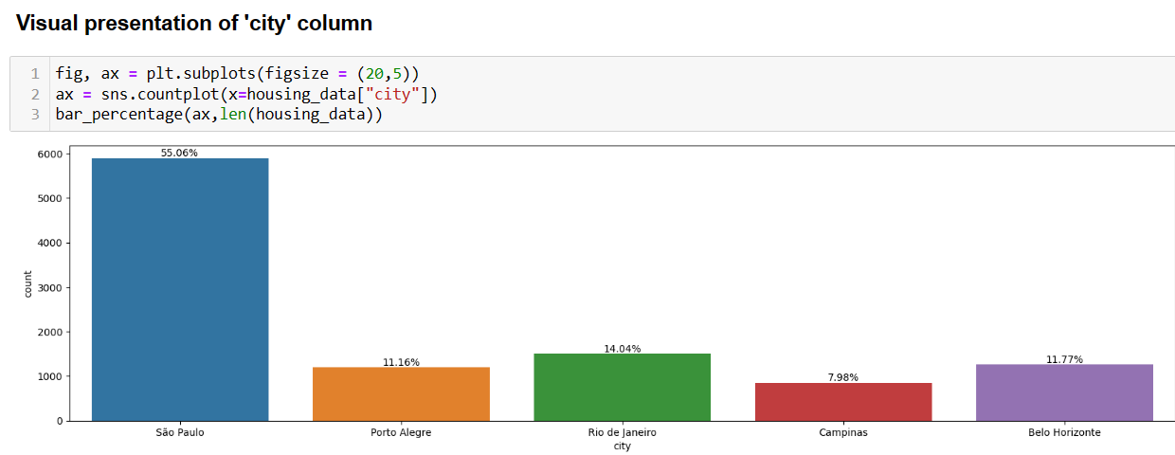
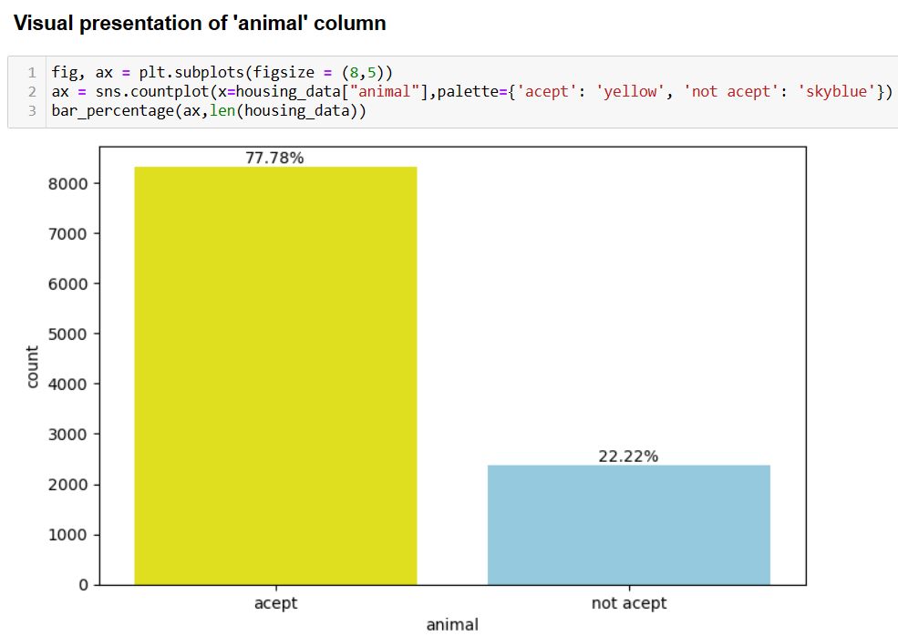
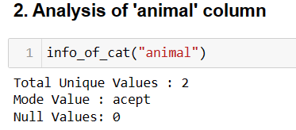
Univariate Analysis of Categorical columns

Slide 7
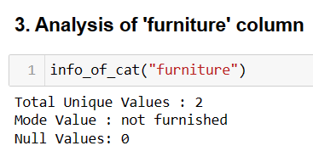
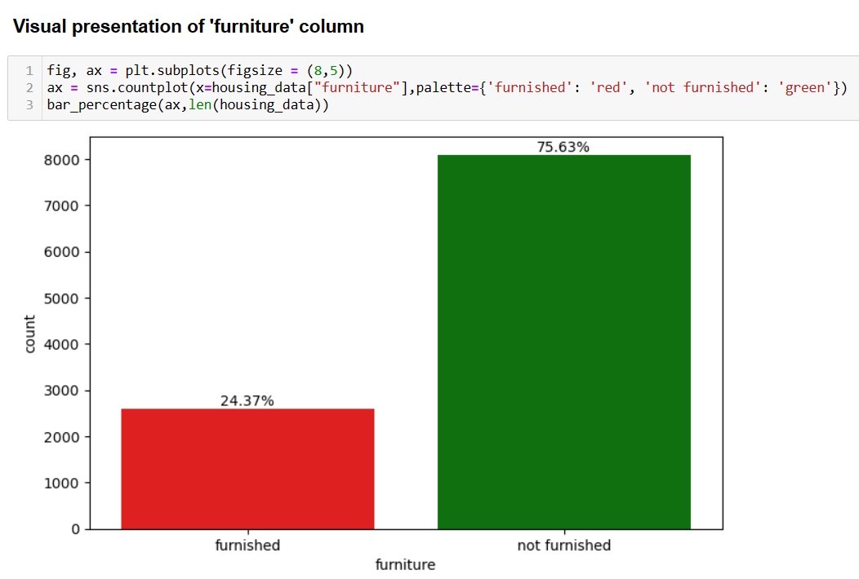

Slide 8
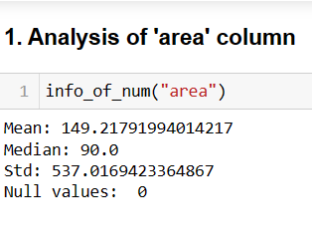
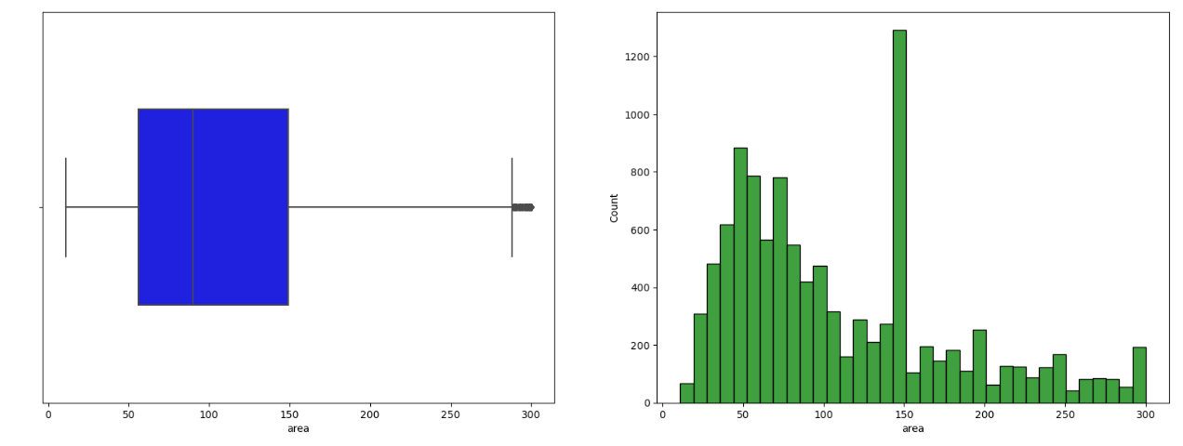
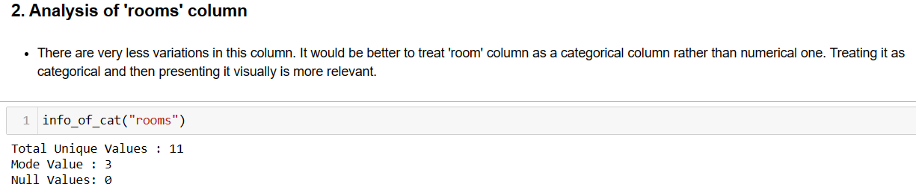
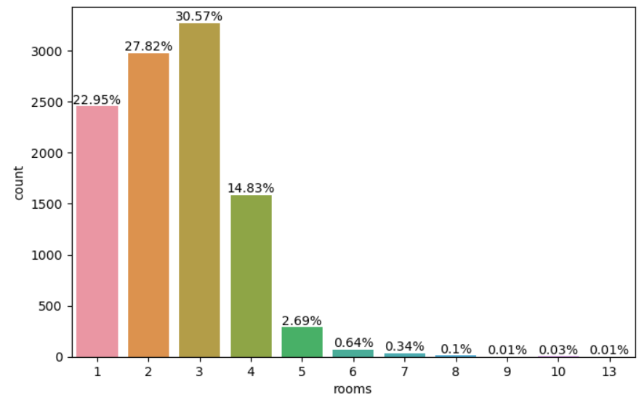
Univariate Analysis of Numerical columns

Slide 9
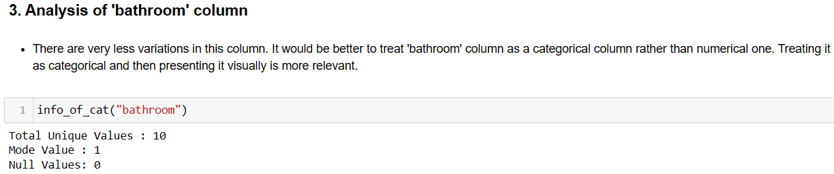
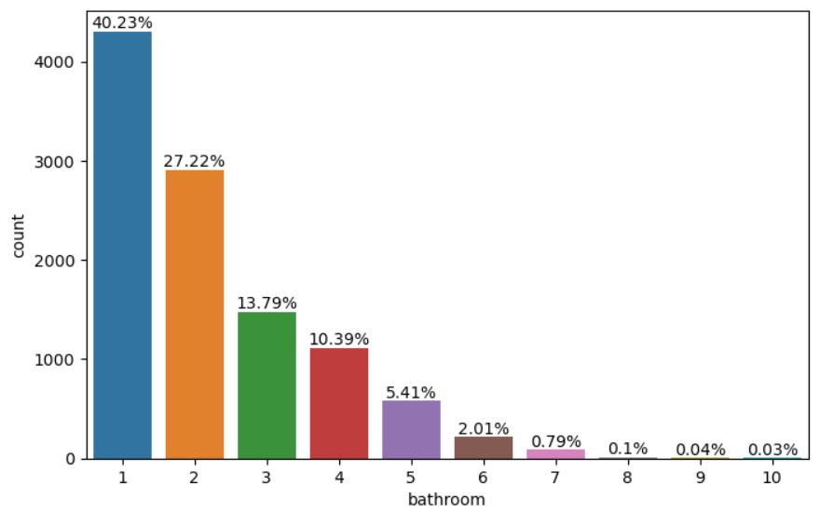
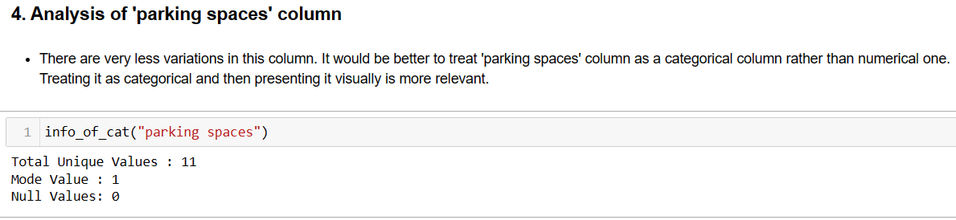
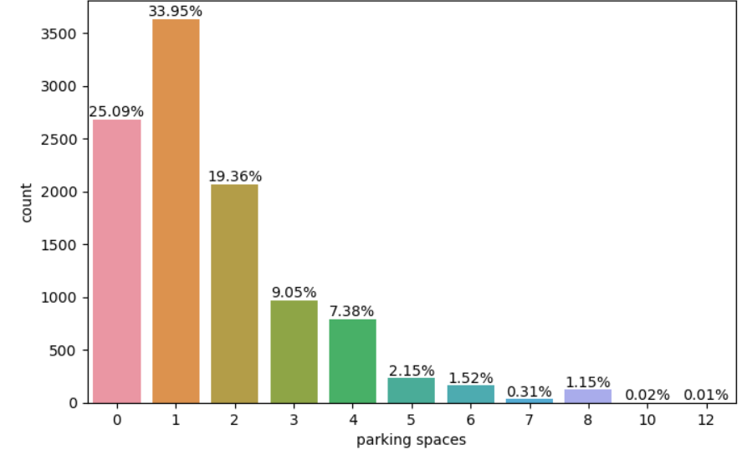

Slide 10
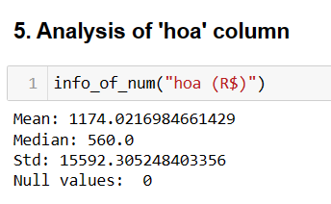
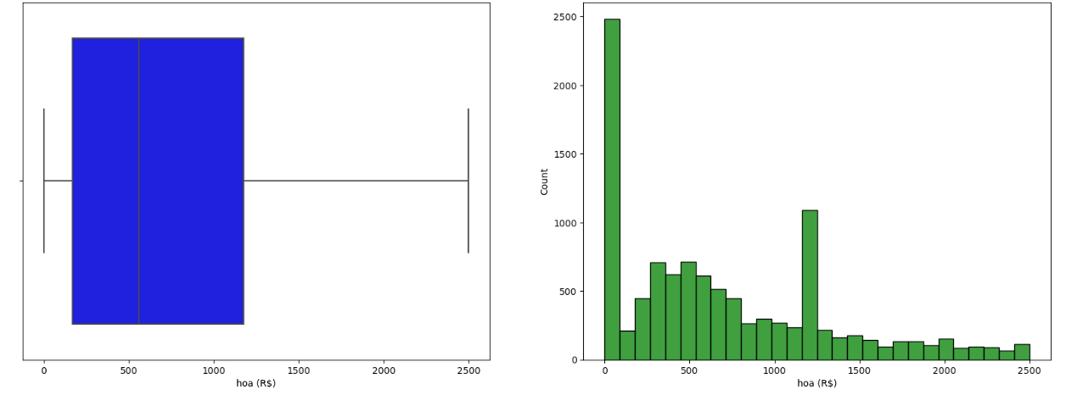
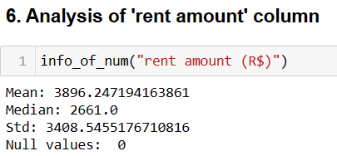
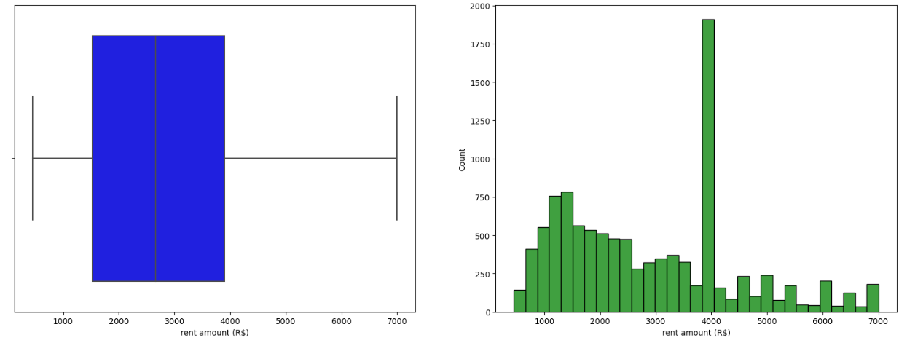

Slide 11
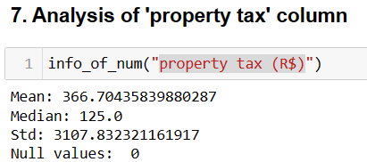
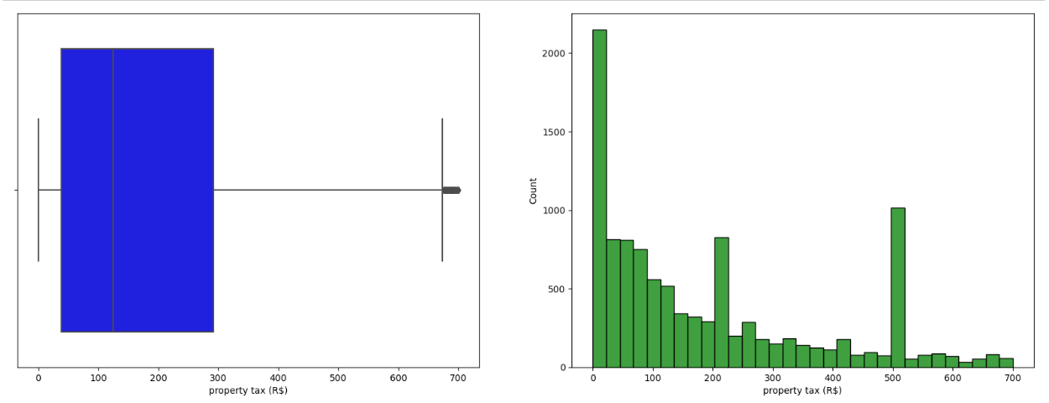
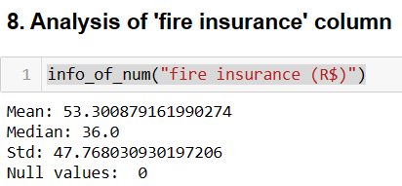
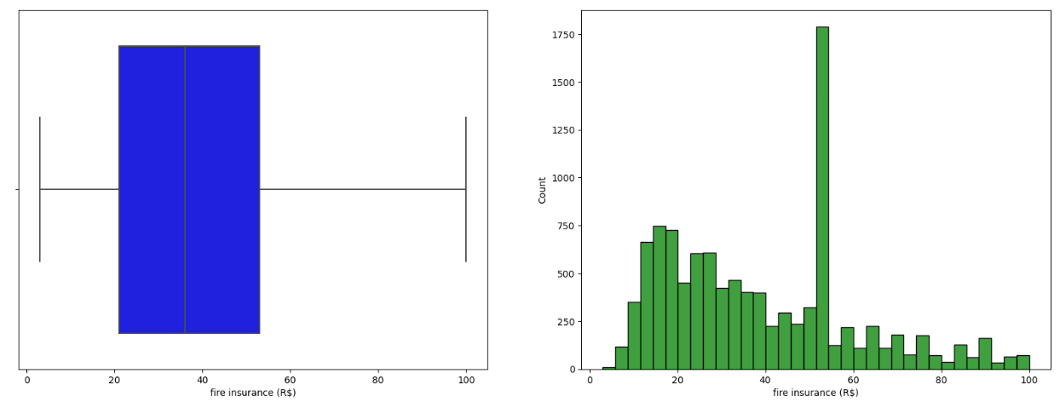

Slide 12
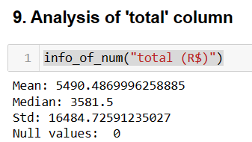
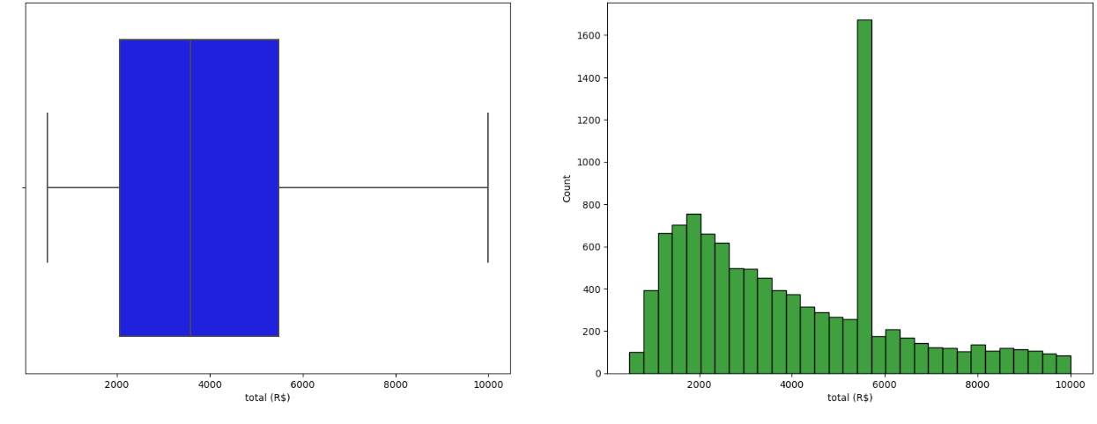
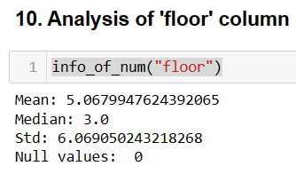
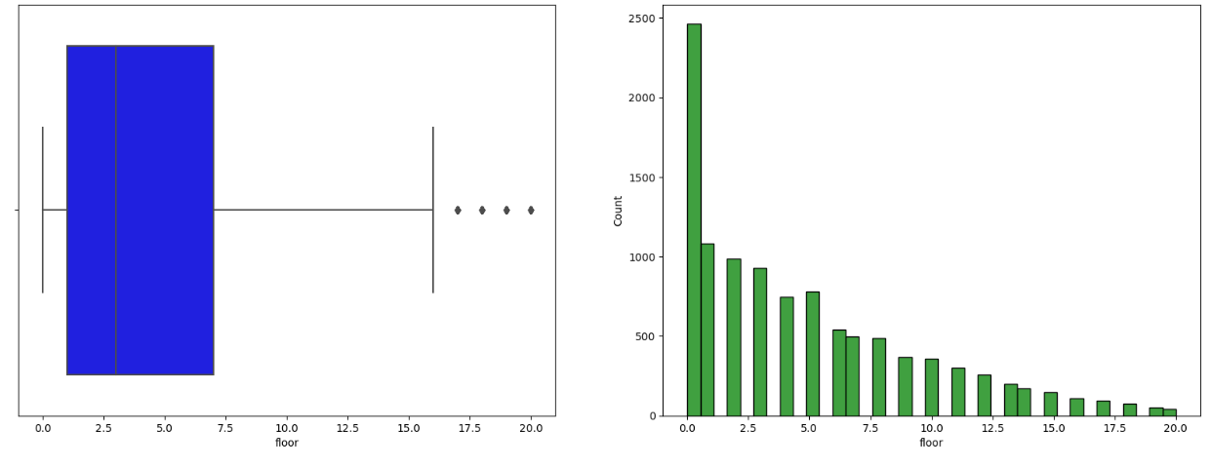

Slide 13
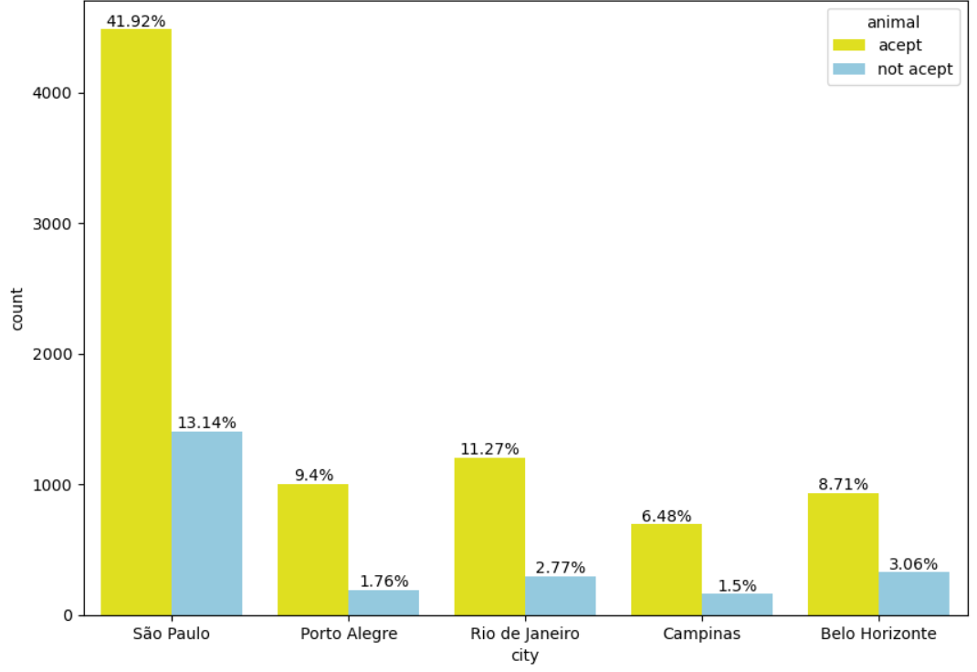
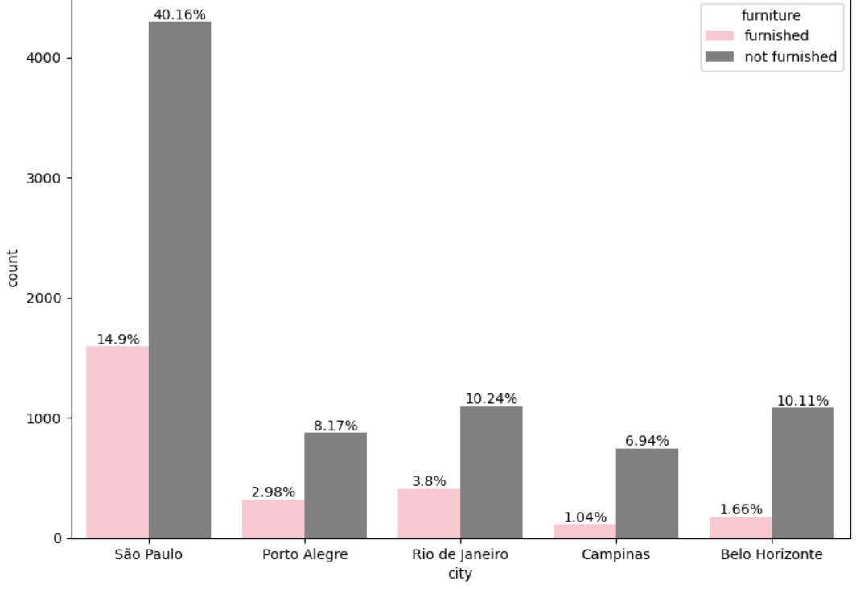
Level 2 Analysis : Bi-Variate Analysis
CAT- CAT ANALYSIS
Requirement 1:
Relationship between city and animal.
Interpretation :
41% of the flats in Sao Paulo City allow pets
which is maximum as compared to other cities.
Requirement 2:
Relationship between city and furniture.
Interpretation :
40.16% of flats in Sao Paulo city are not furnished
which is higher as compared to other cities.

Slide 14
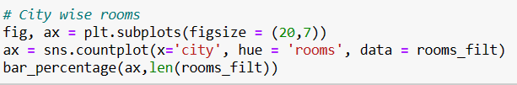
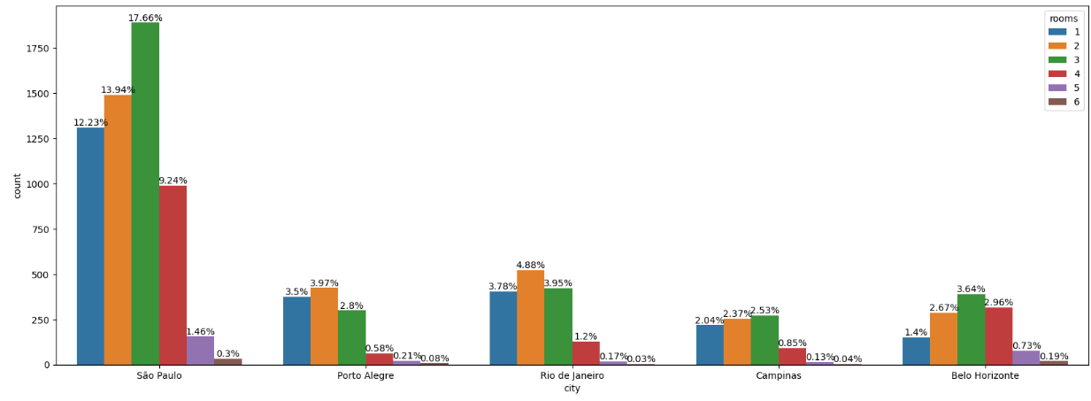
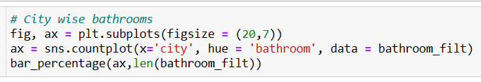
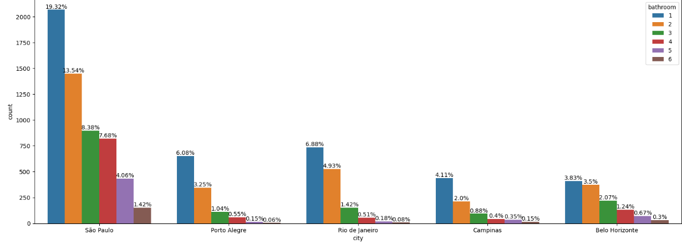
Requirement 3:
Relationship between city and rooms.
Interpretation :
Sao Paulo city has maximum variety of number of rooms as compared to other cities.
Requirement 4:
Relationship between city and bathrooms.
Interpretation :
Sao Paulo city has maximum variety of number of bathrooms as compared to other cities.

Slide 15
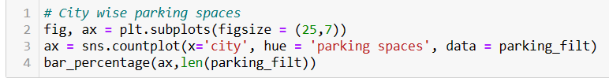
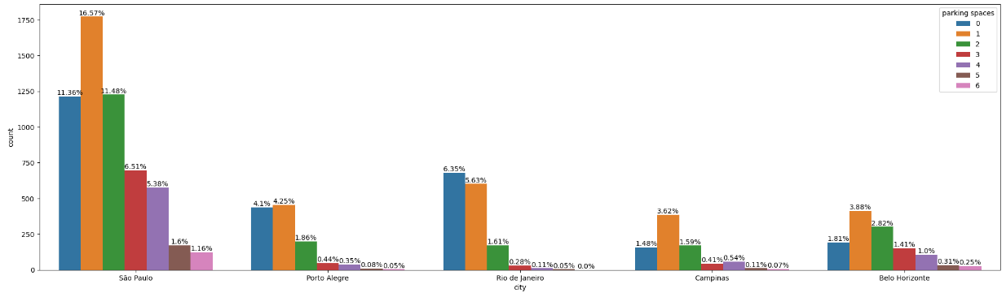
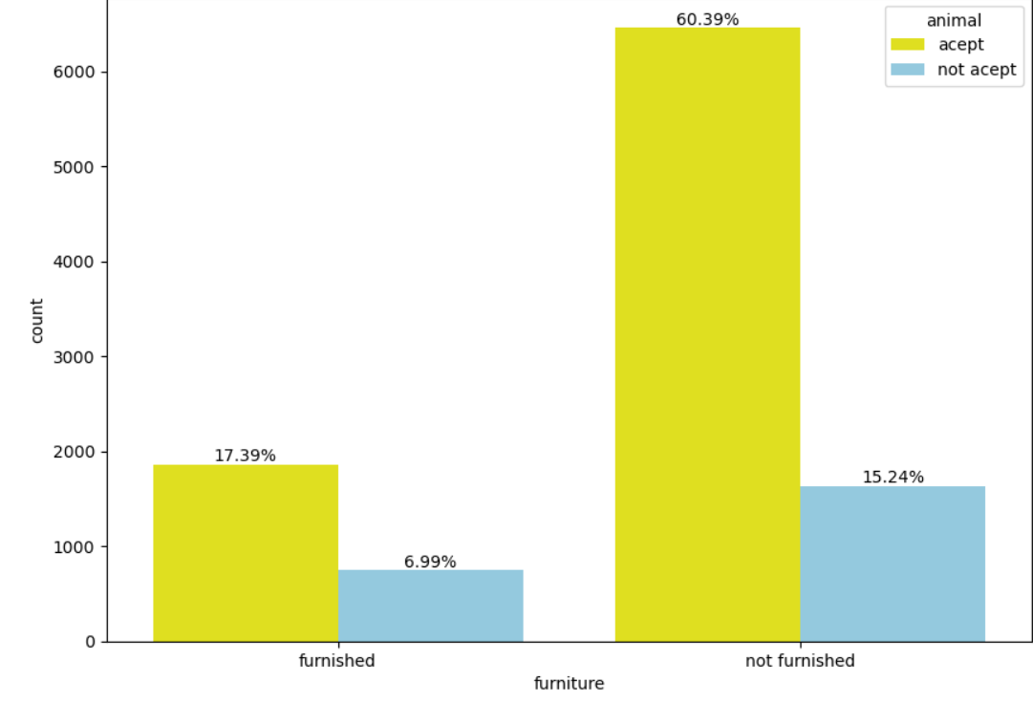
Requirement 5:
Relationship between city and parking spaces.
Interpretation :
Sao Paulo city has maximum variety of number of parking spaces as compared to other cities.
Requirement 6:
Relationship between furniture and animal.
Interpretation :
60.39% percent of flats which are not furnished allow to keep pets.

Slide 16
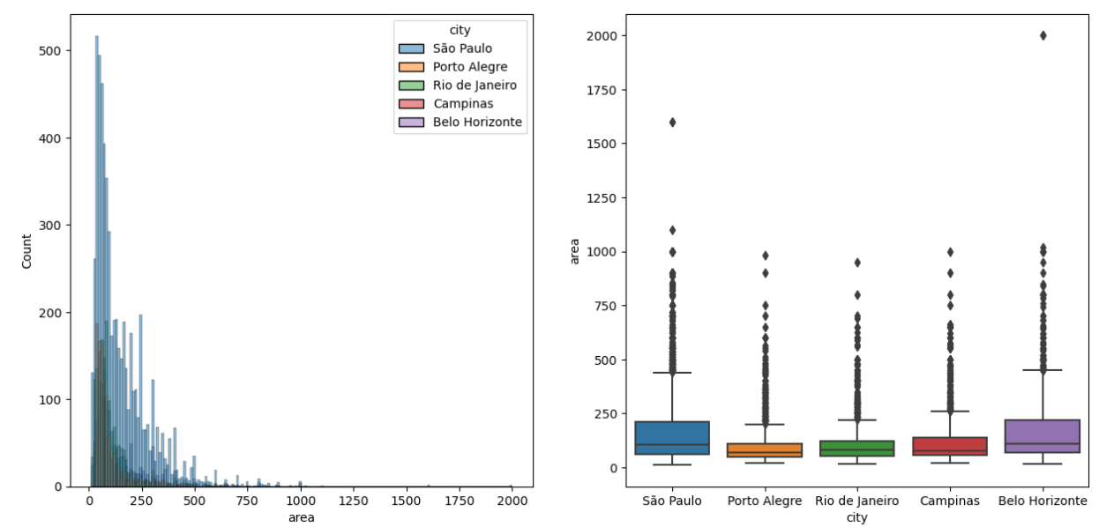
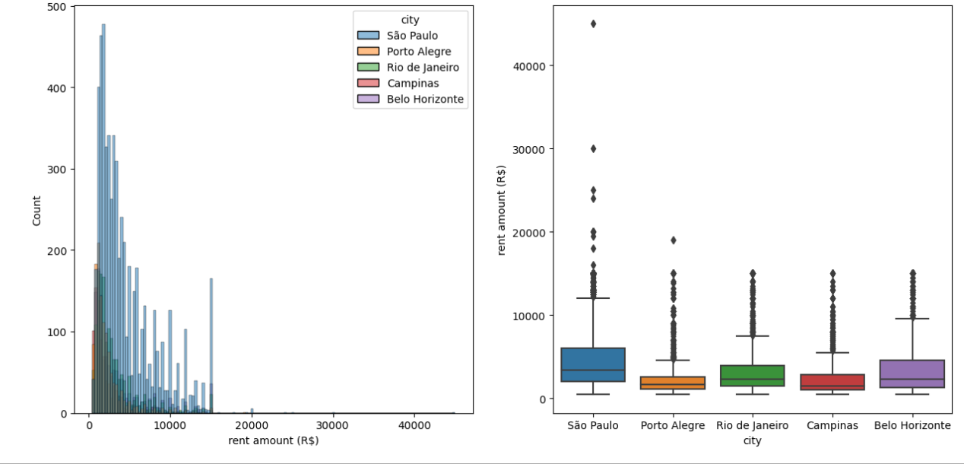
CAT – NUM ANALYSIS
Requirement 1:
Relationship between city and area.
Interpretation :
Sao Paulo and Belo Horizonte appears
to have maximum area as compared to
other cities.
Requirement 2:
Relationship between city and rent
Interpretation :
Most of the rent amount is less than 20,000. Sao Paulo appear to have generally higher rent than other cities.

Slide 17
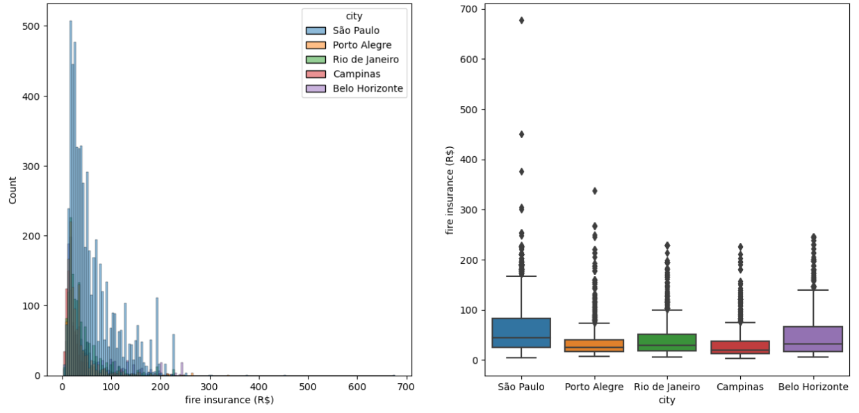
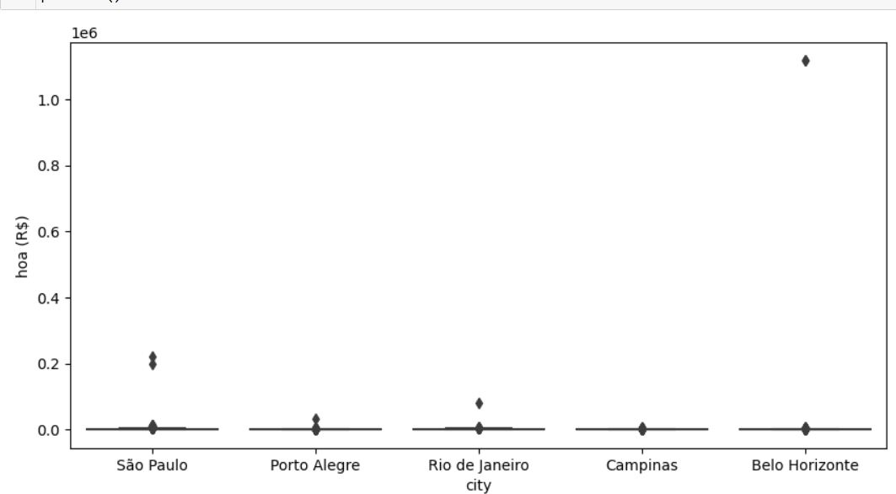
Requirement 3:
Relationship between city and Fire Insurance.
Interpretation :
The city of Sao Paulo appears to have the highest fire
insurance cost while the city of Campinas appears to
have the lowest average cost.
Requirement 3:
Relationship between city and hoa.
Interpretation :
The city of Sao Paulo appears to have the highest HOA fees, while the city of Campinas appears to have the lowest HOA fees.

Slide 18
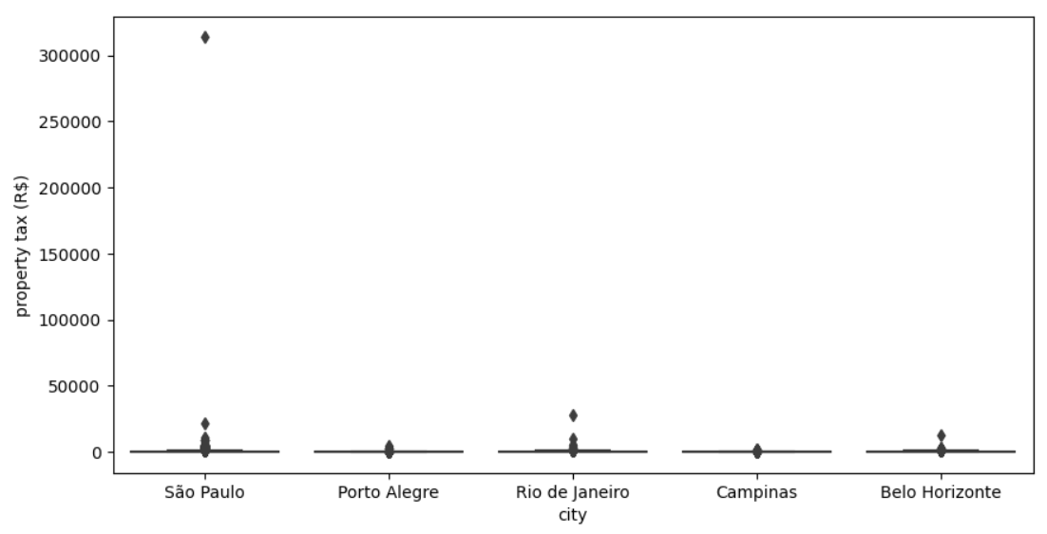
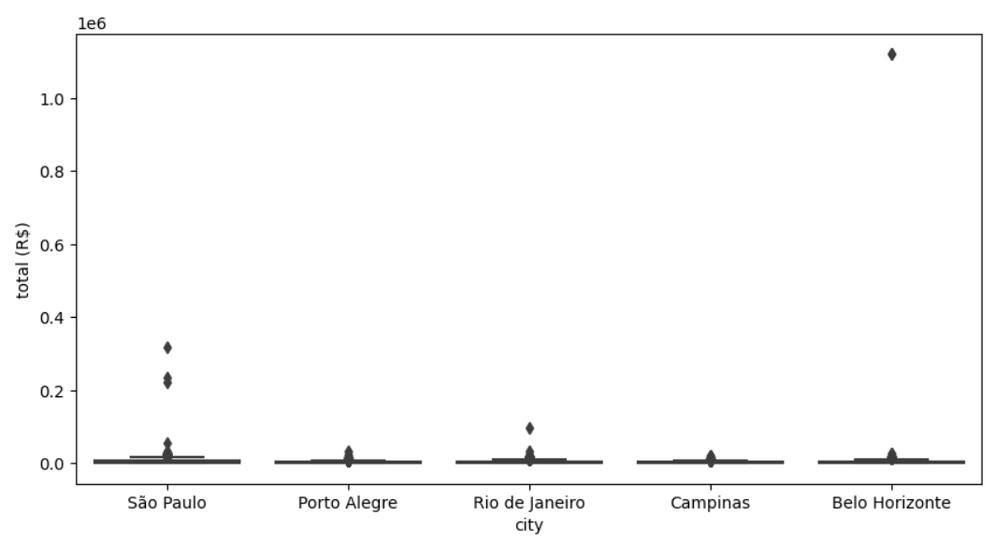
Requirement 5:
Relationship between city and Property Tax.
Interpretation :
Rio de Janeiro has the highest property taxes, while Campinas has the lowest.
Requirement 6:
Relationship between city and Total.
Interpretation :
Sao Paulo has generally higher total amount and Belo Horizonte has the lowest total amount.

Slide 19
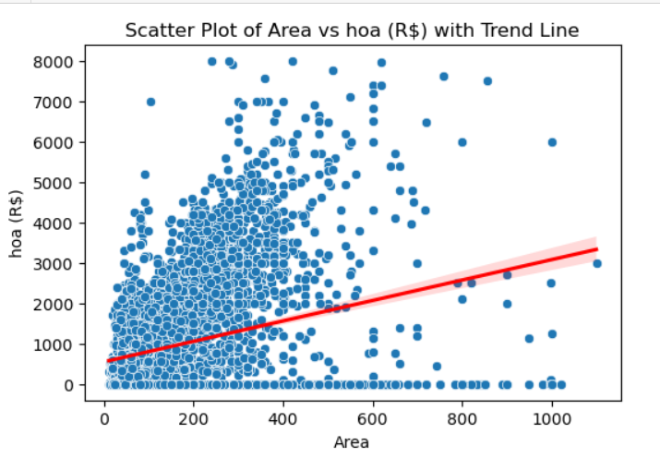
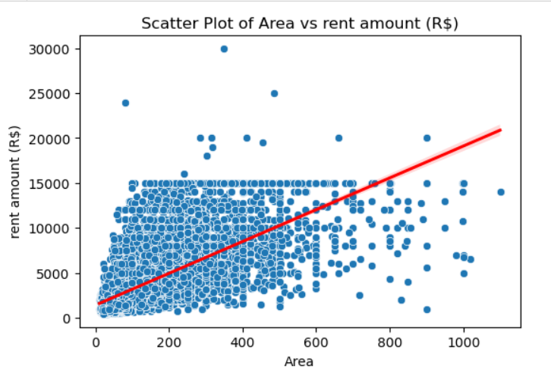
NUM – NUM ANALYSIS
Requirement 1:
Relationship between area and hoa.
Interpretation :
The data points in the scatter plot show a weak positive correlation between the area of a house and its HOA fees. This means that there is a slight upward trend, with larger houses having slightly higher HOA fees. However, the data points are spread out, so there is a lot of variability. Some large houses have lower HOA fees than some small houses.
Requirement 2 :
Relationship between area and rent.
Interpretation :
The data points in the scatter plot show a weak positive correlation between the area and rent amount. This means that there is a slight upward trend, with houses with more area having slightly higher rent. However, the data points are spread out, so there is a lot of variability. Some houses with more area have lower rent than some houses with less area.

Slide 20
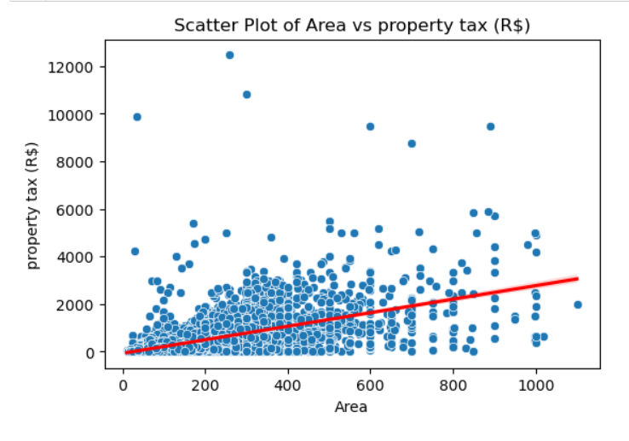
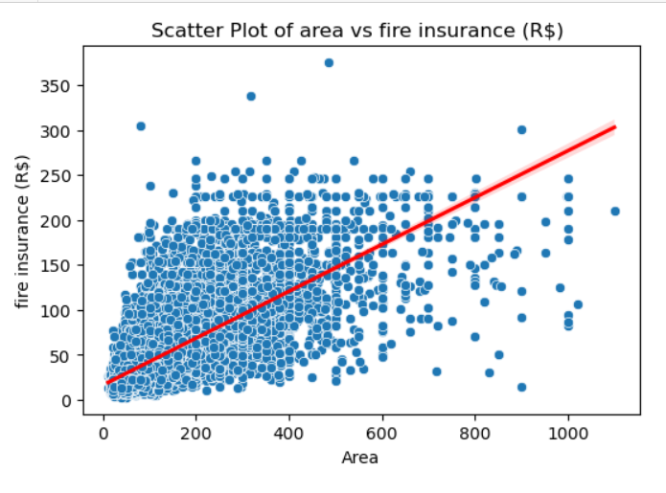
Requirement 3:
Relationship between area and property tax.
Interpretation :
The data points in the scatter plot show a weak positive correlation between the area of a property and its property tax. This means that there is a slight upward trend, with larger properties having slightly higher property taxes. However, the data points are spread out, so there is a lot of variability. Some large properties have lower property taxes than some small properties.
Requirement 4:
Relationship between area and fire insurance.
Interpretation :
The data points in the scatter plot show a weak positive correlation between the area and fire insurance. This means that there is a slight upward trend, with houses with more area having slightly higher fire insurance costs. However, the data points are spread out, so there is a lot of variability. Some houses with more area have lower fire insurance costs than some areas with less area.

Slide 21

Requirement 5:
Relationship between area and total.
Interpretation :
The data points in the scatter plot show a weak positive correlation between the area and total amount. This means that there is a slight upward trend, with areas with more area having slightly high total amount. However, the data points are spread out, so there is a lot of variability. Some houses with more area have lower total amount than some areas with less area.

Slide 22


Level 3 Analysis : Multivariate Analysis
FOR BACHELORS
Question 1 : A Bachelor named Jim wants to relocate to a new city to live and work remotely. The requirements given by Jim are as follows :
1. The city should not be expensive.
2. The flat should be 1Bhk(1bedroom + 1bathroom), furnished and should be in low-rise building.
3. There should be 1 parking space.
4. The pets should not be allowed to keep.
5. The carpet area should be between 20-40 square meters.
6. The maximum rent he can afford is 6000.
7. There should be no HOA ( Homeowner Association Tax)
8. The total amount including all taxes(property tax & fire insurance) and rent should not be greater than 8000.
Interpretation :
According to the requirements provided by the bachelor, there are three options of cities for him. But 'Belo Horizonte’ city has more house options as compared to other two.

Slide 23


FOR MID-SIZED FAMILIES
Question 2: A mid sized family wants to relocate to a new city to live and work remotely The requirements given by family are as follows :
1. The city should not be expensive.
2. The flat should be 2Bhk or 3Bhk(2/3bedroom + 2bathroom), well furnished and should be in high-rise building.
3. There should be 2 parking space.
4. The pets should be allowed to keep.
5. The carpet area should be between 60-100 square meters.
6. The maximum rent they can afford is 15000.
7. The maximum HOA ( Homeowner Association Tax) should be less than 3000.
8. The total amount including all taxes(property tax & fire insurance) and rent should not be greater than 20000.
Interpretation :
According to the requirements provided by the mid-sized family , there are three available options of the cities .But 'Campinas' has more house options as compared to other two. It is suggested that they should move to city 'Campinas'.

Slide 24


FOR LARGE-SIZED FAMILIES
Question : 3 A large sized family wants to relocate to a new city to live and work remotely The requirements given by family are as follows :
1. The city should not be expensive.
2. The flat should be 4 Bhk (3/4bedrooms + 3/4bathroom), well furnished and should be in low-rise building.
3. There should be 3/4 parking space.
4. The pets should be allowed to keep.
5. The carpet area should be between 100-200 square meters.
6. The maximum rent they can afford is 30000.
7. The maximum HOA ( Homeowner Association Tax) should be less than 5000.
8. The total amount including all taxes(property tax & fire insurance) and rent should not be greater than 60000.
Interpretation :
According to the requirements provided by the large-sized family, there are two available options of cities. But 'Belo Horizonte' has more house options as compared to the other one. It is suggested that they should move to city 'Belo Horizonte'.

Slide 25
CONCLUSION
On the basis of analysis of data, it seems that ‘Belo Horizonte’ emerges as the preferred choice according to the bachelor’s requirements and large- sized families. ‘Campinas' city is preferred among mid-sized families . These cities appears to offer a combination of suitable housing options and other amenities that meet the diverse needs of these different groups.

Slide 26
THANK YOU!

