Slide 1
data analysis on sales of a store
By Megha Vij

Slide 2

About project analysing retail sales and factors that affect weekly sales
Reason for selecting this project marketing/shopping are interesting topics
Weekly Sales

Slide 3

Data and its source
Stores
Store
Type ‘A’, ‘B’ or ‘C’.
Size
Test
Date
Store
Dept
Is holiday
Four csv files
Train
Date
Weekly Sales
Store
Dept
Is holiday
Features
Temperature
Fuel_Price
MarkDown1-5
CPI
Unemployment

Slide 4
Questions:
Question: 1 How do different types of stores (e.g., Type A, Type B, Type C) perform in terms of average weekly sales and growth over time?
Question: 2 Are there significant seasonal patterns in average weekly sales?
Question: 3 How do external factors such as temperature, fuel prices, CPI, and unemployment rates affect weekly sales?
Question: 4 How do holidays impact weekly sales? Compare the sales during holiday weeks to non-holiday weeks.
Question: 5 Do promotional offers lead to increased weekly sales?

Slide 5
BASIC STEPS :
Basic steps in this analysis:
Understanding data
Cleaning and preprocessing
Statistical Analysis
Visualization for trend analysis to answer the questions.
EDA IS AN APPROACH FOR DATA ANALYSIS USING VARIETY OF TECHNIQUES TO GAIN INSIGHTS ABOUT THE DATA

Slide 6
UNDERSTANDING DATA
(3 years information was included)
Exploring columns of all datasets(using function display)
Number of rows and columns (using shape function)
Data types for all columns in different datasets(using dtypes)
Checking count of null values (using isnull )

Slide 7
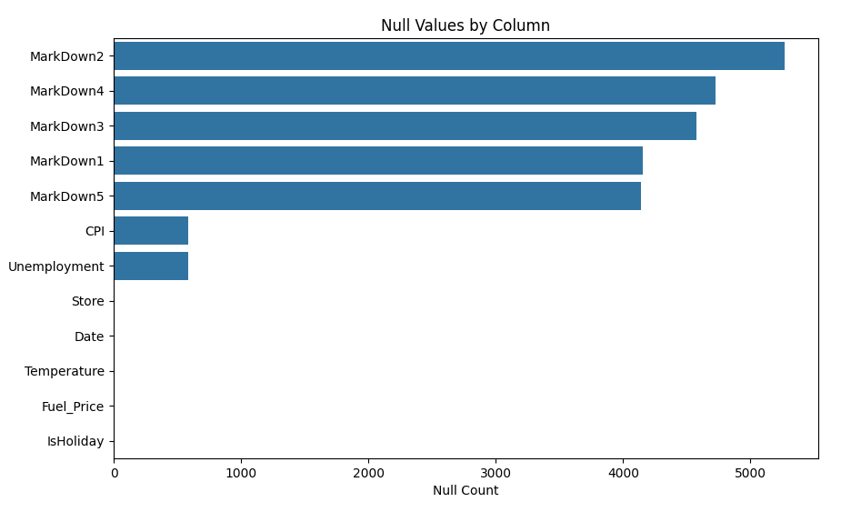
CONCLUSIONS OF EXPLORAING DATASETS AND PLAN OF ACTION
Some Features Present Only One Dataset(like Markdown , UPI , temperature, Fuel)
NULL VALUES
Null values seen in many columns but promotions had the maximum number of null values(markdown is promotional discounts or reductions in the prices of products or items offered by a retail store)
DATATYPES
Mostly numerical and a date column as object(is converted into actual date and time values. That helps to perform date-based operations on the "Date" column, such as extracting specific date components (year, month, day) or comparing dates.)
Common Columns In Datasets(date ,store, holiday Weeks)
DATA SETS

Slide 8
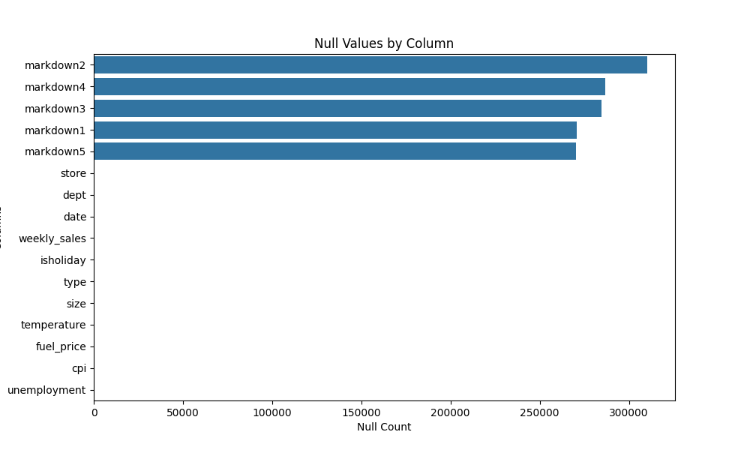
Understanding data
Merging data using join to get one table with desired columns
Reducing null values(but not of promotions which remained same)
Weekly sales, Store, Type, Department, Holiday week, Markdown, Fuel, Temperature, UPI, Date, Unemployment

Slide 9
Two columns of is holiday appear in the combined data frame,drop one of them after checking if they are same.
Change the names of the columns to lower case and remove white spaces
Checking unique values/NaN’s in all columns
Markdown value has lot of nan which later were filled with 0.
CLEAN
DATA

Slide 10
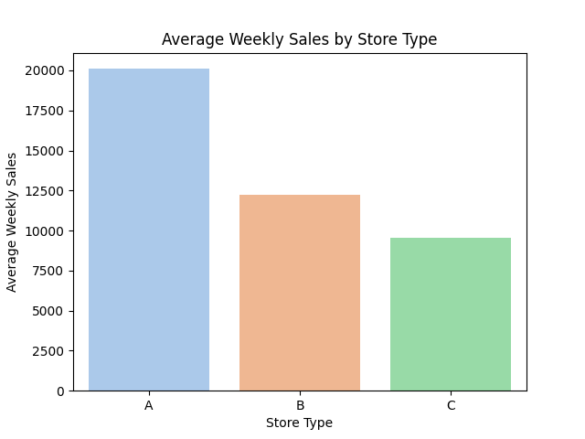
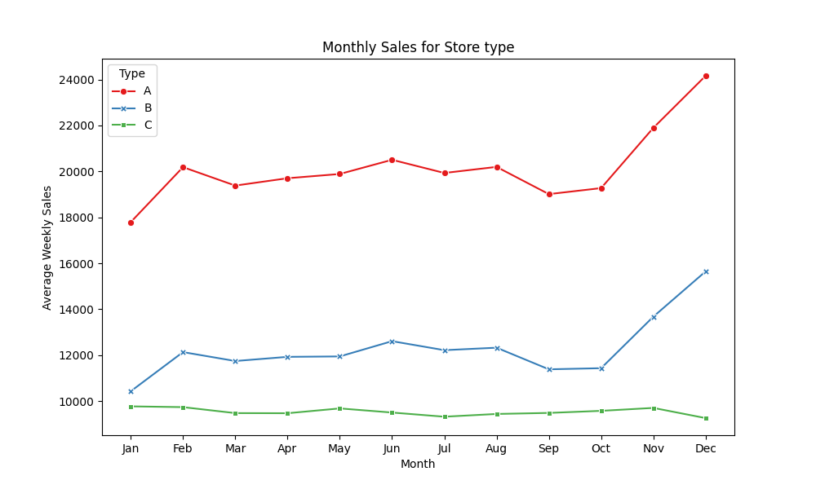
Question 1
Store Performance Comparison
AVERAGE WEEKLY SALES BY STORE TYPES
MONTHLY CHANGE IN AVERAGE WEEKLY SALES

Slide 11
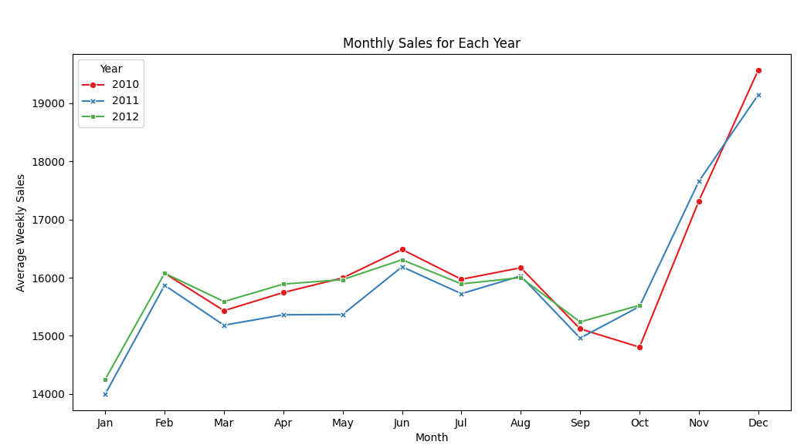
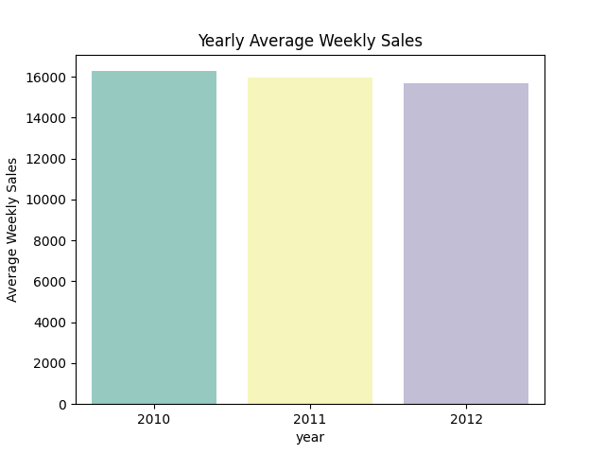
Question 2
Seasonal Sales Patterns
OVERALL WEEKLY SALES BY year
MONTHLY SALES FOR EACH YEAR

Slide 12
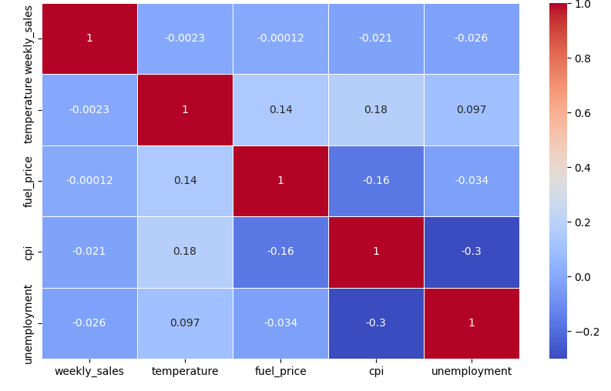
Question 3
Impact of External Factors
correlation heatmap

Slide 13
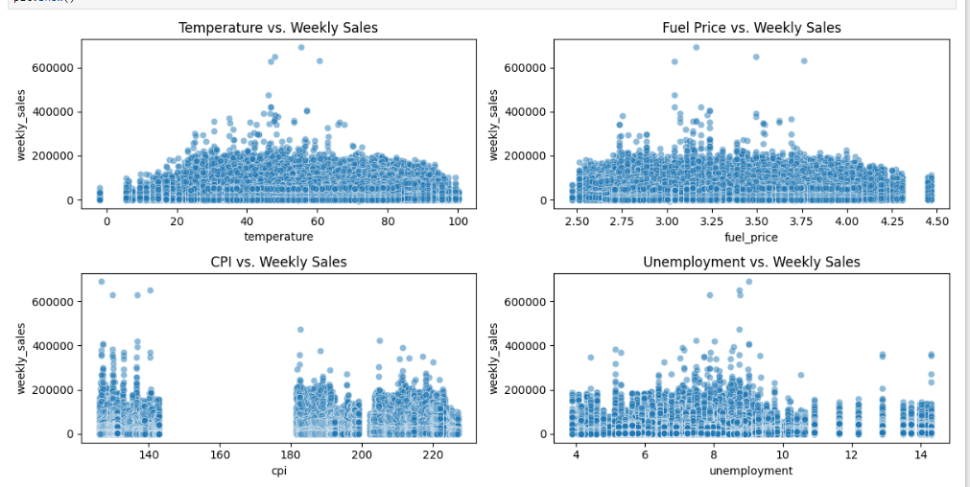
Question 3
Impact of External Factors
Scatter plots

Slide 14
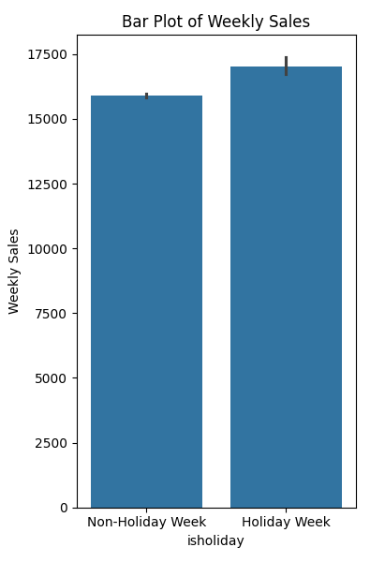
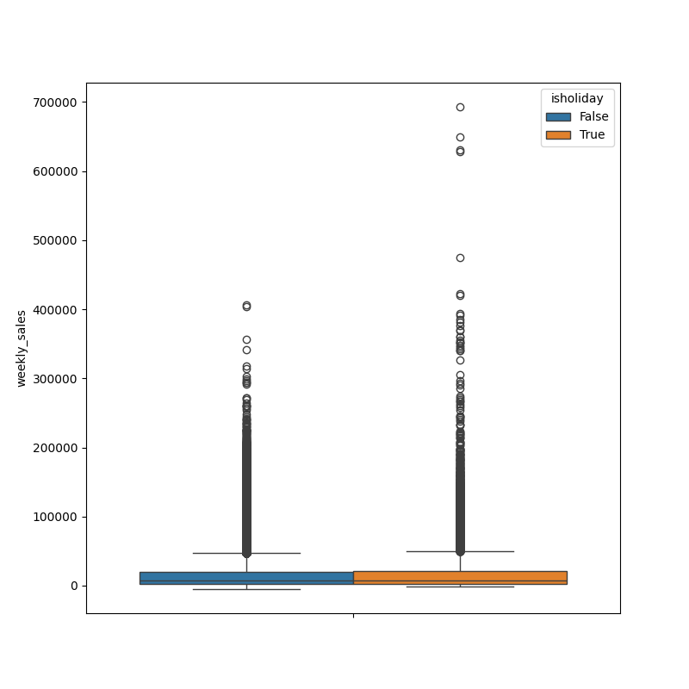
Question 4
Holiday Sales Analysis
mean sales between holiday and non-holiday weeks
Box plots for holiday and non-holiday weekly sale

Slide 15
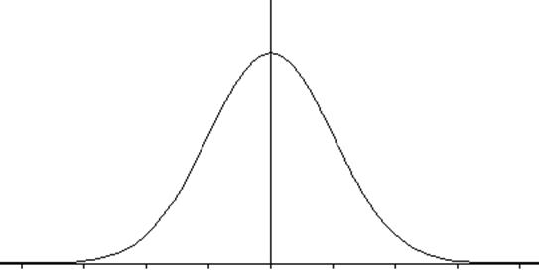
Hypothesis test-to determine if there is a statistically significant difference in mean sales between holiday weeks and non holiday weeks.
(H0) assumes that there is no difference in mean sales between the two groups
Two tailed
t-test to find
t-statistic
p-value.
(H1) points that there is a significant difference in mean sales between the two groups.
mean sales (p-value: 1.0912222677432845e-16)
Very less p value , hypothesis rejected

Slide 16
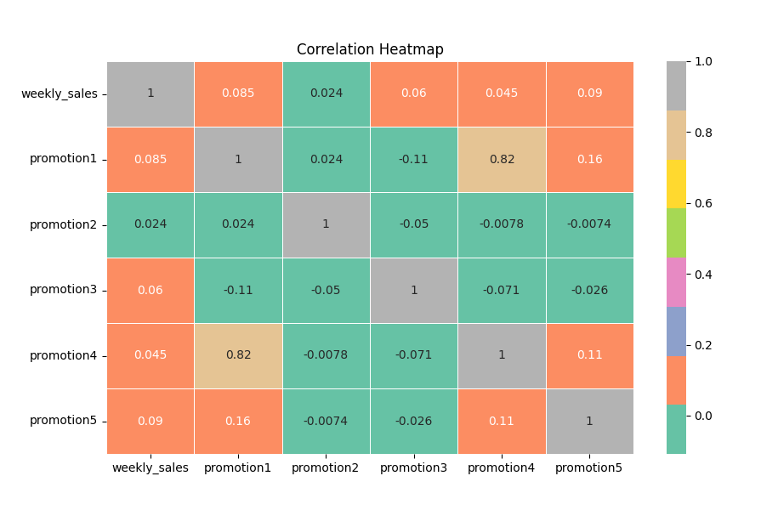
Question 5 promotions Impact
correlation heatmap
markdown is promotional discounts or reductions in the prices of products or items offered by a retail store.

Slide 17
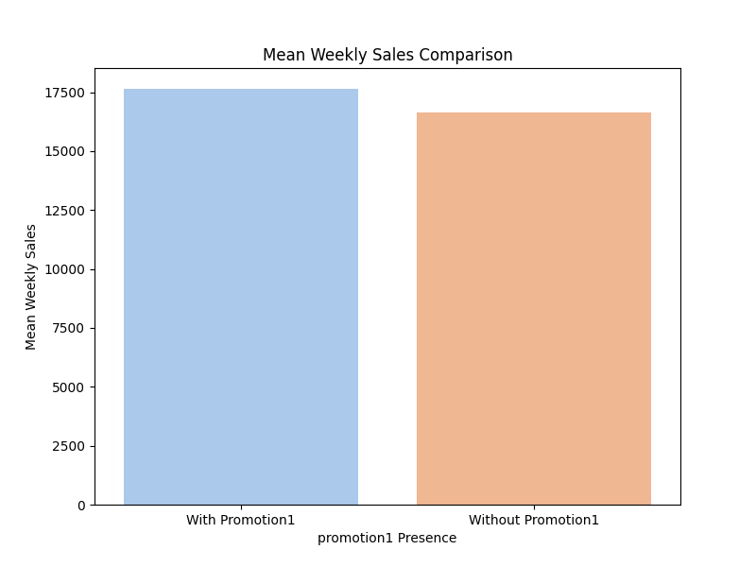
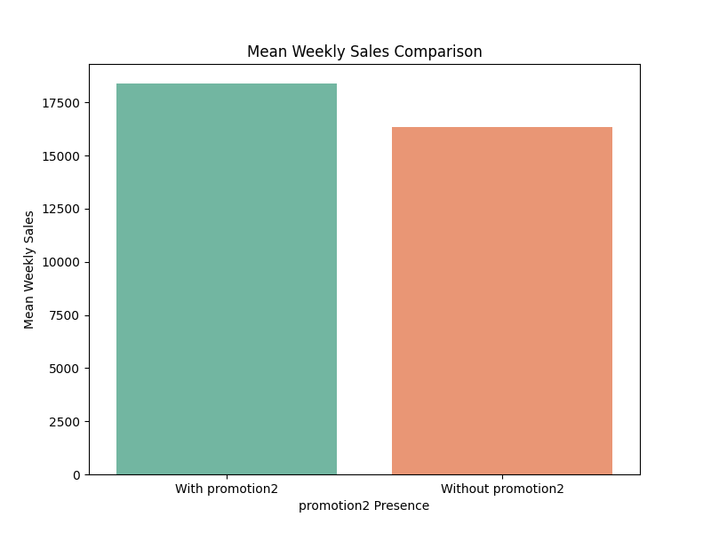
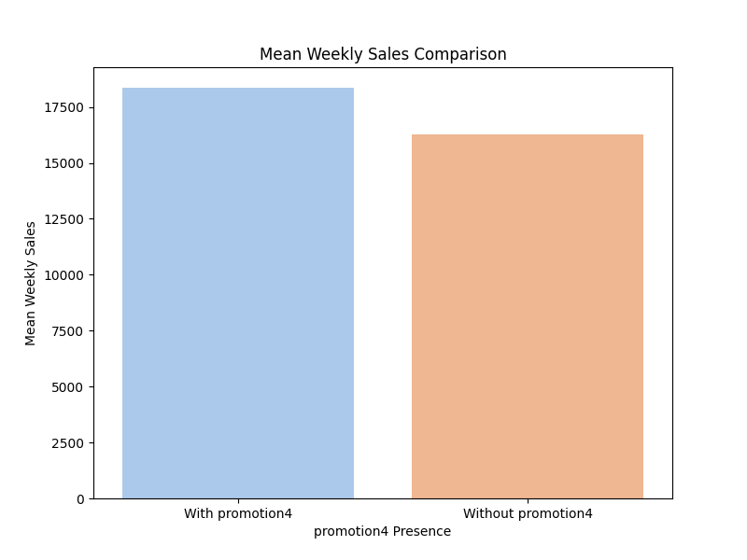
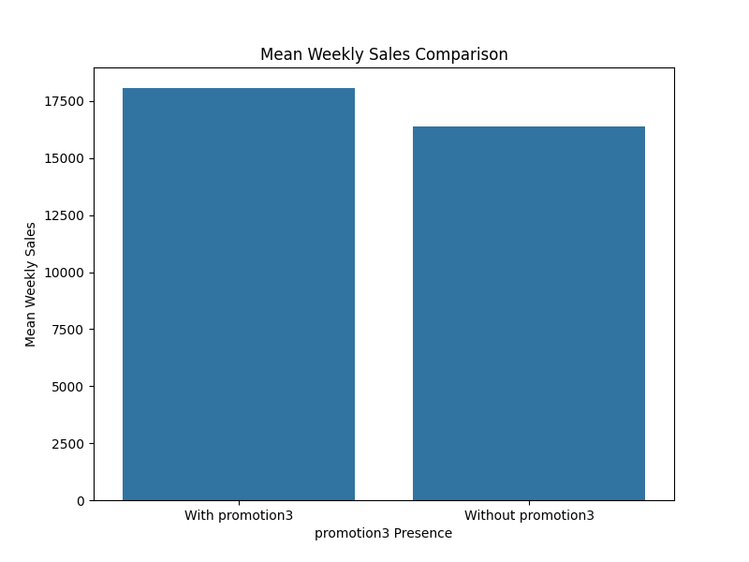
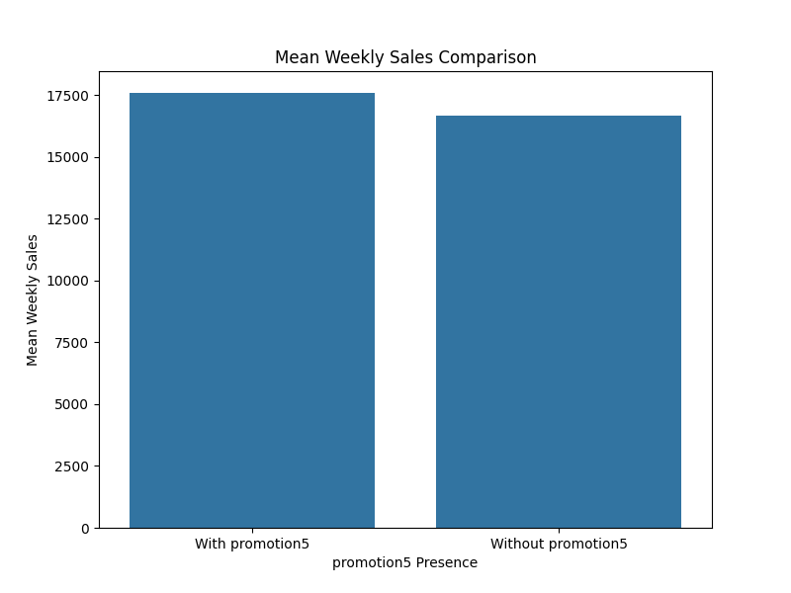
WEEKLY SALES WITH AND WITHOUT PROMOTIONS DURING HOLIDAY WEEKS
Question 5
Impact of Promotions

Slide 18
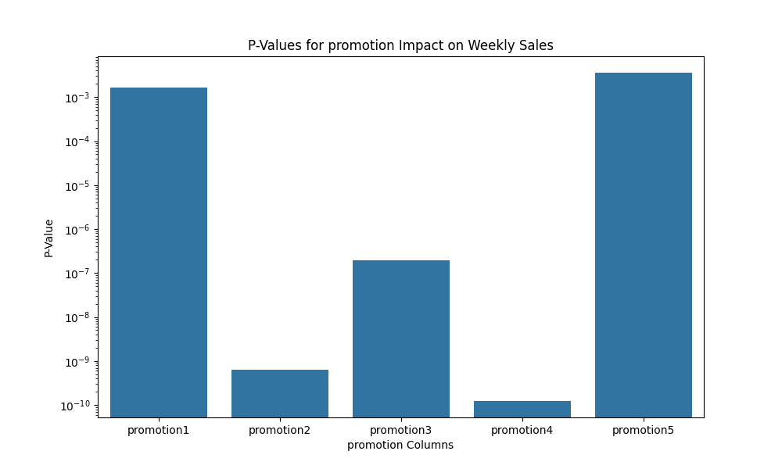
Question 5
Markdown Impact
Hypothesis testing: promotion effect on sales (in holiday weeks)
H0 (EQUAL MEAN SALES)
HA (UN EQUAL MEAN SALES)
P values for two sampled t test
Again values for five promotions were less than 0.05 which shows there is s relation between holidays and promotional offers

Slide 19
conclusion
Store A performs the best.
Seasonal sales patterns are observed.
Limited impact of external factors.
Holidays, especially with promotions, boost sales.
Correlations with promotions are relatively weak.

Slide 20
Future work
limitations
Hypothesis tests using varied samples from the population.
Promotions nans as 0.
Only linear analysis
Machine Learning Models
Non linear analysis
Dealing with markdown values
Make predictions

Slide 21


