Slide 1

VIDEO
TREND ANALYSIS
By Megha Vij

Slide 2
About project Predict the view count of YouTube videos using various features such as likes, dislikes, view count , comment count and other relevant metadata.

Slide 3

Data and its source
Csv and json
Steps involved
Understanding and preprocessing data – dealing with columns, changing names, checking null values, info etc to understand and obtain the desired columns for analysis.
Exploratory Data analysis – to see the correlations between features and view count and bar plots to check the highest view count for the given dataset
Applying ML models
Select the best model
Use it for prediction

Slide 4
Questions:
Question 1
What are the key factors influencing the view count of YouTube videos?
Question 2
How do different metadata features, such as video title, tags, and description correlate with the view count?
Question 3
What are the most significant features that contribute to the prediction of view count and how do they influence the outcome?
Question 4
Which machine learning model performs the best in predicting the view count of YouTube videos based on the available data?
Question 5
How reliable is the developed model in making predictions about the view count of new YouTube videos?

Slide 5
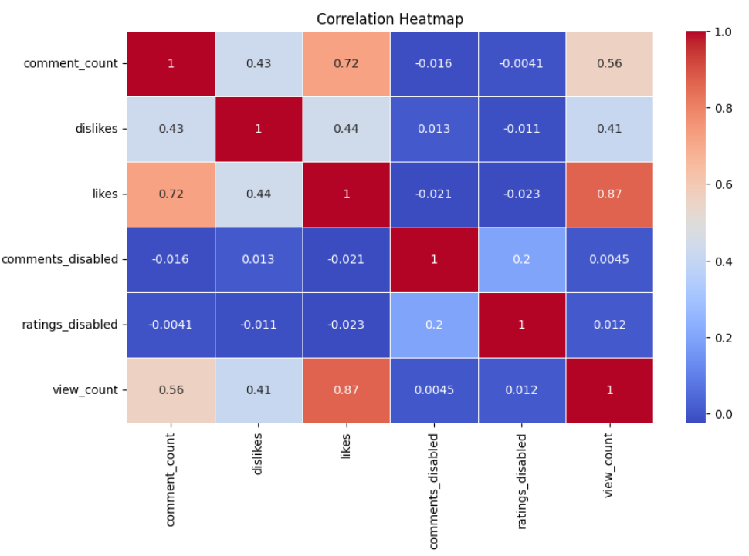
Key Factors affecting view count
1. View count and numerical columns(comment count, dislikes, likes, comments disabled, ratings disabled ,view count)

Slide 6
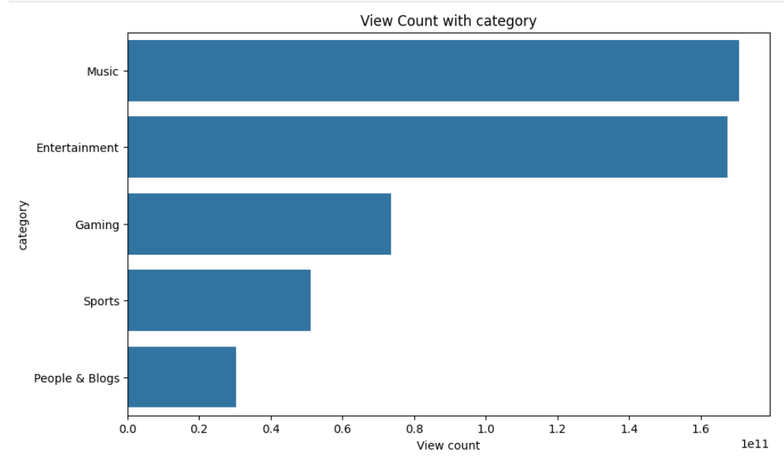
Key Factors affecting view count
2. View count and categorical columns(category)

Slide 7
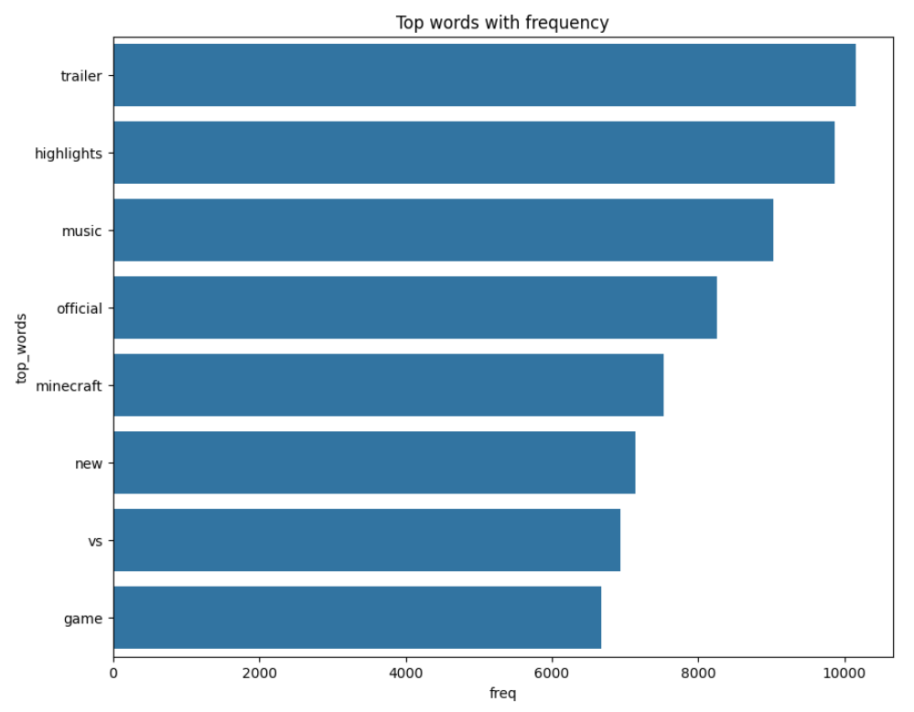
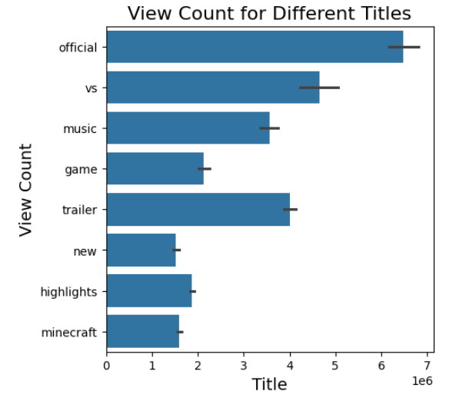
Key Factors affecting view count
2. View count and categorical columns(titles)-title into individual words and the count of each word was taken.

Slide 8
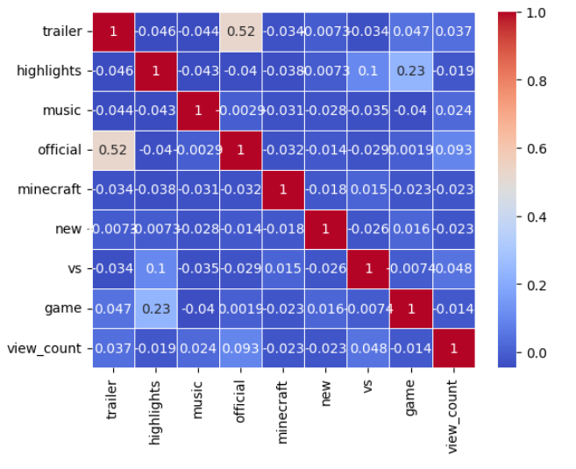
Key Factors affecting view count
2. View count and categorical columns(titles)-correlation between top words

Slide 9
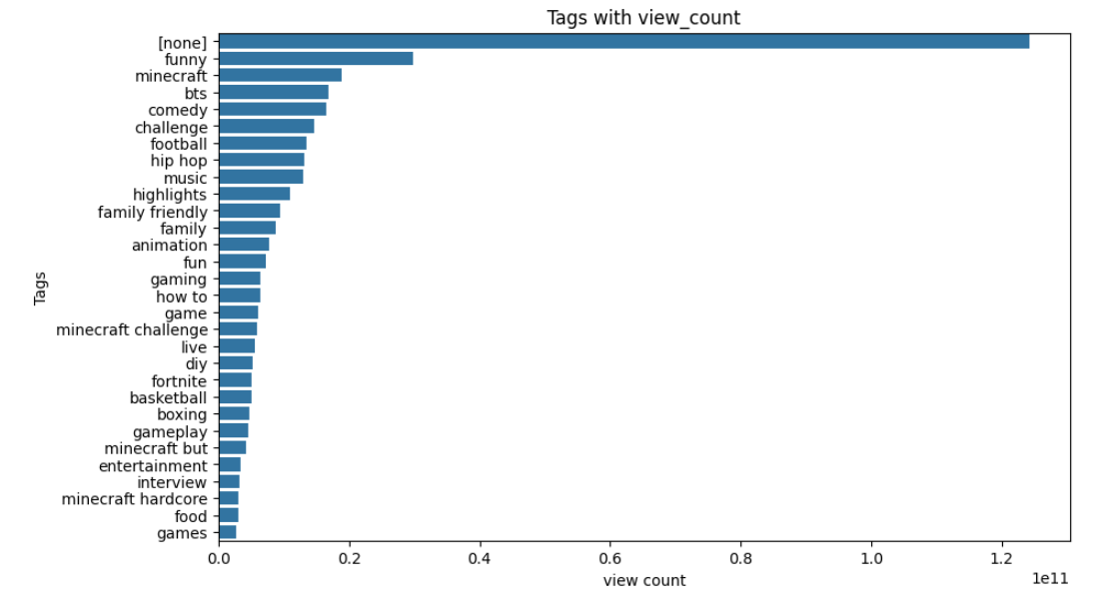
Key Factors affecting view count
2. View count and categorical columns(tags)

Slide 10
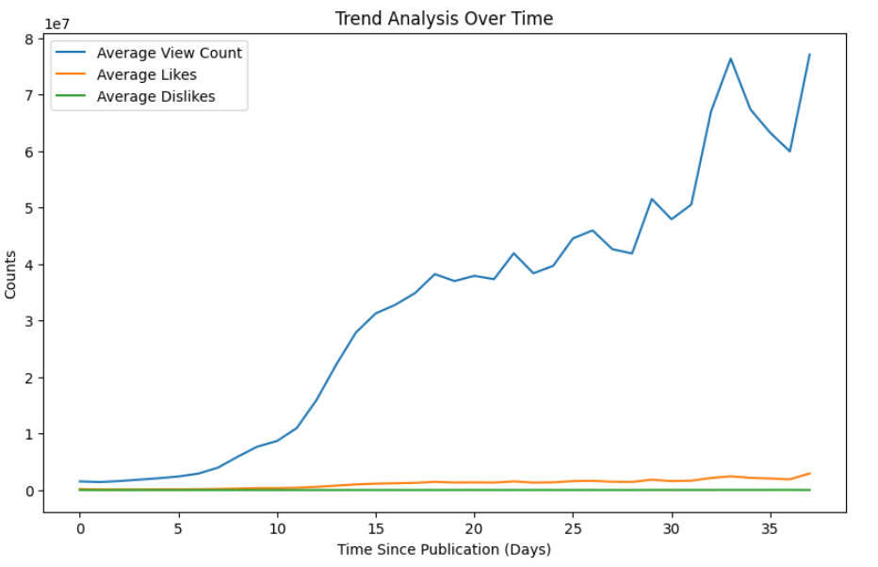
Feature Analysis- date and time
Engagement increases over period of time specially for view count.

Slide 11
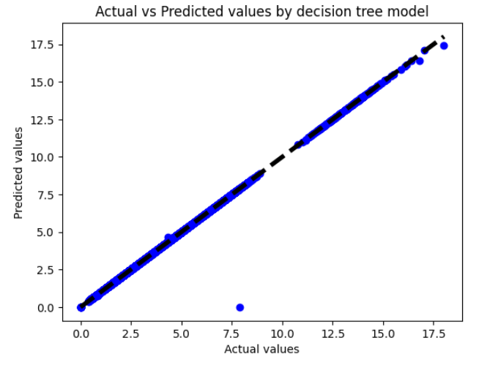
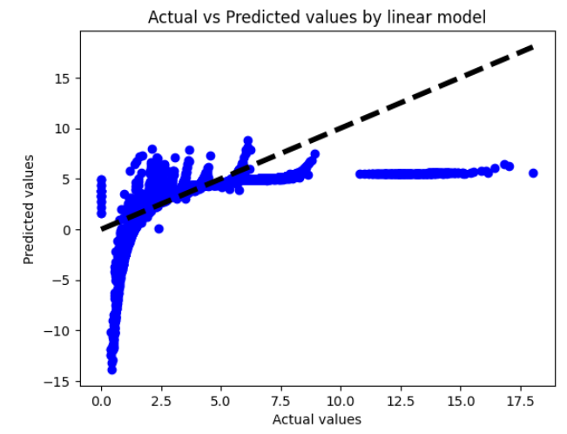
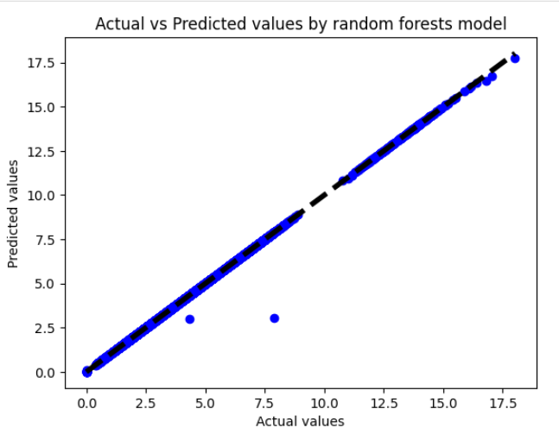
Machine learning Models
Decision Tree
Linear model
Random forest

Slide 12
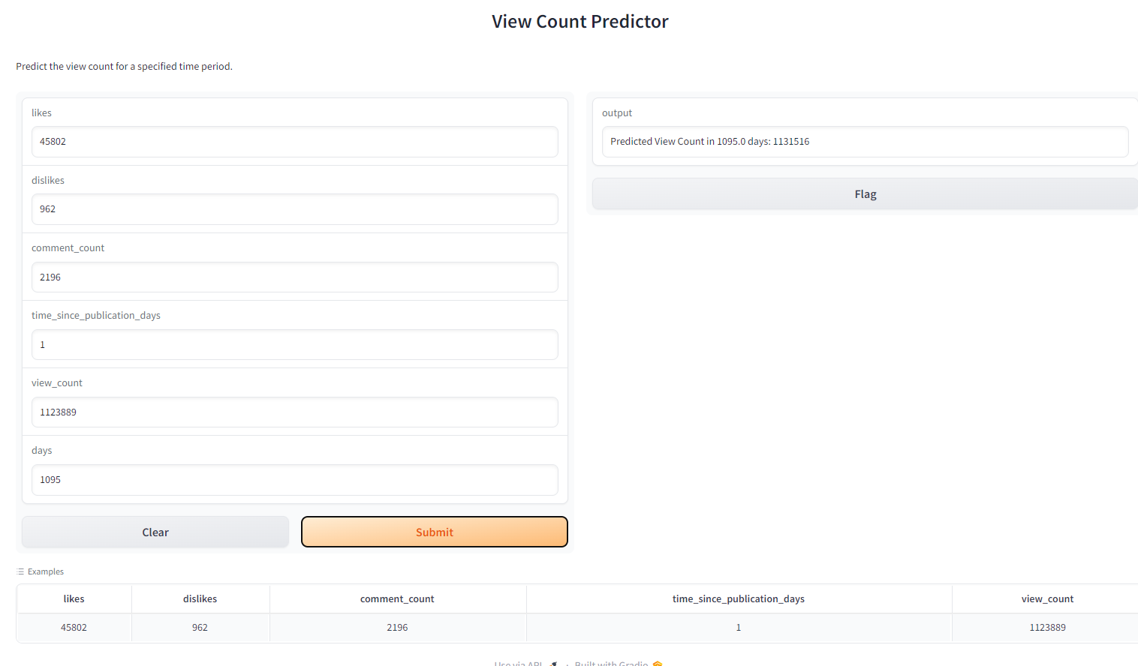
View count predictor app

Slide 13
Conclusion
Various factors such as likes, comments, video tags, and specific words in the title have a significant influence on YouTube video view counts.
The Random Forest Regressor outperformed other models in predicting YouTube video view counts due to its robustness and generalizability.
Despite the Decision Tree Regressor showing perfect performance, the ensemble nature of the Random Forest Regressor makes it a more suitable choice for this project.

Slide 14
Future work
Expand the dataset to improve the robustness and accuracy of the predictive models, allowing for a more comprehensive understanding of the factors influencing YouTube video view counts.
Do similar predictions on the basis of specific regions and content.
Do title and description sentiment analysis

Slide 15


