Slide 1

Airline Route & Fare Analysis Using Hadoop and Hive
Presented By:
Vishala Vemuri
Megha Chandrasekharan Nair
Mallikarjun Gudumagatte Nagaraja

Slide 2

Introduction
The airline industry is fast-paced and influenced by dynamic factors such as demand, competition, and seasonal trends. Gaining insights into fare patterns enables travelers to make smarter booking decisions and empowers airlines to refine their pricing and operational strategies.
Notes:
Imagine you’re planning a trip. You check flight prices today, and they seem reasonable. The next day, the same ticket has skyrocketed. Frustrated, you wait, hoping prices drop—only to see them climb even higher.
This is the reality of airline ticket pricing. Airlines adjust fares based on demand, competition, and external factors like fuel costs and holidays. As a traveler, understanding these fluctuations can help you book smarter and save money. For airlines, analyzing pricing patterns allows them to optimize revenue while staying competitive.
In this project, we leverage Big Data tools like Hadoop and Hive to uncover insights into flight prices. Through data-driven analysis, we aim to answer three key business questions that impact both travelers and airlines.

Slide 3

Objective
• Identify top revenue-generating routes • Analyze flight frequency and route demand • Examine fare variations based on the day of the week • Leverage Hadoop-Hive for scalable big data analysis

Slide 4

Dataset Features
Dataset:
Source: Expedia via Kaggle(Flight Prices Dataset)
Timeframe: April 16, 2022 – October 5, 2022
Size: 31.09 GB
Key Features:
Airline: Name of the airline
Source & Destination: Departure and arrival cities
Departure & Return Date: Travel dates
Price: Ticket cost in USD
**Due to size constraints on our ubuntu machines, we have picked records only for the month of June 2022 and this subset of data has a size of 3 GB** (Number of Rows: 11.77M Number of Columns: 27)

Slide 5
Methodology
Data Processing:
Hadoop is used to store large datasets.
Hive is used for SQL-like queries on structured data.
2. Steps Followed:
Data Ingestion: Loaded the dataset into Hadoop Distributed File System (HDFS).
Data Verification: Checked data integrity and structure before analysis.
Query Execution in Hive: Ran HiveQL-based queries to extract insights.
Result Analysis: Interpretation of the output and transformed them into actionable insights.

Slide 6

Business Question 1:
What are the top 10 most revenue
Generating routes?

Slide 7
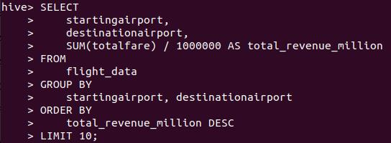
Query 1

Slide 8
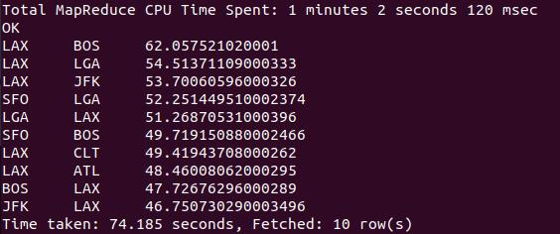
Output and Insights
Notes:
Interpretation:
The most revenue-generating route is LAX-BOS, with a revenue of 62 million dollars, followed by LAX-LGA with 54.5 million dollars and LAX-JFK with 53.7 million dollars.
LAX appears in 8 out of the top 10 routes, making it a major revenue center. This indicates that both inbound and outbound traffic from LAX is commercially significant.
Many of the top routes are cross-country (e.g., LAX–BOS, LAX–JFK), showing the importance of coast-to-coast travel.
Cities like New York (JFK/LGA), LA (LAX), San Francisco (SFO), and Boston (BOS) are both tourism magnets and business hubs.
These insights highlight how route-level revenue analysis can drive better operational planning, customer experience, and profitability.
This result can be helpful in:
Capacity Planning: Add more flights, and use larger aircraft.
Customer Experience: Introduce non-stop options, and improve check-in.
Revenue Strategy: Apply dynamic pricing to top routes.
Growth Strategy: Explore new routes from LAX and other key hubs.

Slide 9
Business Question 2:
Which routes have the highest number of flights departing from DFW?

Slide 10

Query 2

Slide 11
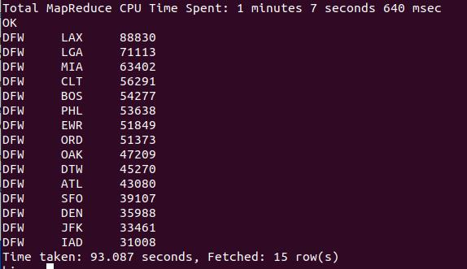
Output and Insights
Notes:
Interpretation:
The most frequent flight destination from DFW: The LAX (Los Angeles) route has the highest number of flights from Dallas/Fort Worth, totaling 88,830 flights.
Other significant routes from DFW: After LAX, the following most frequent routes are to LGA (New York - LaGuardia) with 71,113 flights and MIA (Miami) with 63,402 flights. These routes seem to be the most popular ones.
Least frequent route: The least frequent destination on this list is IAD (Washington D.C. - Dulles), with 31,008 flights.
Key insights:
Popular destinations like LAX, LGA, and MIA see a high volume of flights, indicating strong demand for travel to these cities.
Routes such as IAD or JFK have fewer flights, which could suggest lower demand or less frequency on those specific routes.
This result can be helpful in:
Airlines: Identifying the busiest routes to plan for more frequent flights or larger planes.
Travel Agencies: Understanding where most travelers are flying to/from DFW to target these destinations more aggressively.
Airport Operations: Forecasting and managing airport traffic, resources, and security needs.

Slide 12
Business Question 3:
How do flight prices vary over time
based on weekday vs. weekend?

Slide 13
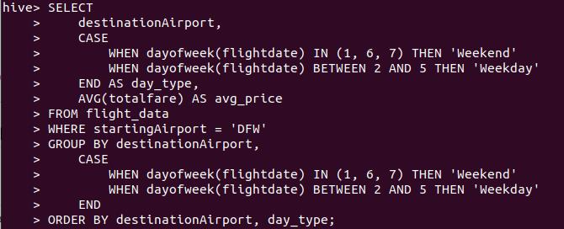
Query 3

Slide 14
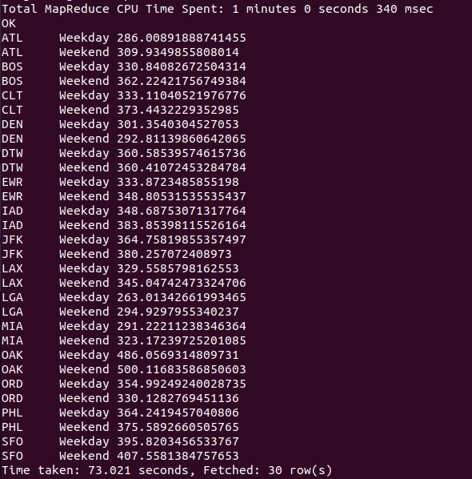
Output and Insights
Notes:
Interpretations:
Weekend Prices Are Higher on Most Routes
For most of the destinations (e.g., BOS, JFK, DTW, CLT, EWR), weekend prices are more than weekday prices.
Some Routes Show Minor Differences
Routes like DEN or LAX have smaller price differences, suggesting more stable pricing.
This can be due to business-heavy traffic where the demand is strong throughout the week.
This result is helpful in:
Revenue Optimization: Shows when ticket prices can be increased (e.g., weekends) to maximize profit. Helps in applying dynamic pricing based on demand patterns.
Flight Scheduling & Capacity Planning: Identify weekend peak travel routes so that airlines can add extra flights or increase the capacity.
Targeted Marketing & Promotions: Design weekday travel promotions to fill low-demand periods.

Slide 15
Conclusion
Key Takeaways:
Impact:
Notes:
Conclusion & Key Takeaways
This analysis offers a strategic overview of flight operations, revenue trends, and passenger demand patterns. The insights extracted are highly actionable across multiple domains of airline management.
1. Route-Level Revenue Insights
Actionable Takeaway: Prioritize LAX routes for premium services, targeted marketing, and capacity enhancement.
2. High-Frequency Flight Routes
Actionable Takeaway: Use frequency data to optimize flight scheduling, reduce operational inefficiencies, and enhance airport resource allocation.
3. Weekday vs. Weekend Fare Patterns
Actionable Takeaway: Apply demand-based pricing and schedule adjustments for weekend peaks; consider promotional pricing for weekdays to improve seat occupancy.
Overall Recommendations
Revenue Strategy: Strengthen pricing models with insights from high-yield routes and peak-time trends.
Operational Planning: Use traffic volume data to adjust flight frequency, aircraft size, and crew allocation.
Marketing Strategy: Focus campaigns around key hubs like LAX and high-demand days (weekends) to maximize ROI.
Growth Strategy: Explore expanding services from high-performing hubs and evaluate underperforming routes for potential realignment.

Slide 16
Thank You

