Slide 1

Analyzing Trade Behavior in Financial Markets
A Data-Driven Analysis Using PySpark
Presented By
Megha Chandrasekharan Nair
Vishala Vemuri
Mallikarjun Gudumagatte Nagaraja

Slide 2



Financial Markets and Trade Analytics
Trades occur both visibly (lit) and invisibly (hidden).
Financial decision-making increasingly relies on order-level data.
Data analytics can uncover hidden trading strategies and market behaviors.
Notes:
“First, trades happen both visibly and invisibly.
Visible trades or lit trades — are open for everyone to see on public order books.
But a lot of trading also happens hidden — big investors place orders that are either not visible at all or only partially shown. Understanding the mix of lit and hidden trading is crucial to interpreting market behavior.”
“Second, financial decision-making today relies more and more on detailed, order-level data.
Traders, institutions, and even regulators no longer look only at price movements.
They study patterns in how orders are placed, canceled, hidden, and executed to make smarter decisions.”
“Finally, through data analytics, we can uncover these hidden trading strategies.
Big data tools like PySpark allow us to analyze millions of orders and find patterns that aren’t obvious — like detecting stealth institutional activity or predicting when a big market move is about to happen.”

Slide 3
Common Challenges
Hidden Liquidity: Not visible in order books.
Volatility: Leads to market unpredictability.
Market Impact: Large visible orders can shift prices.
Regulatory Pressure: Need for fair market transparency.
Notes:
“Hidden Liquidity means that not all buying and selling intentions are visible in the public order book.
Big traders often hide their large orders to avoid influencing the market, making it harder for others to see the true supply and demand.”
“Volatility refers to the market being unpredictable — prices can move up or down very quickly.
This unpredictability increases the risk for traders and makes it harder to forecast price movements.”
“Market Impact happens when very large visible orders cause price shifts.
For example, if a huge buy order appears, others might rush to buy, pushing the price up immediately — and the same happens with large sell orders driving prices down.”
“Regulatory Pressure is the growing demand from government agencies and exchanges to make markets more transparent and fair.
They want to prevent hidden manipulation and protect all types of investors, especially smaller retail traders.”

Slide 4
Data Used for the Analytics
Data Source: Data.gov
Size: 2.6 GB
Timeframe: Jan2024 – Dec2024
Dimensions: 25 million rows* 20 columns
Notes:
Data is from : The home of the US government's open data

Slide 5



Data Preparation
Merged four datasets, loaded and inspected trading data (cancellation rates, volumes, volatility ranks, etc.).
Created new calculated fields like HiddenRatio, PrevDayCancels, OddLotRatio etc.
Exploratory Data Analysis

Slide 6
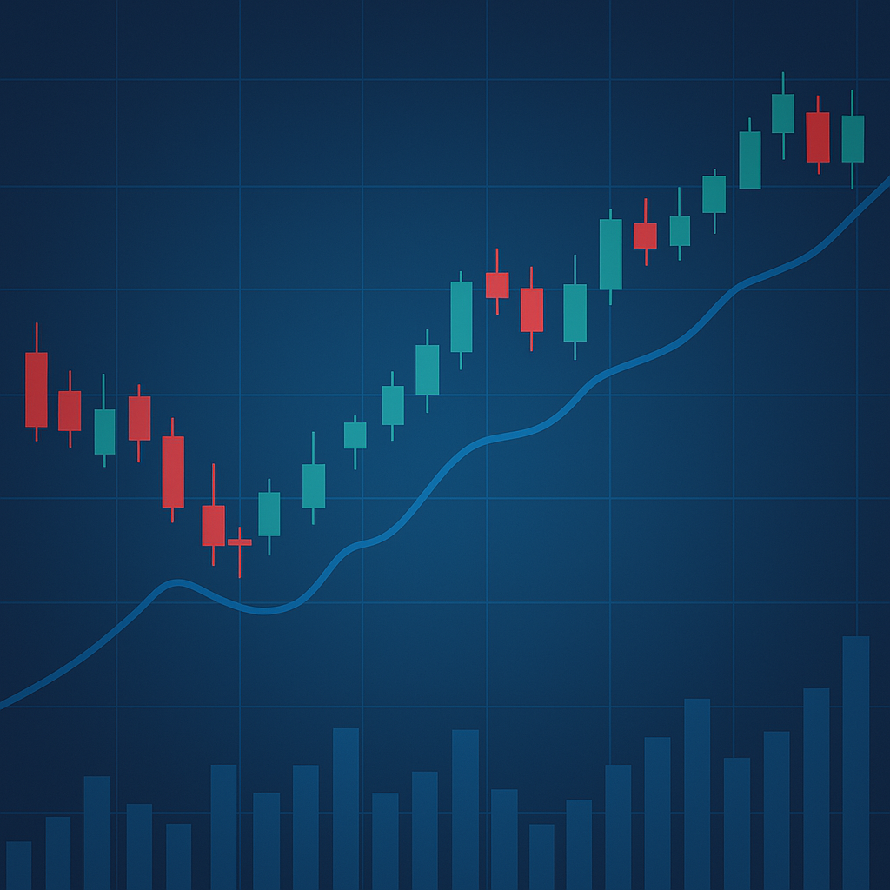
Business Question 1: Are high-volatility stocks traded more through hidden orders than regular (lit) ones?
Created HiddenRatio column.
Selected Top 25% high-volatility stocks.
Aggregated and ranked by average hidden trade ratio.

Slide 7
Output:
Findings:
1. Many high-volatility stocks show over 70% hidden trading.
2. Example: DECM (76.6% hidden), HYZN (73.3% hidden).
Ticker | AvgHiddenTradeRatio
DECM | 0.766
HYZN | 0.733
VCRM | 0.704
SOND | 0.684
HELO | 0.669
DFGX | 0.660
DGCB | 0.645
AVSC | 0.641
CRMT | 0.617
RDVTI | 0.614
Insight:
1. Traders prefer hidden orders to manage risks during volatility.

Slide 8
Business Question 2: Do high trade volumes follow high cancellation days for the same stock (prep before action)?
Used lag function to shift cancellations one day back.
Created a signal if high trades followed high cancellations
Aggregated by ticker.
Notes:
In the second question, we aimed to determine if high cancellation days are followed by high trade volumes for the same stock. This would suggest a "prep" before major trading action. To do this, we used a lag function to shift cancellations one day back, identified when high cancellations were followed by high trade volumes, and aggregated the results by ticker.

Slide 9
Output:
Ticker | Occurrences | Total Days | Trigger Rate
SQQQ | 2160 | 3780 | 0.57
XLF | 1836 | 3780 | 0.49
F | 1600 | 3780 | 0.42
NVDA | 1590 | 3780 | 0.42
FXI | 1518 | 3780 | 0.40
SPY | 1491 | 3780 | 0.39
SOXS | 1509 | 3780 | 0.40
HYG | 1457 | 3780 | 0.39
TQQQ | 1433 | 3780 | 0.38
INTC | 1417 | 3780 | 0.38
SPXS | 1389 | 3780 | 0.37
PLTR | 1369 | 3780 | 0.36
TLT | 1371 | 3780 | 0.36
PLUG | 1317 | 3780 | 0.35
SOXL | 1335 | 3780 | 0.35
EEM | 1323 | 3780 | 0.35
BAC | 1281 | 3780 | 0.34
IWM | 1242 | 3780 | 0.33
QQQ | 1255 | 3780 | 0.33
Findings:
1. Some stocks show strong patterns where high cancels lead to high trade volumes next day.
2. Potentially indicates strategic market preparation by participants.
Insight:
1. Cancellation behavior can signal trading action.
Notes:
The analysis showed that certain stocks exhibit strong patterns where high cancellations lead to high trade volumes the next day. This pattern can signal strategic market preparation by traders.
Key Points:
Stocks like SQQQ and XLF demonstrated a high trigger rate (0.57 and 0.49) indicating a clear pattern of cancellations leading to high trading volumes.
Insights:
Cancellation behavior can serve as an early indicator of future trading action.

Slide 10
Business Question 3: Are stocks with high odd lot volume traded differently compared to regular orders?
Compared odd lot volumes against total trading volumes.
Grouped by ticker and ranked by proportion.
Notes:
The third question we addressed was whether stocks with high odd lot trading are traded differently compared to regular orders. Odd lots are typically small trades, often linked to smaller investors or liquidity testing. We compared odd lot volumes against total trade volumes and ranked stocks by the odd lot ratio. Then grouped by ticker and ranked by odd lot proportion.

Slide 11
Output:
Exchange | Year-Month | Total Odd Lot Volume | Total Trade Volume | Odd Lot Ratio
Amex | 2024-1 | 39249.19 | 376366.51 | 0.1043
Amex | 2024-10 | 34184.38 | 327054.83 | 0.1045
Amex | 2024-2 | 33328.37 | 384846.07 | 0.0865
Amex | 2024-3 | 33843.71 | 360887.67 | 0.0938
Amex | 2024-4 | 43147.09 | 360847.87 | 0.1196
Amex | 2024-5 | 31232.47 | 418937.56 | 0.0745
Amex | 2024-6 | 34818.81 | 350717.41 | 0.0993
Amex | 2024-7 | 37265.65 | 363511.47 | 0.1025
Amex | 2024-8 | 42446.07 | 377216.85 | 0.1125
Arca | 2024-1 | 1377143.34 | 1.373887381E7 | 0.1002
Arca | 2024-10 | 1547331.88 | 1.496955875E7 | 0.1034
Arca | 2024-2 | 1483608.7 | 1.460975987E7 | 0.1015
Arca | 2024-3 | 1438015.51 | 1.34143596E7 | 0.1072
Arca | 2024-4 | 1546469.31 | 1.428770398E7 | 0.1082
Arca | 2024-5 | 1511435.97 | 1.470953597E7 | 0.1028
Arca | 2024-6 | 1257692.6 | 1.173959309E7 | 0.1071
Arca | 2024-7 | 1506526.56 | 1.306873827E7 | 0.1154
Arca | 2024-8 | 1544669.57 | 1.342415597E7 | 0.1151
Arca | 2024-9 | 1362431.81 | 1.180225835E7 | 0.1155
Bats-Y | 2024-1 | 157700.25 | 1538116.6 | 0.1025
Bats-Y | 2024-10 | 193435.97 | 1521360.96 | 0.1272
Bats-Y | 2024-2 | 160681.83 | 1531696.9 | 0.1050
Bats-Y | 2024-3 | 152700.63 | 1428196.63 | 0.1069
Findings:
Certain stocks have very high odd lot trading.
Example: Some securities are dominated by odd lots (>50%).
Insight:
Odd lot trading indicates different trading profiles — smaller investors, algorithmic splitting, or liquidity testing.
Notes:
We found that certain exchanges and stocks have a higher proportion of odd lot trades. This behavior can reveal alternative liquidity dynamics, where smaller trades are dominating the market.
Key Points:
Odd lot ratios were higher on exchanges like Amex and Arca.
Bats-Y exchange showed a slight increase in odd lot trading over time.
Insight:
High odd lot trading might reflect retail investor activity, algorithmic splitting, or liquidity testing.

Slide 12

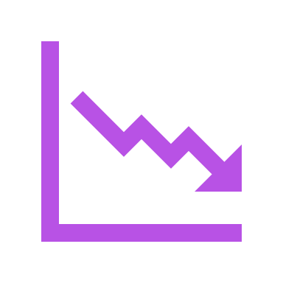

Conclusions
Hidden trades dominate in highly volatile stocks.
Cancellation patterns can predict trading surges.
Odd lot dominance reveals alternative liquidity dynamics.
Notes:
"Understanding hidden trades, cancellation behavior, and odd lot trades is crucial for assessing market dynamics."
️⃣ Hidden trades dominate in highly volatile stocks.
How to explain it:
"In stocks that are more volatile — meaning prices move rapidly — traders often hide their orders."
"This prevents other market participants from seeing large buying or selling interest, which could move prices against them."
"Our analysis showed that for the highest volatility stocks, 70% or more of trade volume came from hidden orders."
2️⃣ Cancellation patterns can predict trading surges.
How to explain it:
"We investigated whether high order cancellations one day are linked to high trading volumes the next day."
"The idea is that cancellations may indicate traders are preparing — adjusting or pulling orders before making big moves."
"We found that for several stocks, there is a clear pattern where a spike in cancellations is followed by a spike in trade volume."
3️⃣ Odd lot dominance reveals alternative liquidity dynamics.
How to explain it:
"An odd lot is a trade of fewer than 100 shares. Traditionally, they were considered less important."
"Today, odd lot trades are a huge part of the market, especially in certain stocks and exchanges."
"We found that for some stocks and months, odd lots made up more than 10% of total trade volume."
"This shows that liquidity is often fragmented — many small orders together make a large part of the market activity."
Audience Tip: If asked why odd lots matter, say: "Because they can indicate activity from retail investors, algorithmic trading, or liquidity fragmentation — all of which affect how we interpret supply and demand in the market."
"In summary, hidden orders, cancellation behavior, and odd lot trades are critical hidden layers of market behavior that traditional order books don't fully reveal. Understanding these aspects helps in better forecasting market moves and designing trading strategies."

Slide 13
Business Implications
Traders: Must account for hidden liquidity and cancellation patterns.
Exchanges: Need real-time monitoring of hidden trading.
Data Scientists: Opportunities to build models predicting market microstructure behavior.
Notes:
"Now that we've seen the key insights about hidden trades, cancellation patterns, and odd lot dominance, let's talk about what this actually means for different stakeholders in the financial market."
For Traders:
🔸 Text: "Traders must account for hidden liquidity and cancellation patterns."
How to explain it:
"Traders can't rely only on visible order books anymore."
"Hidden liquidity — which isn’t visible until the trade happens — is a major factor in volatile stocks."
"Additionally, monitoring cancellation patterns can provide early warning signals of upcoming large trades or shifts in market sentiment."
For Exchanges:
🔸 Text: "Exchanges need real-time monitoring of hidden trading."
How to explain it:
"Exchanges are responsible for maintaining a fair and transparent market."
"High levels of hidden trading may mask true market liquidity and create unfair advantages for some players."
"Thus, exchanges must track hidden order activity in real time to detect abnormalities or manipulation risks."
For Data Scientists:
🔸 Text: "Opportunities to build models predicting market microstructure behavior."
How to explain it:
"From a data science perspective, there’s a huge opportunity here."
"We can build predictive models using order book data, cancellations, hidden ratios, odd lot patterns, and volatility measures."
"These models can help forecast trade surges, price movements, or liquidity risks in real time."

Slide 14
Technical Details of the project implementation
Multinode Cluster Setup Demonstration
Project .ipynb file

Slide 15
Thankyou

