Slide 1
Learning to Classify Imbalanced data streams for Binary Classification

Slide 2
Project Guide : Prof. Kiran Bhowmick
Proposed by : Megha Jakhotia - 60004140033 Yash Kapadia - 60004140040
Nikita Luthra - 60004140047

Slide 3
Introduction
Imbalanced Data
Classification of Imbalanced Data
Data streams & their characteristics
Availability of labels
Classification of Data Streams
Real-time Applications

Slide 4
Scope and Objective
Working for at least 2 Datasets
Clustering & Binary classifier
Problems considered:
Class imbalance
Data Streams
Absence of Labels

Slide 5
Review of literature
Paper | Description | Advantages | Discussion
“Learning from class-imbalanced data: Review of methods and applications”, International Journal of Expert systems with applications, Elsevier, Dec 2016. | In depth review of rare event detection from an imbalanced learning perspective and application in various fields. | Provides a thorough review or rare event detection techniques and its application. | Gave various methods that are used to solve the problem of imbalanced data focussed on rare events and the wide application of the same.
N. V. Chawla, K. W. Bowyer, L. O. Hall, et al., “Smote: synthetic minority over-sampling technique,” Journal of Artificial Intelligence Research, Vol. 16, pp. 321–357, 2002. | About the Data Level approach to handle Imbalanced Data. | It gives one of the best methods for sampling the data that overcomes the drawbacks of the undersampling and oversampling algorithms standalone. | Explains the working of the SMOTE algorithm and how it samples the minority and majority class.

Slide 6
Review of literature
Paper | Description | Advantages | Discussion
Clustering Algorithms for Data Stream Karishma Nadhe1, Prof. P. M. Chawan | Depicted various algorithms that are used for clustering and explained their orkings in brief. | It describes the working of algorithms: DBSCAN, DENCLUE, SNN, CHAMELEON, DBSTREAM | Explains the working of the density-based clustering algorithm and its various types.
Data Stream Clustering Algorithms: A Review Maryam Mousavi1 , Azuraliza Abu Bakar1 , and Mohammadmahdi Vakilian. | The different data stream clustering algorithms in the literature by considering their respective advantages and disadvantages are discussed. | It describes about the different data stream clustering methods: hierarchical, partitioning, grid-based, density-based and model-based. | This paper provides an explanation about the clustering algorithms which help us to concentrate our implementation on a selected few like DStream.

Slide 7
Conclusion from Review of literature
Important Issues in various domains
Approaches to learning from imbalanced data
Data-level methods
Algorithm-level methods
Hybrid methods
Data-level Method: SMOTE
Clustering Algorithms for Data Streams

Slide 8
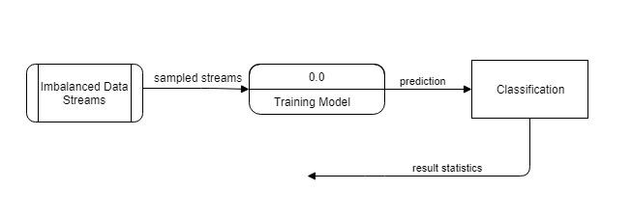
Overview of Process

Slide 9
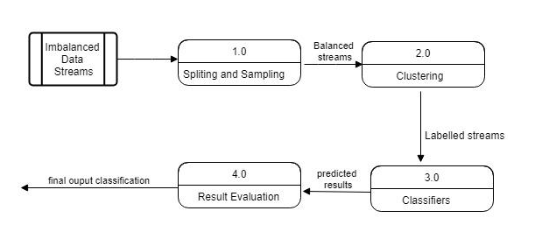
Overall Process

Slide 10
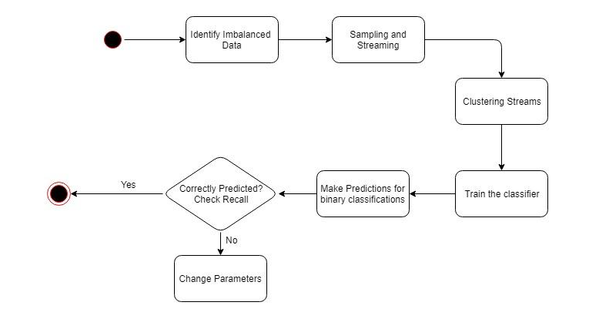
Activity Diagram

Slide 11
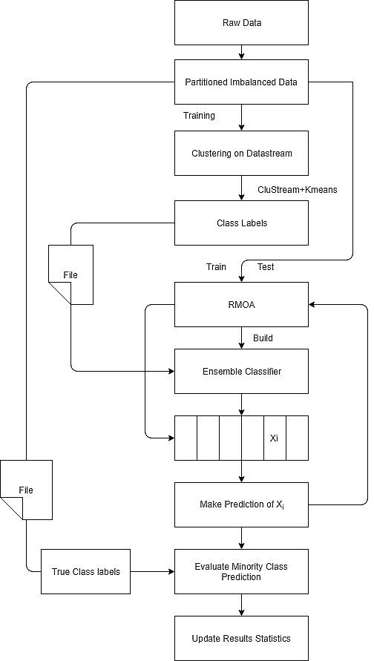
Proposed Solution
Splitting of sample data into:
Training
Testing
“Stream” package in R to convert data sets to data streams
Clustering algorithms followed by classification using Ensemble Classifiers

Slide 12
System Analysis
Functional Requirements
Clustering
Classification
Labelling
Specific Requirements
Datsets
Mammography
Sea
Language - R programming
Non-functional Requirements
Accuracy
Sensitivity
Specificity
Precision
Recall
F-measure
G-mean
Performance - Recall used to compare the classifiers

Slide 13
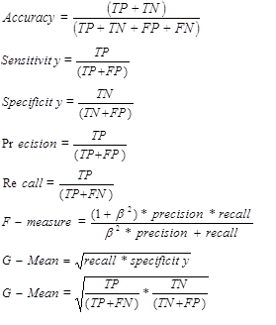
Performance Metrics
Confusion Matrix:
 | Predicted as positive | Predicted as negative
Actual positive | True positive(TP) | False negative(FN)
Actual negative | False positive(FP) | True negative(TN)

Slide 14
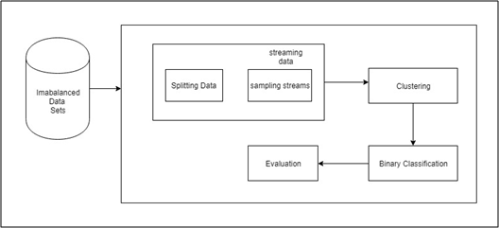
Architectural Design

Slide 15
Implementation
SMOTE
Generating synthetic examples for minority (positive) class
Clustering Algorithms
Sliding window + k-means
Clustream + k-means
Classification Algorithms
Naive Bayes
OzaBoost

Slide 16
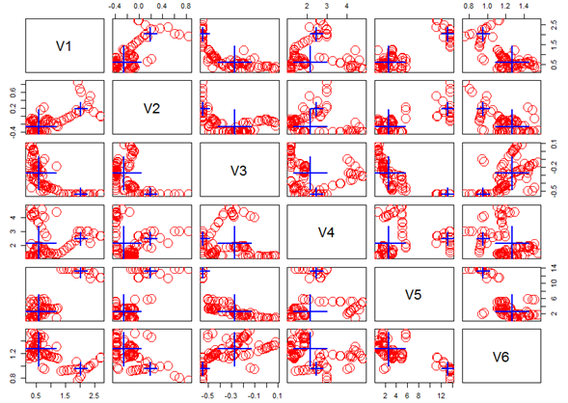
Sliding window + k-means clustering

Slide 17
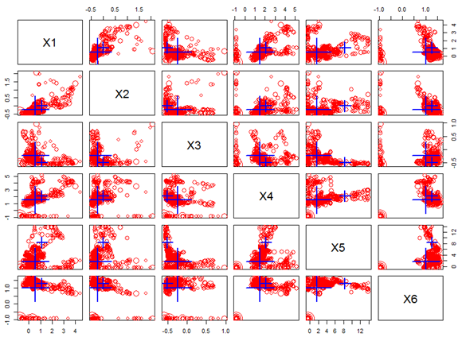
Clustream + k-means clustering

Slide 18
Metrics | Naïve Bayes | OzaBoost
Accuracy | 0.9528 | 0.9825
95% CI | (0.9469, 0.9582) | (0.9787, 0.9857)
P-value | 1 | 0.04749
Kappa | 0.381 | 0.5456
Sensitivity | 0.75214 | 0.52586
Specificity | 0.95707 | 0.99214
Pos Pred Value | 0.27245 | 0.58654
Neg Pred Value | 0.99450 | 0.98997
Prevalence | 0.02093 | 0.02075
Positive Class | 1 | 1
Testing
Classification using true labels
Naive bayes:Confusion Matrix
5239 | 29
235 | 88
OzaBoost Classifier: Confusion Matrix
5431 | 55
43 | 61

Slide 19
Testing
Metrics | Naïve Bayes | OzaBoost
Accuracy | 0.6803 | 0.5908
95% CI | (0.6661, 0.6943) | (0.5758, 0.6056)
P-value | < 2.2e-16 | < 2.2e-16
Kappa | 0.3722 | 0.2007
Sensitivity | 0.3832 | 0.2066
Specificity | 0.9961 | 0.9990
Pos Pred Value | 0.9906 | 0.9956
Neg Pred Value | 0.6031 | 0.5423
Prevalence | 0.5152 | 0.5152
Positive Class | 1 | 1
Clustream + k-means Clustering and Classification with SMOTE
Naive bayes:Confusion Matrix
2059 | 1355
8 | 842
OzaBoost Classifier: Confusion Matrix
2065 | 1743
2 | 454

Slide 20
Testing
Metrics | Naïve Bayes | OzaBoost
Accuracy | 0.8377 | 0.7416
95% CI | (0.8263, 0.8487) | (0.7281, 0.7546)
P-value | < 2.2e-16 | < 2.2e-16
Kappa | 0.6774 | 0.4902
Sensitivity | 0.7319 | 0.5121
Specificity | 0.9502 | 0.9855
Pos Pred Value | 0.9398 | 0.9740
Neg Pred Value | 0.7693 | 0.6552
Prevalence | 0.5152 | 0.5152
Positive Class | 1 | 1
Sliding Window(horizon = 100) + k-means Clustering and Classification with SMOTE
Naive bayes:Confusion Matrix
1964 | 589
103 | 1608
OzaBoost Classifier: Confusion Matrix
2037 | 1072
30 | 1125

Slide 21
Testing
Metrics | Naïve Bayes | OzaBoost
Accuracy | 0.8377 | 0.7655
95% CI | (0.8263, 0.8487) | (0.7525, 0.7781)
P-value | < 2.2e-16 | < 2.2e-16
Kappa | 0.6774 | 0.5349
Sensitivity | 0.7319 | 0.6222
Specificity | 0.9502 | 0.9178
Pos Pred Value | 0.9398 | 0.8894
Neg Pred Value | 0.7693 | 0.6956
Prevalence | 0.5152 | 0.5152
Positive Class | 1 | 1
Sliding Window(horizon = 10) + k-means Clustering and Classification with SMOTE
Naive bayes:Confusion Matrix
1964 | 589
103 | 1608
OzaBoost Classifier: Confusion Matrix
1897 | 830
170 | 1367

Slide 22
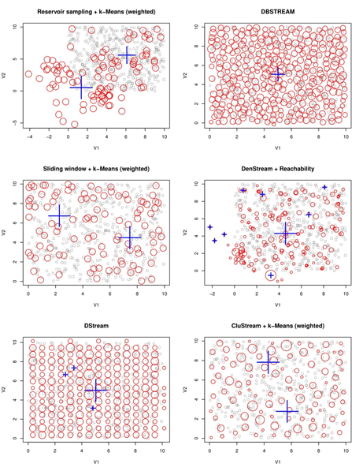
Testing

Slide 23
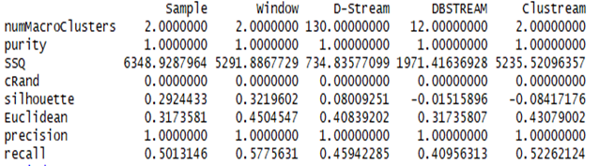
Results and Discussions
Compared 6 clustering algorithms:
Sliding Window + k-means Clustering Algorithm along with Naive bayes classifier performs the best providing sensitivity value as 0.73.
The performance of OzaBoost classifier improves on reducing the horizon size of sliding window to 10.

Slide 24
Thank You !

