Slide 1
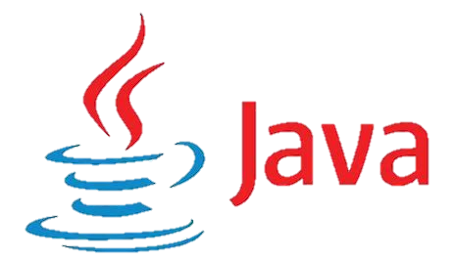
Java Part-1
GOALS
Keep Learning
Be FOCUS
Practice makes you progress
Duration : Learning is a way that meets with infinity

Slide 2
Set Class Path
1
First Way :-
Open COMMAND PROMPT
Write down Set path=C:\program files\java\jdk1.8\bin →Location
Second Way :-
Open Edit the system environment variables
Click Environment Variables
User Variables
New
Variable Name → Path
Variable Value → Location

Slide 3
Java:-
2
Java is a Platform Independent (that means it will work different hardware & OS like Windows , Linux , Mac OS. The ability to run a program an different machines )
“Write Once , Run Anywhere”
Java is a High Level and Object Oriented Programming Language.
Java is a both Interpreted and Compiler Language.
Java is a robust language that can handle run-time errors as it checks the code during the compile and runtime.
Java(Source) → Bytecode →Object Code(Executable code)
Compilation → Javac filename.java
Execution(Byte code) → Java Classname
Java(Source) → Javac → Bytecode → Java → Objectcode
Source Code can be compiled anywhere
Bytecode can be executed anywhere
Extension of Java .java

Slide 4
Components of Java:-
3
Different Components of Java:-
1. JDK (Java Development Kit)
2. JRE (Java Runtime Environment)
3. JVM (Java Virtual Machine)
1.JDK :-
JDK is used for development and execution both(Developer)
2.JRE :-
JRE is used for Execution only(Client)
3.JVM :-
JVM(Abstract Machine)
1.LOADER
2.Verified
3.Execute

Slide 5
Actual process of Java Program :-
4
JDK – Java Development Kit
.java
.class
JVM
Output
Compilation
Compiler
JRE – Java Runtime Environment
(Byte Code)
.Class file/byte code
JVM – Java Virtual Machine
It depends upon Operating Systems
It can be different from Windows OS , Linux OS , Mac OS
But Output will be same for different OS
Output

Slide 6
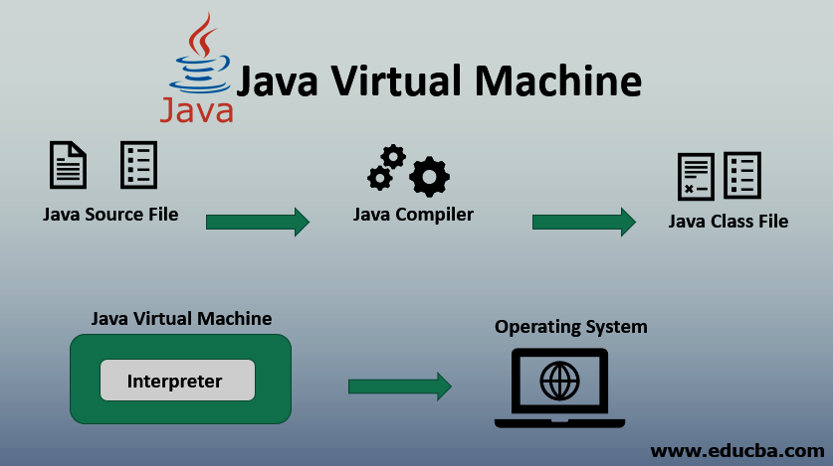
Actual process of Java Program :-
5

Slide 7
Flavours of Java:-
6
JDK is an implementation of any one of the below given Java Platforms released by
Oracle corporation:
Standard Edition Java Platform →JSE
Enterprise Edition Java Platform →JEE
Micro Edition Java Platform →JME
JSE:-
Java Standard Edition(J2SE)
This forms the core part of Java Language.
JEE:-
Java Enterprise Edition(J2EE)
These are the set of packages that are used to develop distributed enterprise scale applications.
These applications are deployed on JEE application servers.

Slide 8
Flavours of Java:-
7
JME:-
Java Micro Edition(J2ME)
These are the set of packages used to develop application for mobile devices and
embedded systems.
Java Bytecode is produced when Java programs are compiled.
To execute Java program, JRE must be installed in the system.
JRE gets installed automatically when JDK is installed.

Slide 9
Types of Errors : -
8
System Errors / Compile Time Errors : -
These syntactical problems may be :
missing semicolons,
missing brackets,
misspelled keywords,
use of undeclared variables,
improperly named variable or function or class,
class not found,
missing double-quote in Strings, etc.
These errors are detected by the Java compiler at compile time of the program which is why they are also known as compile-time errors.

Slide 10
Types of Errors : -
9
2) Run Time Errors : -
Runtime errors occur when the program has successfully compiled without giving any errors and creating a ".class" file. However, the program does not execute properly. These errors are detected at runtime or at the time of execution of the program.
The Java compiler does not detect runtime errors because the Java compiler does not have any technique to catch these errors as it does not have all the runtime information available to it. Runtime errors are caught by Java Virtual Machine(JVM) when the program is running.
These runtime errors are called exceptions and they terminate the program abnormally, giving an error statement

Slide 11
Features of Java Language :-
10
1.Simple →No concepts of Pointers , Explicit memory Allocations , Structures , Operator Overloading 2.Object oriented Language :-
Abstraction
Encapsulation
Inheritance
Polymorphism
3.Portable and platform independent →Run on any Environment
4.Robust →Early Checking of Errors with the help of Garbage collector , Exception Handling
5.Multithreading →Concurrent Execution of several parts of same program at the same time
→Improve CPU Utilization
6.Dynamic Linking
7.Secure →Secure for Internet Application
→Raise Out of Boundary Exception in Arrays
→Strong Typed Language
8.Performance

Slide 12
Platform Independent :-
11
1.A Java program requires JVM (part of JRE) to execute Java code. When java application starts to executes, Java Virtual Machine also starts.
2.Bytecode has instructions that Java Virtual Machine can understand and execute.
3.JVM converts the Bytecode to machine specific code.
4.Java Bytecode can be copied on to any machine that has JVM and executed.This is what makes Java Platform Independent.
5."Write Once , Run any where"

Slide 13
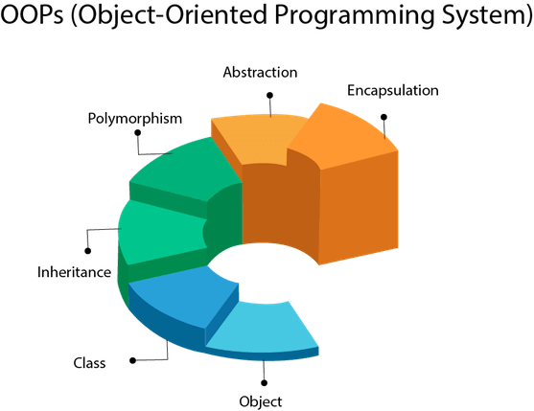
OOPS Concepts :-
12
1.Object
2.Class
3.Abstraction
4.Encapsulation
5.Inheritance
6.Polymorphism

Slide 14
OOPS Concepts :-
13
1.Object
Real World Entity
Properties(Variables)
Tasks Performed
Instance of a Class
Any entity that has state and behavior is known as an object
Example :-
Human is a Object
Name
Colour Properties
Height
Tasks :-
Walk()
Run()
Read()
Write()

Slide 15
OOPS Concepts :-
14
2.Class
Collection of objects is called class
Blue Print that Object follows
It is a logical entity
Example :-
Student
Sname
Srollname Properties
SDOJ
Tasks :-
read()
write()
play()

Slide 16
Program :-
15
Class Hcl
{
public static void main(String[]args)
{
System.out.println(“Hello World !!! “);
}
}
Output :-
Hello World !!!
Class Name
Main Method

Slide 17
How to Compile and Run the Given Program
16
1.How to compile the given program : -
Open cmd on the given program
And Type → Javac filename.java
Example: -
javac test.java
2.How to run the given program : -
Open cmd on the given program
And Type → Java classname (Classname should be there in Caps.
There is no need to write .Java Extension)
Example: -
java Megha

Slide 18
Notes
17
1. | How to check directory on Cmd ? | dir
2. | How to clear the screen on Cmd ? | Cls
3. | How to compile on Cmd ? | Javac test.java
4. | How to run the given program ? | Java Classname

Slide 19
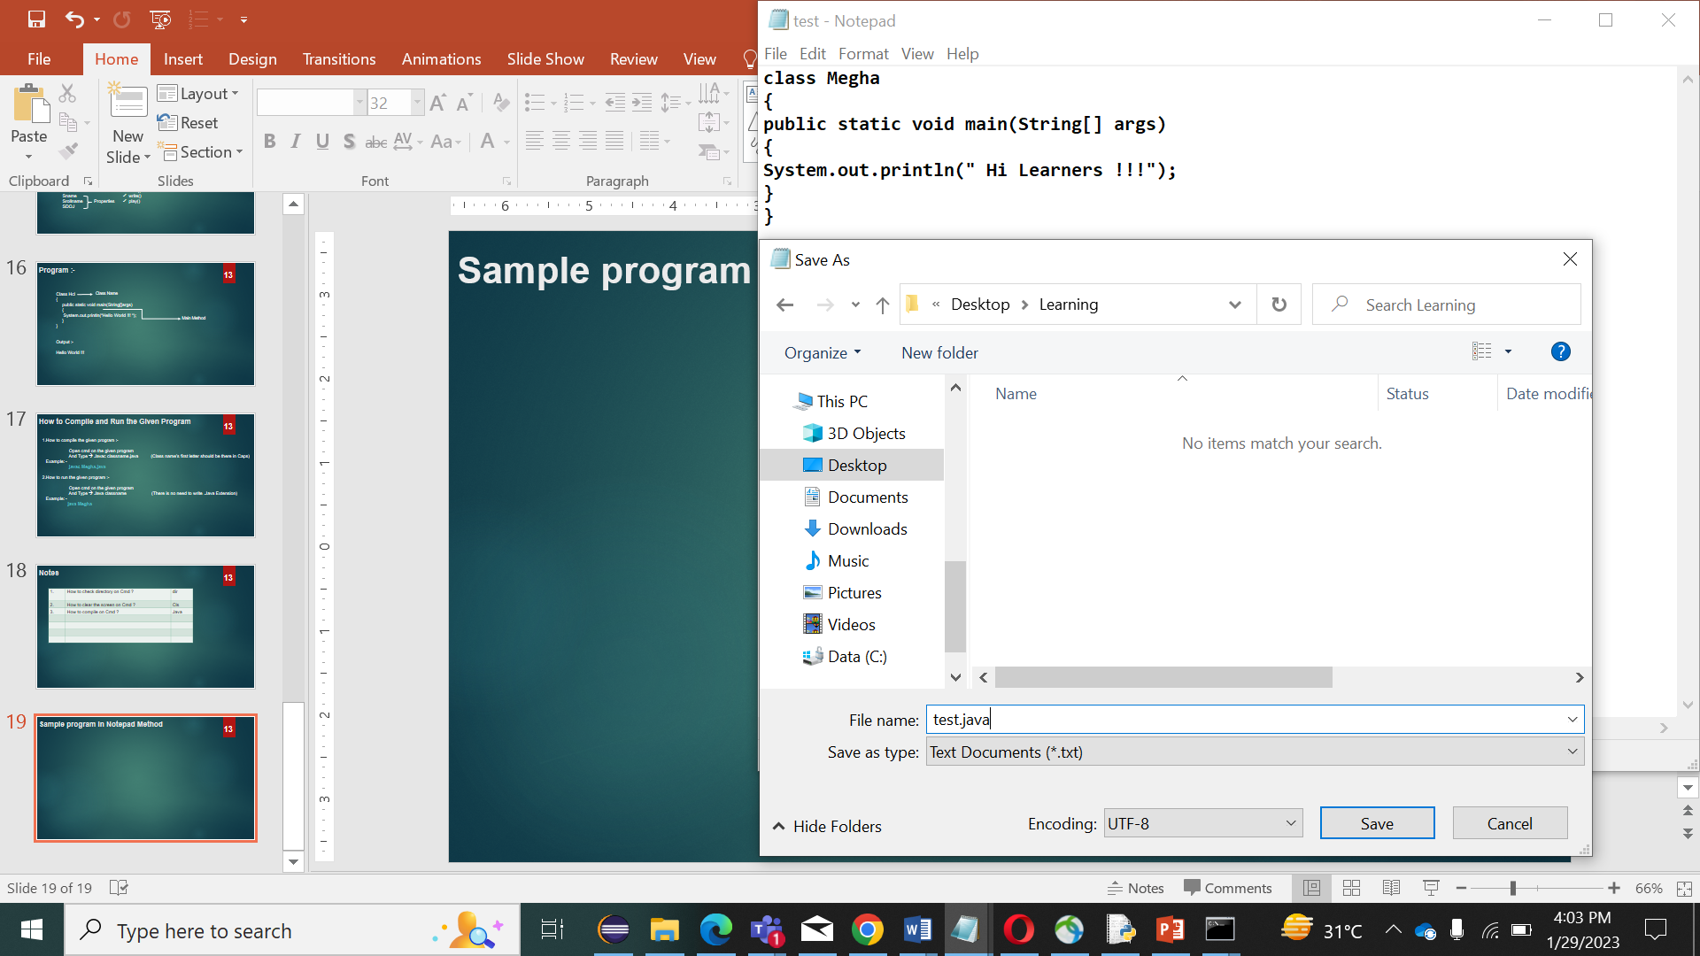
Sample program in Notepad Method
18

Slide 20
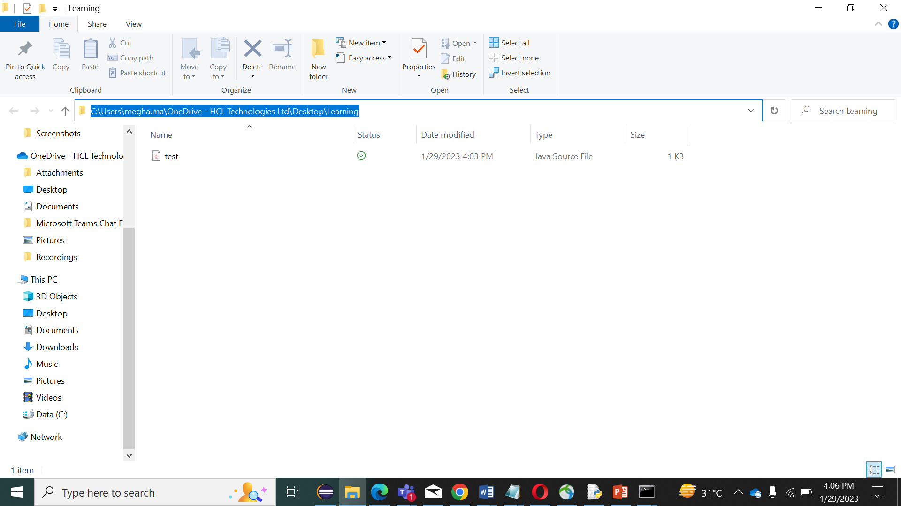
Sample program in Notepad Method
19
Type “ cmd ”on it.

Slide 21
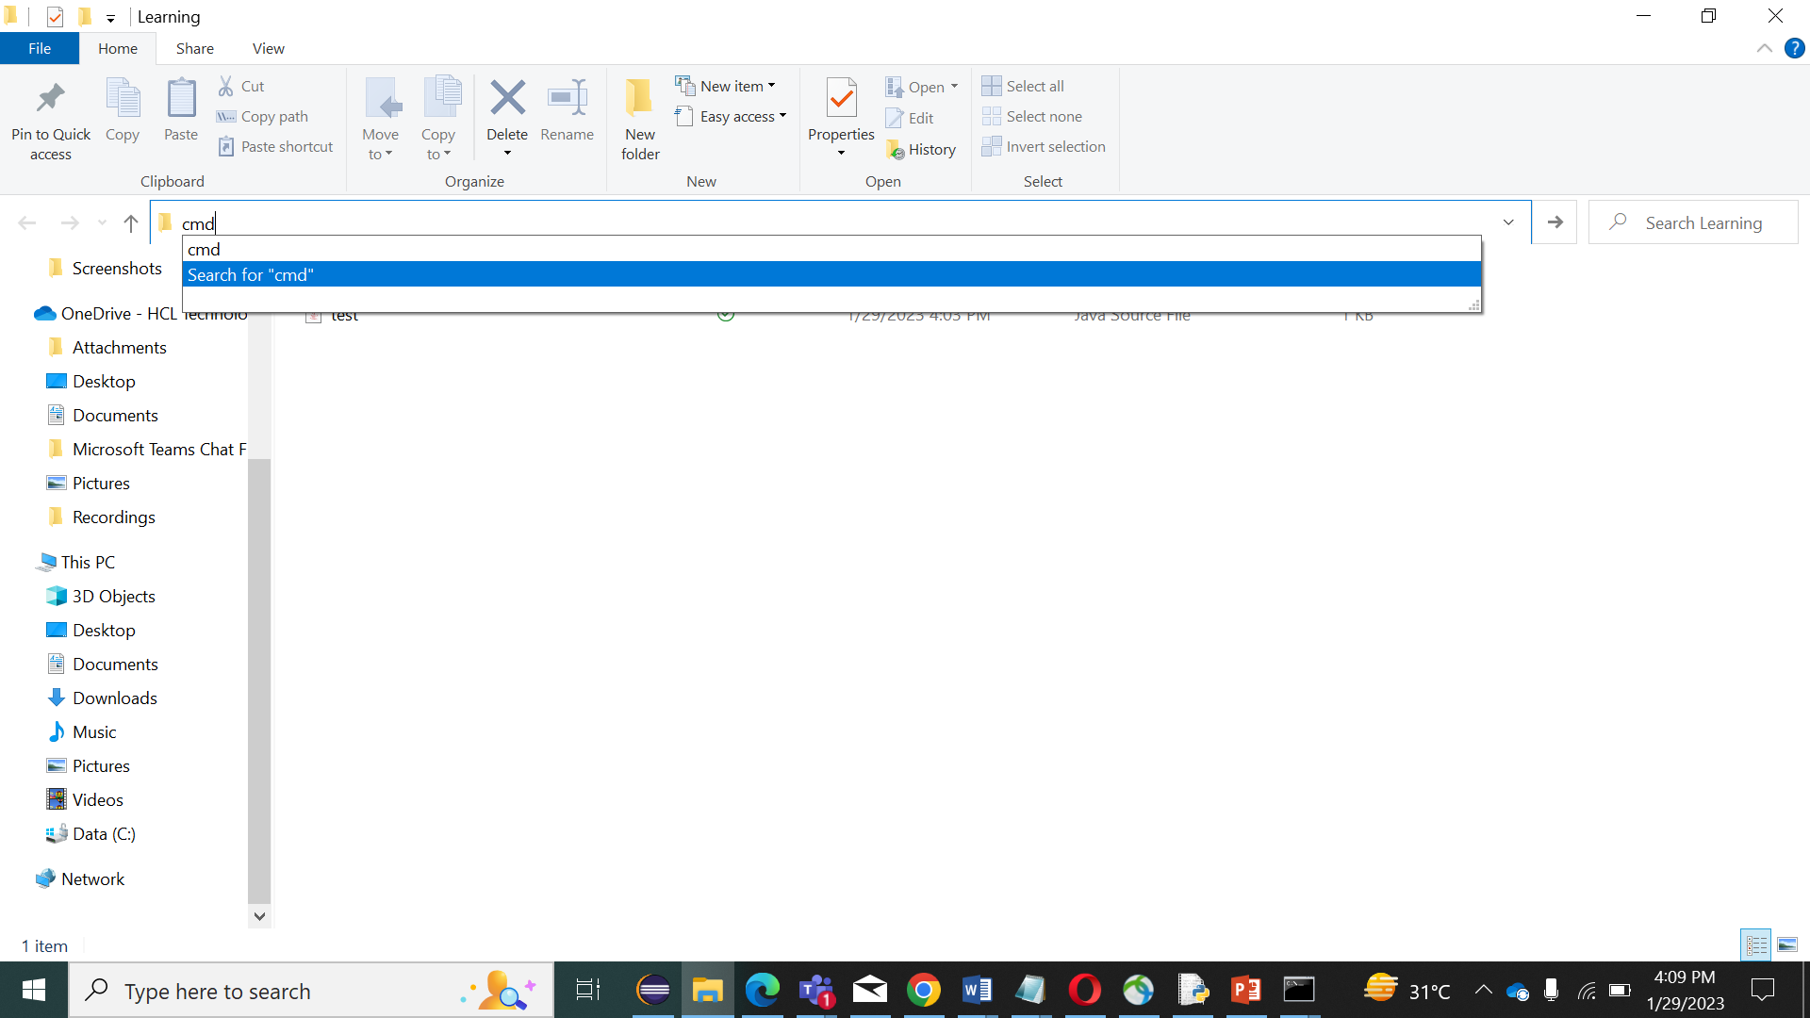
Sample program in Notepad Method
20

Slide 22
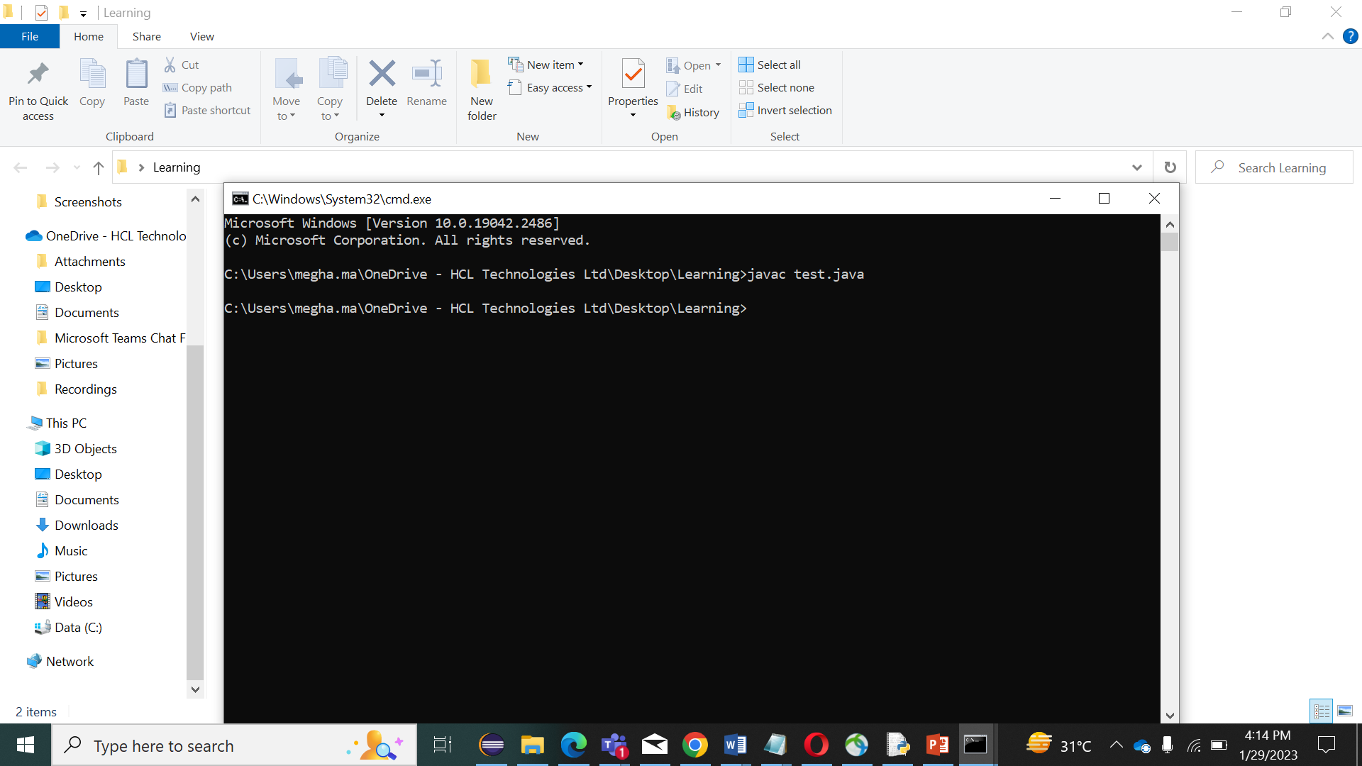
Sample program in Notepad Method
21
Type “ javac test.java ” . Java programs are compiled using the javac command. It takes .java files as input and generates bytecode.

Slide 23
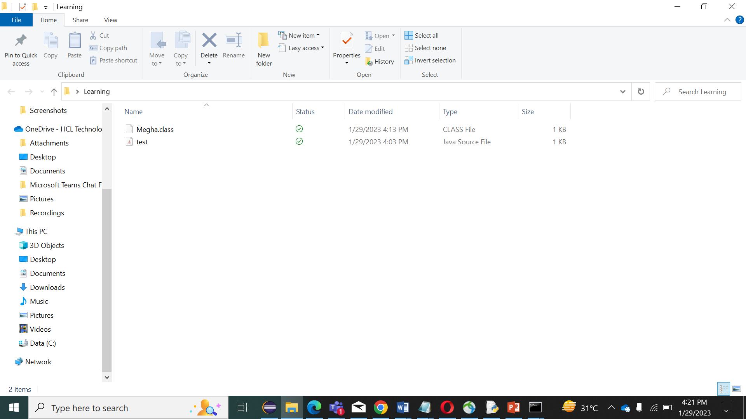
Sample program in Notepad Method
22
Then we can see that a new file has been created with the .class extension. The name of the file would be the name of the class that we have used inside our program. In this program, I have used the Megha as a class name.
Now Again we have to click Alt +d and type cmd on it.

Slide 24
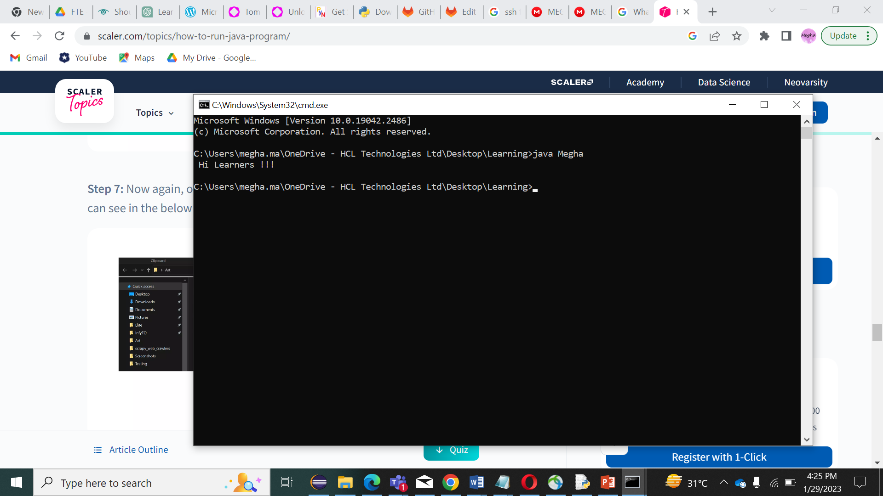
Sample program in Notepad Method
23
This command prompt we have to type “ java Megha “ (Megha is a class name)
Output

Slide 25
Command
24
Javac Command
Java programs are compiled using the javac command. It takes .java files as input and generates bytecode.
Syntax :-
javac test.java
Java Command
The Java command is used to execute Java bytecode. It takes bytecode as input, executes it, and outputs the result.
Syntax :-
Java Megha

Slide 26
Conclusion :-
25
We have seen how to run a Java program using notepad.
Create the Java file using Notepad and run it using Java and Javac commands.
Java programs are compiled using the Javac command.
The Java command is used to execute Java bytecode.

