Slide 1

WISP 2023
Healthcare Security Breaches in the United States: Insights and their Socio-Technical Implications
Speaker: Megha M. Moncy, BDS, MSHI
Co-authors: Saptarshi Purkayastha, PhD
Sadia Afreen, BTech
Institution: Indiana University, Indianapolis, IN, USA

Slide 2
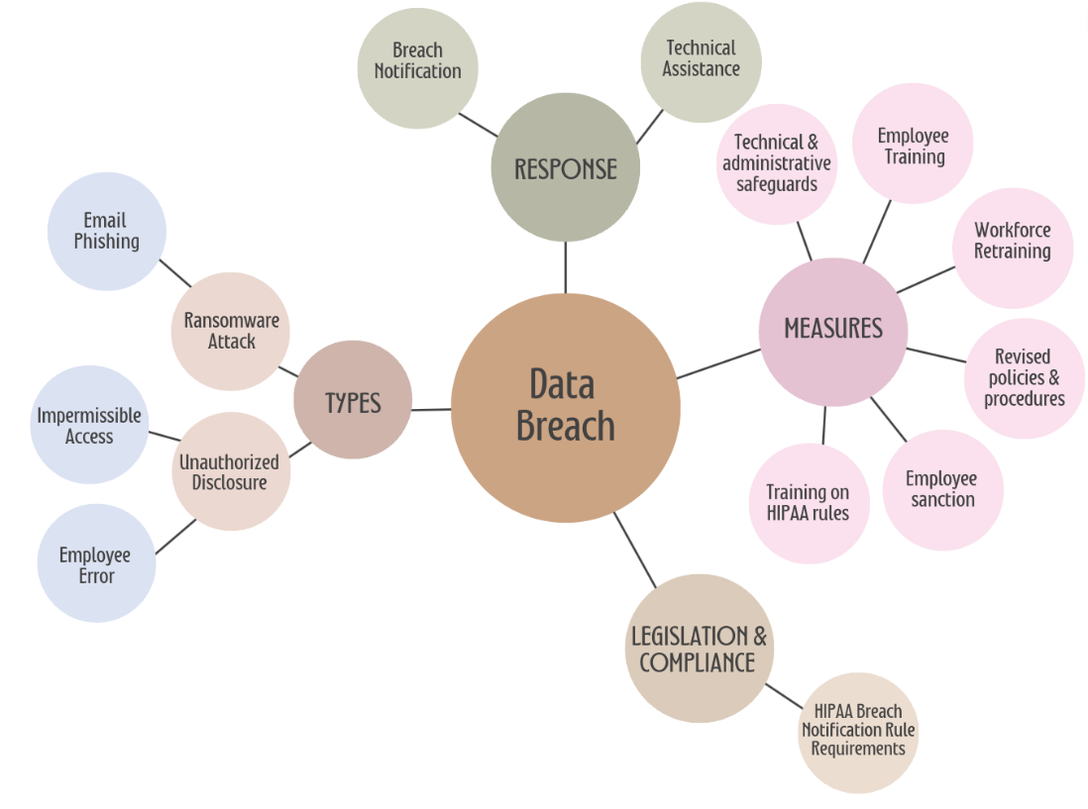
Research Agenda
Data Source: Breach Notification Portal, U.S. Department of Health and Human Services.
Data composition- Comprises of 4751 rows and 9 columns
Mixed-methods study:
  Phase 1: Quantitative Analysis of 4751 Breach Notifications (2009-Present)
    Examined the Yearly Trends in breach incidents over time.
    Identified which types of Entities are most frequently involved.
    Breach Type Analysis: Most common types of breaches and their frequency identified.
  Phase 2: Qualitative Discourse Analysis of Breach Descriptions.
    Stratified random sample for representative coverage.
    Thematic coding of textual descriptions.
18th Pre-ICIS Workshop on Information Security and Privacy, Hyderabad, India December 10, 2023

Slide 3
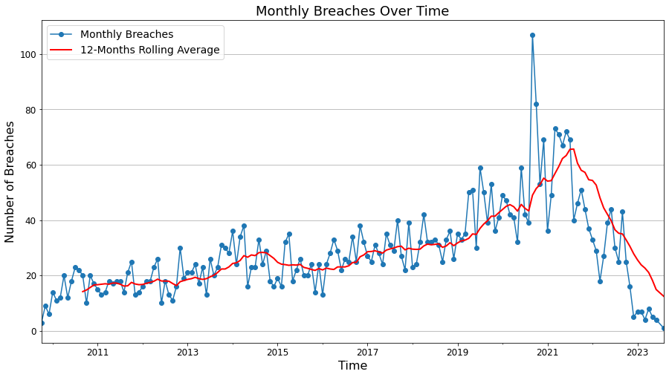
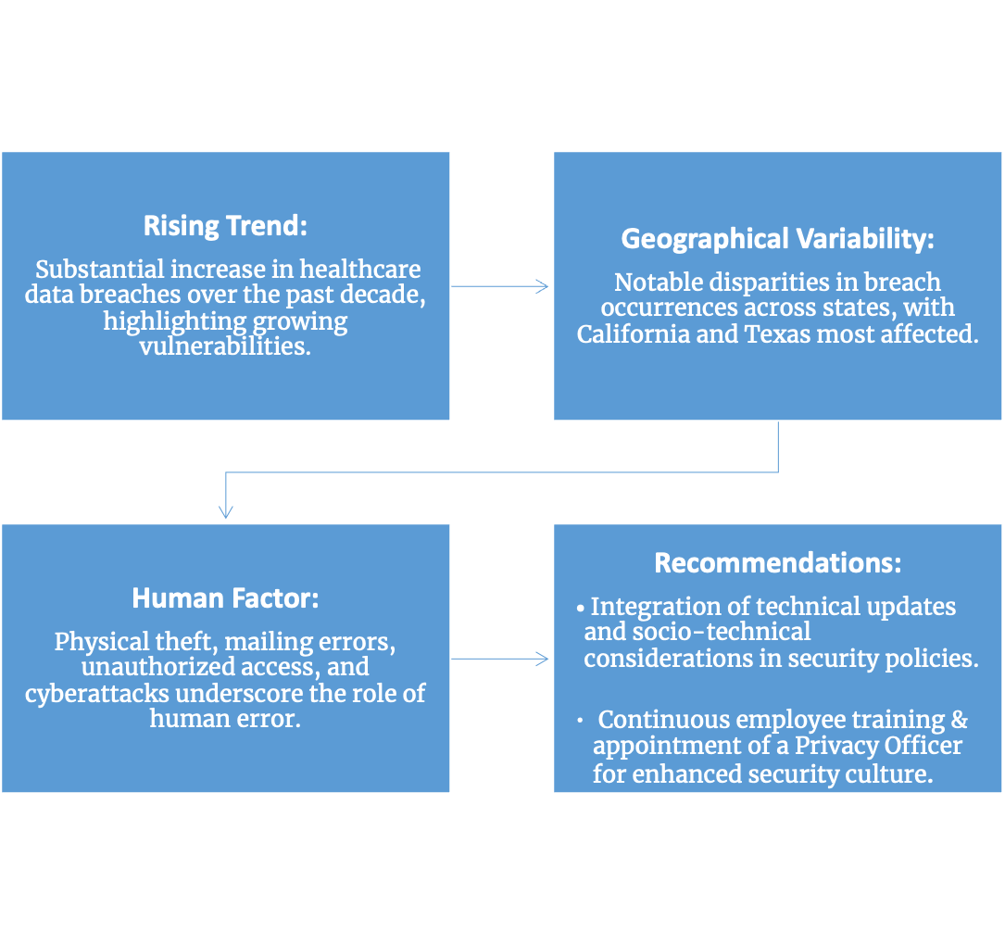
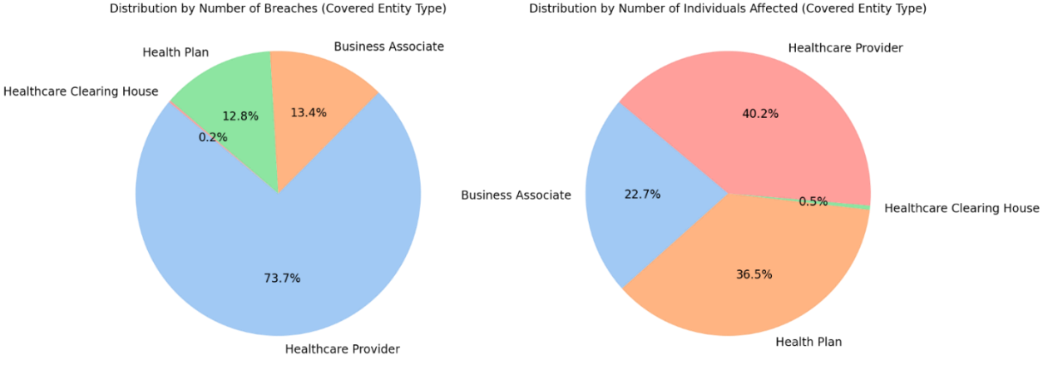
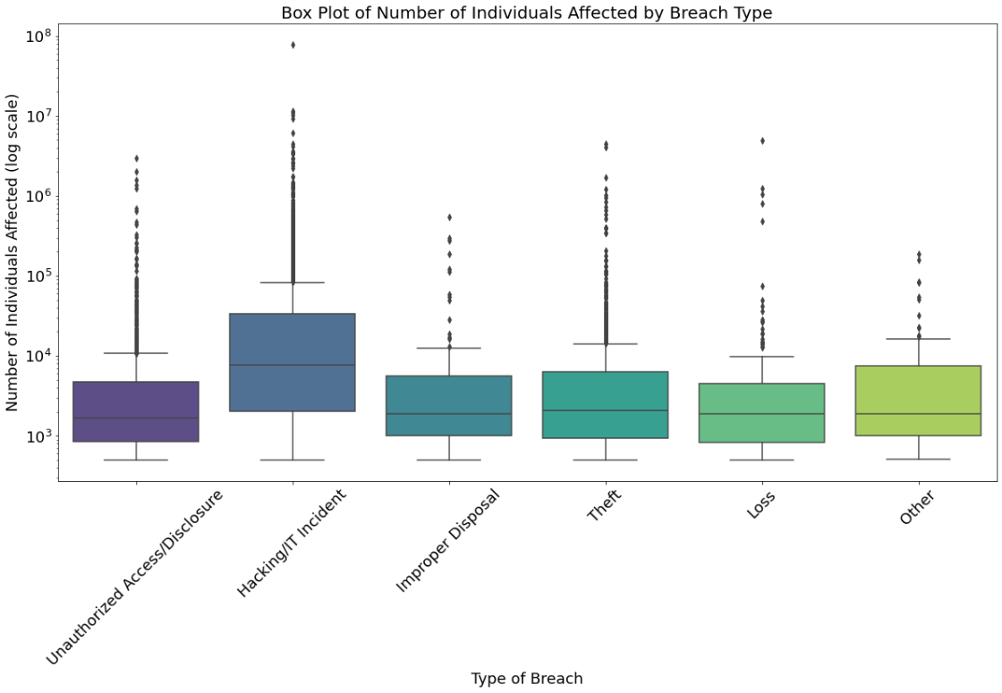
Key Findings and Insights
Visit https://arxiv.org/abs/2311.03664 to learn more.
Contact me:
memoncy@iu.edu
18th Pre-ICIS Workshop on Information Security and Privacy, Hyderabad, India December 10, 2023

