Slide 1
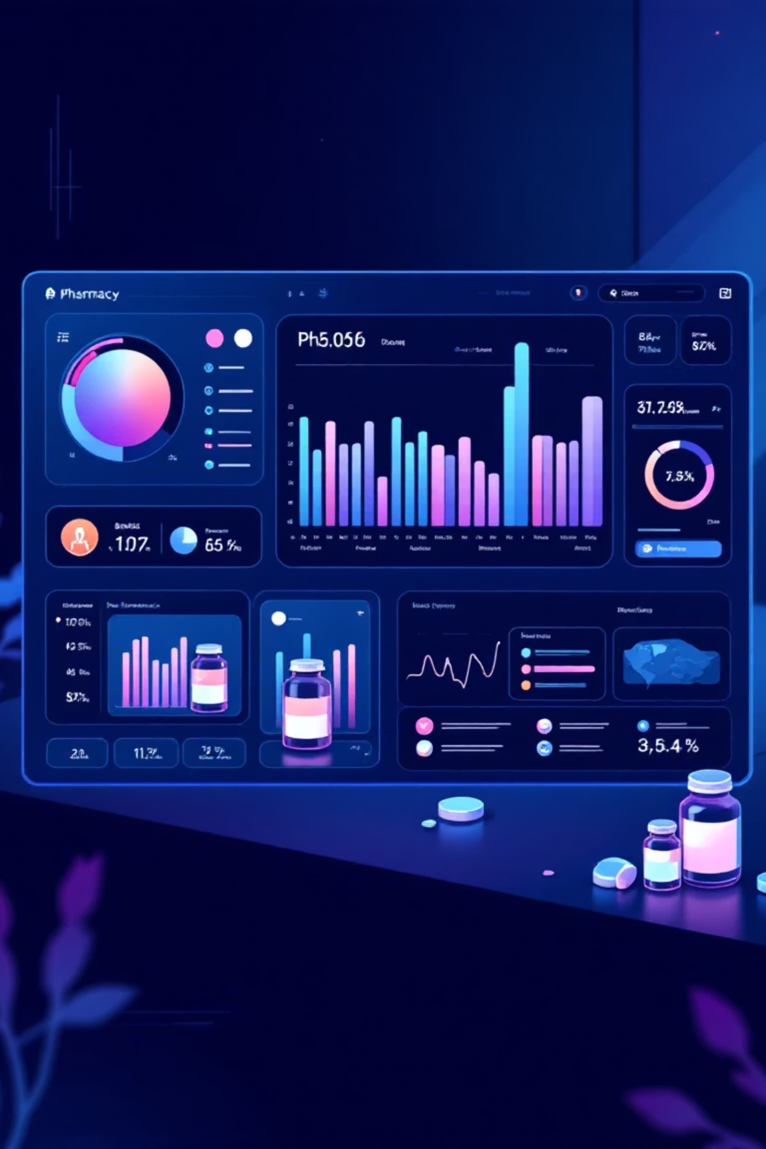
AI-Powered Solution for Pharmacy Inventory Management
Automated Forecasting | Real-time Stock Alerts | Pharmacist-Centric Workflows
Team Supply Soul:
Megha Narendra Simha
Poorrnima Vetrivelan
Nada Feteiha

Slide 2

Problem Statement: Inventory Challenges
Frequent Stockouts of Critical Medicines
Overstocking & Expiry Wastage
Manual Tracking & Ordering Delays
Running out of essential medications impacts patient care and pharmacy reputation.
Excess inventory leads to expired medicines and financial losses.
Difficulty tracking consumption patterns makes accurate ordering nearly impossible.
Our solution automates and predicts pharmacy inventory management using AI agents, addressing these critical issues.

Slide 3

Key Features of Our Solution
Real-time Stock Monitoring
AI-Driven Demand Forecasting
Instant visibility into current inventory levels with low-stock alerts.
Predictive analytics reduce shortages and optimize stock levels.
Alternative Medicine Recommendations
Automated Reorder Emails
Suggests substitutes when primary medicines are unavailable.
Streamlined communication with suppliers for faster restocking.
Voice-Enabled Queries
Post-Purchase Updates
Hands-free interaction for busy pharmacy environments.
Automatic inventory adjustments after transactions.

Slide 4

Our Robust Tech Stack (Pharmacy Implementation)
Backend Technologies
Frontend & Tools
Python (FastMCP) - Agent orchestration for pharmacy workflows
React - Pharmacy dashboard with TTS-enabled chatbot for pharmacist queries
PostgreSQL for scalable data storage
Sentence Transformers (Vector Embeddings)
Chart.js for interactive data visualisation
Flask/NGROK bridge for connectivity
Tailwind / Custom CSS for styling
Igentic
Ngrok, GitHub, VS Code for development
OAuth & Gmail API
Text-to-Speech (TTS) Engine for voice-enabled pharmacist interactions
Launchctl for scheduling daily pharmacy operations

Slide 5





Pharmacy Workflow Architecture
Our system processes pharmacist queries through a multi-stage architecture optimized for pharmacy operations:
Pharmacist Query
Initiates with a pharmacist request (e.g., Stock Check, Medicine Recommendation, Reorder Status).
Orchestrator
Routes query to the appropriate pharmacy agent.
Data Retrieval
Agent fetches inventory and consumption data and also updates purchases to PostgreSQL.
Processing
Semantic search resolves medicine names; predictive analytics models forecast demand.
Output & Dashboard
Agents return insights, updating the pharmacy dashboard dynamically.
This is Workflow 1: Real-time Pharmacist Queries

Slide 6
Workflow 2: End-of-Day Background Operations
Automated inventory updates and supplier notifications
01
02
03
End-of-Day Trigger
Receipt Processing
Inventory Update
Launchctl triggers background agent at end of business day.
Background Agent reads and processes all pharmacy receipts and transactions from the day.
Updates inventory tables in PostgreSQL with new stock levels and consumption data.
04
05
Alert Generation
Email Notifications
Identifies low-stock items and generates reorder alerts.
Email Agent sends automated reorder emails to suppliers and alerts to pharmacy staff.

Slide 7







Multi-Agent System Design (Pharmacy)
Our solution employs specialized AI agents, coordinated by a central orchestrator, to streamline pharmacy inventory management and support pharmacist decision-making.
Stock Agent
Greeter Agent
Monitors real-time inventory levels and identifies low-stock medicines.
Manages pharmacist interactions and provides dashboard overview.
Reorder Agent
Update Inventory & Recommendation Agent
Automates reorder processes, communicates with suppliers, and sends automated alerts for critical updates.
Updates inventory records in real-time and generates alternative medicine recommendations based on stock availability and patient needs.
Demand Agent
Analyzes consumption patterns to understand patient medication needs.
Background Agent
Runs end-of-day operations: processes receipts, updates inventory tables, and triggers notifications for low-stock items.
Forecast Agent
Predicts future demand using advanced machine learning models for optimal stock planning.

Slide 8
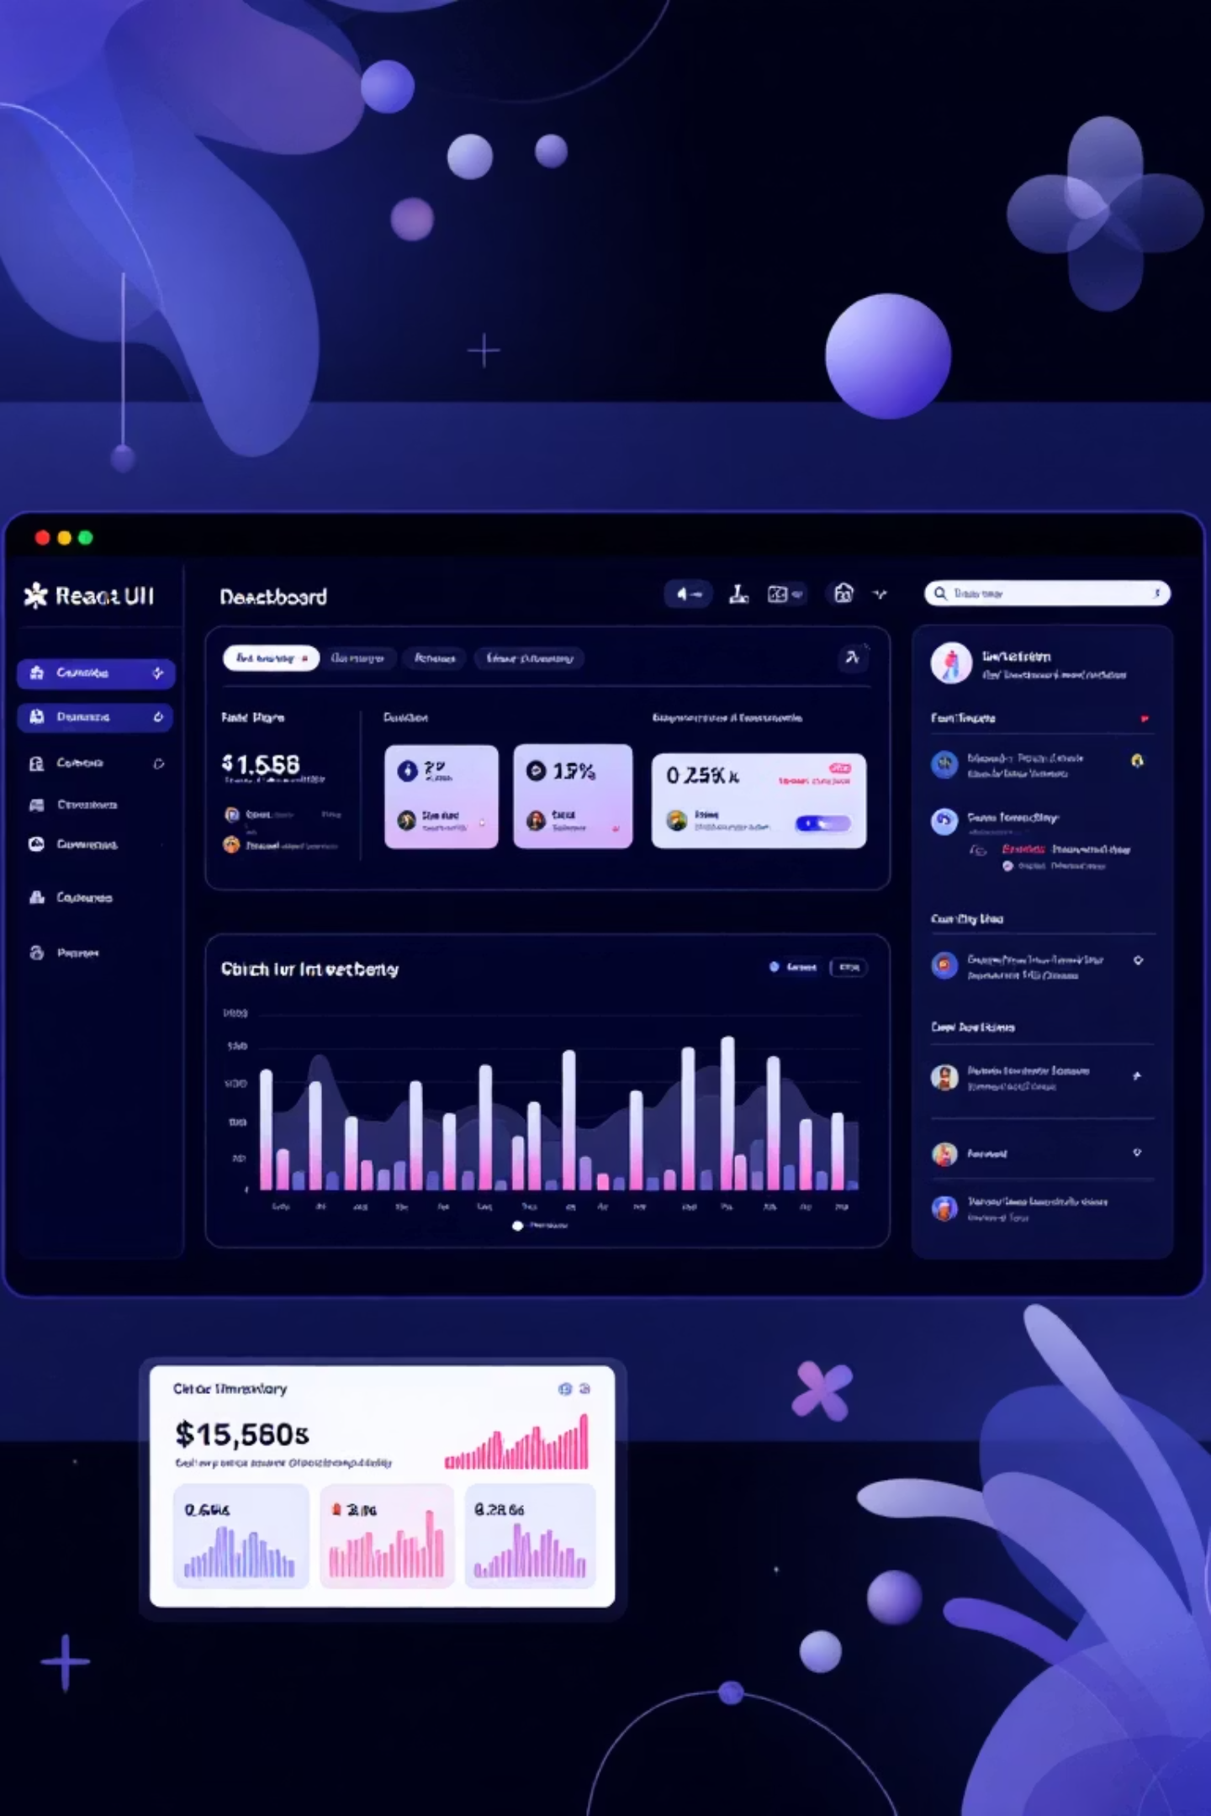
Dashboard Features: Intuitive & Informative
Medicine Inventory Table: Detailed overview of all medicines with stock levels and expiry dates.
Voice-Enabled Queries: Hands-free interaction for busy pharmacy staff.
Real-Time Alerts: Notifications for low stock, out-of-stock, and expiring medicines.
Robust Error Handling: Comprehensive feedback for all pharmacy operations.
Demand Forecast Charts: Visual predictions for upcoming medicine demand.
Dynamic Visuals: Charts showing stock trends, demand patterns, and reorder recommendations.

Slide 9
Impact & Problems Solved
Transforming Pharmacy Operations with AI
Reduced Stockouts
Before: Frequent stockouts impact patient care.
After: Medicine availability maintained consistently.
Lower Wastage
Before: Expired medicines due to overstocking.
After: Significant reduction in wastage.
Faster Decision-Making
Before: Manual ordering takes hours.
After: Automated reorders in minutes.
Improved Patient Satisfaction
Before: Patients leave without medicines.
After: Consistent availability improves satisfaction.

Slide 10
Future Enhancements for Pharmacy Operations
Real-time Deployment
Real-time SMS Alerts
Mobile App Integration
Seamless cloud deployment for instant system updates and scalability.
Instant SMS notifications to pharmacists for urgent stock situations.
Access pharmacy inventory and alerts on-the-go via mobile app.
Advanced Analytics
Multi-branch & Hospital Network Integration
Medical Expiry & Seasonal Demand Tracking
Comprehensive dashboard with deeper insights into medicine trends and forecasts.
Seamless connection with existing Pharmacy Management Systems (PMS) and expansion to multi-branch pharmacies or hospital networks.
Intelligent monitoring of medicine expiry dates and seasonal demand patterns for optimized inventory planning.

