Slide 1
Assignment 4
Megha Patel
Cohort - B

Slide 2
Problem 1
Sales Transactions Weekly Dataset
Use k-means clustering method to create small clusters of similar time series, and those clusters with very small intra-cluster variability are used to find similar time series.

Slide 3
Default Charts for Problem 1
In the default k-means clustering, 8 different clusters are formed.
The following are the different charts for different clusters.

Slide 4
Default Charts for Problem 1

Slide 5
Default Charts for Problem 1

Slide 6
Default Charts for Problem 1

Slide 7
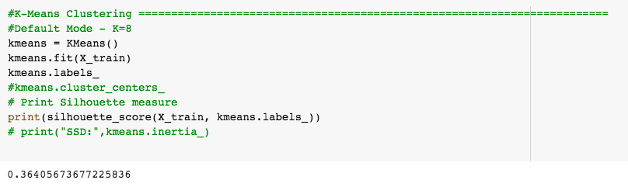
Chart representing different clusters
The below chart shows the time series from 8 different clusters.
It shows that some of the clusters are overlapping.
Here, I have selected a particular row from each clusters and then made a line chart based on all clusters.
The clusters are overlapping as the silhouette score is 0.36.

Slide 8
Charts after Hyper Parameter Tuning for Problem 1

Slide 9
Charts after Hyper Parameter Tuning for Problem 1

Slide 10
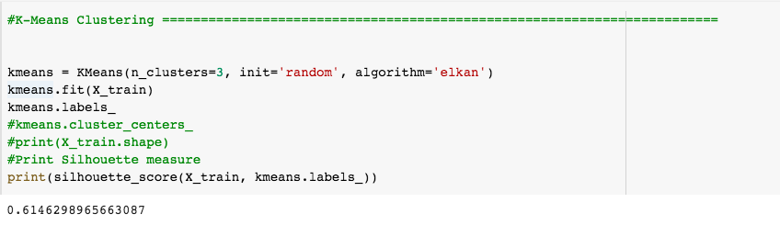
Hyper Parameter Tuning(Results)

Slide 11
Problem 2 Wholesale Customer Data
In this exercise, we are supposed to cluster on the basis of annual spending on different product types and then relate/interpret those cluster characteristics by region and channel.

Slide 12
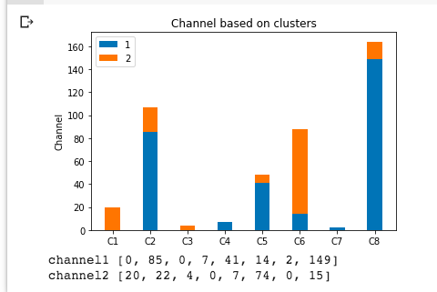
Channels based on Clusters(Default k-means)

Slide 13
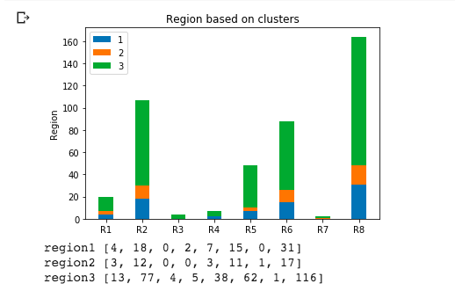
Regions based on Clusters(Default k-means)

Slide 14
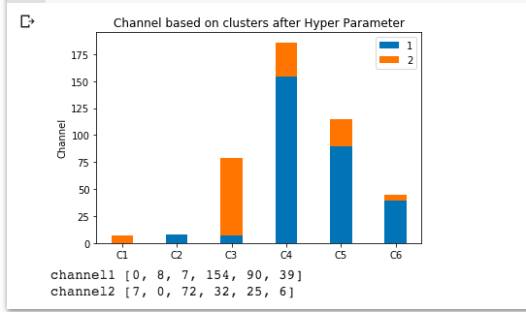
Channels based on Clusters(Hyper Parameter)

Slide 15
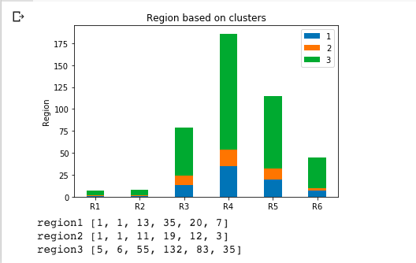
Regions based on Clusters(Hyper Parameter)

Slide 16
What’s different from previous assignments
In the previous assignments, we learned various classification techniques to classify the data into one of numerous already defined definite classes. It is mainly involved in supervised learning and has labeled data provided.
While in this assignment, we are doing clustering of the data which means that this function maps the data into one of the multiple clusters where the arrangement of data items relies on the similarities between them. It is mainly involved in unsupervised learning and labeled data is not provided.
Here, we are using k-means clustering to form clusters according to their similarities. We used silhouette score to find out whether the clusters are formed properly or not-The best value is 1 and the worst value is -1. Values near 0 indicate overlapping clusters. Negative values generally indicate that a sample has been assigned to the wrong cluster, as a different cluster is more similar.

Slide 17
Thankyou!

