Slide 1
Assignment-3
Megha Patel
Cohort B

Slide 2
Things Covered in the presentation
Excel Comparison of all models
Summary
Screenshots of various classifiers with the result of hyperparameter tuning and Kaggle scores.

Slide 3
Comparison of all models in Excel

Slide 4
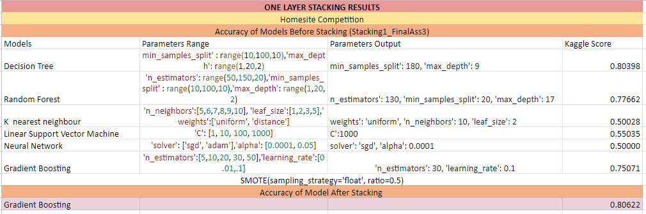
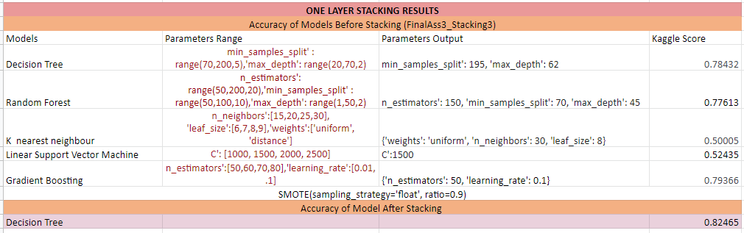
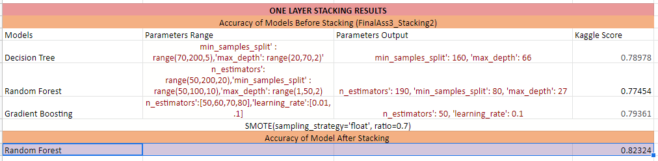
Here, is the summary of 3 different models on which I performed one layer stacking.
The excel sheet shows which various classifiers
are used in the various models and their respective individual and the stacked accuracy (Kaggle) score is mentioned.
From all the three models we can say that model 2 and model 3 are quite similar in terms of the accuracy score and have high accuracy compared to model 1.

Slide 5
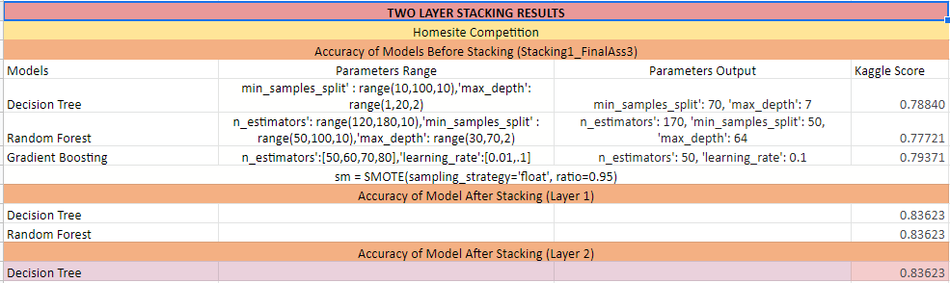
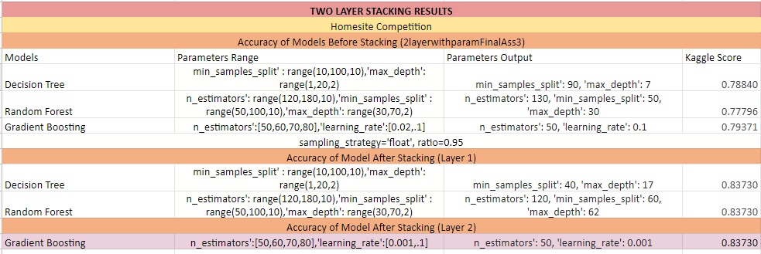
Here, is the summary of 2 different models on which I performed two layer stacking.
The excel sheet shows which various classifiers are used in the various models and their respective individual and the stacked accuracy (Kaggle) score is mentioned.
In the first model,I used the default classifiers after stacking the model and got an accuracy of 0.83623.
In the second model, I used the default classifiers after stacking the model and got an accuracy of 0.83730.
From both the models we can say that model 2 has a bit more accuracy.

Slide 6
Summary
In this assignment, we observed that we can get high level of accuracy by stacking various models. We can iterate the same process again and again in order to improve the accuracy on the data.
We also learnt SMOTE, for increasing the number of cases in the dataset in a balanced way. This module works by generating new instances from existing minority cases that you supply as input.

Slide 7
Screenshots of various classifiers with the results of hyperparameter tuning and Kaggle scores.

Slide 8
Individual Models Prediction Model 1(Stacking1_FinalAss3)

Slide 9
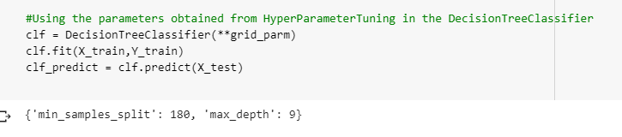
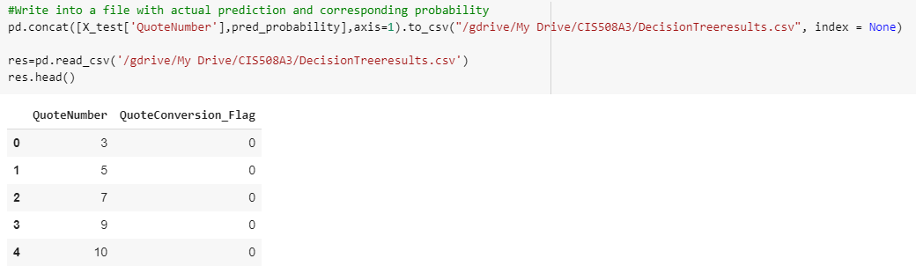
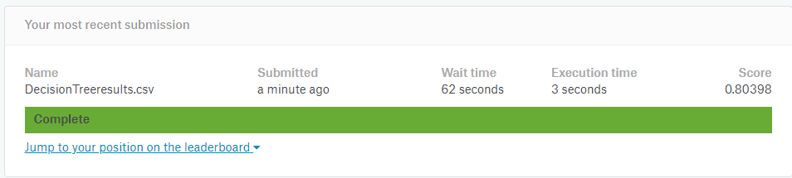
Random Search with Hyperparameter Tuning in Decision Tree Classifier

Slide 10
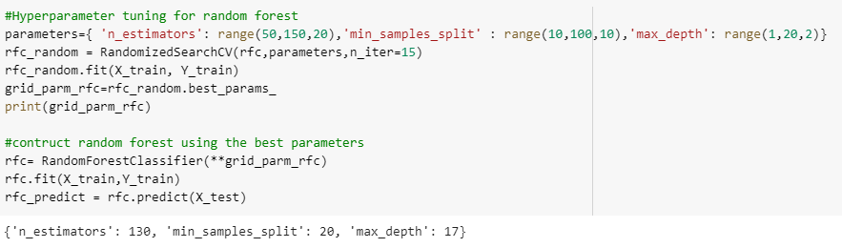
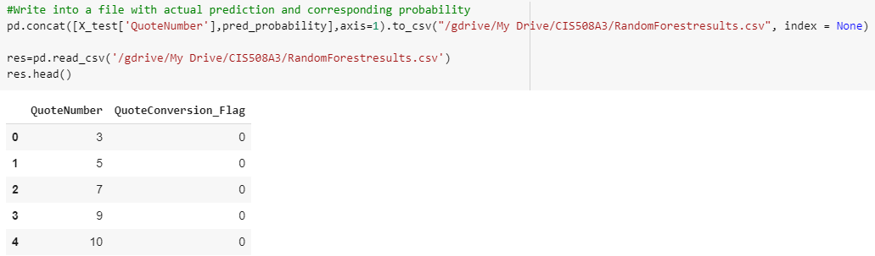
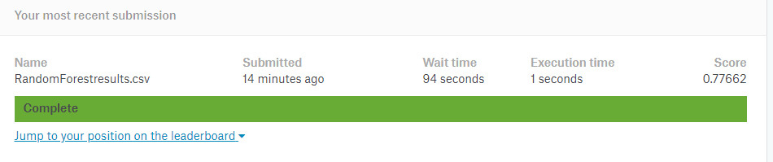
Random Search with Hyperparameter Tuning in Random Forest

Slide 11
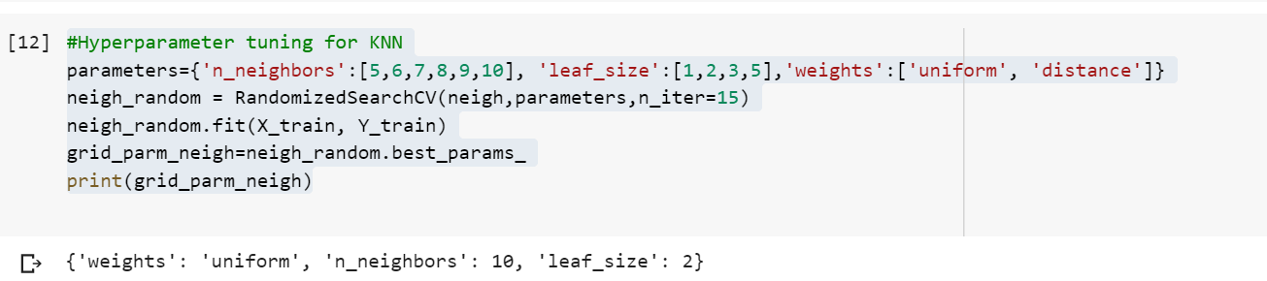
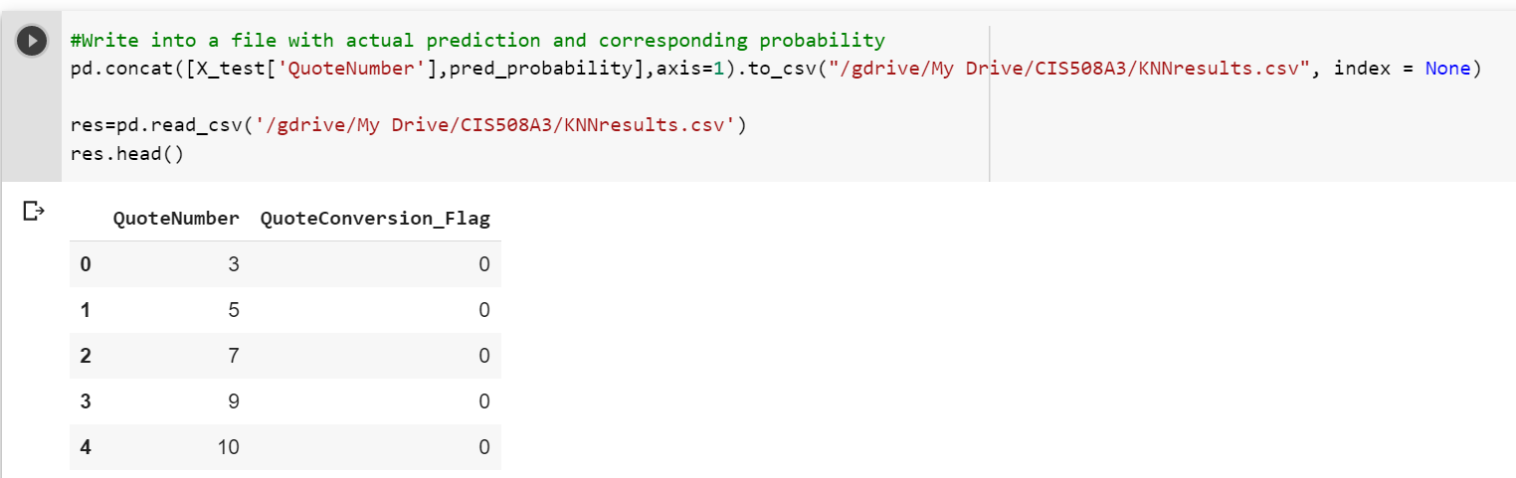
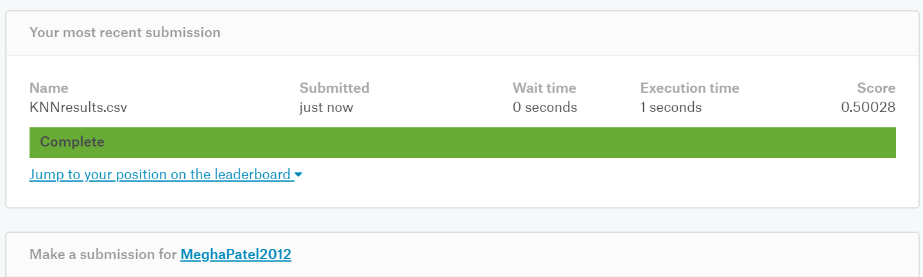
Random Search with Hyperparameter Tuning in KNN

Slide 12
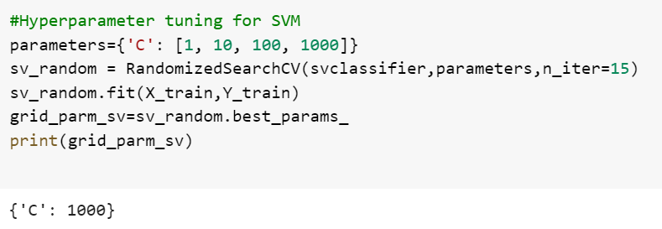
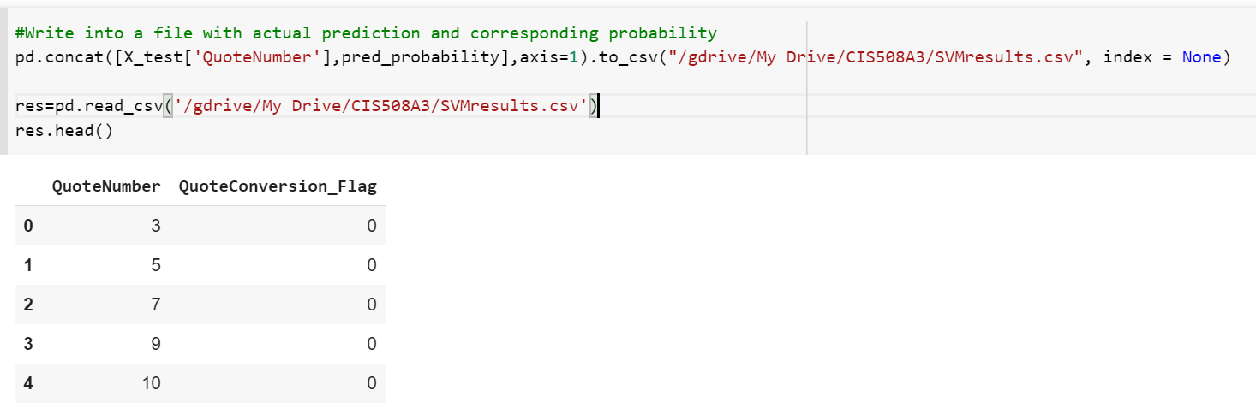
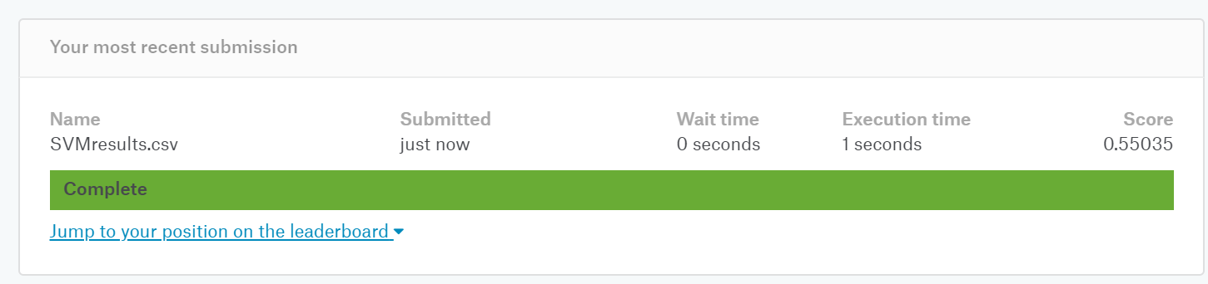
Random Search with Hyperparameter Tuning in Support Vector Machine

Slide 13
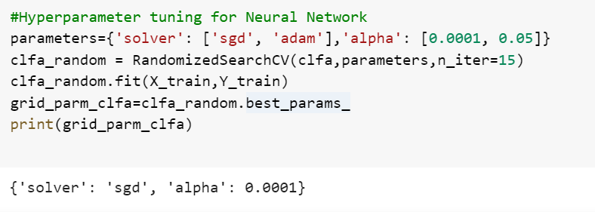
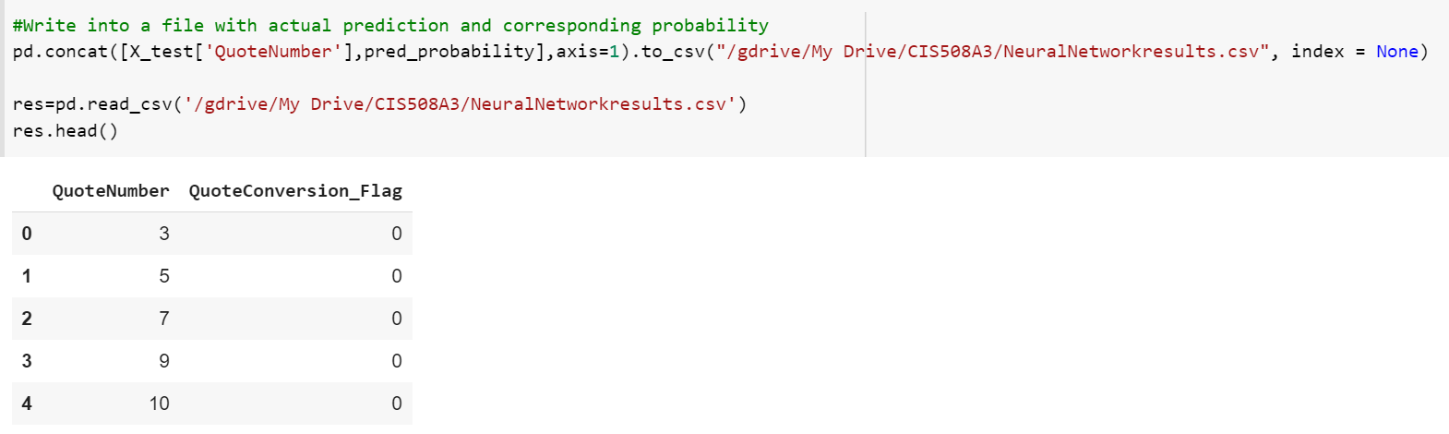
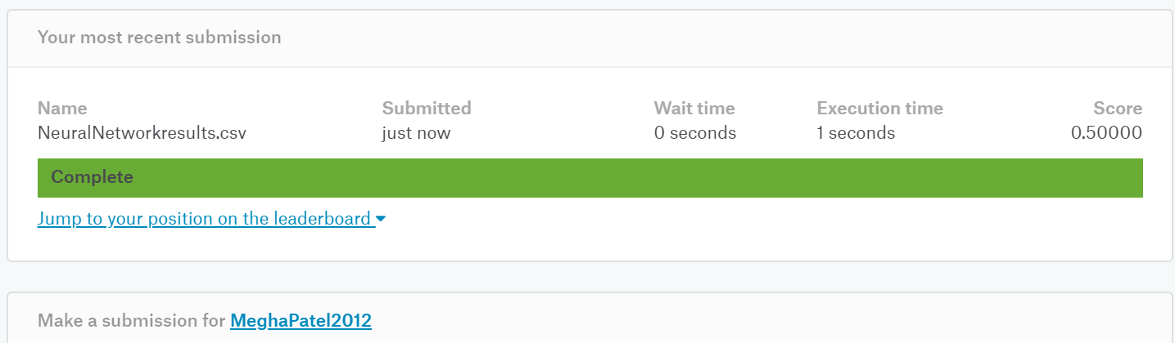
Random Search with Hyperparameter Tuning in Neural Network

Slide 14
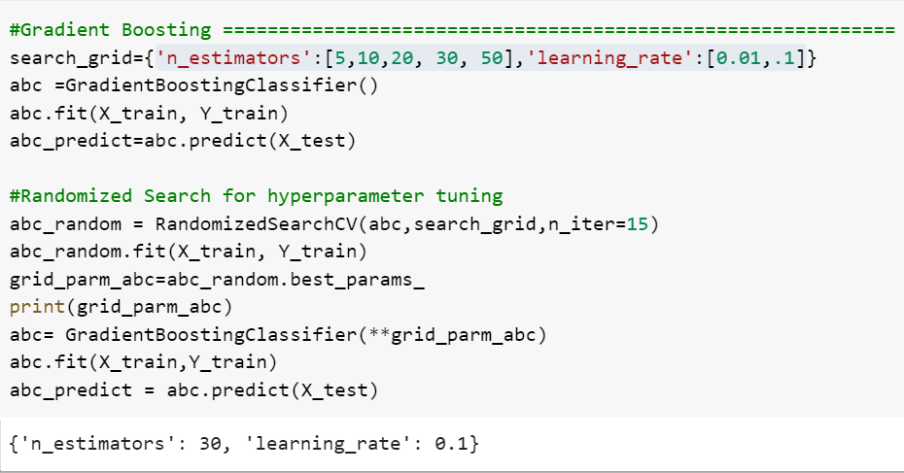
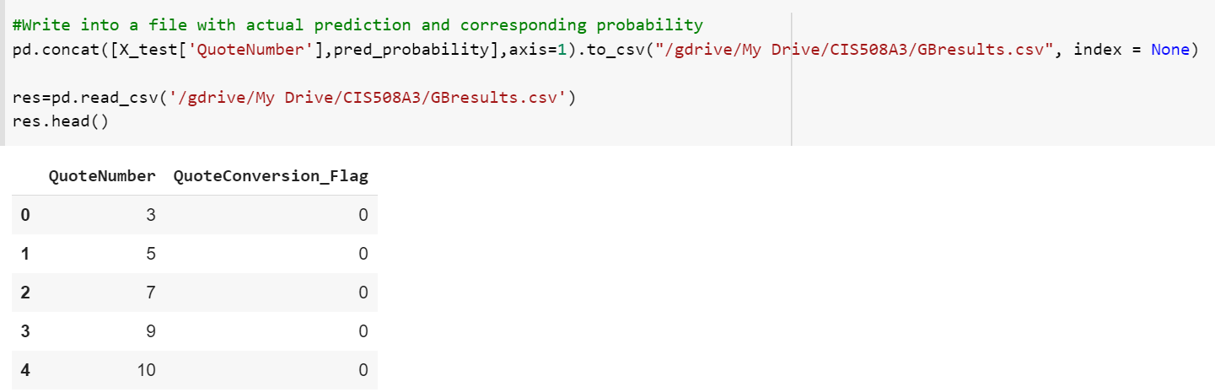
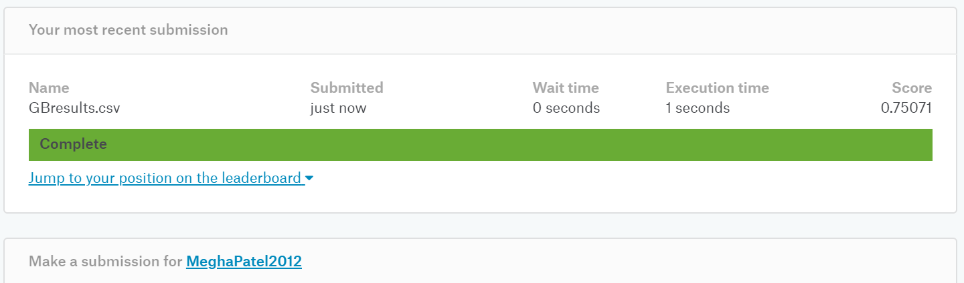
Random Search with Hyperparameter Tuning in Gradient Boosting

Slide 15
One Layer Stacked Model Prediction Model-1(Stacking1_FinalAss3)

Slide 16
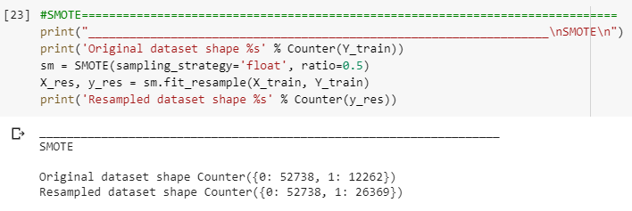
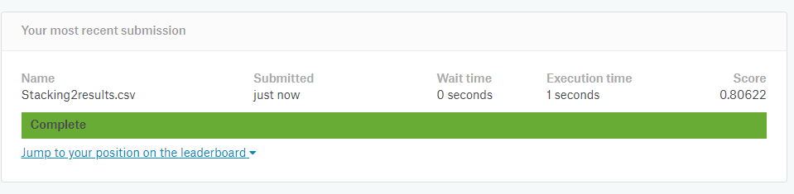
Default Gradient Boosting after Stacking and SMOTE value

Slide 17
Model 1 Excel Sheet

Slide 18
Individual Model Prediction Model-2(FinalAss3_Stacking3)

Slide 19
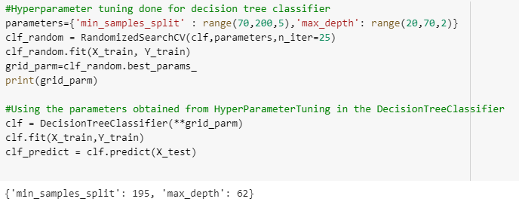
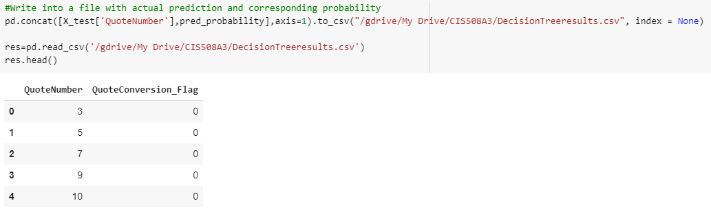
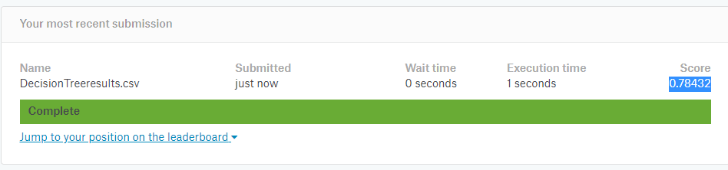
Random Search with Hyperparameter Tuning in Decision Tree Classifier

Slide 20
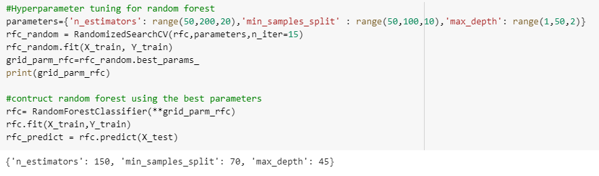
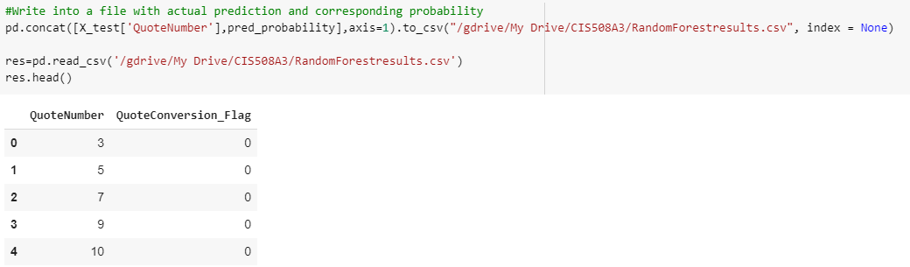
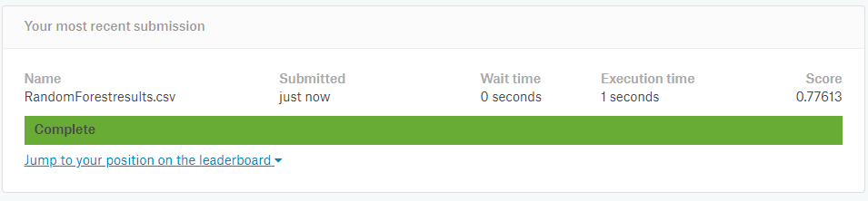
Random Search with Hyperparameter Tuning in Random Forest

Slide 21
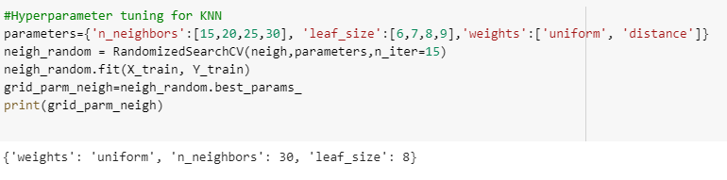
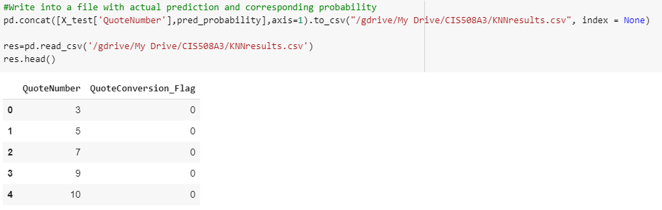
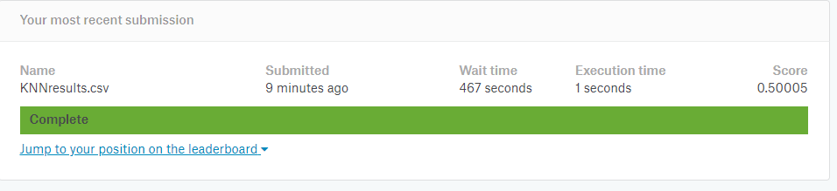
Random Search with Hyperparameter Tuning in KNN

Slide 22
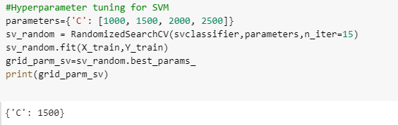
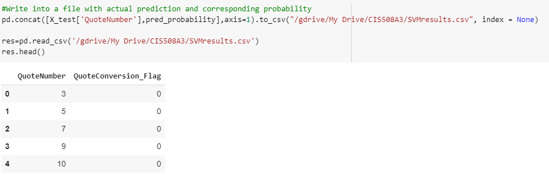
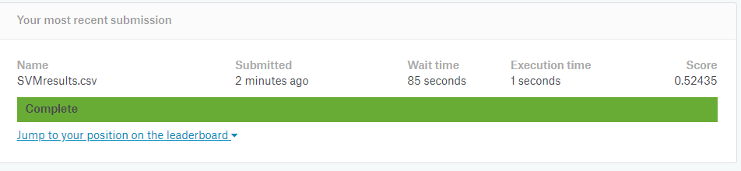
Random Search with Hyperparameter Tuning in Support Vector Machine

Slide 23
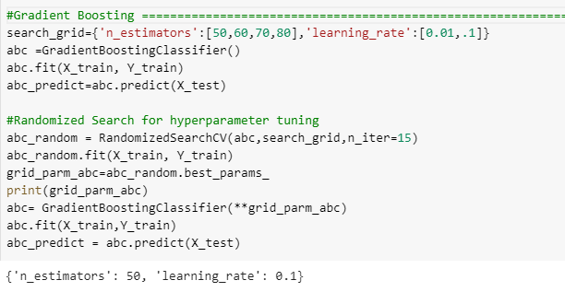
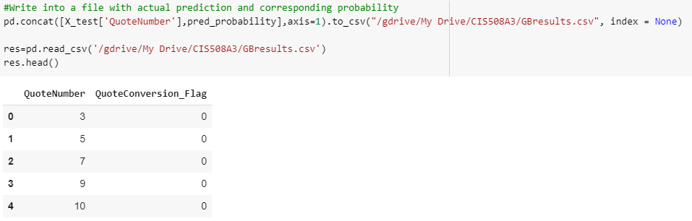
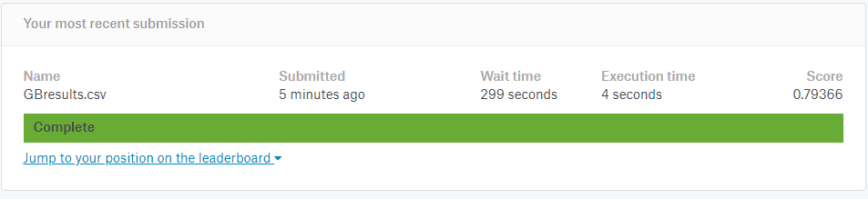
Random Search with Hyperparameter Tuning in Gradient Boosting

Slide 24
One Layer Stacked Model Prediction Model-2(FinalAss3_Stacking3)

Slide 25
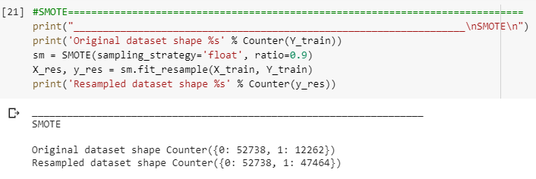
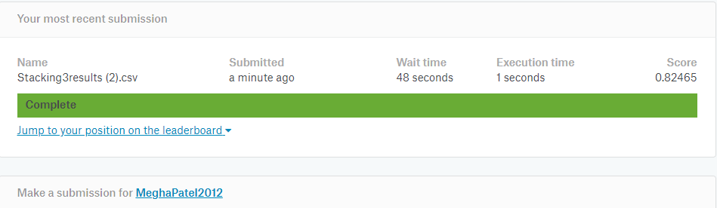
Decision Tree after Stacking and SMOTE value

Slide 26
Model 2 Excel Sheet

Slide 27
Individual Model Prediction Model-3(FinalAss3_Stacking2)

Slide 28
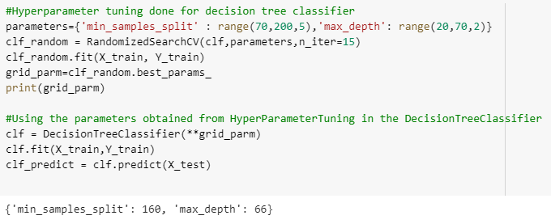
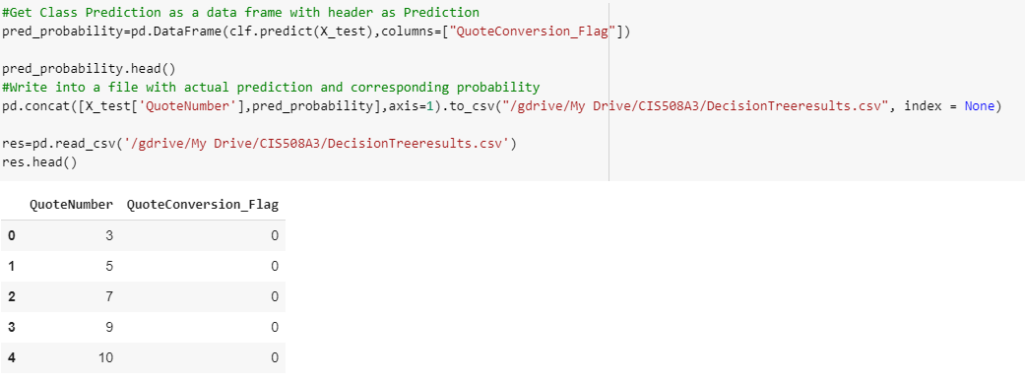
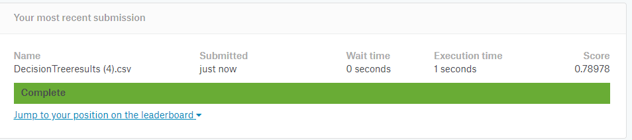
Random Search with Hyperparameter Tuning in Decision Tree

Slide 29

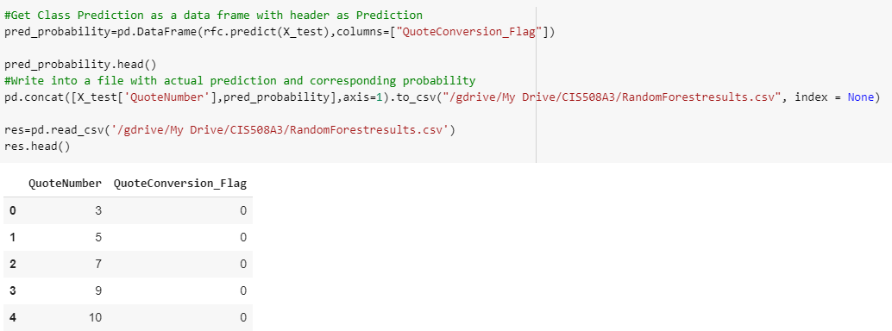
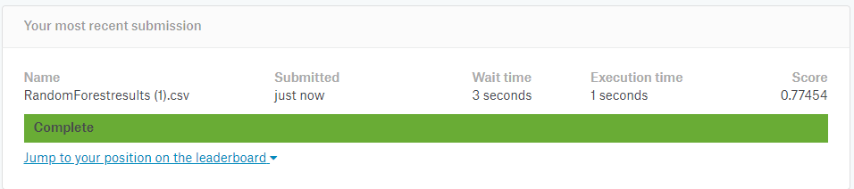
Random Search with Hyperparameter Tuning in Random Forest

Slide 30
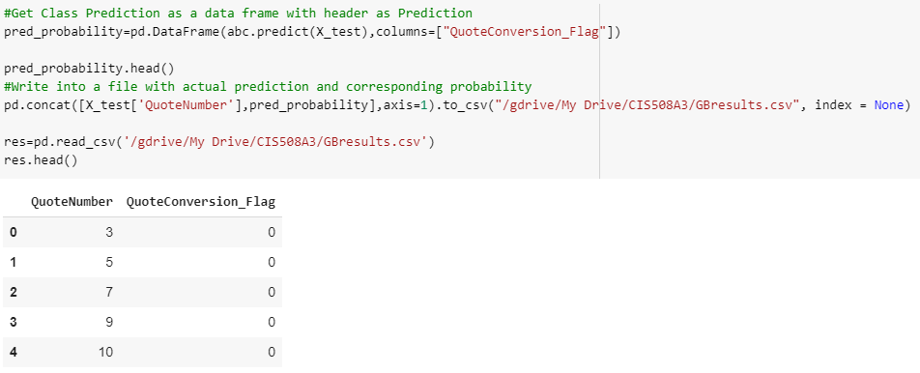
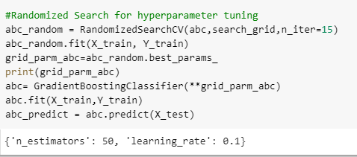
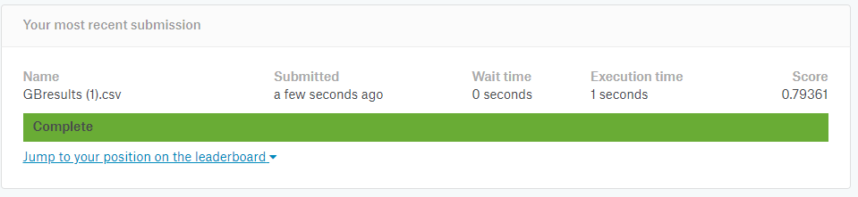
Random Search with Hyperparameter Tuning in Gradient Boosting

Slide 31
One layer Stacked Model Prediction Model-3(FinalAss3_Stacking2)

Slide 32


Random Forest After Stacking and SMOTE value

Slide 33
Model 3 Excel Sheet

Slide 34
Individual Model Prediction Model-4 (2layerwithoutparamFinalAss3)

Slide 35



Random Search with Hyperparameter Tuning in Decision Tree

Slide 36



Random Search with Hyperparameter Tuning in Random Forest

Slide 37



Random Search with Hyperparameter Tuning in Gradient Boosting

Slide 38
Two layer Stacked Model Prediction Model-4(Layer One) (2layerwithoutparamFinalAss3)

Slide 39



Default Decision Tree

Slide 40


Default Random Forest

Slide 41
Two layer Stacked Model Prediction Model-4(Layer Two) (2layerwithoutparamFinalAss3)

Slide 42


Default Decision Tree

Slide 43
Model 4 Excel Sheet

Slide 44
Individual Model Prediction Model-5 (2layerwithparamFinalAss3)

Slide 45



Random Search with Hyperparameter Tuning in Decision Tree

Slide 46



Random Search with Hyperparameter Tuning in Random Forest

Slide 47



Random Search with Hyperparameter Tuning in Gradient Boosting

Slide 48
Two layer Stacked Model Prediction Model-5(Layer One) (2layerwithparamFinalAss3)

Slide 49



Random Search with Hyperparameter Tuning in Decision Tree

Slide 50



Random Search with Hyperparameter Tuning in Random Forest

Slide 51
Two layer Stacked Model Prediction Model-5(Layer Two) (2layerwithparamFinalAss3)

Slide 52



Random Search with Hyperparameter Tuning in Gradient Boosting

Slide 53
Model 5 Excel Sheet

Slide 54
Thank you!

