Slide 1
Assignment 5
CIS 508
Megha Patel
Cohort B

Slide 2
The Problem Definition
In this assignment, we have been given a semi-structed machine learning problem.
With the help of the Natural language Tool kit, using different stemmers (Porter, Lancaster, Snowball),different Filtering method( Filter, Wrapper),computing the TFIDF matrix, we have to build different classification model in order to test which model achieves highest accuracy.

Slide 3
Steps
1) Tokenize the data-Tokenization means breaking down words eg. audit becomes adit.
Code- textData['CommentsTokenized'] = textData['Comments'].apply(word_tokenize)
2)Using various Stemmers to construct the term-document matrix
Porter- Number of stemmed words by Porter: 366
Lancaster- Number of stemmed words by Lancaster: 364
Snowball- Number of stemmed words by Snowball: 354
3) Construct the TF-IDF matrix from the term-document matrix
Porter- [2070 rows x 366 columns]
Lancaster-[2070 rows x 364 columns]
Snowball-[2070 rows x 354 columns]

Slide 4
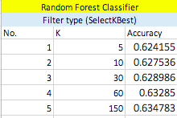
Steps
4) Feature Selection
Filter Method(SelectKBest)
As we know that the filter method is faster compared to the wrapper method and also it is unbiased towards the classification algorithm.
In this example, I used Random Forest Classifier to test different values of K and get the accuracy score.
Following table shows different K values and the accuracy score:-
From this table we can see that, even after changing the value of K from 5 to 150, there is no significant change in the accuracy score.

Slide 5
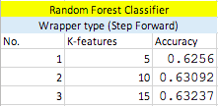
Steps
Wrapper Method(Step Forward Feature Selection method)
The wrapper method is slower compared to the filter method.
Also the resulting output is biased towards the algorithm being used.
In this case, we are using Random Forest Classifier to test the accuracy using the Step Forward method.

Slide 6
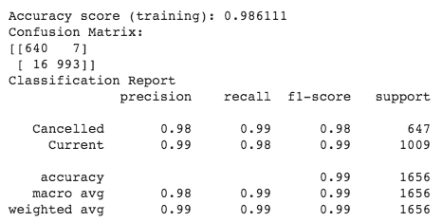
Steps
5) After combing the TF-IDF matrix with the customer data and doing one-hot encoding, we split the dataset as 80% training data and 20% testing data.
Using the best set of features from the feature selection method, I constructed two models.
1)Random Forest Classifier
From this, we can see that the accuracy score is 0.98 , which is good.

Slide 7
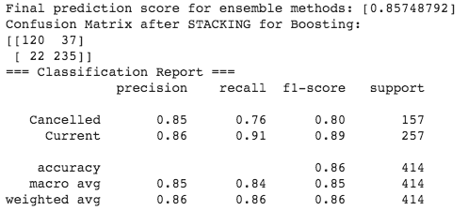
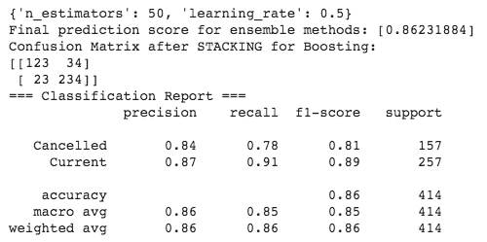
Steps
2) Gradient Boosting Method
From this, we can see that running a default gradient boosting method, we are getting accuracy score of 0.85
After doing hyper parameter tuning, accuracy scored increased to 0.86.
By comparing both the models, i.e Random Forest and Gradient Boosting we can see that the accuracy score for random forest is higher.

Slide 8
What’s new in this assignment
In the previous assignments, we learned how to build different classifiers and regressors and achieved the accuracy scores by solving the structed data.
But in this assignment, we are dealing with the real-life situation where we have semi-structed data. With the help of Natural language Toolkit we can solve the complex data by first tokenizing the data, perform various stemmers, constructing TFIDF matrix, doing feature selection, using various filtering methods to get higher accuracy of the data.

Slide 9
Thank You!

