Slide 1
Project presentation on :- PFA HOUSING PROJECT
Name: Megha Singh
Batch #1834

Slide 2
Table Of Contents :-
1. Introduction
1.1 Problem Statement and understanding
2. EDA steps and Visualization
3. Steps and assumptions used to complete the project
3.1 Data Preprocessing Done
3.2 Problem solving approaches
3.3 Set of assumptions related to the problem under consideration
4. Model Dashboard
5. Finalized Model
6. Conclusion
7. Acknowledgement

Slide 3
INTRODUCTION
Problem statement and understanding
A US-based housing company named Surprise Housing has decided to enter the Australian market.
The company uses data analytics to purchase houses at a price below their actual values and flip them at a higher price. For the same purpose, the company has collected a data set from the sale of houses in Australia.
We are required to build a model using Machine Learning in order to predict the actual value of the prospective properties and decide whether to invest in them or not.

Slide 4
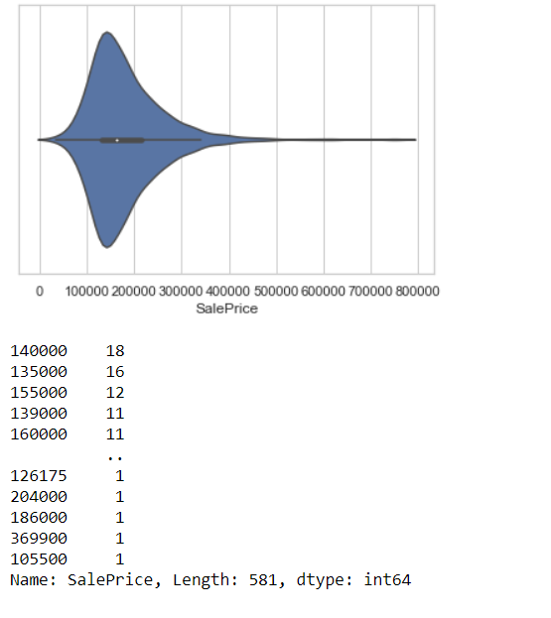
EDA steps and Visualization
Observation:
Maximum number of SalePrice lies between 140000 and 230000.

Slide 5
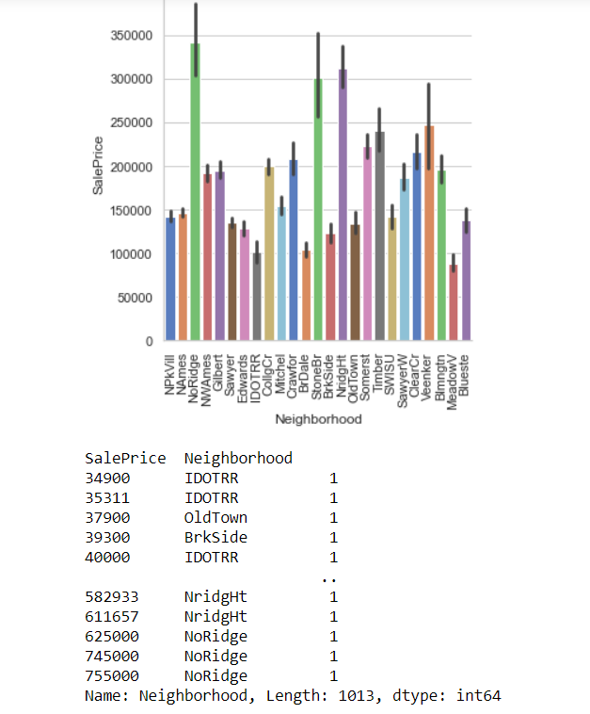
Observation:
SalePrice is maximum with NoRidge Neighborhood.

Slide 6
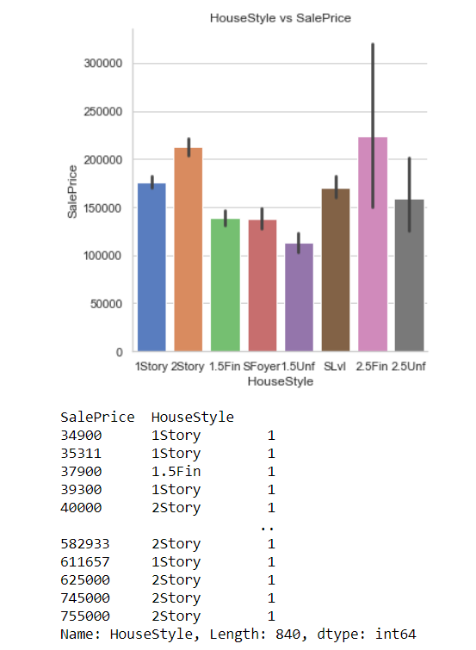
Observation:
SalePrice is maximum with 2.5Fin HouseStyle.

Slide 7
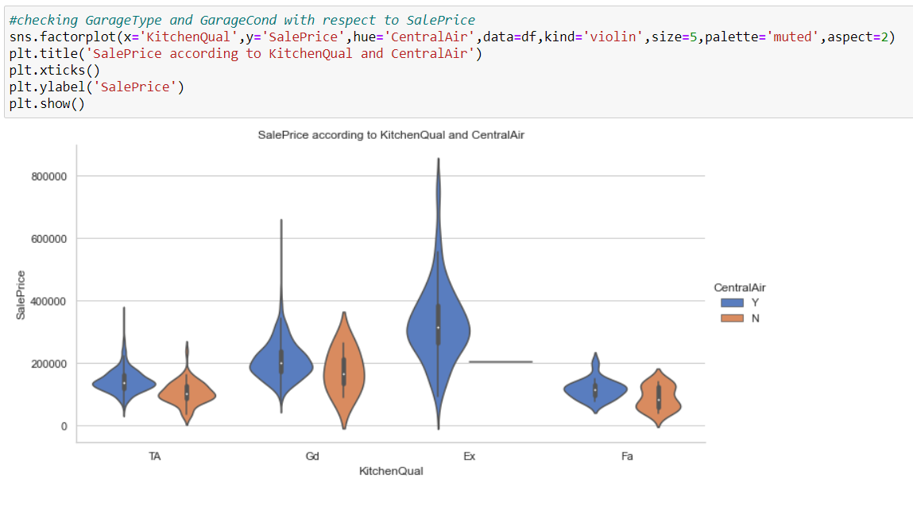
Observation:
SalePrice is maximum with Ex kitchenQual and CentralAir.

Slide 8
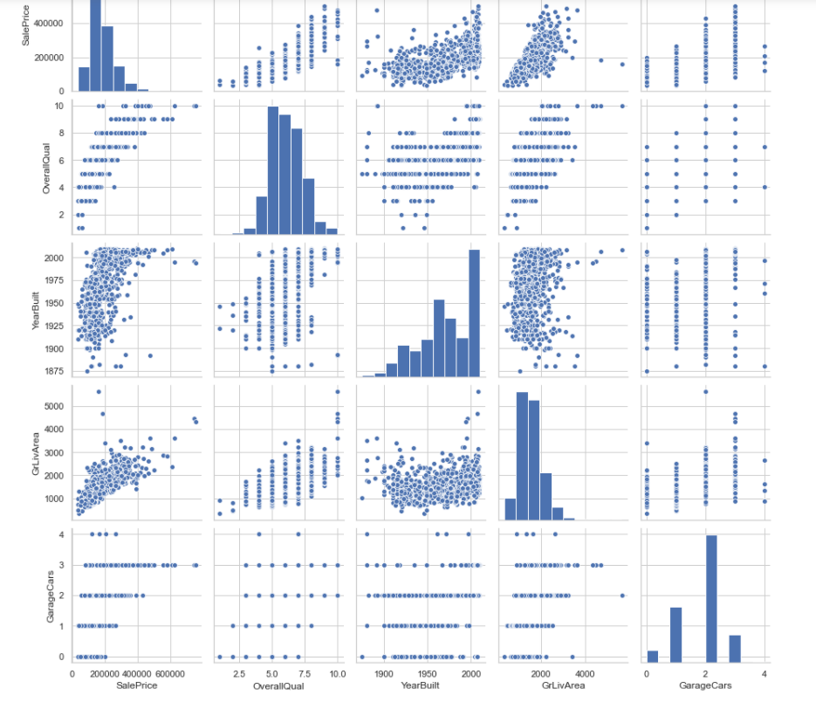
Observation:
SalePrice is highly positively correlated with GrLivArea and OverallQual.

Slide 9
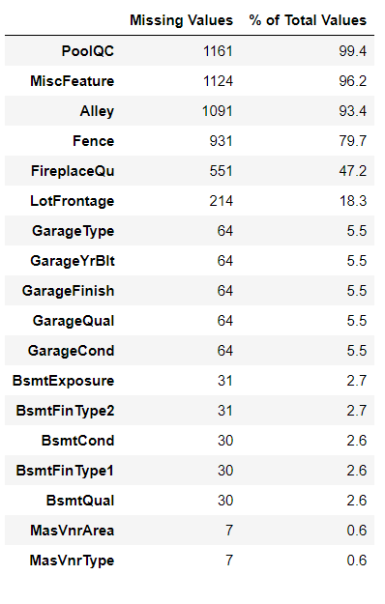
Steps and assumptions used to complete the project
Data Preprocessing Done
We first done data cleaning. We first looked percentage of values missing in columns then we imputed missing values .

Slide 10
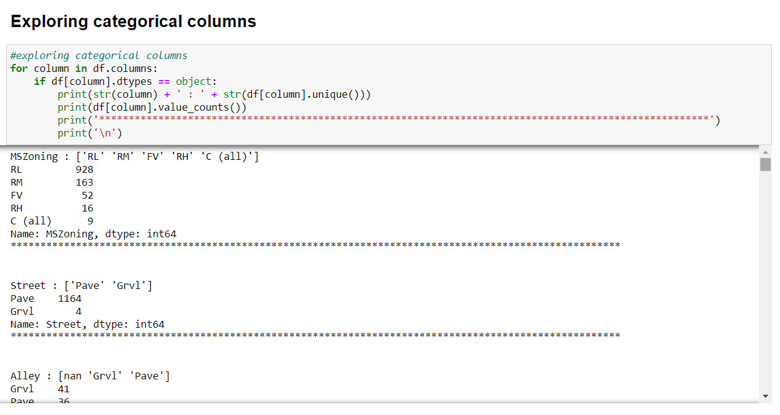
We then explored categorical variables
We observed that there is only one unique value present in Utilities so will be dropping this column.

Slide 11
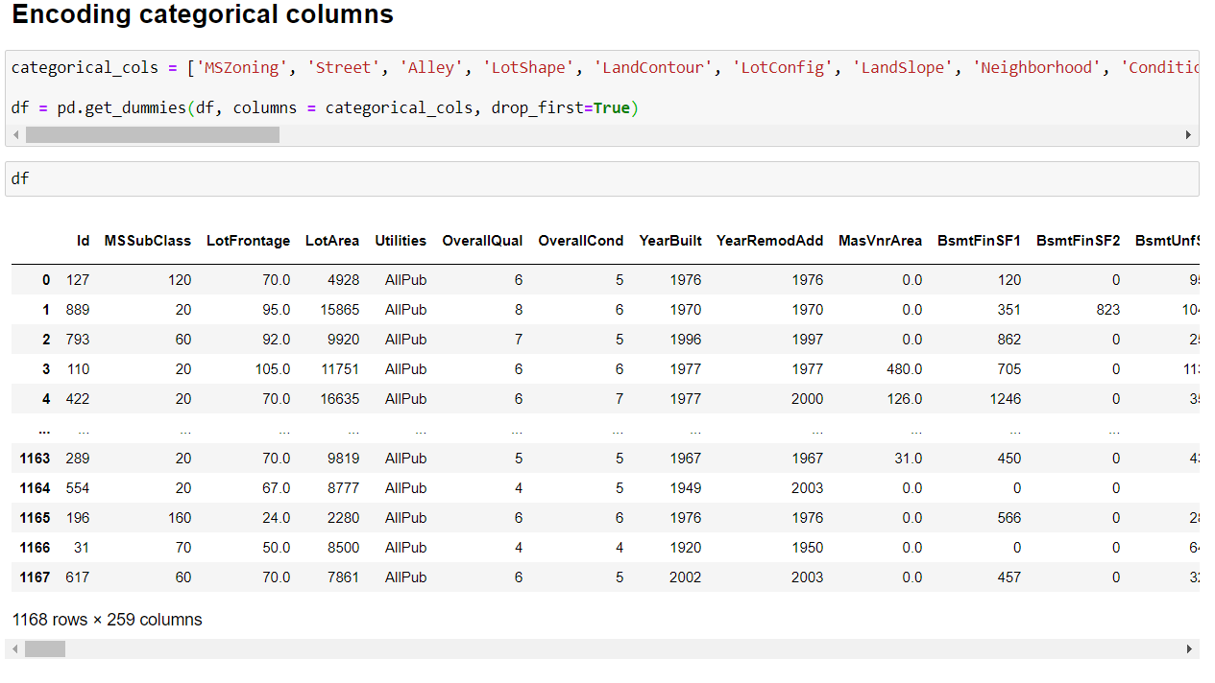
Then we encoded all the categorical columns into numerical colums using dummy variables.

Slide 12
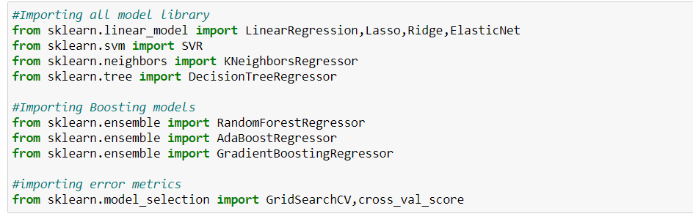
Model Dashboard

Slide 13
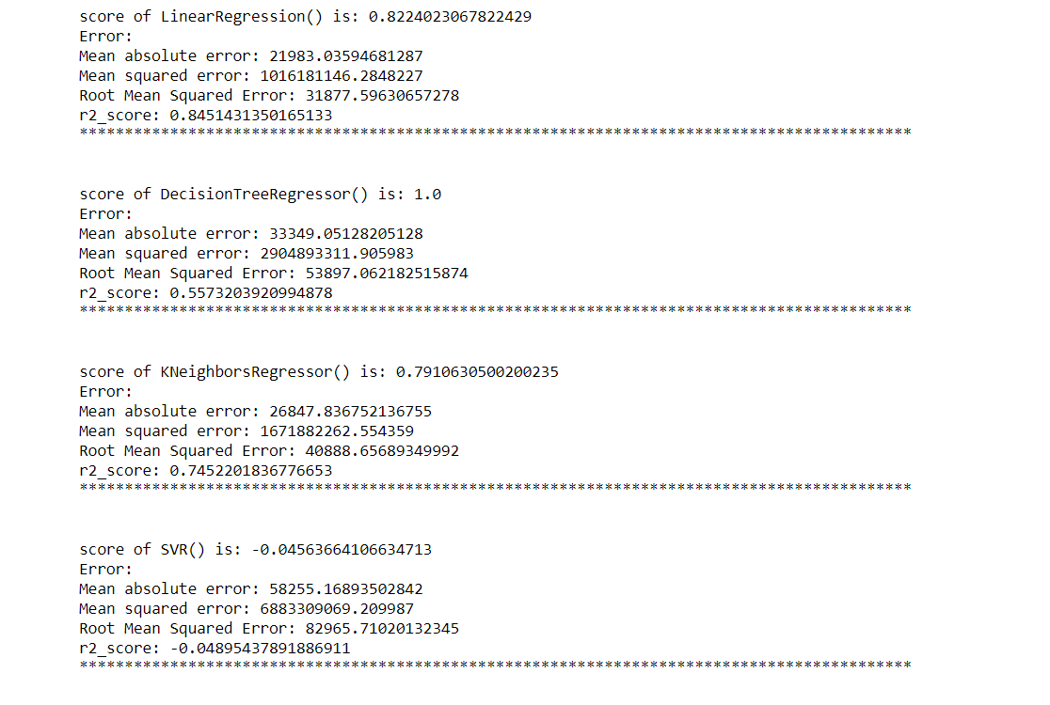

Slide 14
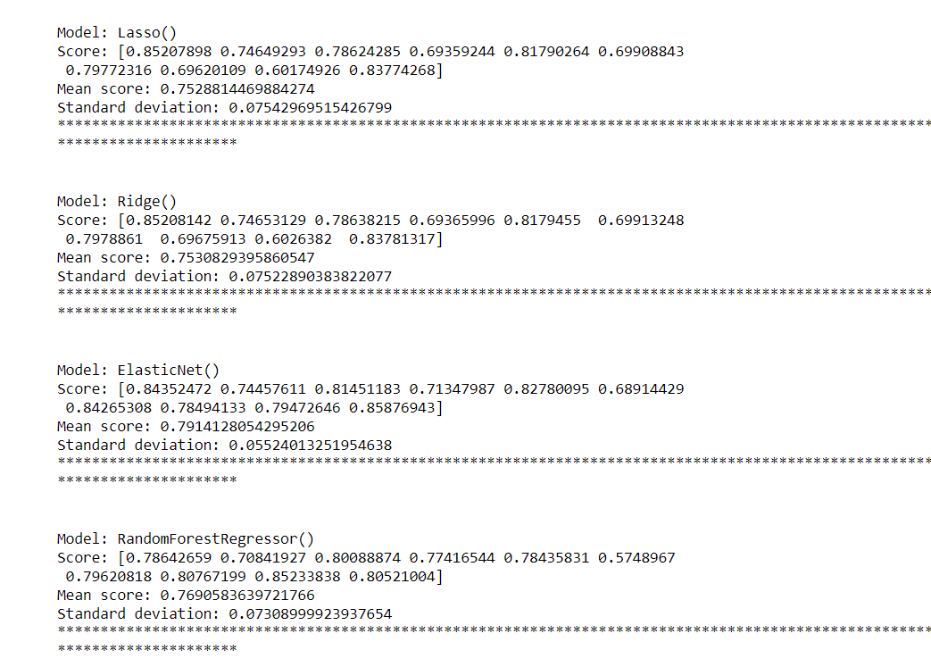

Slide 15
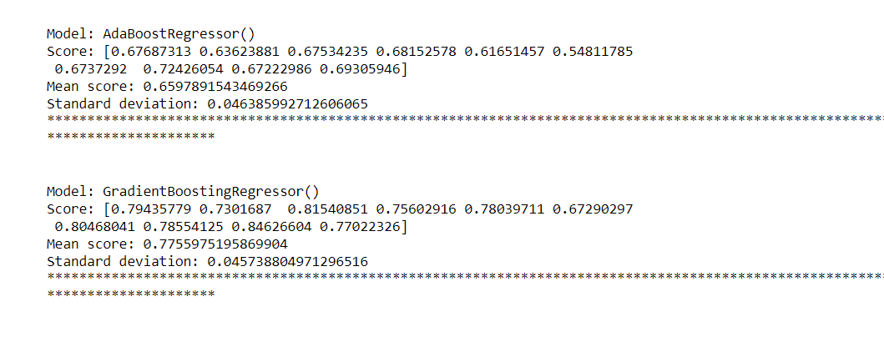

Slide 16
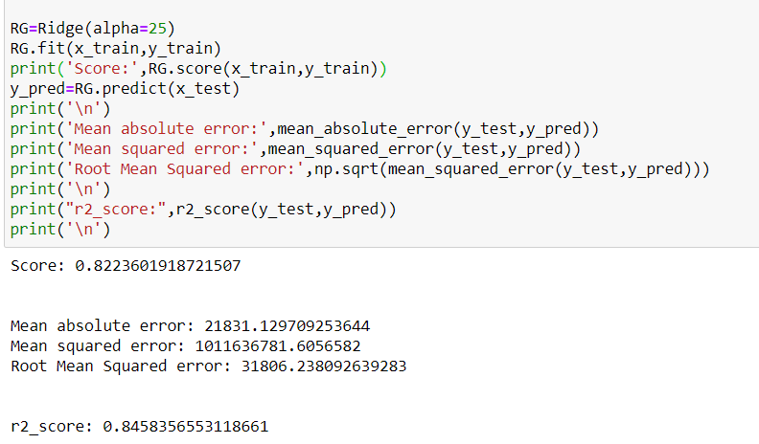
Finalized Model

Slide 17
Conclusion
In this project we have tried to show how the house prices vary and what are the factors related to the changing of house prices. The best(minimum) RMSE score was achieved using the best parameters of Ridge Regressor through GridSearchCV though Lasso Regressor model performed well too. While we couldn’t reach out goal of minimum RMSE in house price prediction without letting the model to overfit, we did end up creating a system that can with enough time and data get very close to that goal.

Slide 18
Thank you

