Slide 1
EVLTR- AI Research Final Project: Classification of diagnosis of Blood WORK
Megha Srinivas

Slide 2
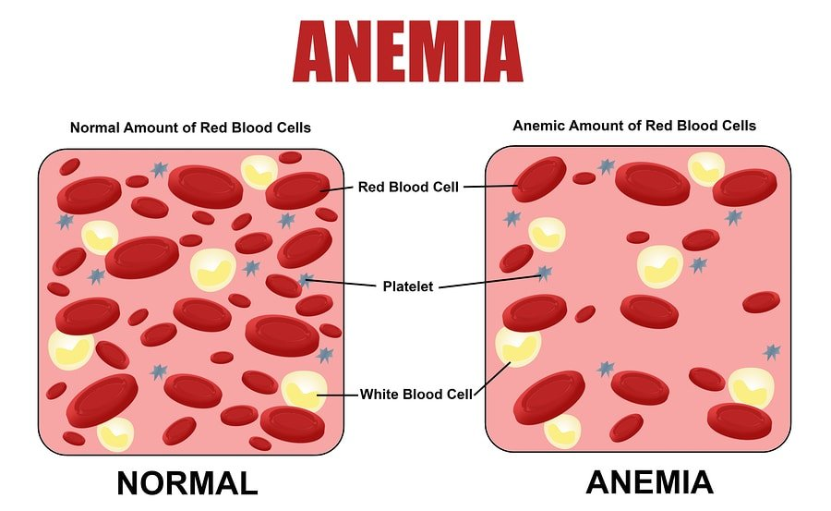
Data Set and Problem Statement
Data Set: Anemia dataset from Kaggle
https://www.kaggle.com/datasets/ehababoelnaga/anemia-types-classification
Problem statement:
Classification of different types of Anemia and detecting leukemia using Clinical Data and synthetic data
Picture taken from https://labs.selfdecode.com/blog/iron-deficiency-excess-diseases/

Slide 3
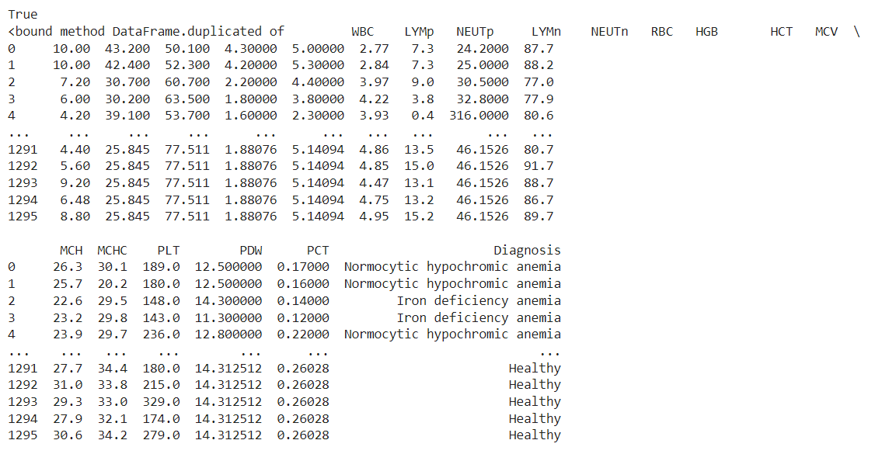
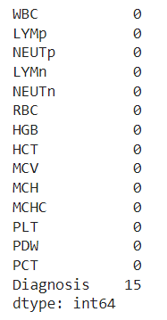
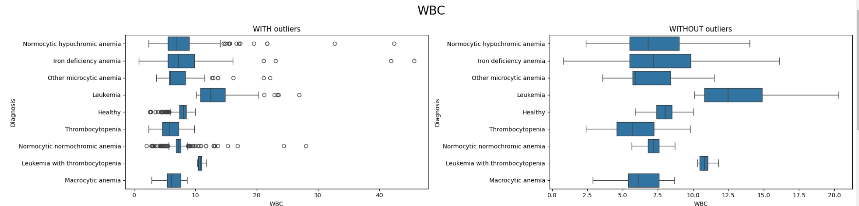
Data Issues Identified
Null Values present
Duplicate Data present
Outliers identified
2.
1.
3.

Slide 4
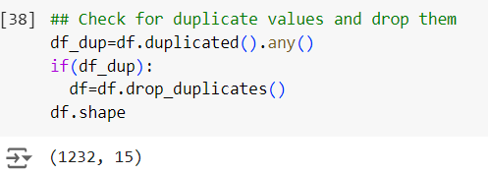
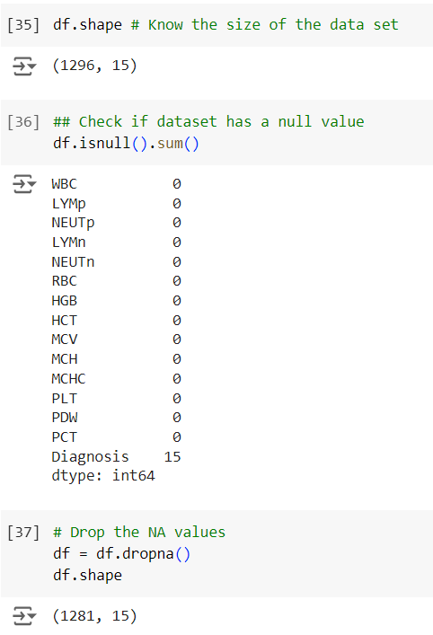
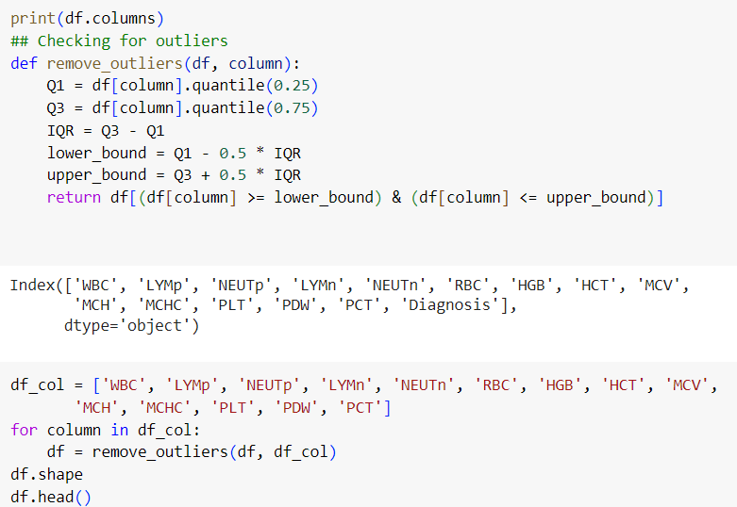
Data Issues Cleaned
2.
Null values removed
Duplicate Data removed
Outliers removed
1.
3.

Slide 5
Feature Engineering
Differentiated healthy and unhealthy diagnosis
Saw the average count of different blood counts such as WBC, RBC, and HCB among the different diagnoses to attempt to see which values anomaly leads to unhealthy diagnosis.

Slide 6
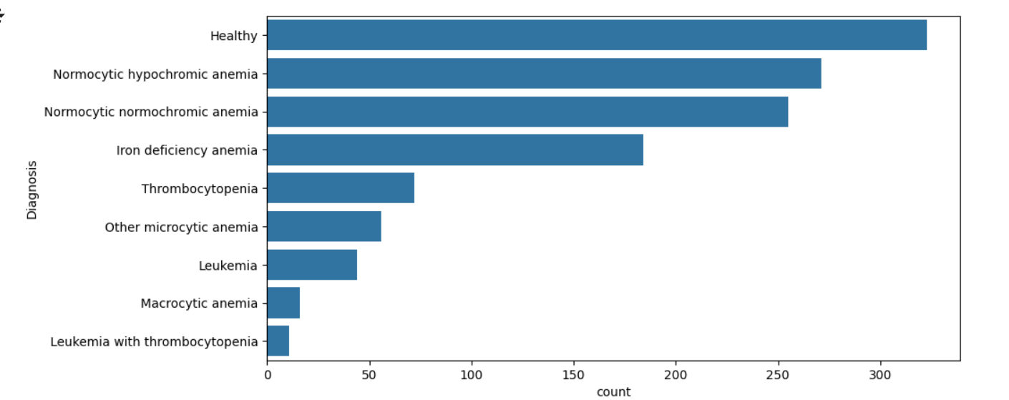
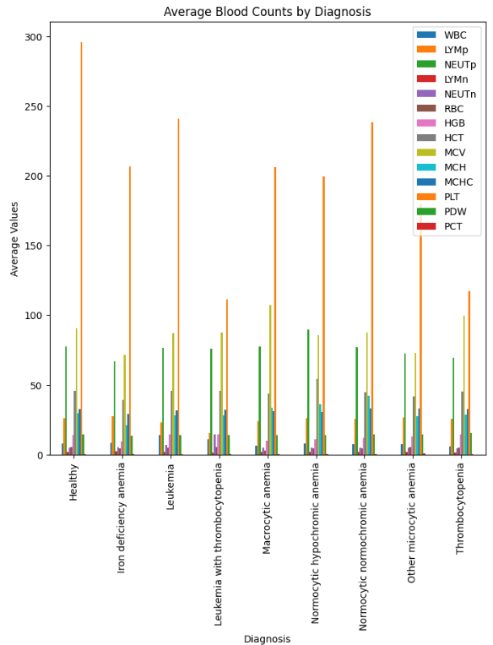
Data Visualization
Graph to show number of Healthy and Unhealthy Diagnosis
Average Blood Counts by Diagnosis

Slide 7
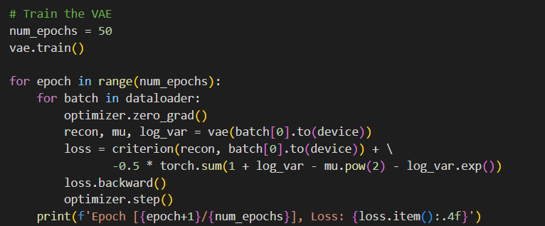
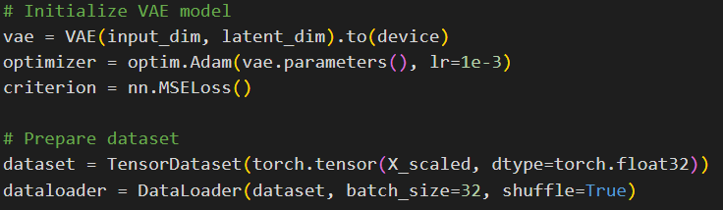
Model and Algorithm
Using the VAE model to generate the data
Initialising the VAE model and preparing the dataset

Slide 8
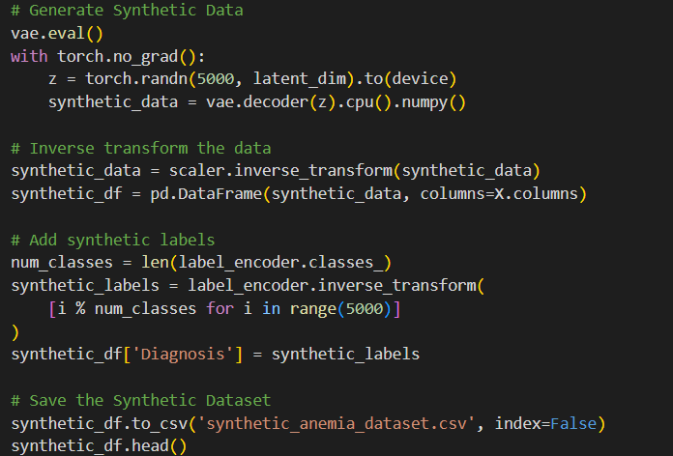
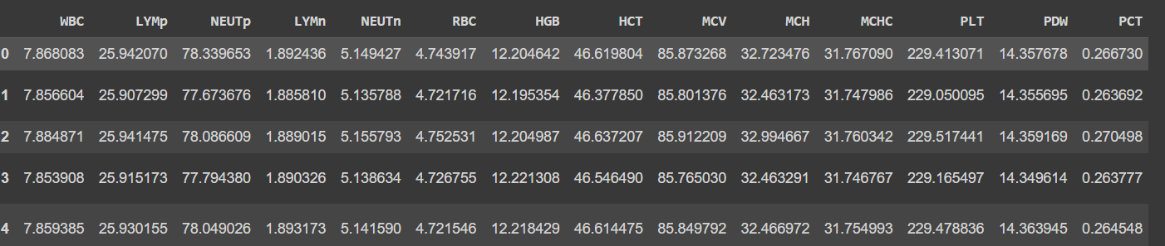
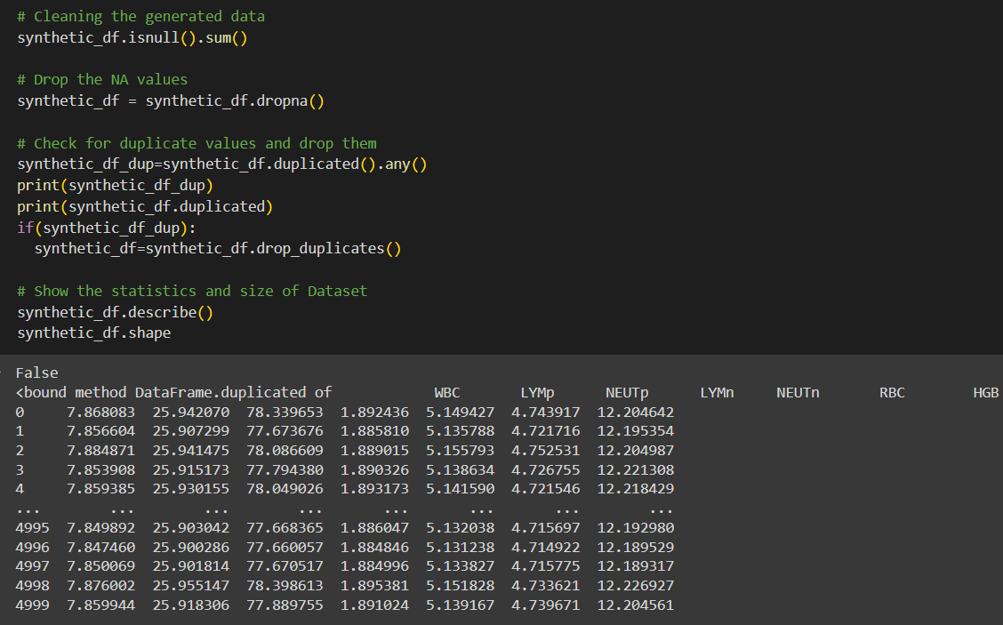
Generating Synthetic Data
Generate the data
Clean the synthetic data

Slide 9
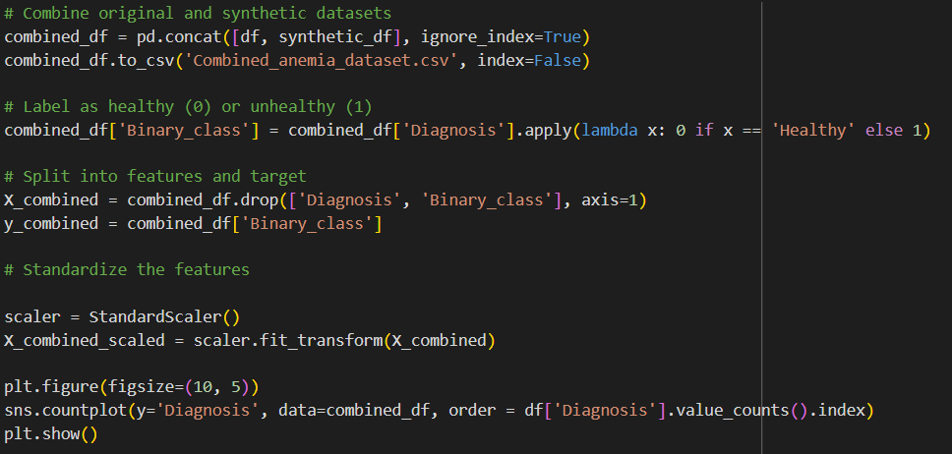
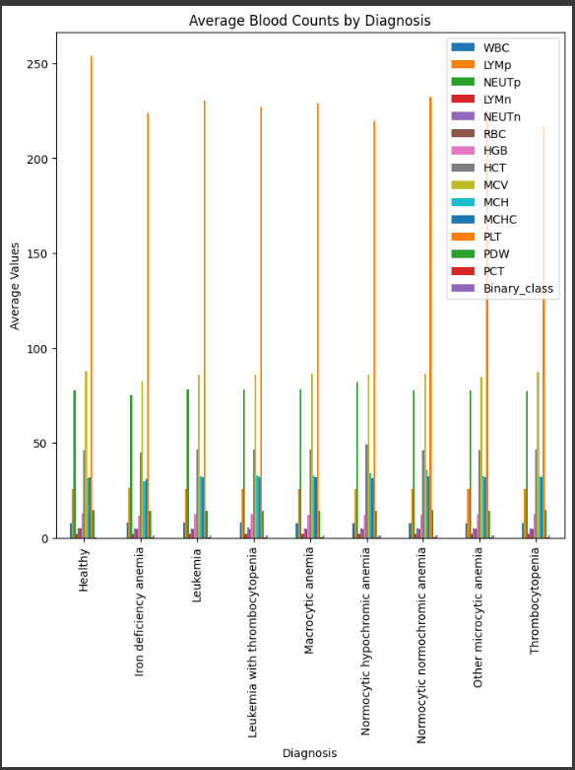
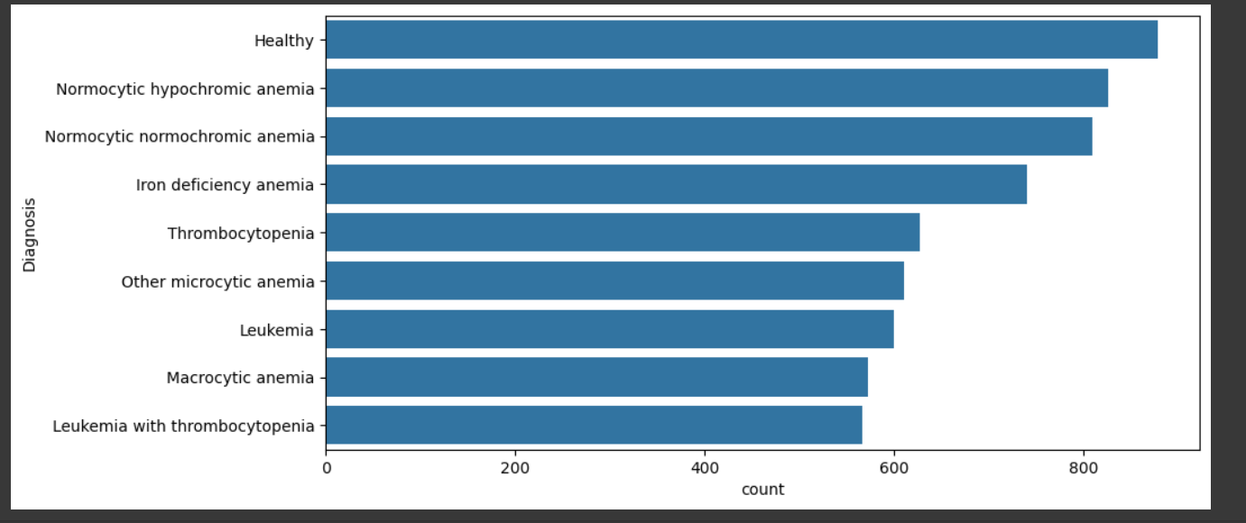
Combining both Data
Combine and standardize the data and plot them

Slide 10
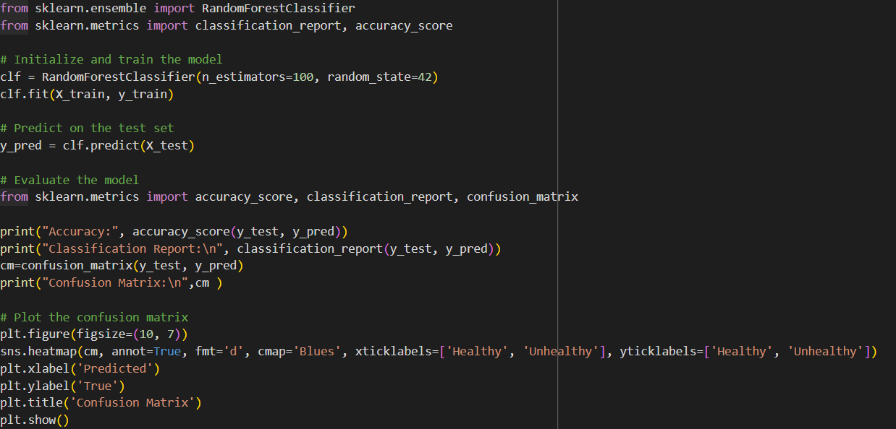
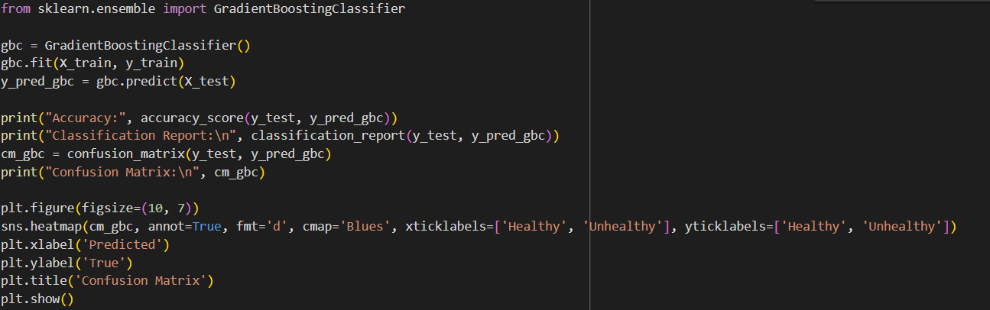
Training
Split the combined dataset to training and testing dataset
Used two models to train the combined dataset
Random Forest Classifier
Gradient Boosting Classifier

Slide 11
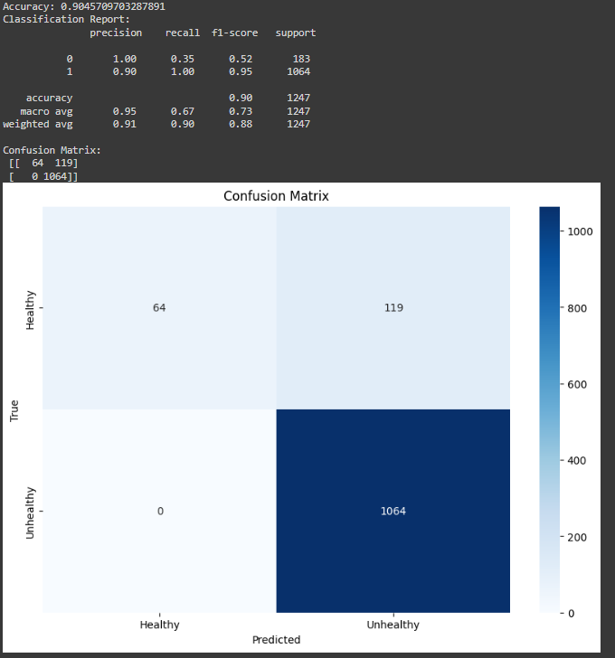
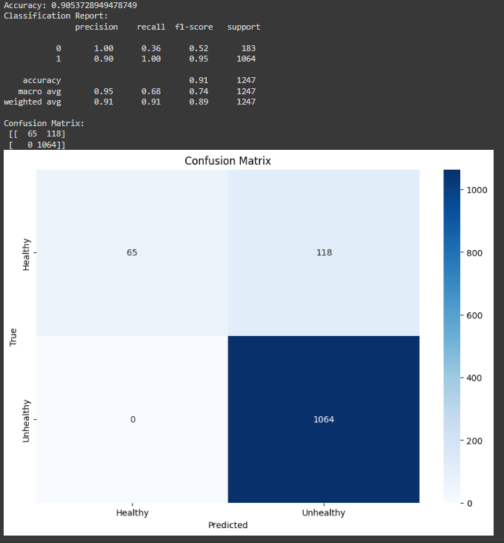
Outputs
Parameters | Split Size | Random State | Accuracy | Confusion Matrix
RandomForest Classifier | 0.2 | 42 | 90.45 | [[64,119],[0,1064]]
GradientBoosting Classifier | 0.2 | 42 | 90.53 | [[65,118],[0,1064]]

Slide 12
Inferences and Future Work
Generated Data Integrity: The generated data adhered closely to the cleaned clinical data, ensuring there were no null values or duplicate values in the generated data.
Classifier Model Comparison: Utilizing two different classifier models resulted in varying accuracies, confusion matrices, and classification reports, highlighting the importance of model selection.
Impact of Data Split and Random State: Altering the split value between the training and testing datasets, as well as changing the random state, led to different accuracy scores, confusion matrices, and classification reports.
Future Work with Advanced Models: For future work, we could explore using advanced models such as RoBERTa, BERT, GPT-3, or other state-of-the-art models to generate data.
Exploring Diverse Classifier Models: Experimenting with a wider range of classifier models like SVM, XGBoost, and LightGBM could provide insights into which models are best suited for the task.
Advanced Data Preprocessing and Feature Engineering: Employing various data preprocessing techniques and advanced feature engineering methods, such as normalization, scaling, and the creation of new features, can significantly enhance model performance.

Slide 13
Ethical Implications
Bias and Fairness: Ensuring that the generated data and models do not perpetuate biases, leading to unfair treatment of certain groups. Implementing bias mitigation techniques to evaluate the fairness of the model.
Privacy and Data Security: Protecting the privacy of individuals by ensuring that the generated data does not reveal personal information. Apply strong security measures to safeguard data.
Transparency and Explainability: Strive for transparency in how data is generated and models are trained. Use interpretable models and provide clear documentation to build trust.
Accountability: Establish clear accountability for the decisions made by the models, especially in high-stakes domains like healthcare. Monitor models continuously to address any issues.
Informed Consent and Ethical Use: Obtain informed consent from individuals whose data is used. Ensure that the use of data and models is ethical and does not harm individuals or groups.

