Slide 1
Digital Portfolio
STUDENT NAME: Megha Varshini B
REGISTER NO AND NMID: 2426J1519 AND asbruaz2426j1519
DEPARTMENT: Bsc,Information Technology
COLLEGE: KPR College of Arts Science and Research/Bharathiyar University

Slide 2
PROJECT TITLE
INTERNSHIP PORTFOLIO PROJECT

Slide 3


AGENDA
Problem Statement
Project Overview
End Users
Tools and Technologies
Portfolio design and Layout
Features and Functionality
Results and Screenshots
Conclusion
Github Link
3/21/2024 Annual Review

Slide 4

PROBLEM STATEMENT
In today’s competitive environment, students and graduates require more than just a traditional resume to showcase their skills and achievements. A static document often fails to reflect creativity, technical expertise, and project work effectively. There is a strong need for an interactive and visually appealing portfolio website that can act as a digital resume. This project addresses the problem by developing a responsive internship portfolio website that highlights technical skills, internship experiences, and projects in an engaging format.

Slide 5

PROJECT OVERVIEW
The Internship Portfolio project is a personal website designed to display academic background, internship experiences, technical skills, and project work. The website is developed using HTML, CSS, and JavaScript, ensuring responsiveness and user interactivity. It acts as a one-stop solution for recruiters, peers, and mentors to learn about the candidate’s qualifications. The portfolio also demonstrates the developer’s proficiency in front-end web technologies through its design and implementation

Slide 6

WHO ARE THE END USERS?
The primary users of the project include students who want to showcase their work, recruiters who evaluate candidates, and faculty members who guide students. Additionally, potential clients or companies may also use the website to evaluate technical expertise when considering candidates for internships or freelance opportunities. Thus, the portfolio benefits both creators and evaluators.

Slide 7

TOOLS AND TECHNIQUES
HTML
CSS
JAVASCRIPT
GITHUB/GIT

Slide 8
POTFOLIO DESIGN AND LAYOUT
The website follows a clean and minimalistic design for better readability and user experience. It consists of multiple sections such as the Home, which introduces the candidate with a tagline; the About section, providing a brief overview of skills; the Internship Experience section, which details roles and contributions; the Projects section, showcasing key work done during the internship; and the Contact section, which allows users to leave messages. A fixed navigation bar ensures smooth movement across the sections, while the responsive layout adapts seamlessly to desktops, tablets, and mobile devices.
8

Slide 9
FEATURES AND FUNCTIONALITY
The portfolio website provides several important features. It includes a fixed navigation bar with hover effects for easy movement between sections. The design is responsive, ensuring compatibility across devices. The contact form allows users to enter their details and messages, which are stored locally in the browser using JavaScript. Internship and project details are displayed in a card-based layout for better readability. Additionally, the website focuses on providing a professional yet simple user experience through modern design practices

Slide 10
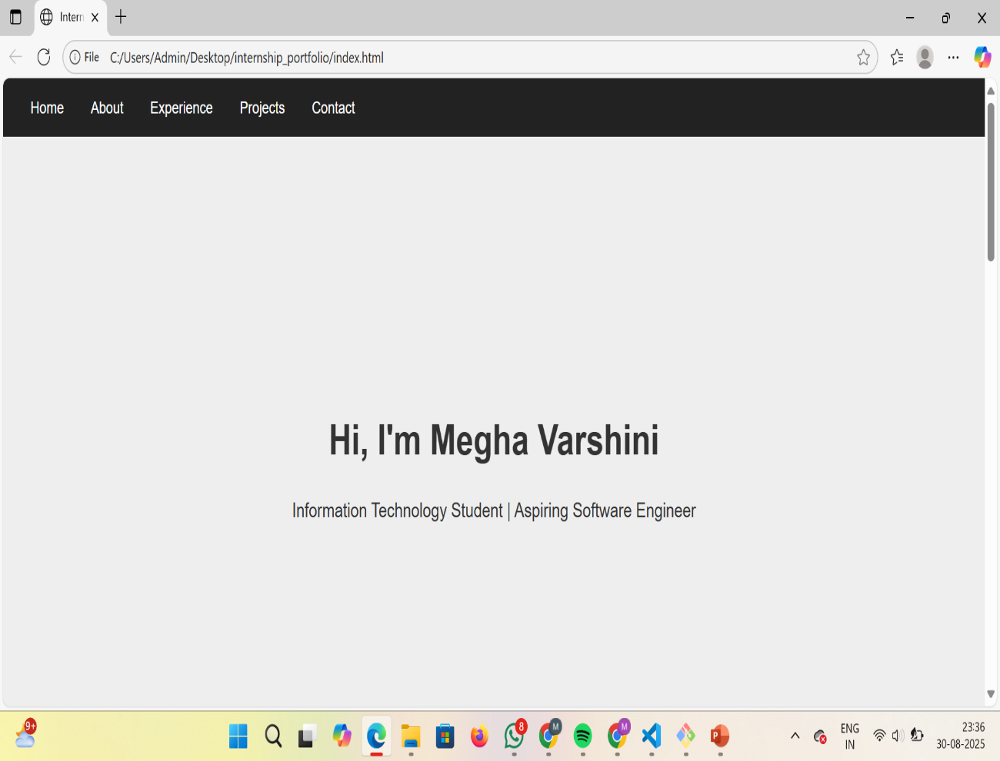

RESULTS AND SCREENSHOTS
3/21/2024 Annual Review
10

Slide 11
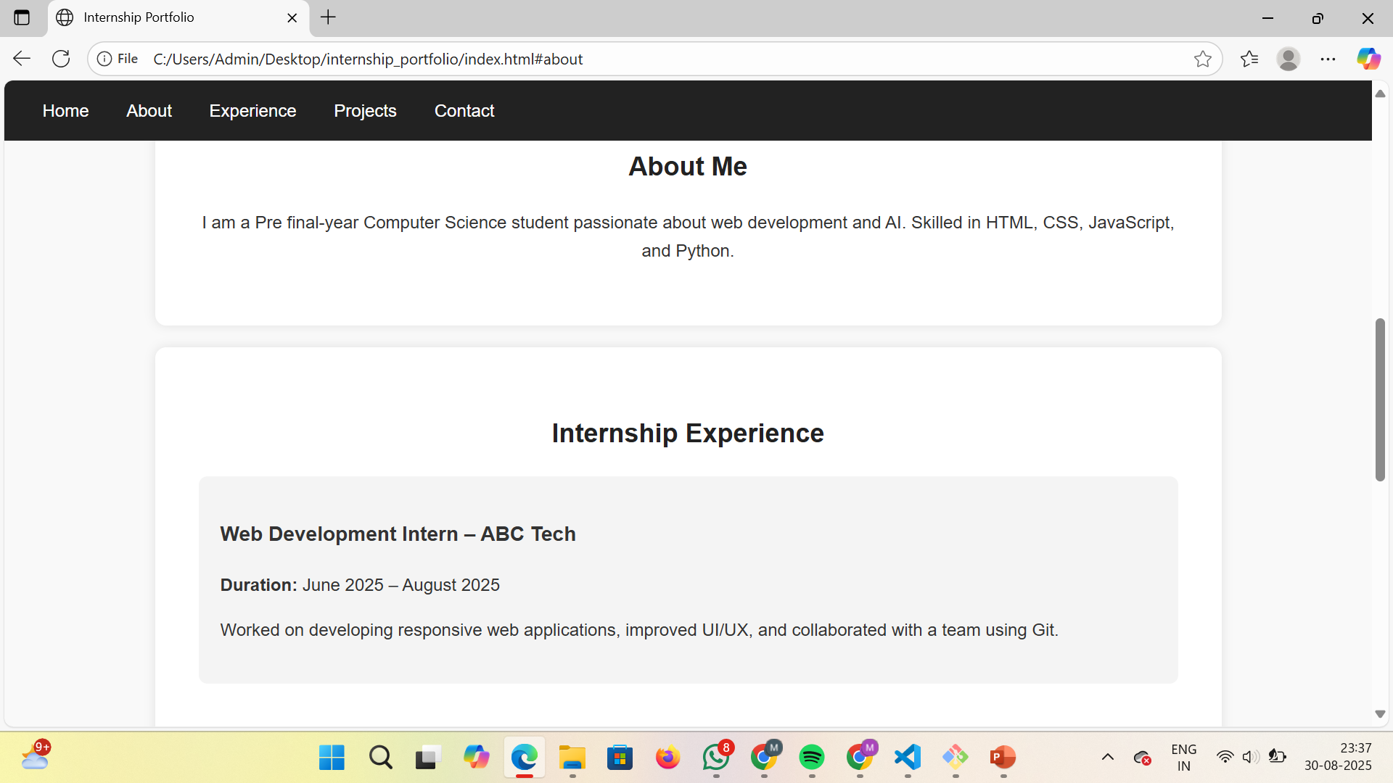
RESULTS AND SCREENSHOTS

Slide 12
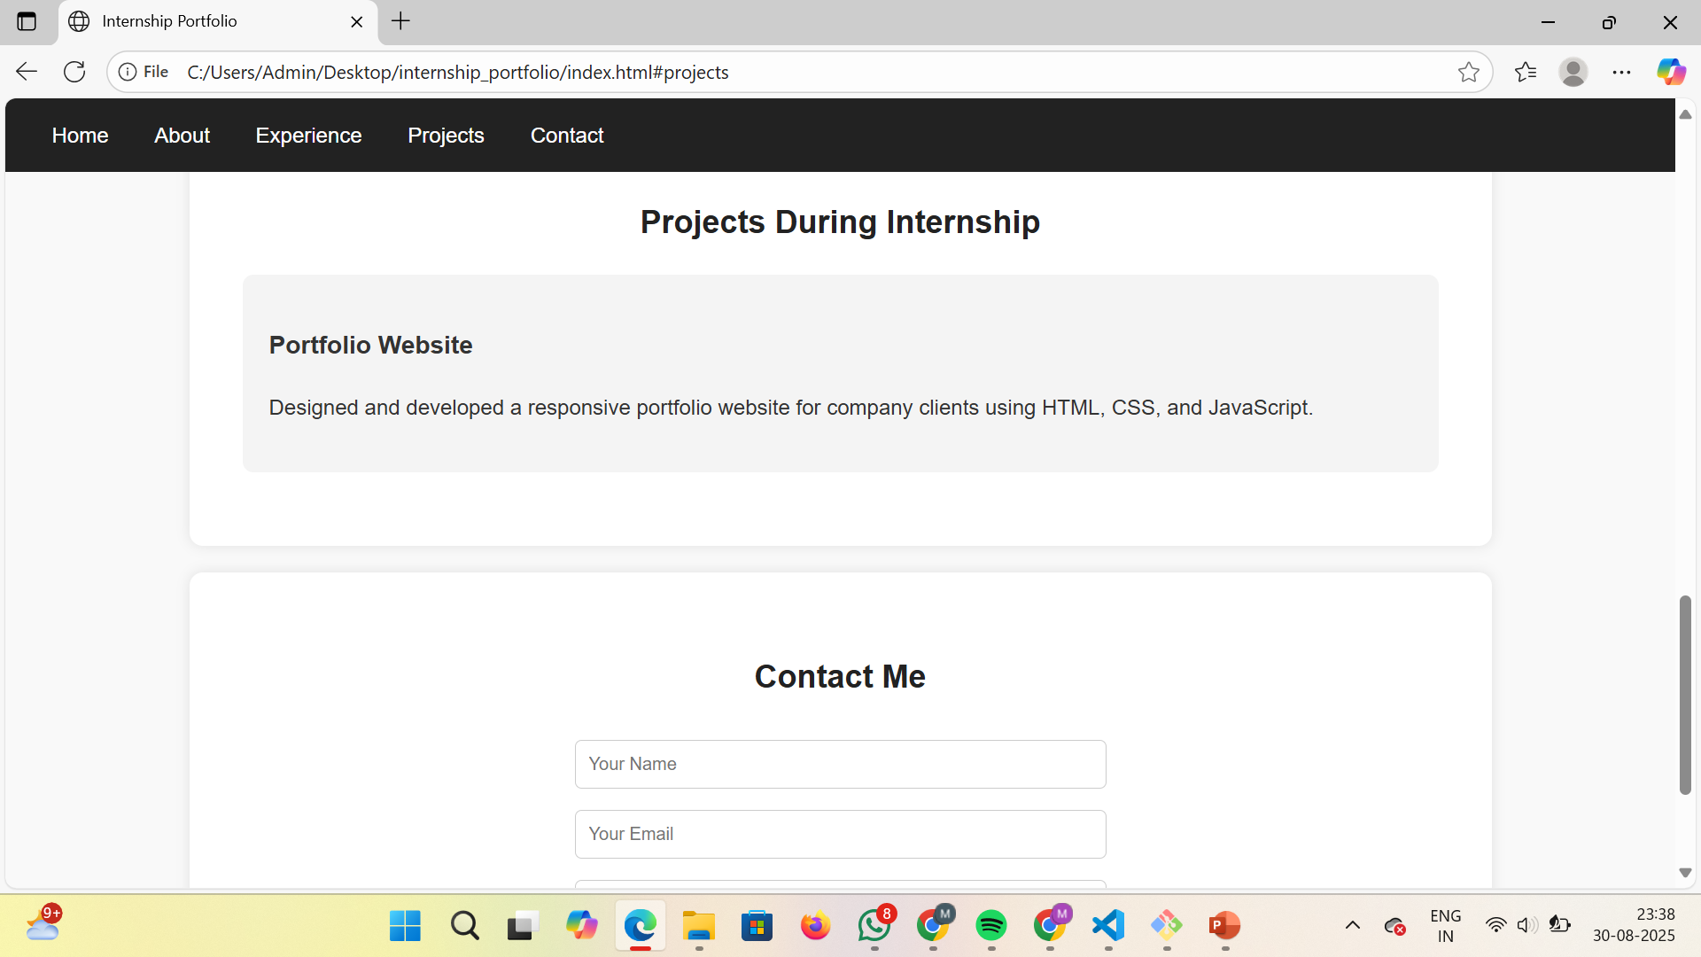
RESULTS AND SCREENSHOTS

Slide 13
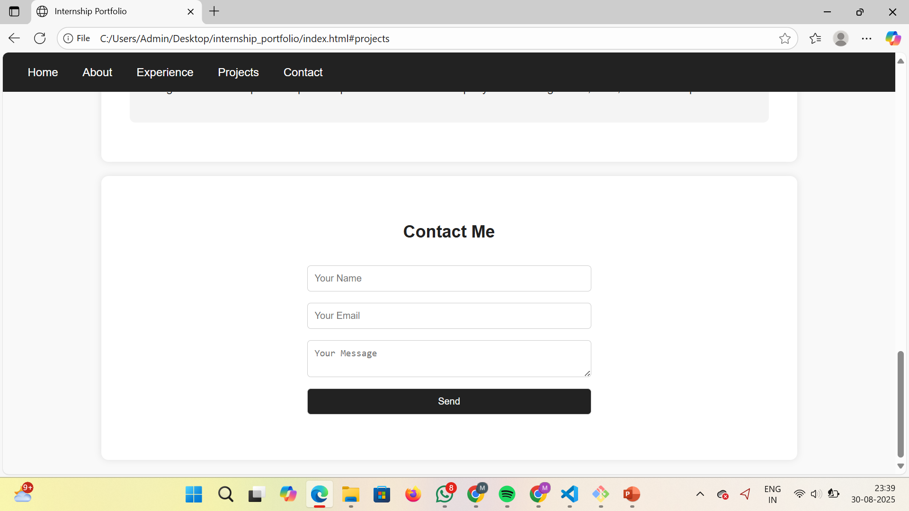
RESULT AND CONCLUSION

Slide 14
CONCLUSION
The Internship Portfolio website demonstrates the application of web development skills in solving the problem of presenting student achievements in an interactive format. It provides a professional platform for showcasing internship experiences, academic skills, and projects. The portfolio is not only a digital resume but also an example of front-end development expertise. In the future, the project can be extended by integrating backend services to send emails directly, adding a project gallery, or linking GitHub repositories for live demonstrations. Overall, the project successfully fulfills its goal of creating a functional and professional portfolio website.
14

Slide 15
GITHUB LINK
https://github.com/Meghabala02/internship_portfolio.git
https://github.com/Meghabala02

