Slide 1
Renal disease prediction using K-means clustering algorithm
Under the guidance of:
Mr. M. M. Meera Durga
Submitted by: Team-B15 K.Meghamala (Y20ACS487)
P. Bhargavi (Y20ACS528)
K.Bhanu Prakash(Y20ACS467)
K. Navya Sri (Y20ACS465)

Slide 2
Table Of Contents:
Abstract
Existing System
Proposed System
Design
Implementation
Result
Conclusion

Slide 3
Abstract:
The incidence, prevalence, and progression of chronic kidney disease (CKD) vary across countries due to differing social determinants of health.
Diabetes and hypertension are the leading causes of CKD.
CKD is characterized by a decline in kidney function over time, as measured by glomerular filtration rate (GFR) and markers of kidney damage.
This project proposes the development of an intelligent system to classify patients as either CKD or non-CKD, facilitating faster diagnosis and treatment.
To implement k-means algorithm for enhancing accuracy and detection rate.

Slide 4
Existing System:
Various machine learning supervised and unsupervised algorithms have been employed to develop predictive models for CKD risk assessment and progression.
These models utilize large datasets containing demographic, clinical, and laboratory data to predict the likelihood of CKD development or progression in individuals.
Unsupervised algorithms include k-means, DB-SCAN, I-Forest, Autoencoder.
Supervised algorithms include Decision Tree, Random Forest, XGboost, Adaboost.

Slide 5
Proposed System:
k-means clustering algorithm for predicting CKD.
Patient’s symptoms are to be considered as features in the dataset.
k-means clustering algorithm’s advantage over all other clustering algorithms is it guarantees convergence, can warm-start the positions of centroids, easily adapts to new examples, generalizes to clusters of different shapes and sizes such as elliptical clusters.
Goal: The accuracy of the algorithm is to be increased in this proposed system.

Slide 6
Design:
K-Means:
Choose k random points as initial centroids.
Assign each data point to the nearest centroid to form K clusters.
Recalculate centroids as the mean of data points in each cluster.
Continue until centroids converge (minimal change) or a maximum number of iterations is reached.
Data points are assigned to the cluster represented by the nearest centroid.
This iterative process partitions the data into k clusters, where each data point belongs to the cluster with the nearest centroid.

Slide 7
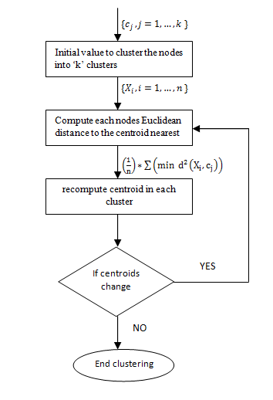
Working of K-Means

Slide 8
Implementation:
Import all the necessary packages.
Loading the data and performing data preprocessing.
Exploratory data analysis.
Selecting a model which is k-means in our project.
Training, testing and validation.
Dataset
Dataset is a collection of data for analytics and prediction purposes.
This dataset has been collected from Kaggle.
This dataset consists of 24 features, 1 class feature and 400 instances.

Slide 9
Result:
We are achieving a 99% accuracy rate in renal disease prediction using the k-means algorithm is a significant accomplishment, indicating the effectiveness of the model in accurately identifying patterns and making predictions based on patient data.

Slide 10
Conclusion:
In conclusion, renal disease prediction using k-means clustering algorithm was able to identify patterns or groupings within the data related to renal disease.
Also identifies any correlations discovered between features and renal disease and the potential utility of these insights for medical diagnosis or treatment planning.

Slide 11
References:
L. Antony et al., "A Comprehensive Unsupervised Framework for Chronic Kidney Disease Prediction," in IEEE Access, vol. 9, pp. 126481-126501, 2021, doi: 10.1109/ACCESS.2021.3109168.
O. Abuomar and P. Sogbe, "Classification and Detection of Chronic Kidney Disease (CKD) Using Machine Learning Algorithms," 2021 International Conference on Electrical, Computer and Energy Technologies (ICECET), Cape Town, South Africa, 2021, pp. 1-8, doi: 10.1109/ICECET52533.2021.9698666.
Bai, Q., Su, C., Tang, W. and Li, Y., 2022. Machine learning to predict end stage kidney disease in chronic kidney disease. Scientific reports, 12(1), p.8377.

Slide 12
THANK YOU

