Slide 1
Final Python project – Statistical Modelling

Slide 2
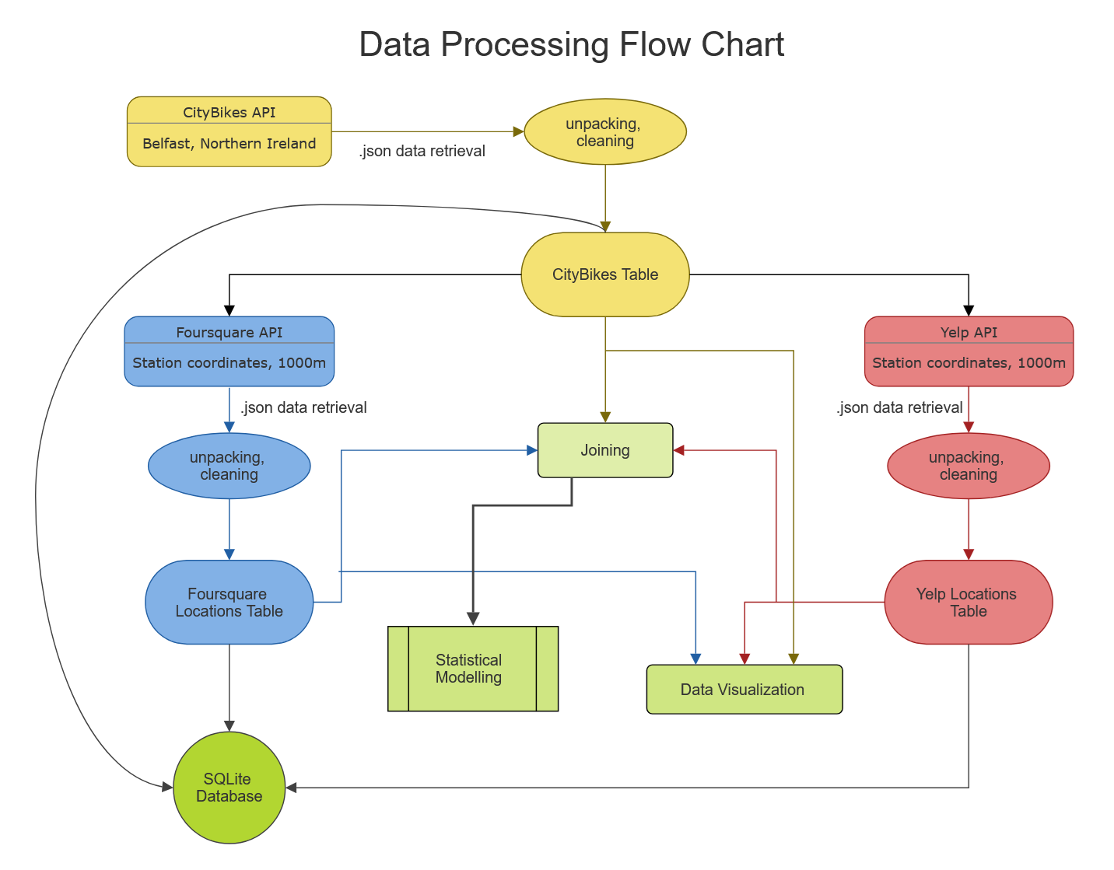
inner line color based on database
due to overlaps

Slide 3
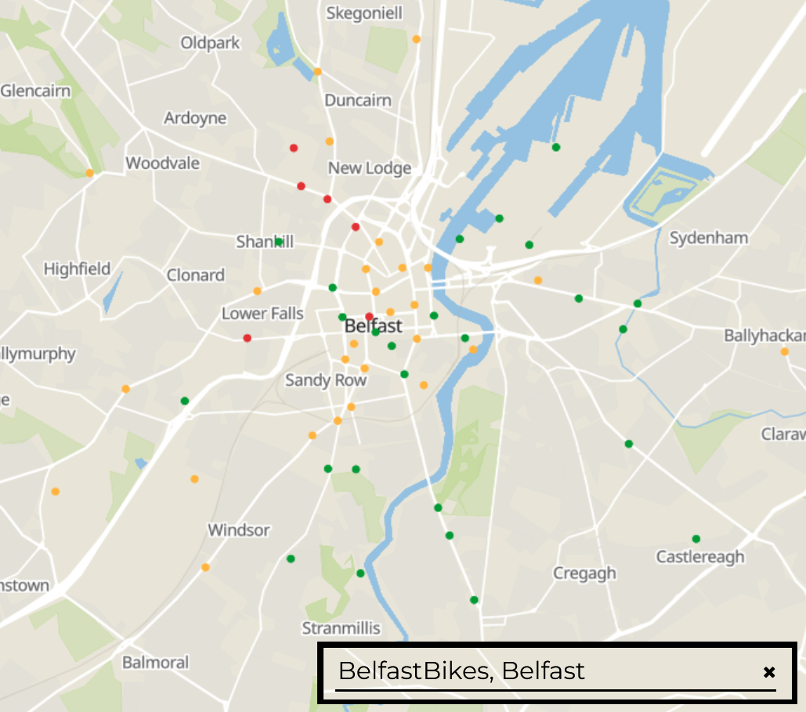
Belfast, North Ireland
one network
57 stations

Slide 4
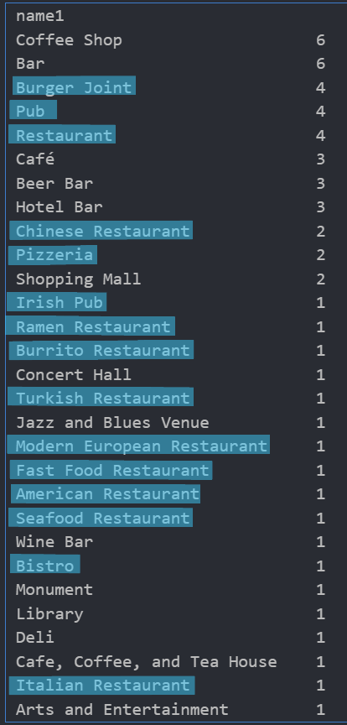
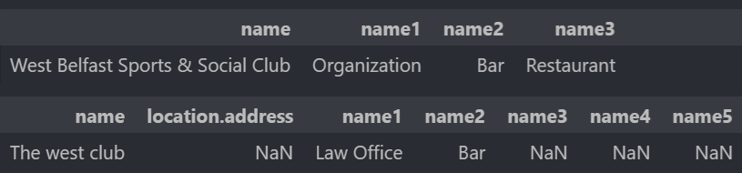
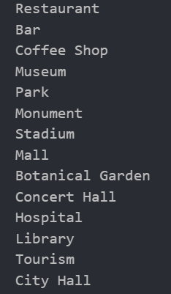
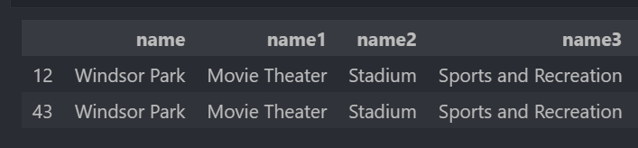
Data cleaning
The goal:
Some weirdness:
Turned out to be the same place. And not a law firm.
Not sure why a football pitch is primarily a movie theater…
Eventual location tags
I had to Google both of those.
Initial primary location tags
counting as ‘restaurant’

Slide 5
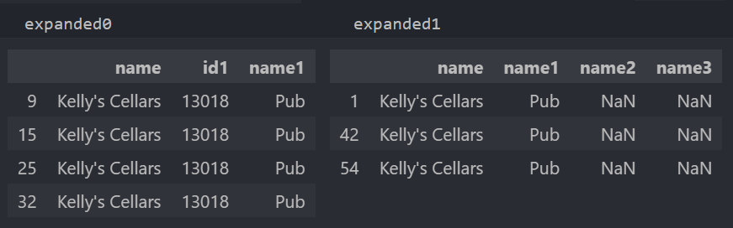
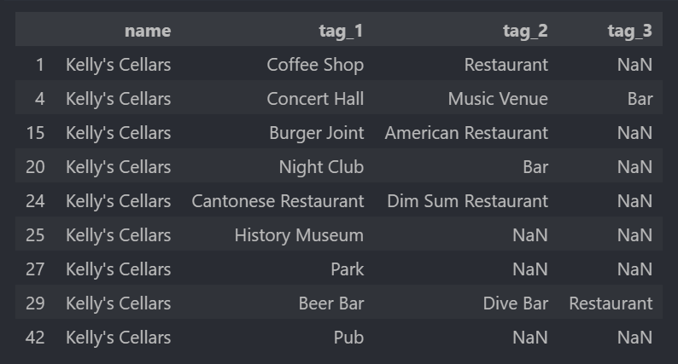
A slight snafu along the way…
What should have come out-
What I ended up with.

Slide 6
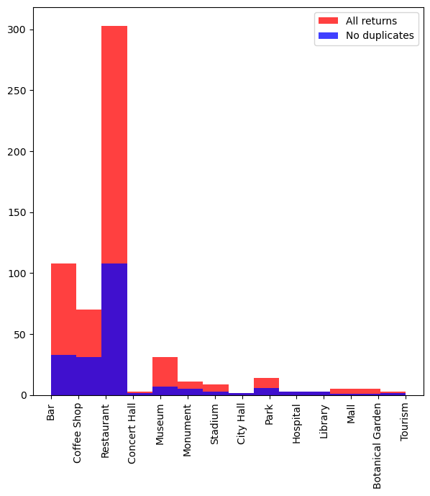
Redundancy
So much redundancy.
Foursquare:
total returns: 570
unique returns: 218
Yelp:
total returns: 1,140
unique returns: 393
Distribution of Foursquare locations data by type before and after duplicate drop

Slide 7
The Model
ran two versions; one looking at the number of free bikes, one at the number of empty slots
variables removed:
latitude and longitude used, station number dropped
Categorization left off in favor of individual yes/no columns for each type value
each station has finite slots, so if a bike is available, that slot cannot be free; whichever was not being modelled was left off

Slide 8
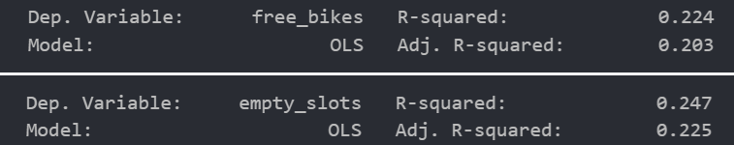

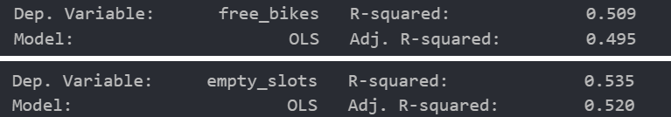
The Model
Results
there’s no really good fit with the data I have
the fits get dramatically better if you add the other slot related variable back in

Slide 9
Potential Future Goals
build a function for unpacking the Foursquare json
build and debug functions for assigning location type; for Foursquare and Yelp
see if usage data on CityBikes from different times of day allows for building better models
expand number of locations returned per station by the API call;
Foursquare defaulted to 10, Yelp to 20

