Slide 1

HIDING A TEXT INSIDE AN IMAGE USING STEGANOGRAPHY
STUDENT DETAILS
NAME : GUDAPATI MEGHANA PRIYA
E-MAIL : meghanapriyagudapati@gmail.com
COLLEGE : ADITYA ENGINEERING COLLEGE, SURAMPALEM
STATE : ANDHRA PRADESH
DOMAIN : CYBER SECURITY [ 03/06/2024 – 11/07/2024 ]
Roll no : 21A91A05D5
BRANCH : CSE

Slide 2
PROJECT TITLE/Problem Statement
In today's digital age, the need for secure communication has become increasingly vital. Traditional encryption methods, while effective, often attract attention and can be easily detected by malicious actors. This project aims to address the challenge of covertly transmitting sensitive information by exploring the use of steganography, a technique that hides data within other seemingly innocuous digital media such as images.
The primary objective of this project is to develop a robust steganographic tool capable of embedding text within images in a manner that is imperceptible to the human eye and resistant to detection by standard analytical methods. By leveraging various steganographic techniques and combining them with encryption, this project seeks to enhance the security and privacy of digital communication, making it a valuable asset for individuals, organizations, and security professionals.

Slide 3

AGENDA
Project overview
Software and tools selection
Who are the end users of this project?
Your solution and its value proposition
How did you customize the project and make it your own
Modelling
Results
Links

Slide 4
PROJECT OVERVIEW
Steganography is the art and science of concealing information within other non-secret data (such as images, audio files, or text) to avoid detection. This project explores various techniques and applications of steganography, emphasizing practical implementation and theoretical understanding.
Key Objectives:
Understanding Steganography Fundamentals
Implementing Steganographic Techniques
Developing a Steganographic Tool
Security and Detection
Applications and Ethical Considerations

Slide 5
WHO ARE THE END USERS of this project?
General Users:
Individuals who use steganography tools to hide sensitive information within digital media for privacy or security reasons.
Law Enforcement and Intelligence Agencies:
Use steganography detection tools to uncover hidden messages or data during investigations.
Military Personnel:
Embed secret messages in images or other media for secure communication.
Security Experts:
Cybersecurity professionals utilize steganography tools to test network defenses or to secure data transmission.

Slide 6
YOUR SOLUTION AND ITS VALUE PROPOSITION
Steganography Techniques:
Implementation of various techniques such as LSB (Least Significant Bit) embedding in images, hiding text in audio files through frequency manipulation, or embedding data in the whitespace of text files.
Encryption:
Combining steganography with encryption to ensure that hidden information remains secure even if discovered.
Detection and Analysis Tools:
Development of tools to detect steganographic content within media files using statistical analysis, anomaly detection, or visual inspection techniques.
Value Proposition:
Flexibility and Versatility: Applicable across various digital media types (images, audio, video, text).
Forensic Applications: Aids forensic investigations by providing insights into hidden communication or digital manipulation.
Research and Development: Supports ongoing research into new techniques and advancements in steganography, contributing to information security and cryptography.

Slide 7
How did you customize the project and make it your own
Algorithm Selection and Modification:
Carefully considered the choice of steganographic algorithm based on its suitability for embedding data within various media types.
User Interface Design:
Customized the user interface to ensure ease of use and intuitive interaction.
Integration of Additional Features:
Integrated additional functionalities to extend the utility of the application beyond basic steganographic operations.
Testing and Validation Procedures:
Rigorous testing procedures were customized to validate the accuracy and reliability of the steganographic techniques employed.
Documentation and Reporting:
Detailed documentation provides comprehensive insights into the project’s development process.

Slide 8
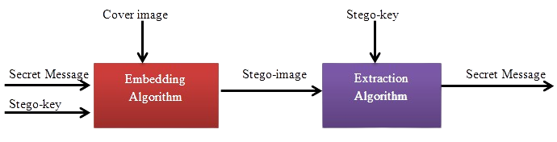
MODELLING
Data Model:
Defining how data will be represented and manipulated within the steganography system. Decisions on data formats (text, binary, etc.), encoding schemes, and how data will be structured for embedding and extraction.
Embedding Model:
Specifies the technique or algorithm used to embed hidden data into a cover media (such as an image or audio file). Modeling involves determining how to modify the carrier file to embed the hidden information while minimizing perceptible changes and maintaining cover media integrity.
Extraction Model:
Defines the method for extracting hidden data from the carrier media. Ensures that the embedded information can be accurately retrieved even after potential alterations to the carrier file.

Slide 9
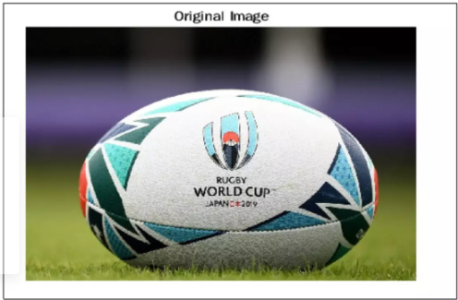
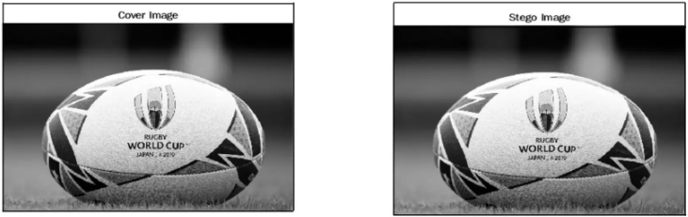
Results
Normal Image:
Downloaded a sample image from the internet for the encryption process. The image appears normal.
Encrypted Image:
After hiding the text in the image, the encrypted image looks the same as the normal image to casual inspection. We can protect our text inside the image with a secure password, which is required to retrieve the hidden message.

Slide 10
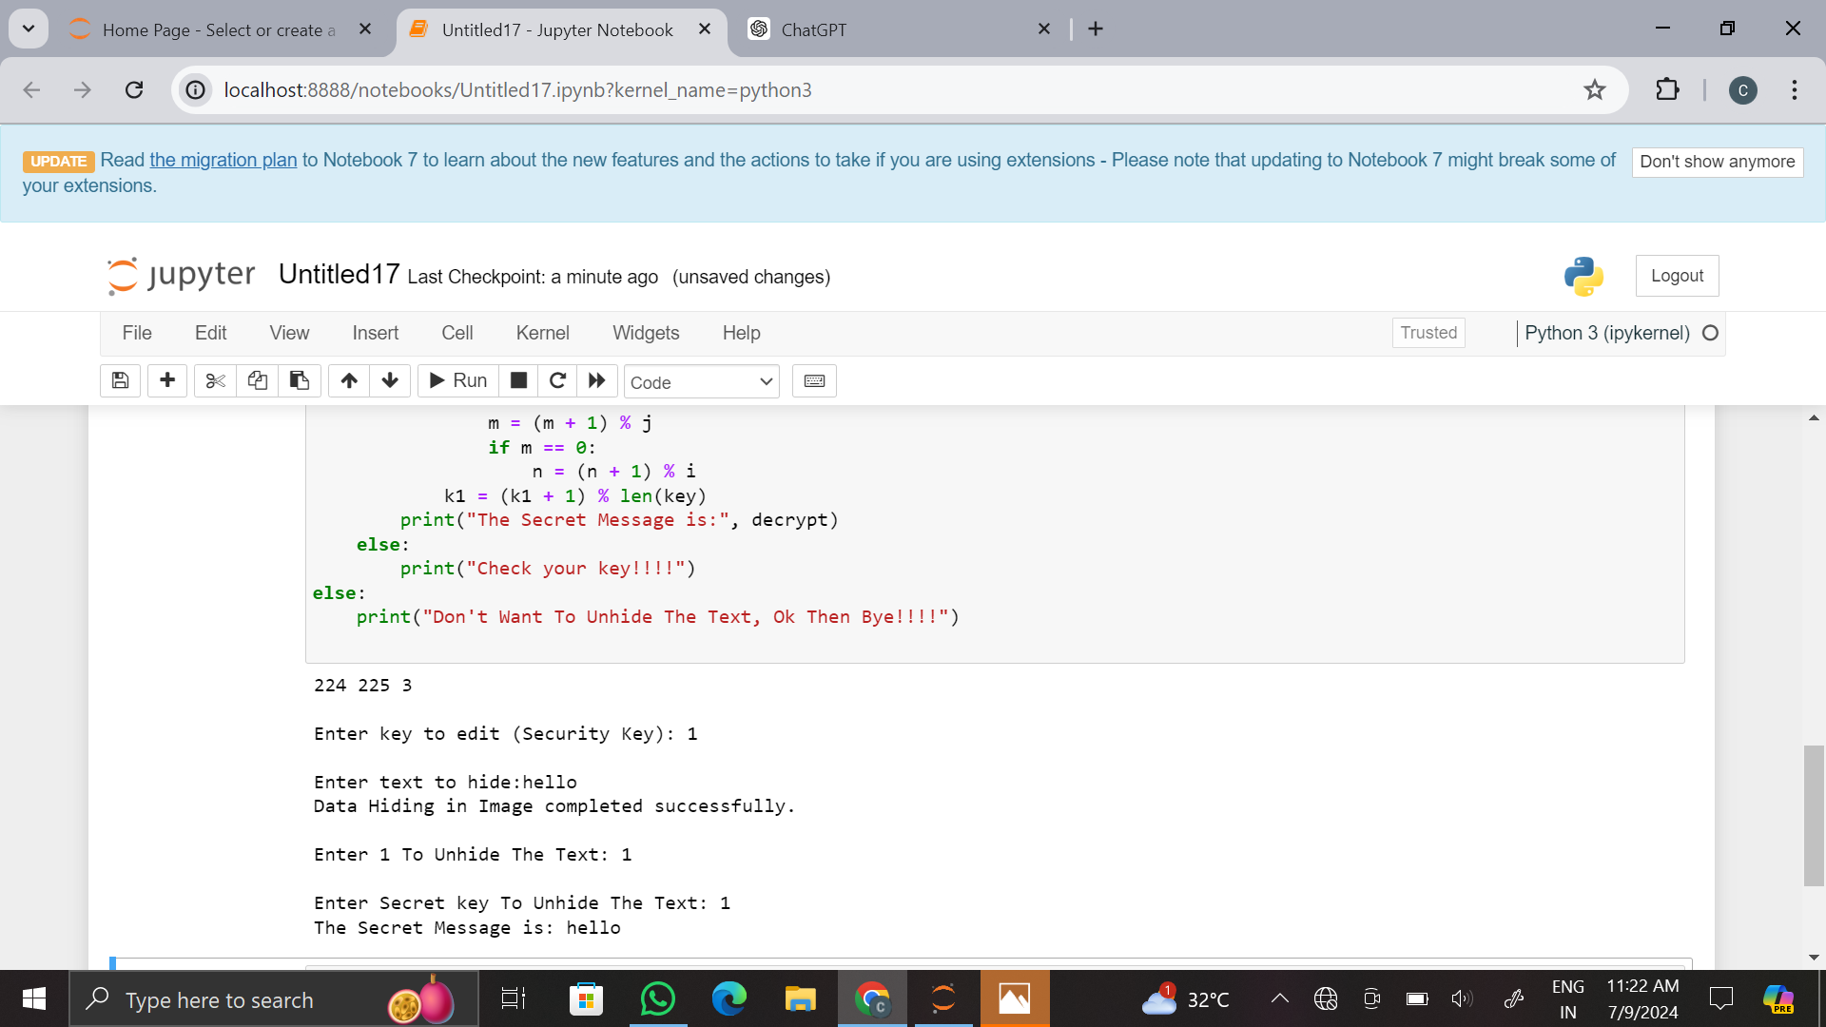
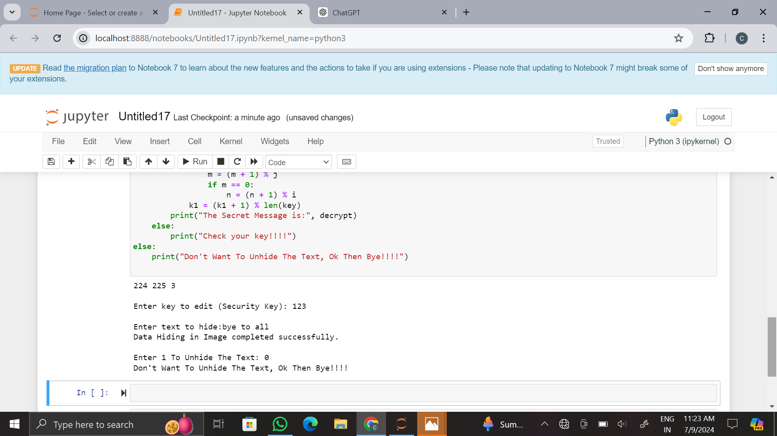

Slide 11
links
Project repository- https://github.com/Meghana-04/CyberSecurity.git
References
https://www.researchgate.net/publication/302594888_Quality_Evaluation_of_Image_Steganography_Techniques_A_Heuristics_based_Approach

