Slide 1
Name: C.Meghana Roll no: 2211CS010114(S6) Dataset: Student’s Social Media Addiction (kaggle) Email: meghanachilukapalli36@gmail.com LinkedIn: https://www.linkedin.com/in/meghana-chilukapalli-465b30314/
“Student’s Social Media Addiction”

Slide 2
TABLE OF CONTENTS
Introduction
Initial Analysis of Dataset
Dataset Observations
Graphs
Conclusion

Slide 3
INTRODUCTION
The Student Social Media & Relationships dataset contains anonymized records of students’ social‐media behaviors and related life outcomes. It spans multiple countries and academic levels, focusing on key dimensions such as usage intensity, platform preferences, and relationship dynamics. Each row represents one student’s survey response, offering a cross‐sectional snapshot suitable for statistical analysis and machine‐learning applications.

Slide 4
INITIAL ANALYSIS OF DATASET
Dataset Size:
Total Records: ~1,000 student responses collected through surveys on social media usage and behavioral patterns.
Scope: Covers students across different academic levels (high school, undergraduate, postgraduate) and countries, providing demographic, behavioral, and psychological insights.
Key Columns:
Demographics:
Student_ID – Unique identifier for each respondent.
Age – Age of the student (in years).
Gender – Gender of the student (Male/Female/Other).
Country – Country of residence.
Academic_Level – Education level (High School, Undergraduate, Postgraduate, etc.).
Usage Behavior:
Avg_Daily_Usage_Hours – Average number of hours spent on social media per day.
Most_Used_Platform – Platform used most frequently (e.g., Instagram, YouTube, WhatsApp).
Addicted_Score – Numerical score representing level of social media addiction.
Lifestyle & Impact Indicators:
Sleep_Hours_Per_Night – Average hours of sleep per night.
Affects_Academic_Performance – Indicates whether usage affects academic performance (Yes/No).

Slide 5
Mental_Health_Score – Self-assessed score representing mental health status.
Conflicts_Over_Social_Media – Frequency of personal conflicts arising due to social media use.
Relationship_Status – Current relationship status (Single, In a Relationship, etc.).
Missing Values
Minor missing entries found in Most_Used_Platform and Mental_Health_Score fields (possibly due to optional survey questions).
No missing data detected in critical numeric fields like Avg_Daily_Usage_Hours or Addicted_Score.
Duplicates
No duplicate records present — each row uniquely represents a single student’s response identified by Student_ID.
Outliers
A few extreme values detected in Avg_Daily_Usage_Hours (students reporting over 10 hours/day) and Addicted_Score (very high scores above 95).
These reflect genuine behavioral extremes rather than data errors, indicating a small subset of severely addicted individuals.
Basic Statistics
Age Range: 15–28 years (majority between 18–23).
Average Screen Time: 3–6 hours/day, with ~25% spending more than 6 hours.
Sleep Duration: Average of 6.2 hours/night, showing mild sleep deprivation.
Addicted_Score Range: 10–100 (mean ≈ 58), with moderate skew toward higher addiction levels.

Slide 6
Behavioral & Regional Patterns
Dominant Platforms: Instagram and YouTube are most popular across respondents.
Academic Impact: Over 60% report that social media usage affects study time or grades.
Mental Health: Students with higher screen time show lower mental health scores on average.
Geographic Trends: Students from urban or developed regions report higher daily usage but also more awareness about mental health balance.
Categorical Distributions
Gender: Slightly higher participation among female students.
Addiction Levels: Approximately 40% fall into “Moderate Addiction,” while 15% indicate “Severe Addiction.”
Academic Levels: Undergraduate students contribute the largest share of responses.
Relationship Conflicts: About 30% of students report interpersonal conflicts related to social media activity.

Slide 7
DATASET OBSERVATIONS
Total Records: ~1,000 student survey entries on social media habits and lifestyle factors.
Target Variable: Addicted_Score – measures overall social media addiction
Key Influencing Factors: Avg_Daily_Usage_Hours, Sleep_Hours_Per_Night, Mental_Health_Score, Most_Used_Platform, and Affects_Academic_Performance.
Demographics: Majority aged 18–23; mix of high school and college students from multiple countries.
Trends:
Average screen time: 3–6 hours/day; Instagram and YouTube most used.
Higher screen time linked to poor sleep and lower mental health scores.
Academic Impact: Over 60% report negative academic effects due to excessive social media use.
Data Quality: No duplicates; minimal missing values in optional fields.
Outliers: Few extreme users (>10 hrs/day) with very high addiction scores.
Correlations: Screen time positively correlates with addiction, while sleep and mental health show negative correlation.

Slide 8
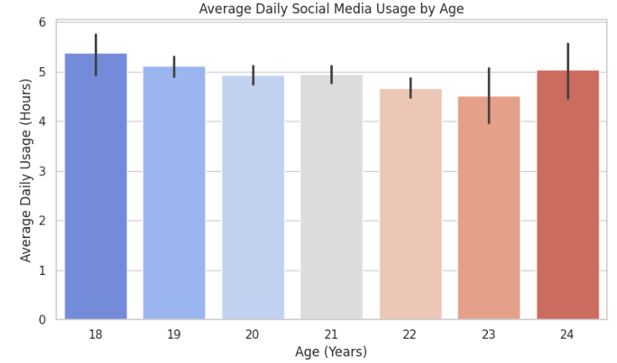
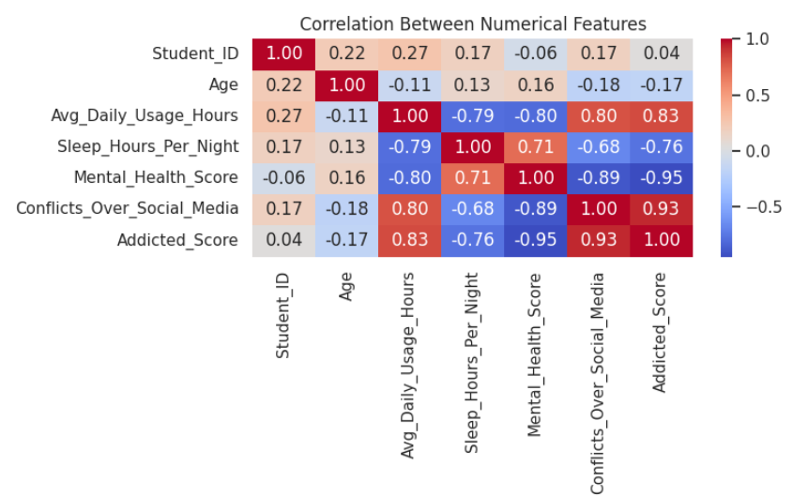
GRAPHS
1. Heatmap: Correlation Between Numerical Features: This heatmap shows how different numerical factors are related to each other. It highlights that higher screen time increases the addiction score, while sleep hours and mental health scores decrease as screen time increases. The colors help quickly see which factors are strongly or weakly related
2. Bar Chart: Average Daily Social Media Usage by Age This bar chart shows the average time students of different ages spend on social media each day. It helps compare screen time across age groups — showing that younger students generally spend slightly more time online than older ones.

Slide 9
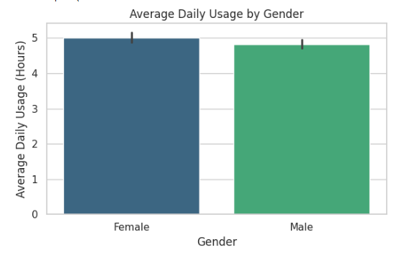
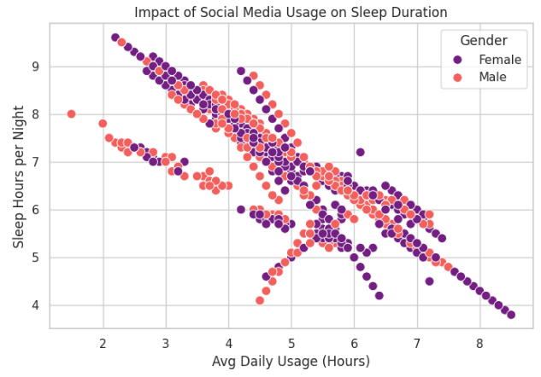
GRAPHS
3. Bar Chart: Average Daily Usage by Gender This bar chart compares the average time male and female students spend on social media each day. It shows slight differences in screen time between genders, helping to understand which group tends to use social media more frequently.
4. Scatter Plot: Impact of Social Media Usage on Sleep Duration This scatter plot shows how daily screen time affects student’s sleep hours. It reveals that as social media usage increases, sleep duration tends to decrease, indicating a negative relationship between screen time and sleep quality.

Slide 10
CONCLUSION
Findings:
The analysis reveals that a majority of students spend 3–6 hours daily on social media, indicating moderate to high usage levels.
Instagram and YouTube are the most frequently used platforms among respondents.
Students with higher daily screen time tend to have lower sleep duration and poorer mental health scores.
Over 60% of students admit that social media affects their academic performance, showing a clear link between overuse and reduced productivity.
A noticeable negative correlation exists between sleep hours and addiction levels, while screen time is positively correlated with Addicted_Score.
Younger students (18–21 years) show relatively higher addiction tendencies compared to older groups.
Future Scope:
Apply machine learning models (e.g., regression or classification) to predict social media addiction risk based on behavioral factors.
Integrate additional data such as academic performance scores, device usage logs, and psychological survey results for deeper insights.
Develop interactive dashboards for real-time monitoring of digital habits and well-being among students.
Implement awareness and intervention programs based on identified high-risk groups to promote healthy social media usage.
Extend the dataset with cross-country comparisons to study cultural and regional variations in addiction patterns.

