Slide 1

Collabedge
A platform where skilled people collaborate together to reach the goals

Slide 2

Problem:
Freshers struggle to get practical experience and visibility
Companies need ready-to-hire skilled talent and innovative ideas
Existing freelance platforms focus on paid gigs, not learning & hiring
Skill exchange opportunities are limited
Reasons:
Not upgrading
Job layoff
AI and
Competition

Slide 3
Solution and key features
01
Skill Exchange
swap knowledge or skill without paying
02
Team Collaboration Hub
Create or join teams for collaborations
03
Project market place
Companies view, buy or hire from team outputs
04
Sustainable Growth
Through community and corporate tie-ups

Slide 4

Conclusion:
This platform aims to bridge the gap between talent and opportunity by enabling freshers and experienced professionals to collaborate, innovate, and showcase their skills.
The integrated skill-exchange feature promotes a knowledge-sharing ecosystem, allowing users to learn from each other without monetary constraints.
Ultimately, this app will become a dynamic marketplace for ideas and talent, empowering individuals to build real-world projects, gain visibility, and transform their skills into career growth.

Slide 5
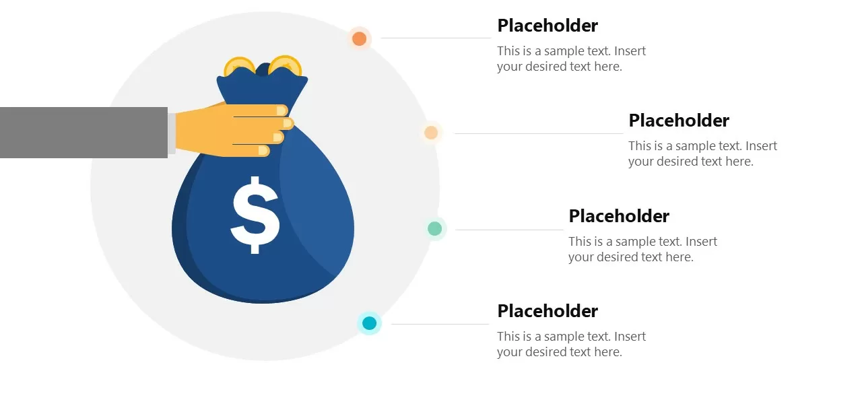
Business Model and Revenue
Premium
1 month free trial and $600 for
1 year Subscription
A
Ads & Sponsorships
Run targeted ads related to tech courses, cloud services etc..
Free Skill Exchange
Experienced can share their knowledge/skill
Company Hirings
If the company likes the project there are high chances of hiring them

Slide 6

Thank You
Our team is grateful for your time, encouragement, and support

