Slide 1
Secure data hiding in images using steganography
CAPSTONE PROJECT
Presented By:
Student Name : Meghana Kadimi
College Name & Department : Methodist college of engineering and Technology & CSE

Slide 2
OUTLINE
Problem Statement
Technology used
Wow factor
End users
Result
Conclusion
Git-hub Link
Future scope

Slide 3
Problem Statement
Secure hidden communication is essential in various fields where confidentiality is crucial, as traditional encryption methods, while effective, can attract attention and signal the presence of a secret message, whereas steganography offers a discreet alternative by embedding secret messages within images, making them nearly undetectable and playing a vital role in cybersecurity, journalism, and personal privacy by enabling covert communication while minimizing the risk of exposure.

Slide 4
Technology used
This project is implemented using a combination of technologies to ensure a smooth and secure steganography process:
Programming Language: Python – Provides powerful libraries and ease of implementation.
GUI Library: Tkinter – Enables user-friendly graphical interaction.
Image Processing: OpenCV & PIL (Pillow) – Facilitates image handling and manipulation.
Encryption Logic: Least Significant Bit (LSB) steganography – Efficiently encodes messages into pixel data.
File Handling & Security: os, numpy, cv2 – Ensures data integrity and image encryption.
These technologies work together to create a system capable of securely embedding and retrieving messages from images with an added layer of password protection

Slide 5
Wow factors
This project offers several unique and impressive features that make it stand out:
Invisible Message Encoding: Secret messages are hidden within images without altering their appearance.
Password-Protected Encryption: Ensures that only authorized users can decrypt the hidden information.
User-Friendly GUI: The application provides an easy-to-use interface for both encryption and decryption.
Side-by-Side Image Display: Users can view the original and encrypted images simultaneously.
Real-World Applications: The tool is applicable in cybersecurity, secure document transmission, and private communication.
Fast & Efficient: The LSB steganography technique ensures quick encryption and decryption without significant file size increase.

Slide 6
End users
The steganography-based encryption and decryption system benefits multiple sectors and individuals who require secure communication:
Cybersecurity Professionals: Use it to protect classified data and sensitive information.
Journalists & Activists: Safeguard confidential reports and sources from surveillance and censorship.
Businesses & Corporations: Securely exchange critical business documents without raising suspicion.
Military & Government Organizations: Enable secure intelligence transmission in defense operations.
General Public & Privacy Enthusiasts: Ensure personal data security in digital communication.

Slide 7
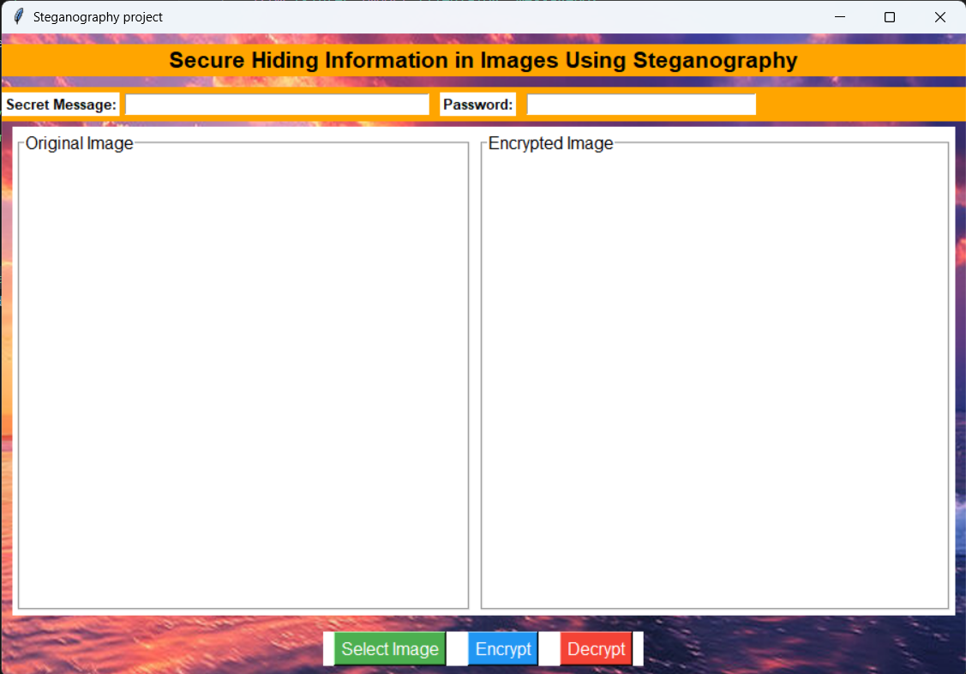
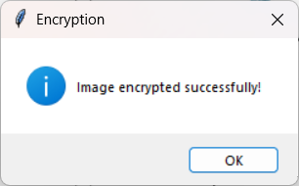
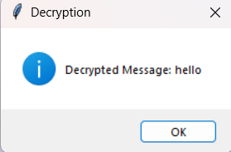
Results
Output 2
Output 3
Output 1

Slide 8
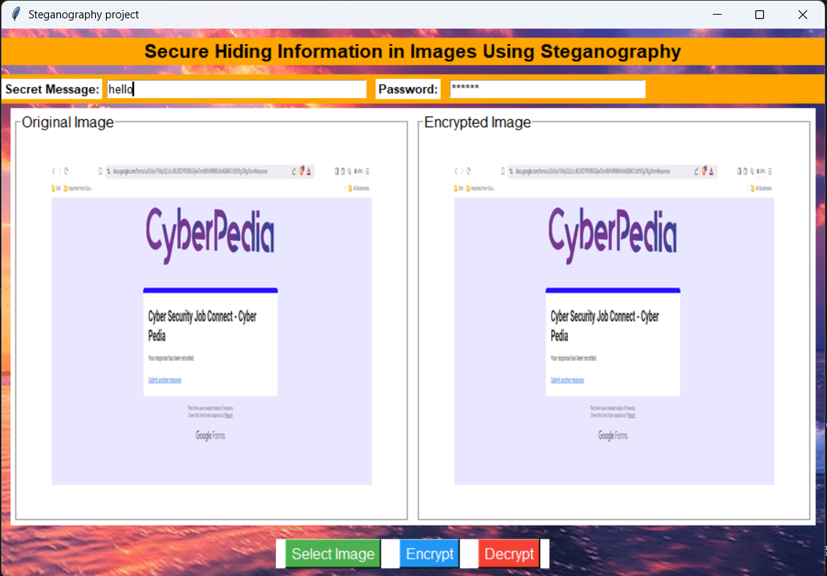
Results
Output 4

Slide 9
Results
After implementing and testing the system, the following results were achieved:
Successful Image Encryption: The system securely embeds the secret message within an image.
Accurate Decryption: Users can retrieve the message with the correct password, ensuring data security.
Preserved Image Quality: The encryption process does not significantly alter the appearance of the image.
Seamless User Experience: The application provides a simple yet effective interface for secure communication.
Efficient Performance: The tool operates with minimal processing time and maintains image integrity.
This proves that the proposed system is a viable and practical solution for secure hidden communication.

Slide 10
Conclusion
Steganography is a powerful technique for secure hidden communication, providing an additional layer of security over traditional encryption methods. By embedding secret messages into images, this project demonstrates a practical approach to discreet data transmission, ensuring that confidential information remains undetectable to unauthorized parties. With password protection, user-friendly implementation, and real-world applications, this system serves as a valuable tool for cybersecurity, journalism, and personal privacy. Future enhancements could include stronger encryption methods, AI-based steganalysis, and support for audio and video steganography, making it even more robust and versatile.

Slide 11
GitHub Link
Repository: https://github.com/Meghana-kadimi/steganography-project.git
Contents: Full source code, setup instructions, and documentation.
Contributions: Open for improvements, feature suggestions, and collaborative development.
License: MIT
This repository provides everything needed to explore, modify, and expand upon the steganography encryption and decryption system.

Slide 12
Future scope
To further enhance the project, the following advancements can be explored:
Advanced Encryption Methods: Integrating stronger cryptographic techniques alongside steganography.
AI-Based Steganalysis Detection: Implementing machine learning models to improve message concealment.
Audio & Video Steganography: Expanding the system to hide messages in multimedia formats.
Cloud-Based Implementation: Developing a web-based version for secure remote access.
Mobile Application Development: Creating an Android/iOS app for easy on-the-go encryption and decryption.
Blockchain Integration: Ensuring tamper-proof hidden communication with decentralized security.
These enhancements can significantly improve the system's security, scalability, and usability.

Slide 13
THANK YOU

