Slide 1
HYBRID CLOUD SETUP USING AWS VPN

Slide 2
Overview:
Hybrid Cloud is a fully functional hybrid cloud architecture project built entirely on AWS Free Tier. It connects an on-premises network simulated using an EC2 instance to a cloud network (AWS VPC) using a Site-to-Site VPN tunnel configured with strongSwan (open-source IPSec VPN). The goal is to simulate a real-world enterprise-grade hybrid environment without any physical hardware.

Slide 3
Objective:
The primary purpose of this project is to:
Demonstrate secure connectivity between on-prem and cloud networks
Simulate enterprise hybrid infrastructure without cost
Learn AWS VPN services and IPSec tunneling using strongSwan
Provide hands-on experience with networking, security, and remote access in cloud computing.

Slide 4
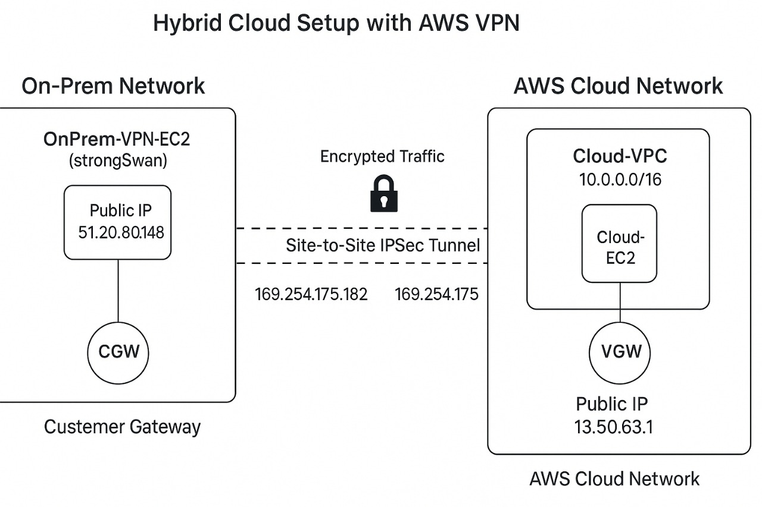
Architecture:

Slide 5
Steps Followed:
Phase 1: AWS VPC Setup (Cloud Side)
a. VPC Creation (Cloud-VPC)
b. Subnet Creation (Cloud-Subnet)
c. Internet Gateway (IGW)
d. Route Table Update
e. Security Group
Phase 2: On-Prem VPC Simulation
a. VPC Creation (OnPrem-VPC)
b. Subnet (OnPrem-Subnet)
c. EC2 Instance: OnPrem-VPN-EC2
d. Security Group

Slide 6
Phase 3: VPN Setup
a. Virtual Private Gateway (VGW)
b. Customer Gateway (CGW)
c. Site-to-Site VPN Connection
Phase 3.1: strongSwan Setup and Tunneling
Packages Installed on Amazon Linux 2023 OnPrem EC2:
Download and install strongSwan from Source
Start strongSwan Service
Manually Bring Up the Tunnel
Verify Tunnel Status
Phase 4: Routing and Testing
a. Route Table Update in AWS
b. Ping Test (Cloud EC2 > OnPrem EC2)

Slide 7
IP Address Summary:
Component | IP Address | Notes
Cloud VPC CIDR | 10.0.0.0/16 | AWS side
Cloud Subnet CIDR | 10.0.1.0/24 | AWS EC2 lives here
Cloud EC2 Private IP | 10.0.1.x | Example: 10.0.1.100
OnPrem VPC CIDR | 192.168.0.0/16 | Local simulation
OnPrem Subnet CIDR | 192.168.1.0/24 | Local subnet for VPN EC2
OnPrem EC2 Private IP | 192.168.1.41 | Static or assigned IP
OnPrem EC2 Public IP | 51.20.80.148 | Dynamic CGW IP
VGW Public IP | 13.50.63.1 | AWS VPN side
Tunnel Inside (CGW) | 169.254.175.182 | VPN tunnel interface
Tunnel Inside (VGW) | 169.254.175.181 | VPN tunnel interface

Slide 8
Conclusion:
This project successfully delivers a production-simulated hybrid cloud setup using AWS VPN and an on-premises simulation. It solves the challenge of learning hybrid connectivity without expensive hardware or third-party tools. Using only Free Tier resources and native Linux tools, it provides hands-on experience in VPN, routing, network design, and secure cloud communication.
Hybrid Cloud is not just a learning project — it’s a foundation for building scalable, secure, real-world enterprise architectures on AWS.

Slide 9
THANK YOU

