Slide 1

US Airline Delay Analysis
Presented By :
Lakshmi Naga Meghana Polisetty
015918708

Slide 2
Why This Study?
There is nothing people dread more than experiencing a flight delay. In the course of the year, a lot of flights get delayed, which leads to some costs for both the airline and the passengers.
As a result, the airline's reputation is at stake as well as the passenger's time and money.
Airlines treat delay as one of the most critical performance indicators. The reasons for delays may be unavoidable due to weather conditions, air traffic, or any unforeseen event. However, they may also be a result of a process that needs to be improved.
In order to understand the performance of a flight, statistics on flight delays are necessary.

Slide 3
For anyone who has traveled on an airplane, you may have experienced one of the inevitable pains of flying: the delays. Sometimes your plane arrives late, other times there may be a queue for takeoff, and occasionally the weather forces hour-long delays (or even cancellation); regardless of the reason for the delay, they pose a huge inconvenience for travelers.

Slide 4
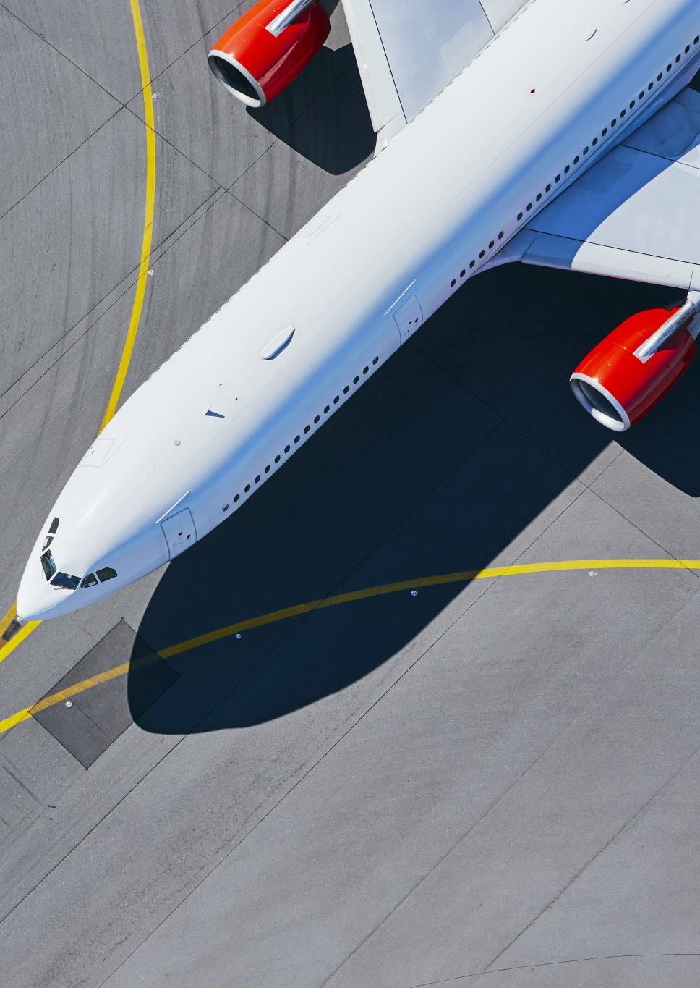
About Data:
The dataset was taken from Kaggle and comprised 4 CSV files containing data from 2016 to 2019. It contained information about airlines, delay information, location details (origins and destinations), and cancellation (reasons labeled as cancellation codes). It also had certain technical details such as the time that the plane was stationary on the ground.
This data about delay and cancellation was collected and published by the DOT’s Bureau of Transportation Statistics. It has a list of all the airports, the airlines served there, the flights canceled and the reasons behind it.
The purpose of this analysis is to determine which airports have the most delays and which airlines are the worst.
In addition, I have tried to understand how the day of the week and the month affect this.

Slide 5
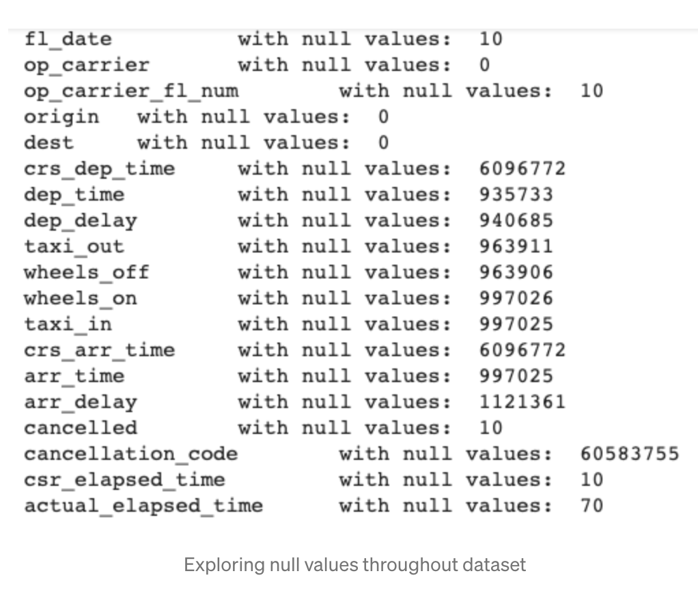
Data Wrangling
Data Cleaning and Preparation
Originally, there were 28 variables to work with. After removing the unnamed columns, the remaining 19 were checked for null values (as shown below). In addition, only columns with relevant data about the flight profile, delay, and cancellation information were kept.

Slide 6
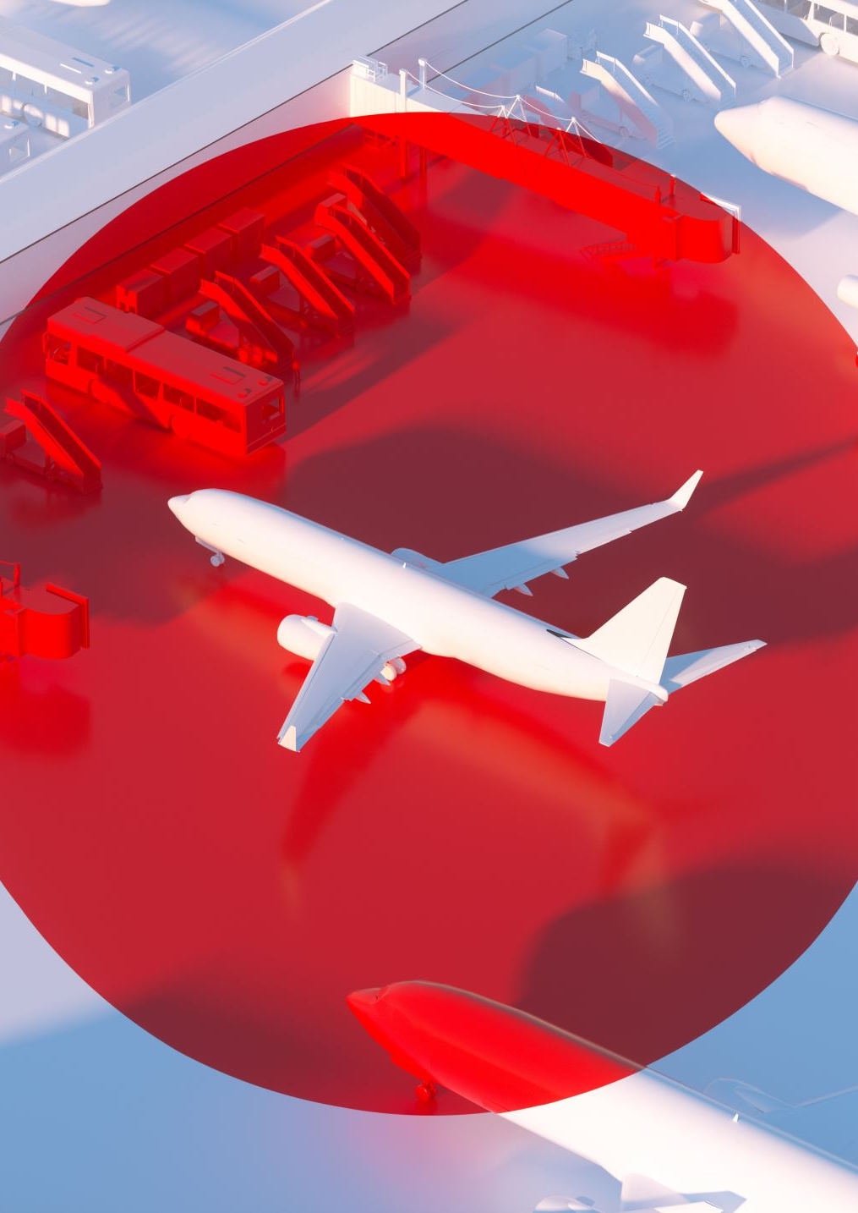
From the profile dataset, there were
25,927,762 flight profile records
13 US domestic Airlines
365 Airports
18 Carriers

Slide 7
Important KPI measure for Airline Delay
When is an aircraft on time/late?
When an aircraft arrives within 15 minutes of its scheduled arrival time or departs within 15 minutes of its scheduled departure time, it is considered on time by the industry. In other words, exactly 15 minutes after the scheduled time is considered late.
Who determines what late is?
For airlines, airports, and travel tech companies, OAG has become the world's top provider of digital flight information and analytics.
Does it matter?
With on-time performance (OTP) becoming more visible among the public and within airports and airlines in recent years, punctuality has progressed from the days when it was only used by ground staff as a performance measure.
Several of the world's largest and best airlines mention it in their annual reports today. It is a Key Performance Indicator (KPI) that is used as a benchmark for relationships between airports, airlines, and other service providers.

Slide 8
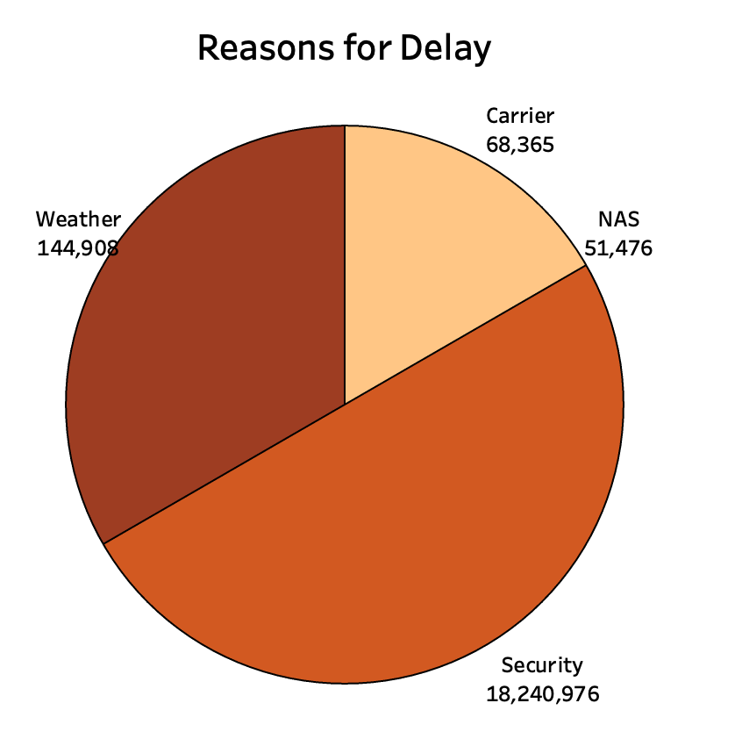
Within the cancellation sub-dataset, the cancel column is categorical data represented by either a 0 or a 1 (not canceled or canceled respectively). The reasons for the cancellation from the data are as follows:
A — Airline/Carrier (68,365)
B — Weather (144,908)
C — National Air System (51,476)
D — Security (18,240,976)

Slide 9
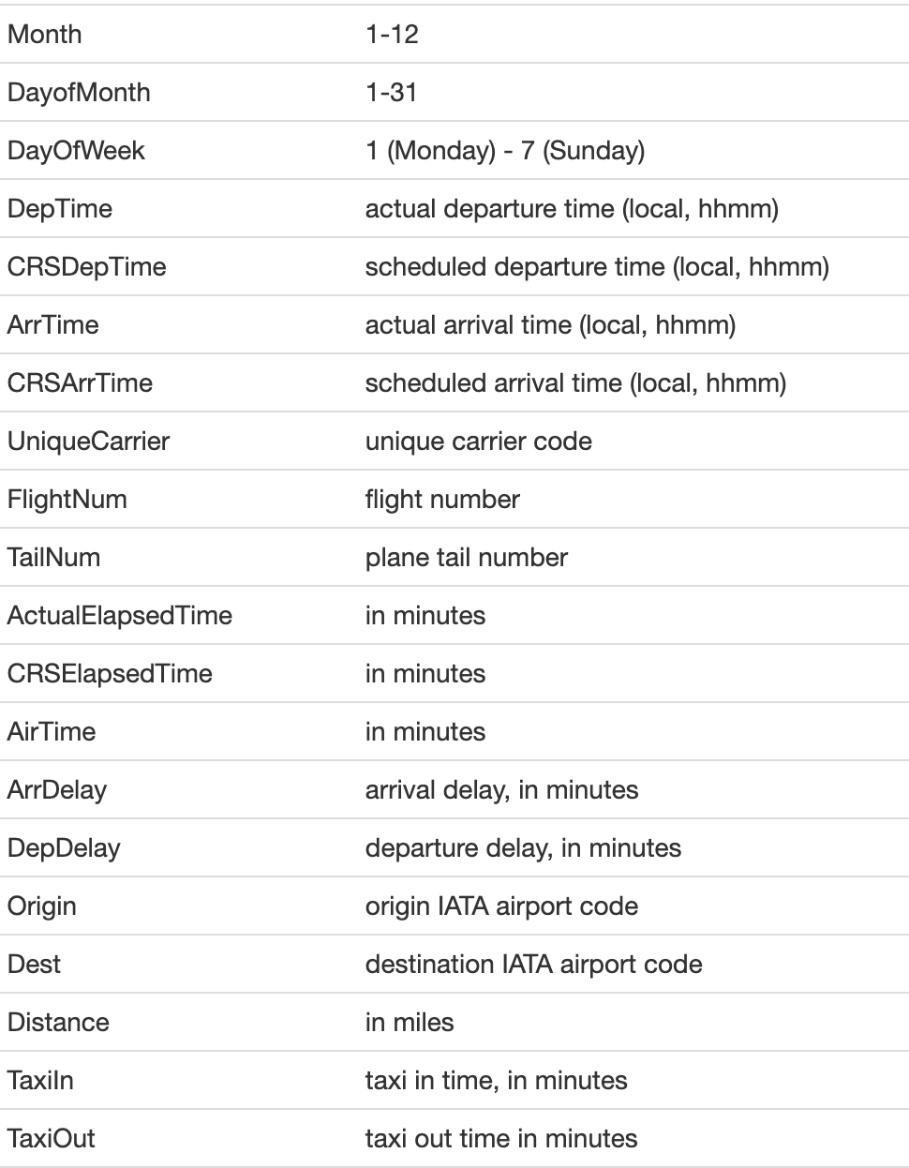
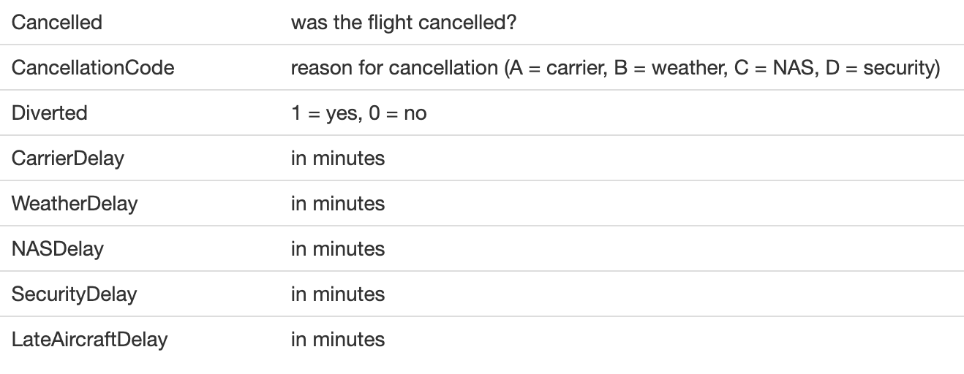
Variables used for visualizations

Slide 10
Key Takeaways :
From the data, the airline with the highest probability of being cancelled was ExpressJet Airlines (EV), with Delta Airlines (DL) having the least probability of being cancelled.
June through August are the most popular months for flying. During these months, a variety of factors can cause delays, such as security issues or airline delays.
American Airlines has the highest number of delays caused by weather conditions, followed by Delta airlines.
Weather conditions, human factors, and technical reasons can all cause delays. Taxing time is one of the main technical reasons for departure delays. However, the increase in airspeed in these cases tends to help ease down the arrival delays quite a bit.

Slide 11
Conclusion
The insights indicate that viewing delay as an aggregate of different components can reveal insights otherwise hidden. The analysis indicates the need of addressing delays across different Time of Days. We observe that there is a seasonality in Departure Delay which can be addressed by appropriate schedule relaxation of the Flights in the required time periods.

