Slide 1

BOAT RENTAL APPLICATION
Presented by:
MEGHANA NERUSU U1438001

Slide 2
Goal and Objective
To present a user-friendly platform for managing boat rentals and customer bookings efficiently.
Streamline and optimize boat rental operations for businesses by automating administrative tasks related to boat management and customer bookings.

Slide 3
Ethical Considerations
Data Privacy & Security: Strong focus on safeguarding user info with secure encryption and limited access.
Fair Data Usage: No misuse for commercial gain, fostering trust among users.
Rigorous Data Validation: Comprehensive measures for data integrity and protection against threats.

Slide 4
Strategy/Approach to the Boat Rental System
Database with boat and customer info tables.
CRUD operations for data management.
Imported boat details from CSV.
Availability check before reservations.
Admins manage boats, customers, reservations.

Slide 5
Error Handling
Utilizes try-except blocks to handle exceptions and errors gracefully.
Proactive handling of potential issues during database and file operations.
Specific error messages for improved debugging and understanding.

Slide 6
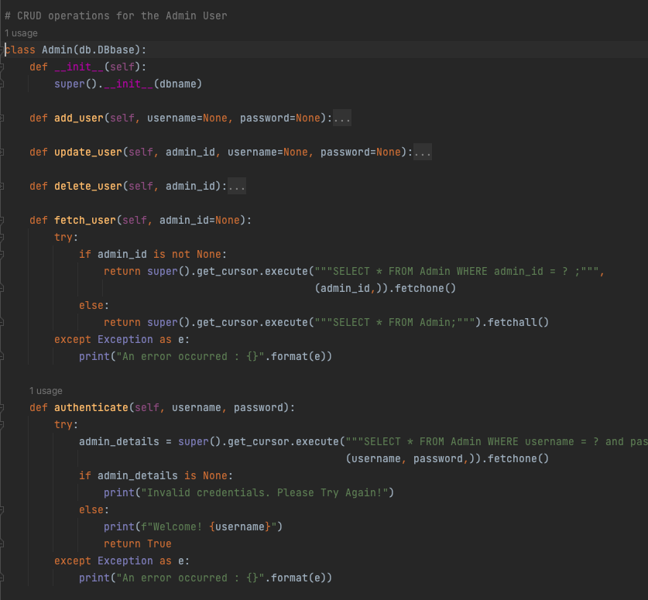
Error Handling

Slide 7
File I/O
Illustrates File Input/Output (I/O) with CSV data reading.
Efficiently saves boat information into the database.
Utilizes csv.reader() to extract data from "BoatDetails.csv".

Slide 8
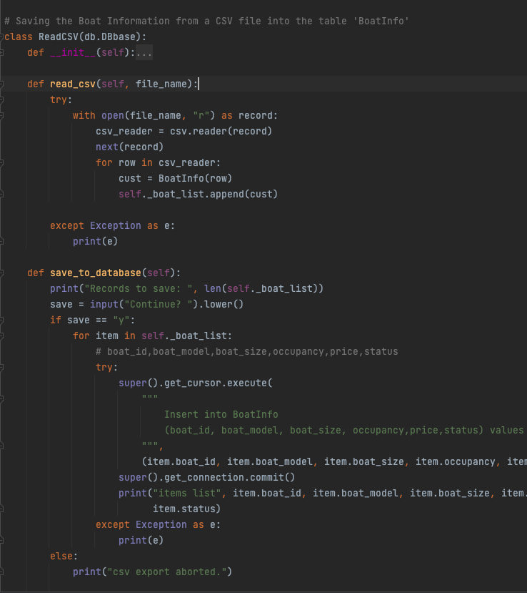
File I/O

Slide 9
Object-Oriented Programming (OOP)
Demonstrates OOP's power through classes and inheritance.
Each class represents a distinct entity with specific functionalities.
Encapsulates CRUD operations for code reusability.

Slide 10
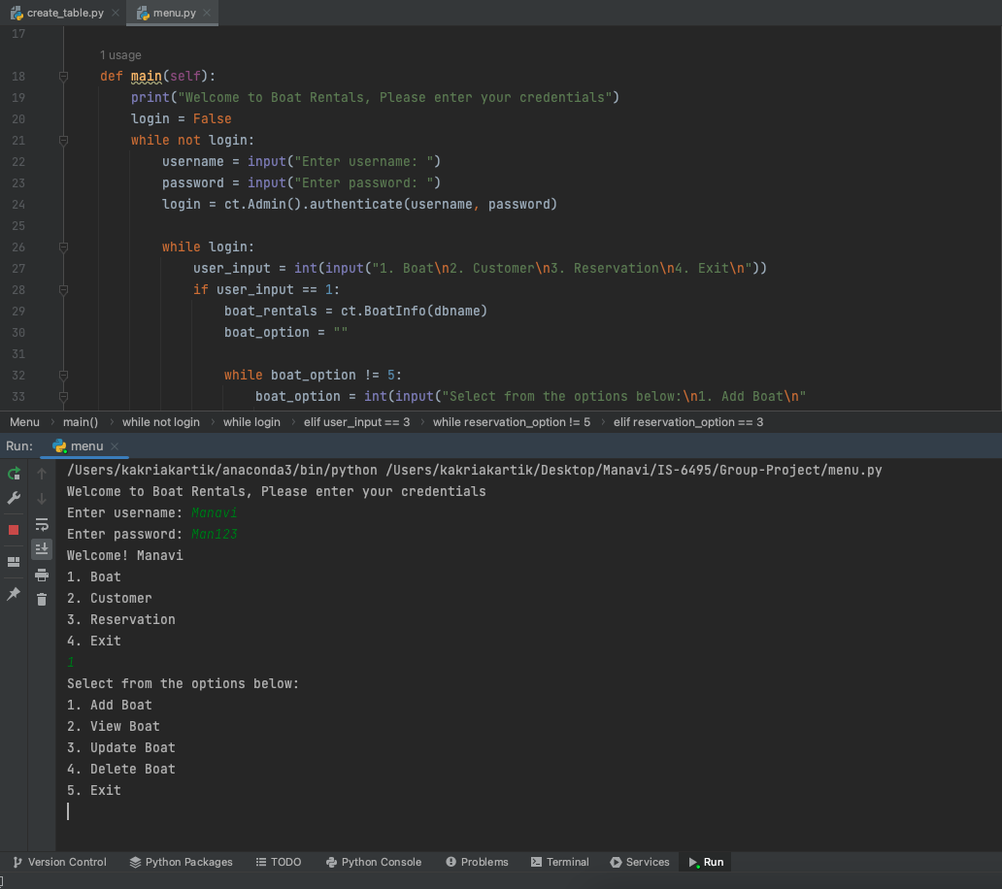
User Interactive Menu

Slide 11
Inline Comments
Extensive inline code comments for improved documentation and readability.
Clear insights into functions, classes, and critical logic blocks.
Simplify code maintenance.

Slide 12
Conclusion
Boat Rentals Database Management System delivers a reliable and efficient solution.
The system's ethical foundation and critical thinking ensure responsible and secure data management, making it a valuable asset for boat rental businesses.

