Slide 1


FIRE CLASSIFICATION

Slide 2

Learning Objectives
Understand the use of MODIS satellite data for fire detection
Identify key features influencing fire classification
Preprocess geospatial data for machine learning
Build and evaluate a fire classification model
Deploy the model using a Streamlit web app
Apply AI for real-world environmental monitoring
GOAL
Source :
www.freepik.com/

Slide 3
Tools and Technology used
Python - Core programming language
Jupyter Notebook - Data analysis and model development
Pandas & NumPy - Data manipulation and numerical operations
Scikit-learn - Machine learning model training and evaluation
Joblib - Model and scaler serialization
Streamlit - Web app development for model deployment
MODIS Satellite Data (CSV) - Source of real-world fire event data
Matplotlib / Seaborn - For data visualization

Slide 4
Methodology
Data Collection
-Collected MODIS fire data for India (2021-2023) in CSV format.
Data Preprocessing
-Cleaned missing values
-Encoded categorical features (e.g., confidence level)
-Scaled numerical data using StandardScaler
Feature Selection
-Selected key attributes: brightness, bright_t31, FRP, scan, track, confidence

Slide 5
Model Training
-Trained a supervised machine learning model (e.g., Random Forest or SVM)
-Tuned hyperparameters and evaluated using accuracy and confusion matrix
Model Saving
-Saved trained model and scaler using joblib for deployment
App Development
-Built an interactive UI using Streamlit
-Integrated model to take user input and predict fire type
Deployment & Testing
-Ran app locally to test prediction results for different input combinations

Slide 6
Problem Statement:
India experiences various types of fire incidents, including vegetation fires, offshore fires, and static land source fires, which can cause severe environmental and economic damage.
However, manual monitoring is slow, and distinguishing between fire types using raw satellite data is challenging.
There is a need for an automated system that can accurately classify fire types using satellite data to support faster and more informed response strategies.

Slide 7
Solution:
Problem:
-Fire incidents in India vary in type and impact Manual monitoring is slow and lacks precision
-Raw satellite data is difficult to interpret without automation
Proposed Solution:
-Use MODIS satellite data and machine learning
-Automatically classify fire types
-Improve speed and accuracy of fire detection

Slide 8
Solution Implementation
Data Processing & Modeling:
-Cleaned and preprocessed MODIS data (2021-2023)
-Selected key features: Brightness, FRP, Confidence, etc.
-Trained a supervised ML model (e.g., Random Forest or SVM)
Deployment:
-Built a Streamlit web app for real-time predictions
-Inputs: Satellite feature values
-Output: Fire Type prediction (Vegetation / Offshore / Static Land)

Slide 9
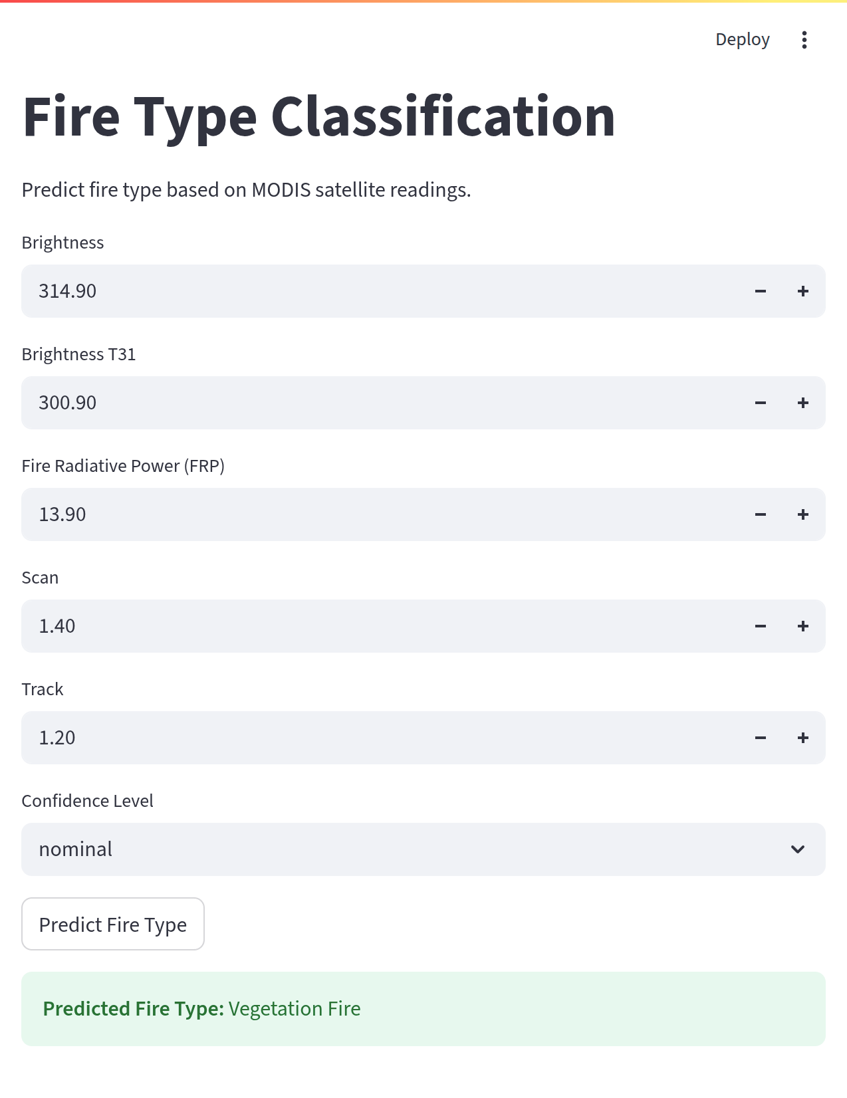
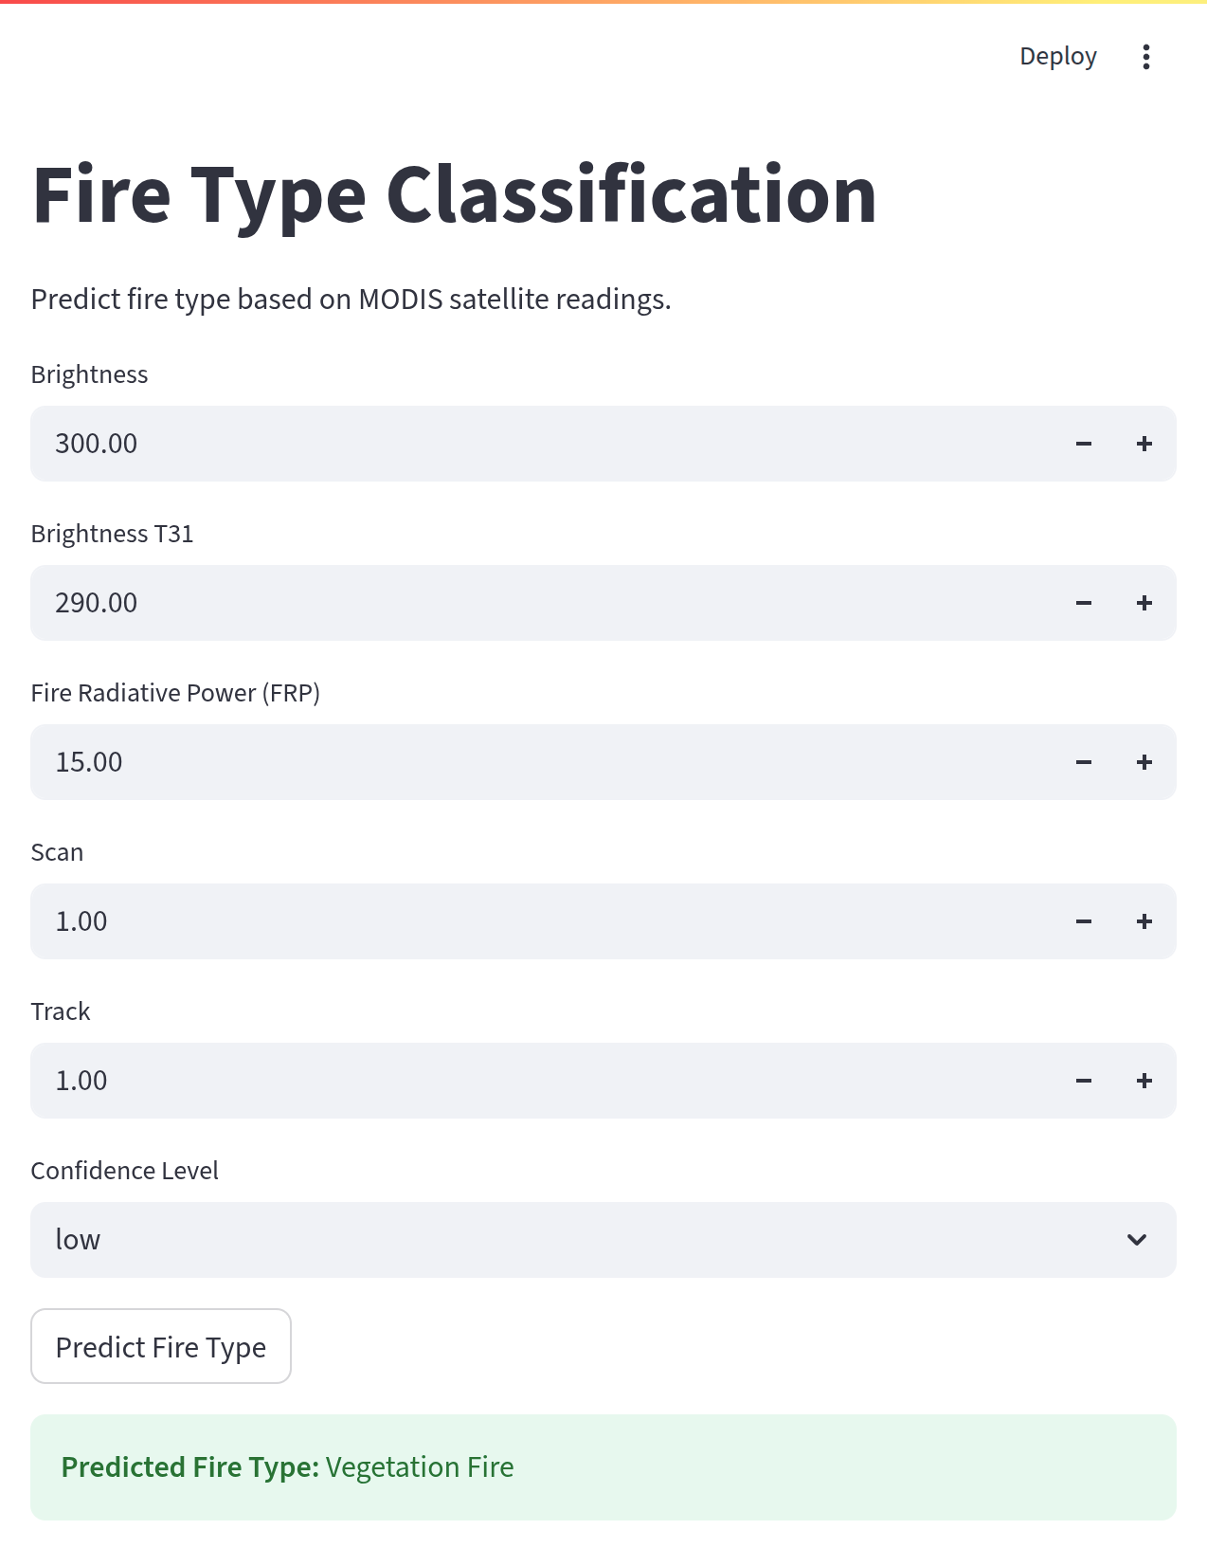
Screenshot of Output:

Slide 10
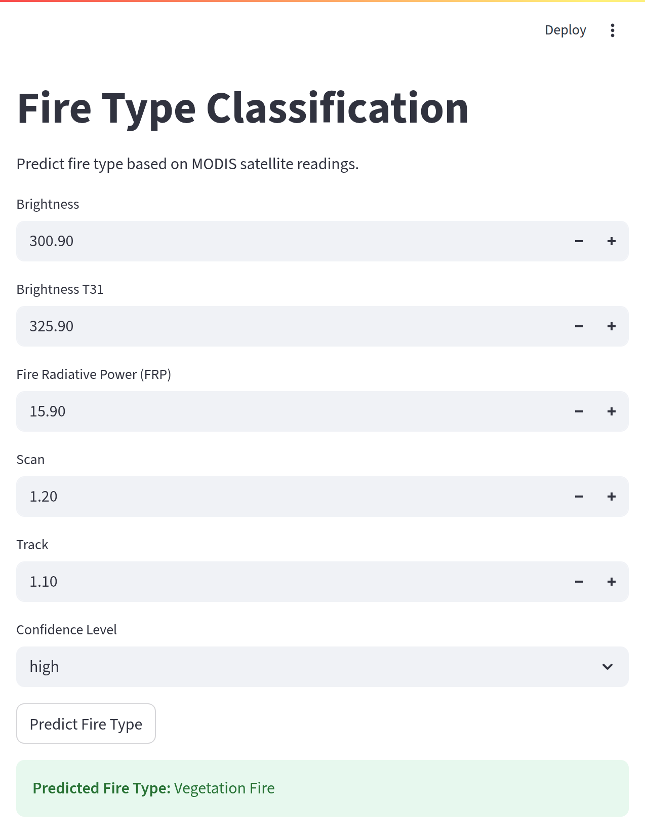
Github Link:
https://github.com/Meghana087/Fire_Classification.git

Slide 11
Conclusion:
Successfully built a machine learning model to classify fire types using MODIS satellite data
Preprocessed and analyzed data from 2021 to 2023 for improved accuracy
Deployed an interactive Streamlit web app for real-time fire type prediction
This solution enhances early detection, aids quicker response, and supports environmental monitoring efforts in India

Slide 12
Thank You!
Presented by: Meghana Doradla

