Slide 1
Fusion Churn Prediction Intelligence
All in one solution to Predict, Prevent & Analyze Customer Churning – AI | Sentiments | FFDC | Retail Banking Integration
GeekGods
Prithumit, Nishita, Bhaskar, Ajay

Slide 2


Customer churn prediction, prevention & Analytics
Customer Churning – Top Issue for most Banks
Sample Churn Propensity Indicator
“25-40 aged Customer possessing only one Banking Product (Savings Account) and no Recent Transactions since a Long Time and Not using Net Banking as Preferred Option”
“In 2012, 50% of customers, globally, either changed their banks or were planning to change.
“It costs more significantly to acquire new customers than retain existing ones – 5x more”
- Global Consumer Banking Survey 2012 Ernst & Young
End to End Solution with Fusion Churn Prediction Intelligence
Knowing the Customer Better – Unlocking Churning Trends and Pattern in Customer Data
Allow Relationship Managers to take Preventive Actions and further increase Customer Engagement
Cross Sell Personalized Offers to Customers Based on Churn Score and Sentiment Analysis
Feature as a Service – Complements Finastra’ s Retail Banking Products with Easy Integration to Persona Based Banking application
NextGen Analytics and automated Lead Generation powered by FFDC Tools & Dashboards

Slide 3


End to end Solution with AI + RETAIL BANKING + FFDC
Fusion Creator (UXP) + FFDC + Azure AI + REST APIs
Complementary feature to Customer 360 View in Retail Banking Products for RMs.
Seamless Integration to Finastra’s Retail Banking Product (Fusion Essence and PBB)
Highly Configurable Offer Management Integration to Increase Customer Engagement
Churn Prediction Intelligence and Sentiment Analysis through Microsoft Azure AI Services
Generate Analytics through FFDC Reporting and Fusion Creator
Fusion UXP + REST APIs
Azure AI + Retail Banking Data
Configurations & Retail Integration
Customer Churn Parameters
Churn Prediction Intelligence
Churn Prediction Score and Indicators
Offer Management
Churn Alert Levels
Churn Prevention – Offers and Communication
Customer Relationship Sentiment
Predictive Analytics & Monitoring – Customer Churning
Alert Queue for Relationship Managers (Red, Amber, Green)
Churn Prediction Analytics and Trends
Predictive Leads Generation to Retain Customers
Fusion UXP + FFDC Dashboards + Fusion Reports
FusionFabric Cloud App | Retail Banking Integration

Slide 4
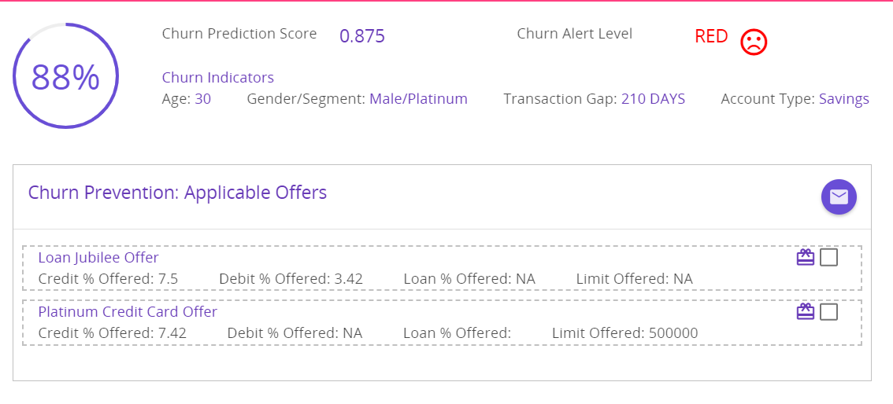
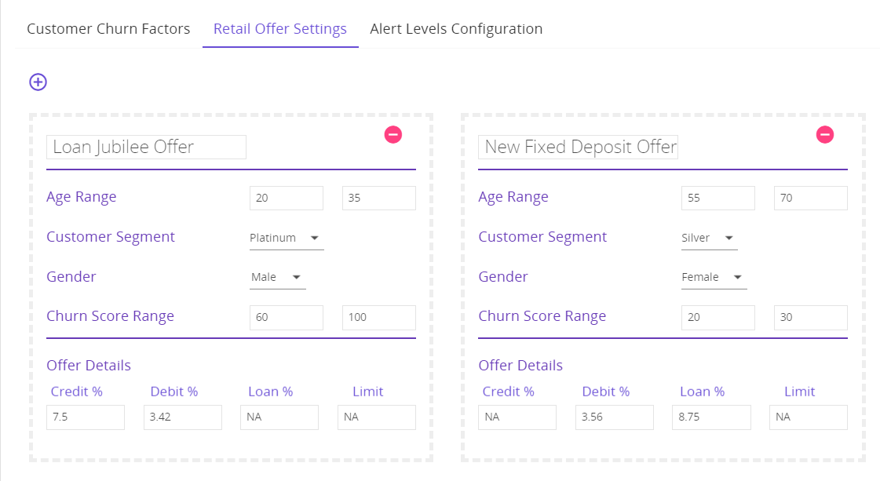
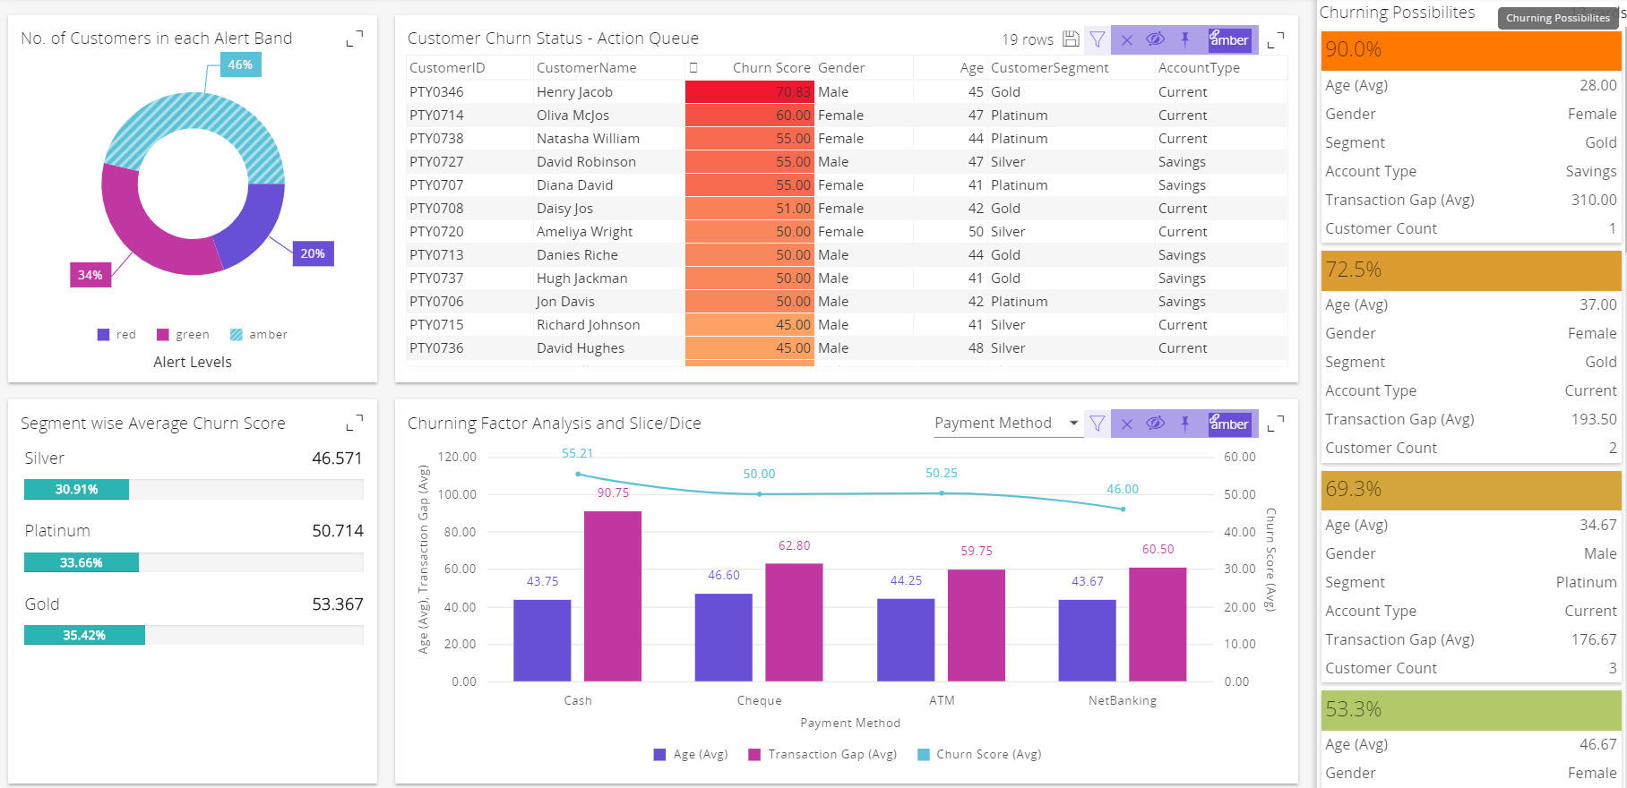
Demo – Fusion Churn Prediction Intelligence
AI – Predict Churn, Sentiment and Push Offers
High Configurability – Churn Parameters & Offers
Open Analytics – Churning Trends & Leads

Slide 5
Thank You ☺ Q & A ??

