Slide 1
STALE FRUIT DETECTION USING SWIN TRANSFORMER
Introduction:
This project focuses on developing an automated system for detecting stale fruits using the Swin Transformer model. Detecting fruit freshness is crucial for reducing food waste and ensuring quality control throughout the supply chain.
Problem Statement:
We address the significant food waste and quality control issues in the supply chain caused by the inability to quickly and accurately identify stale or spoiled fruits. Manual inspection, often performed by vendors and other stakeholders, is subjective, time-consuming, and inefficient, leading to economic losses and potential health risks. Automated systems face challenges due to the visual similarity between fresh and early-stage stale fruits, requiring advanced computer vision techniques.

Slide 2
Objectives:
To accurately classify fruits as 'fresh' or 'stale' using image processing and deep learning.
To explore and evaluate the performance of various Transformer-based architectures, including Vision Transformers (ViT) and hybrid CNN+ViT models, for robust feature extraction and classification.
To leverage the Swin Transformer as our primary model due to its demonstrated efficiency and effectiveness for this task.
To ultimately provide a reliable and efficient method for quality assessment of fruits.

Slide 3
Dataset and Preprocessing:
For this project, we utilized a dataset of Fresh and Stale images of fruits and vegetables containing images of various fruits labeled as 'fresh' or 'stale'. https://www.kaggle.com/datasets/raghavrpotdar/fresh-and-stale-images-of-fruits-and-vegetables.
Our dataset comprises approximately [14,682] images across [12] classes.
Preprocessing steps:
Resizing images to a uniform resolution (e.g., [your resolution] pixels).
Normalizing pixel values.
Applying data augmentation techniques (e.g., random rotations, flips, color jitter) to enhance dataset diversity and prevent overfitting

Slide 4
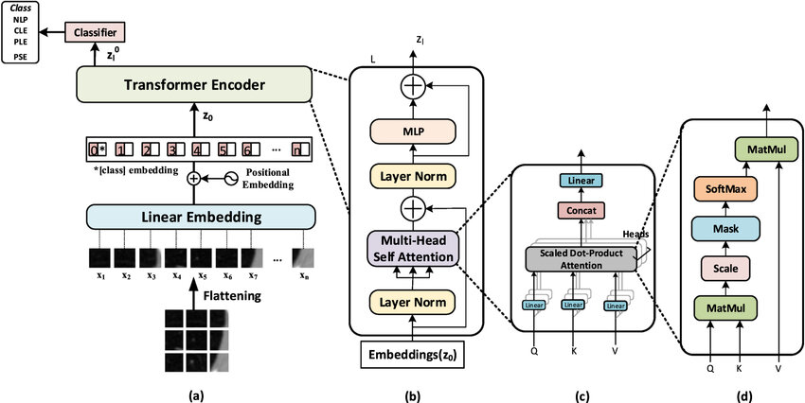
VISION TRANSFORMER[Vit]
Dropout
Linear
[32, 2]
Dropout
[32, 196+1, 768]
= 12
GELU
Linear
[CLS] [32, 768]
[32, 196, 768]
= 12
[32, 768, 196]
Total patches N= (image_size / patch_size)²
16X16
ATTENTION(Q, K, V) = SoftMax(QK^{T} / √d_k) V

Slide 5
# Patch Embedding Layer
class PatchEmbeddingLayer(nn.Module):
def __init__(self, in_channels=3, patch_size=16, embedding_dim=768, img_size=224):
super().__init__()
self.patch_size = patch_size
self.num_patches = (img_size // patch_size) ** 2
self.proj = nn.Conv2d(in_channels, embedding_dim, kernel_size=patch_size, stride=patch_size)
self.class_token = nn.Parameter(torch.randn(1, 1, embedding_dim))
self.position_embeddings = nn.Parameter(torch.randn(1, self.num_patches + 1, embedding_dim))
def forward(self, x):
B = x.shape[0]
x = self.proj(x).flatten(2).transpose(1, 2) # (B, N, C)
cls_tokens = self.class_token.expand(B, -1, -1) # (B, 1, C)
x = torch.cat((cls_tokens, x), dim=1) # (B, N+1, C)
x = x + self.position_embeddings
return x
# MLP Block
class MachineLearningPerceptronBlock(nn.Module):
def __init__(self, embedding_dims=768, mlp_size=3072, mlp_dropout=0.1):
super().__init__()
self.linear = nn.Sequential(
nn.Linear(embedding_dims, mlp_size),
nn.GELU(),
nn.Dropout(mlp_dropout),
nn.Linear(mlp_size, embedding_dims),
nn.Dropout(mlp_dropout)
)
self.norm = nn.LayerNorm(embedding_dims)
def forward(self, x):
x_norm = self.norm(x)
return self.linear(x_norm)
# Transformer Block
class TransformerBlock(nn.Module):
def __init__(self, embedding_dims=768, mlp_dropout=0.1, attn_dropout=0.0, mlp_size=3072, num_heads=12):
super().__init__()
self.msa_block = MultiHeadSelfAttentionBlock(embedding_dims, num_heads, attn_dropout)
self.mlp_block = MachineLearningPerceptronBlock(embedding_dims, mlp_size, mlp_dropout)
def forward(self, x):
x = x + self.msa_block(x)
x = x + self.mlp_block(x)
return x
# Multi-Head Self-Attention Block
class MultiHeadSelfAttentionBlock(nn.Module):
def __init__(self, embedding_dims=768, num_heads=12, attn_dropout=0.0):
super().__init__()
self.layernorm = nn.LayerNorm(embedding_dims)
self.multiheadattention = nn.MultiheadAttention(
embed_dim=embedding_dims,
num_heads=num_heads,
dropout=attn_dropout,
batch_first=True
)
def forward(self, x):
x_norm = self.layernorm(x)
attn_output, _ = self.multiheadattention(x_norm, x_norm, x_norm, need_weights=False)
return attn_output

Slide 6
# Vision Transformer (ViT)
class VisionTransformer(nn.Module):
def __init__(self, img_size=224, in_channels=3, patch_size=16, embedding_dims=768,
num_transformer_layers=12, mlp_dropout=0.1, attn_dropout=0.0, mlp_size=3072,
num_heads=12, num_classes=12):
super().__init__()
self.patch_embedding_layer = PatchEmbeddingLayer(in_channels, patch_size, embedding_dims, img_size)
self.transformer_encoder = nn.Sequential(
*[TransformerBlock(embedding_dims, mlp_dropout, attn_dropout, mlp_size, num_heads)
for _ in range(num_transformer_layers)]
)
self.classifier = nn.Sequential(
nn.LayerNorm(embedding_dims),
nn.Linear(embedding_dims, num_classes)
)
def forward(self, x):
x = self.patch_embedding_layer(x)
x = self.transformer_encoder(x)
x = x[:, 0] # CLS token
return self.classifier(x)

Slide 7
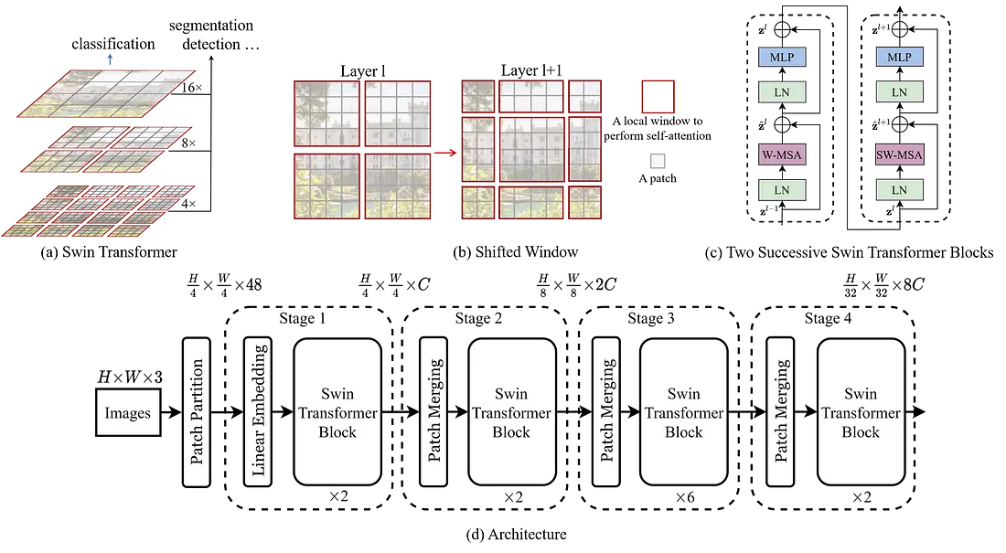




Swin Transformer:
4 × 4
H $×W ×96$
$$\frac{H}{2} ×\frac{W}{2} ×192$$
$$\frac{H}{4} ×\frac{W}{4} ×384$$
$\frac{H}{8} ×\frac{W}{8} ×$ 768
LayerNorm
GlobalAvgPool
Linear
Output
[768 → 12]

Slide 8
# Patch Embedding
class PatchEmbedding(nn.Module):
def __init__(self, in_channels=3, patch_size=4, embed_dim=96):
super().__init__()
self.proj = nn.Conv2d(in_channels, embed_dim, kernel_size=patch_size, stride=patch_size)
def forward(self, x):
x = self.proj(x)
x = x.flatten(2).transpose(1, 2) # B, N, C
return x
# Window Partition / Reverse
def window_partition(x, window_size):
B, H, W, C = x.shape
x = x.view(B, H // window_size, window_size, W // window_size, window_size, C)
windows = x.permute(0, 1, 3, 2, 4, 5).contiguous().view(-1, window_size, window_size, C)
return windows
def window_reverse(windows, window_size, H, W):
B = int(windows.shape[0] / (H * W / window_size / window_size))
x = windows.view(B, H // window_size, W // window_size, window_size, window_size, -1)
x = x.permute(0, 1, 3, 2, 4, 5).contiguous().view(B, H, W, -1)
return x
# Window Attention
class WindowAttention(nn.Module):
def __init__(self, dim, window_size, num_heads):
super().__init__()
self.dim = dim
self.window_size = window_size
self.num_heads = num_heads
self.scale = (dim // num_heads) ** -0.5
self.qkv = nn.Linear(dim, dim * 3, bias=True)
self.attn_drop = nn.Dropout(0.0)
self.proj = nn.Linear(dim, dim)
def forward(self, x):
B_, N, C = x.shape
qkv = self.qkv(x).reshape(B_, N, 3, self.num_heads, C // self.num_heads)
q, k, v = qkv.permute(2, 0, 3, 1, 4)
attn = (q @ k.transpose(-2, -1)) * self.scale
attn = attn.softmax(dim=-1)
attn = self.attn_drop(attn)
out = (attn @ v).transpose(1, 2).reshape(B_, N, C)
out = self.proj(out)
return out
# Downsampling Layer (PatchMerging)
class PatchMerging(nn.Module):
def __init__(self, input_resolution, dim):
super().__init__()
self.input_resolution = input_resolution
self.dim = dim
self.norm = nn.LayerNorm(4 * dim) # 4 * dim due to concatenation of 4 patches
self.reduction = nn.Linear(4 * dim, 2 * dim, bias=False)
def forward(self, x):
H, W = self.input_resolution
B, L, C = x.shape
assert L == H * W, "Input feature dimensions do not match H*W"
assert H % 2 == 0 and W % 2 == 0, f"Input resolution ({H}, {W}) must be divisible by 2"
# Reshape to (B, H/2, 2, W/2, 2, C) and permute to concatenate 4 neighboring patches
x = x.view(B, H // 2, 2, W // 2, 2, C)
x = x.permute(0, 1, 3, 2, 4, 5).contiguous() # (B, H/2, W/2, 2, 2, C)
x = x.view(B, (H // 2) * (W // 2), 4 * C) # Concatenate to 4*C # Apply LayerNorm and Linear reduction
x = self.norm(x)
x = self.reduction(x) # (B, (H/2)*(W/2), 2*C) return x

Slide 9
# Swin Transformer Block
class SwinBlock(nn.Module):
def __init__(self, dim, input_resolution, num_heads, window_size=7, shift_size=0, mlp_ratio=4.0):
super().__init__()
self.dim = dim
self.input_resolution = input_resolution
self.num_heads = num_heads
self.window_size = window_size
self.shift_size = shift_size
self.norm1 = nn.LayerNorm(dim)
self.attn = WindowAttention(dim, window_size, num_heads)
self.norm2 = nn.LayerNorm(dim)
self.mlp = nn.Sequential(
nn.Linear(dim, int(dim * mlp_ratio)),
nn.GELU(),
nn.Linear(int(dim * mlp_ratio), dim),
)
def forward(self, x):
H, W = self.input_resolution
B, L, C = x.shape
assert L == H * W, "Input feature dimensions do not match H*W"
shortcut = x
x = self.norm1(x)
x = x.view(B, H, W, C)
# Cyclic shift
if self.shift_size > 0:
shifted_x = torch.roll(x, shifts=(-self.shift_size, -self.shift_size), dims=(1, 2))
else:
shifted_x = x
# Partition windows
x_windows = window_partition(shifted_x, self.window_size)
# nW*B, window_size, window_size, C
x_windows = x_windows.view(-1, self.window_size * self.window_size, C)
# W-MSA/SW-MSA
attn_windows = self.attn(x_windows)
# Merge windows
attn_windows = attn_windows.view(-1, self.window_size, self.window_size, C)
shifted_x = window_reverse(attn_windows, self.window_size, H, W)
# Reverse cyclic shift
if self.shift_size > 0:
x = torch.roll(shifted_x, shifts=(self.shift_size, self.shift_size), dims=(1, 2))
else:
x = shifted_x
x = x.view(B, H * W, C)
# FFN
x = shortcut + x
x = x + self.mlp(self.norm2(x))
return x

Slide 10
# Swin Transformer Stage
class Stage(nn.Module):
def __init__(self, dim, input_resolution, depth, num_heads, window_size,
downsample=False):
super().__init__()
self.blocks = nn.ModuleList([
SwinBlock(
dim=dim,
input_resolution=input_resolution,
num_heads=num_heads,
window_size=window_size,
shift_size=0 if (i % 2 == 0) else window_size // 2,
) for i in range(depth)
])
self.downsample = PatchMerging(input_resolution, dim) if downsample else None
def forward(self, x):
for blk in self.blocks:
x = blk(x)
if self.downsample is not None:
x = self.downsample(x)
return x
# Swin Transformer stages
self.layers = nn.ModuleList()
patches_resolution = img_size // patch_size
for i_layer in range(self.num_layers):
stage = Stage(
dim=embed_dim * (2 ** i_layer),
input_resolution=(patches_resolution // (2 ** i_layer), patches_resolution // (2 ** i_layer)),
depth=depths[i_layer],
num_heads=num_heads[i_layer],
window_size=window_size,
downsample=(i_layer < self.num_layers - 1)
# Downsample except for the last stage
)
self.layers.append(stage)
self.norm = nn.LayerNorm(embed_dim * (2 ** (self.num_layers - 1)))
self.avgpool = nn.AdaptiveAvgPool1d(1)
self.head = nn.Linear(embed_dim * (2 ** (self.num_layers - 1)), num_classes)
def forward(self, x):
x = self.patch_embed(x)
x = self.pos_drop(x)
for layer in self.layers:
x = layer(x)
x = self.norm(x)
x = self.avgpool(x.transpose(1, 2)) # B, C, 1
x = torch.flatten(x, 1)
x = self.head(x)
return x
# Swin Transformer
class SwinTransformer(nn.Module):
def __init__(self, img_size=224, patch_size=4, in_channels=3, num_classes=12, embed_dim=96, depths=[2, 2, 6, 2], num_heads=[3, 6, 12, 24], window_size=7):
super().__init__()
self.num_classes = num_classes
self.num_layers = len(depths)
self.embed_dim = embed_dim
self.patch_embed = PatchEmbedding(in_channels, patch_size, embed_dim)
self.pos_drop = nn.Dropout(p=0.0)

Slide 11
Hybrid model (CNN+Vit):
Input Image
We implemented a hybrid deep learning model that combines a pretrained ResNet-18 and a pretrained Swin Transformer (Swin-B) for fruit image classification. The ResNet-18 serves as the CNN backbone for capturing local spatial features, while the Swin Transformer captures long-range dependencies through its hierarchical self-attention mechanism. Feature vectors from both models are concatenated and passed through a fully connected layer for final classification. This fusion approach leverages the strengths of both architectures, improving accuracy on the fruit dataset.
CNN
Swin
cnn_features = self.cnn(x)
swin_features = self.swin(x)
Concatenate
Concat(512 + 1024) → 1536
Fully Connected Layer
output

Slide 12
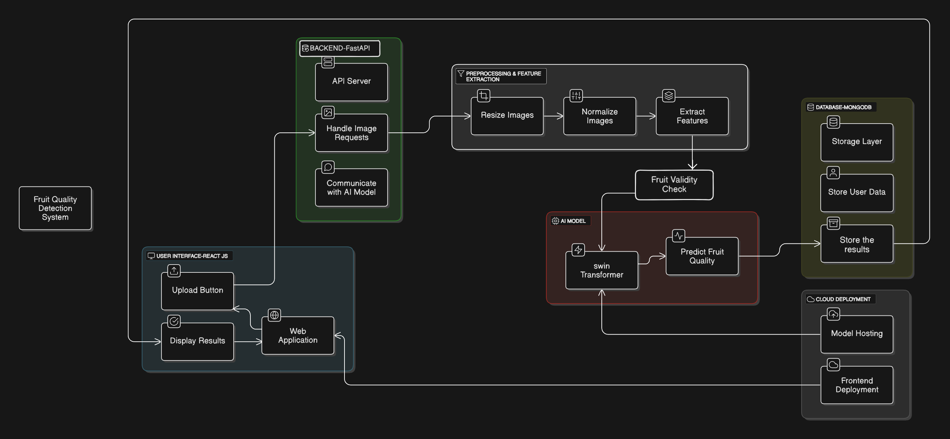
System Architecture:

Slide 13
Training Details:
Parameter | Hybrid (CNN+ViT) | Vision Transformer (ViT) | Swin Transformer
Epochs | 10 | 20 | 20
Batch Size | 8 | 8 | 8
Learning Rate | 1e-4 or 0.0001 | 1e-4 or 0.0001 | 1e-4 or 0.0001
Optimizer | Adam | Adam | Adam
Loss Function | CrossEntropyLoss | CrossEntropyLoss | CrossEntropyLoss
Pre-training Used | resnet18 | ViT-B/16 on IMAGENET_V1 | --

Slide 14
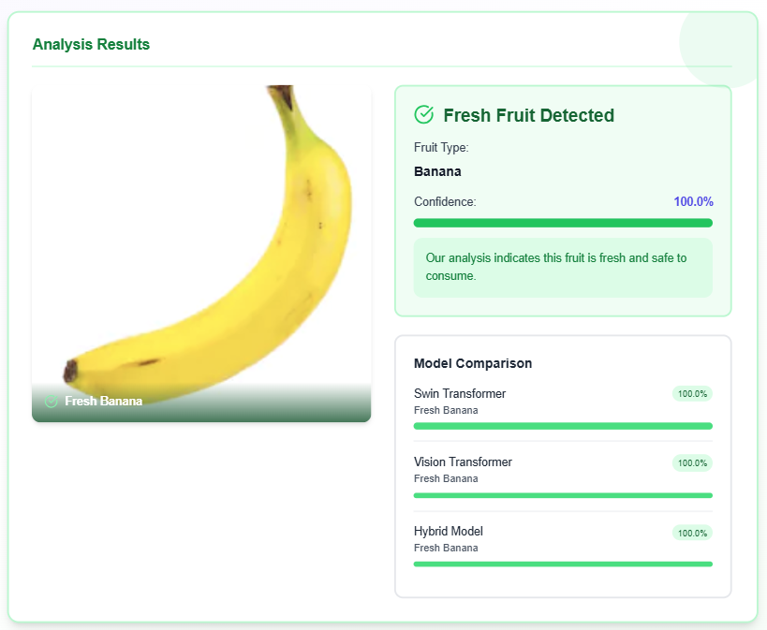
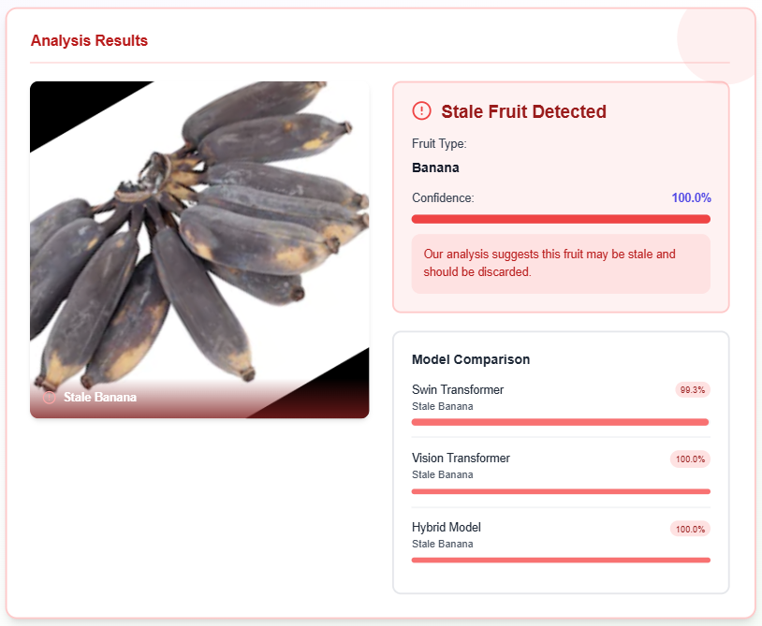
Results:

Slide 15
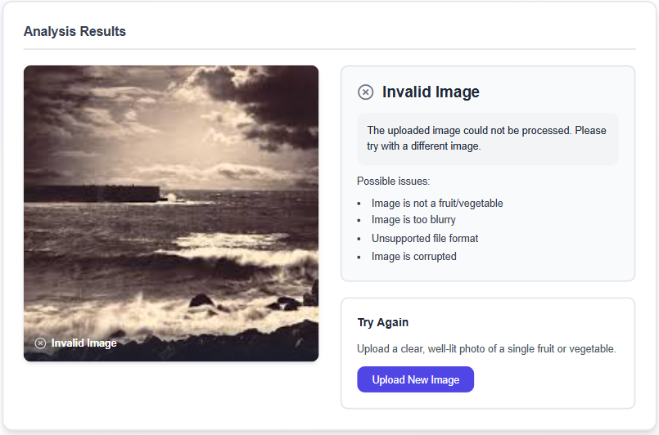
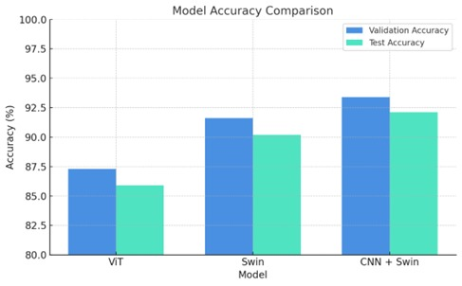

Slide 16
Data Heterogeneity & Training Diversity
AI Model Performance vs. Real-time Demands
Model Interpretability & Trust
Mitigating Overfitting in Complex Architectures
Challenges
Dynamic Data Augmentation Pipeline
Optimized Architecture Selection & Asynchronous Backend
Focus on Explainable AI (XAI) Principles
Multi-Pronged Generalization Strategy
Solutions

Slide 17
Future Work
Our future work includes expanding to multi-fruit detection and localization, developing a more granular freshness scoring system, exploring real-time video stream analysis, and potentially integrating with IoT devices. We also aim to expand the dataset for better generalization and investigate Explainable AI (XAI) to understand model decisions better.
Conclusion and Q&A:
In conclusion, we have successfully developed an accurate and efficient system for stale fruit detection using the Swin Transformer, capable of significantly reducing food waste and improving quality control in the supply chain. We believe this project has substantial real-world impact.
We are now open for any questions you may have.
THANK YOU

